Slide 1
Mastering
Data Engineering
Roman Golovnya
28 September 2024

Slide 2
About me
Data Engineer in SUSE
Over 10 years working experience in data related jobs
Education: Finance, Data Analytics & Computer Science
Ex kaggler
Founder & organiser of DSEClub

Slide 3
What is Apache Airflow?
Apache Airflow is an open-source platform for authoring, scheduling and monitoring data and computing workflows.
DAG Directed Acyclic Graph – is a collection of all the tasks you want to run, organized in a way that reflects their relationships and dependencies.
Batch oriented data processing - scheduler cron
Airflow was created in 2014 by Maxime Beauchemin at Airbnb.

Slide 4
Features of Apache Airflow
Simple and friendly User Interface
Open source
Python code
Robust Integrations
Jinja templates
Scalable
Wide and active community

Slide 5
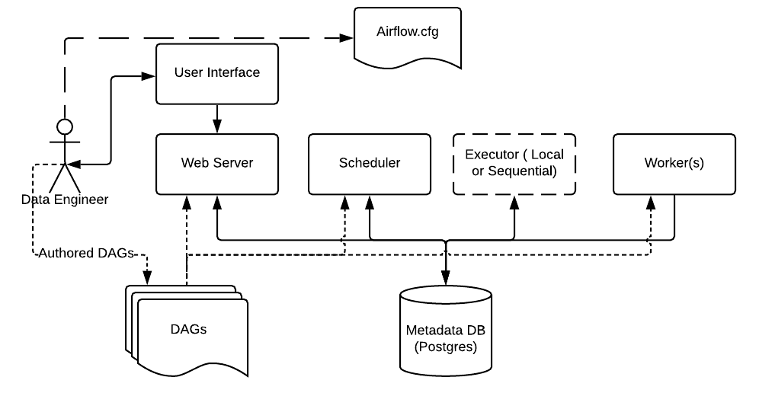
What is Apache Airflow Architecture
https://airflow.apache.org/docs/apache-airflow/2.0.1/concepts.html

Slide 6
Airflow Components:
DAG: It is the Directed Acyclic Graph – a collection of the tasks that you want to run which is organized and shows the relationship between different tasks.
Task is the basic unit of execution in Airflow. Operators, Sensors,Taskflowdecorator
Web Server: It is the user interface built on the Flask. It allows us to monitor the status of the DAGs and trigger them.
Metadata Database: Airflow stores the status of all the tasks in a database Postgres and do all read/write operations of a workflow.
Scheduler: is responsible for scheduling the execution of DAGs. It retrieves and updates the status of the task in the database.
Executor: is process by which task instances are run
Worker: a separate instance which job run specific task

Slide 7
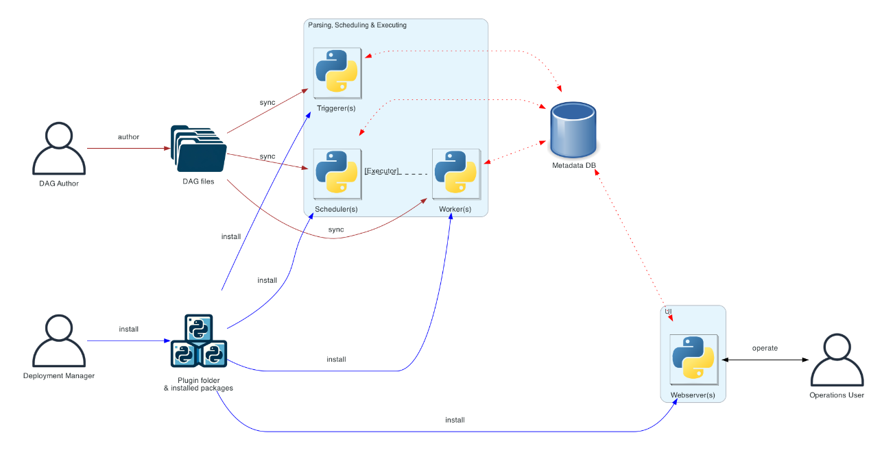
Distributed Airflow architecture
https://airflow.apache.org/docs/apache-airflow/2.10.2/core-concepts

Slide 8
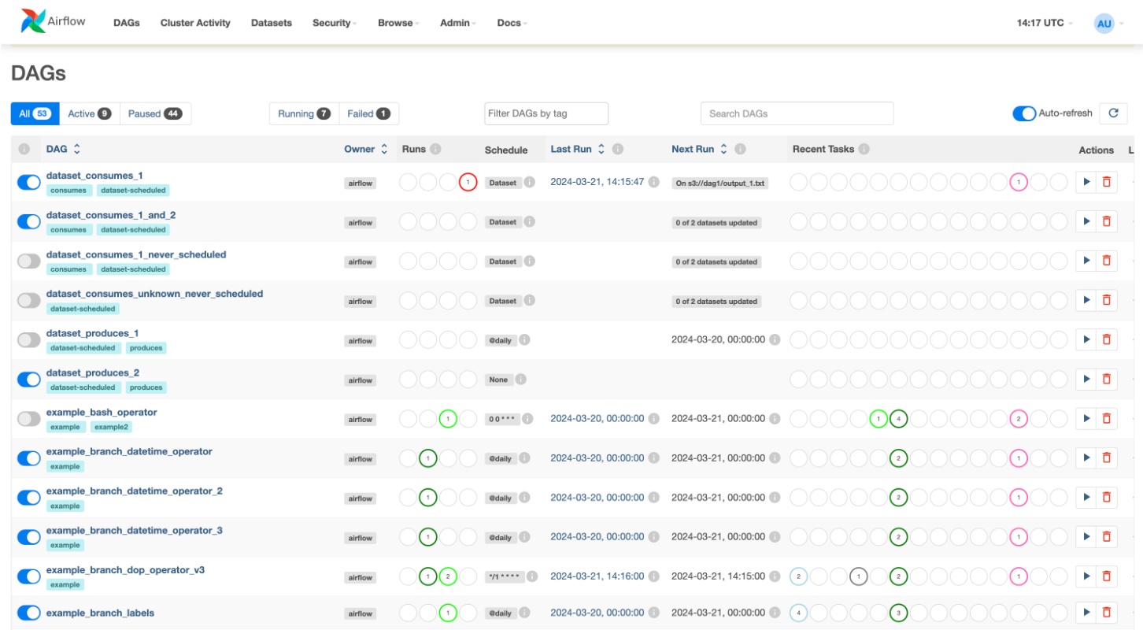
Airflow DAG and UI
https://airflow.apache.org/docs/apache-airflow/2.10.2/core-concepts

Slide 9
Competitors of Apache Airflow:
Dagster https://github.com/dagster-io/dagster
Prefect https://github.com/PrefectHQ/prefect

Slide 10
Apache Airflow learning resources:
https://airflow.apache.org/docs/apache-airflow/stable/tutorial/index.html
https://academy.astronomer.io/path/airflow-101
https://www.astronomer.io/docs/learn/intro-to-airflow
https://theaisummer.com/apache-airflow-tutorial/

Slide 11
Contact me:
roman.golovnya@gmail.com
https://www.linkedin.com/in/romangolovnya
Via meetup.com/messages
https://github.com/dseclub
https://www.kaggle.com/rgolovnya

Slide 12
Thank you!
Any Questions?

