Slide 1
Python Data Cleaning Based on Kaggle 5 Day Challenge
Eamon Thornton
Jupyter Notebook
Data Science and Engineering Club Meetup
May 12th, 2018

Slide 2
Bio
BE Electronics. MSc Business Analytics. PMP
Application Engineer/Project Manager
Currently Lecturing Part Time
Project Management
Business Analytics

Slide 3
Pre-Requisites
It would be good to come with a Jupyter Notebook already installed (Reference: http://jupyter.org/install). See slides at the end of this presentation.
However, if you don't get a notebook installed, we should still be able to run the labs using Jupyter online (Reference: http://jupyter.org/try).
Basic programming experience - this will be aimed at beginner level and you do not need to be a Python expert.

Slide 4
Based on Kaggle 5-Day Data Cleaning Challenge
Agenda:
Get familiar with Python and Jupyter Notebook
Set up the lab files
Review some common data cleaning tasks, learn about the concept behind them and practice applying them
Introduction to Pandas and Numpy
Handling missing values (Day_01)
Scaling and normalisation (Day_02)
Review remaining labs (Days 03-05 from Kaggle Challenge)

Slide 5
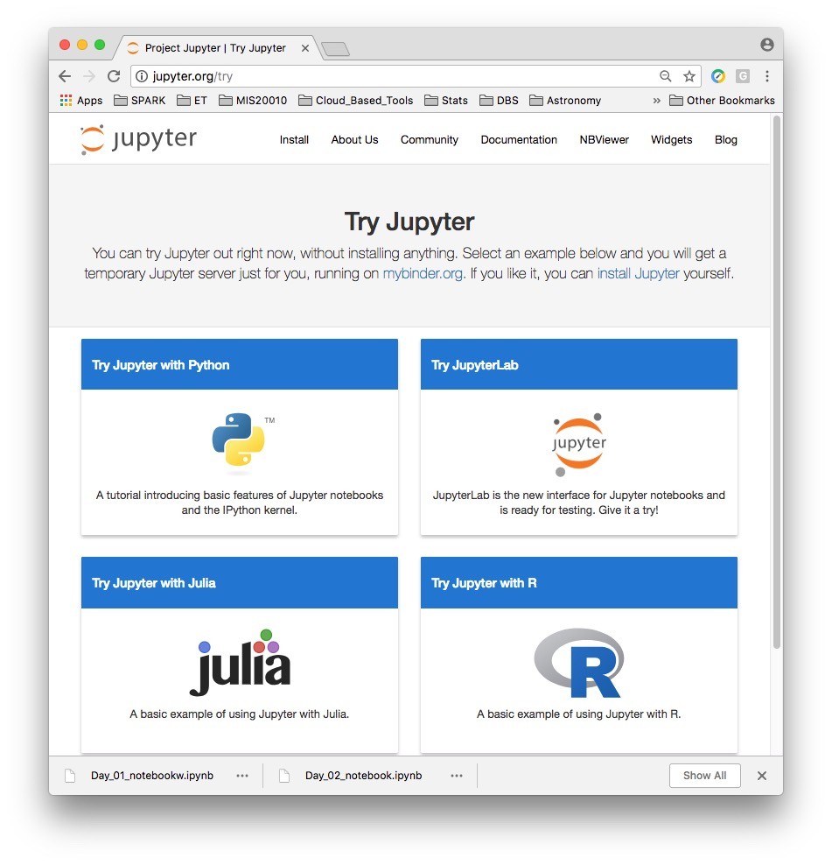
Online Notebook – no install required (easy way to run labs)
http://jupyter.org/try

Slide 6
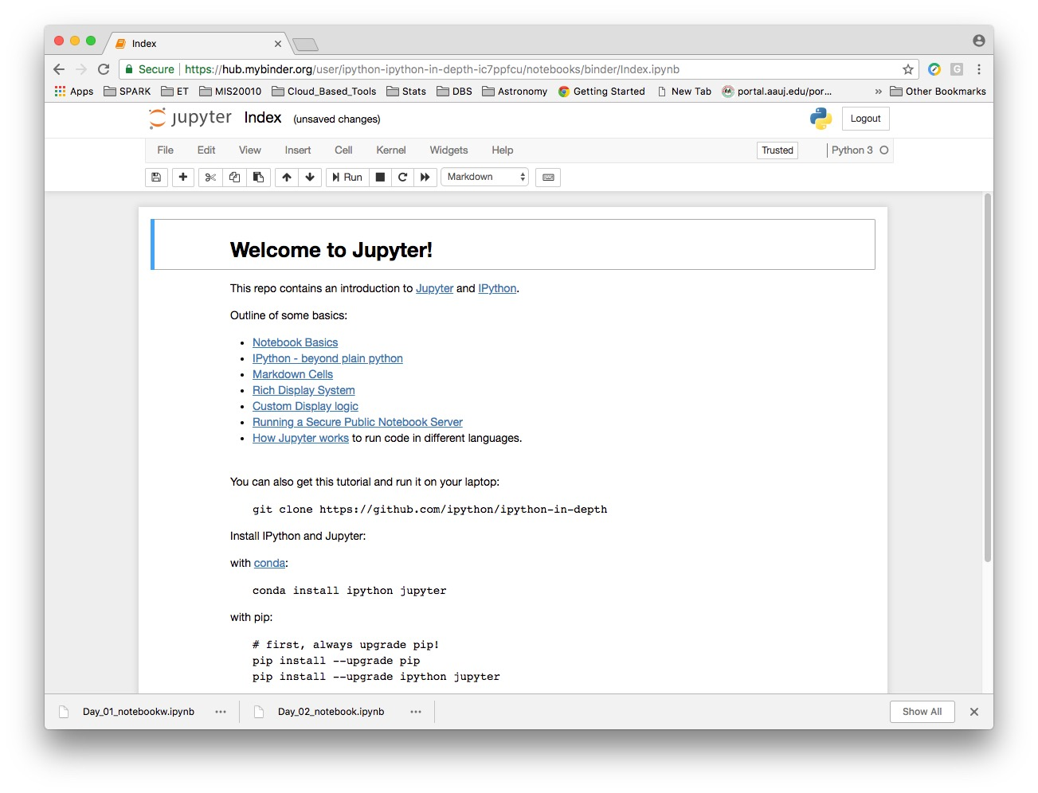
Welcome to Jupyter

Slide 7
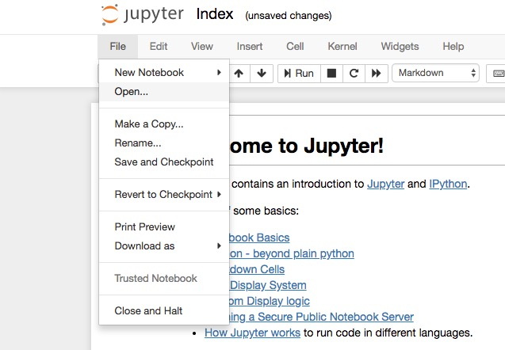
Open a new window with a dashboard view

Slide 8
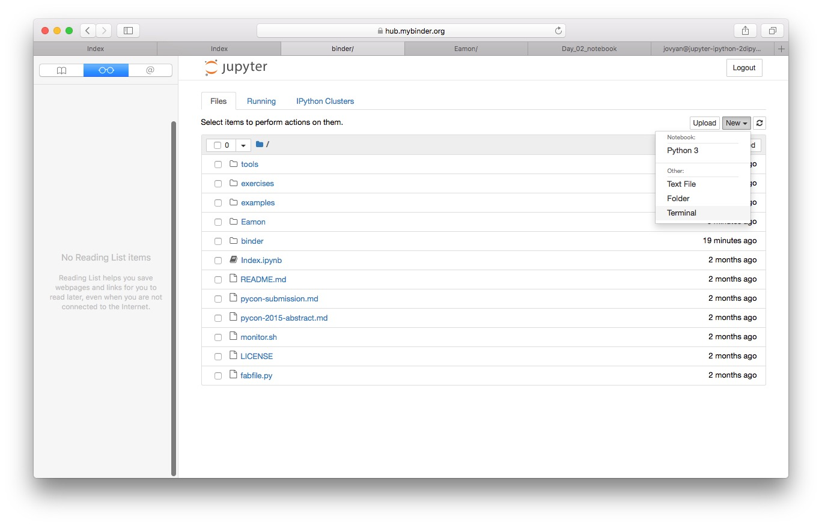
Create a new folder e.g. ”Your_Name”
Also create a sub-folder ”Lab_Data”

Slide 9
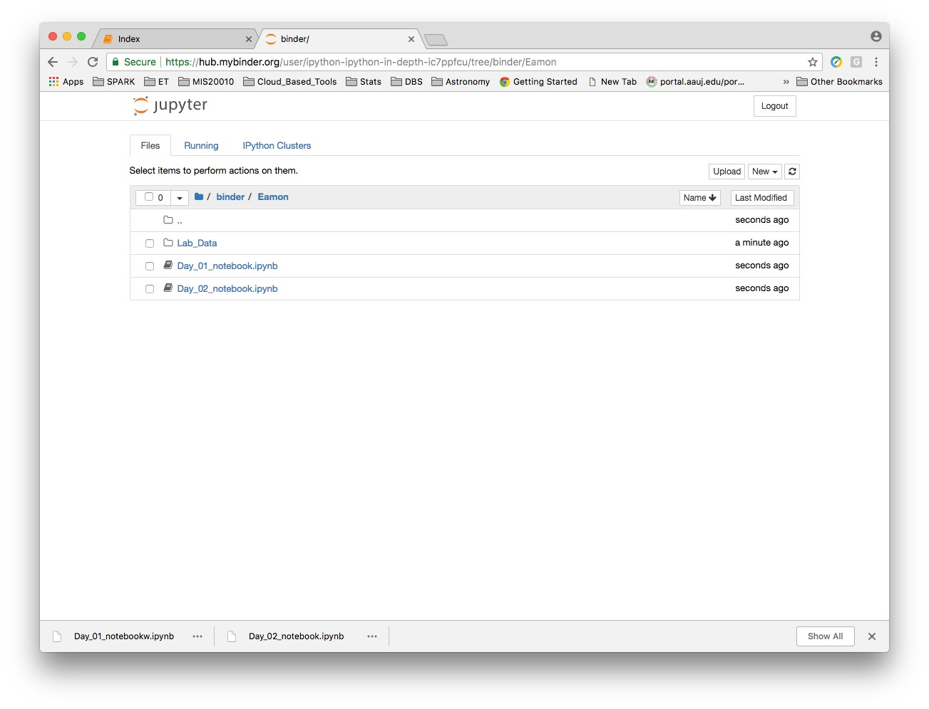
Upload the notebooks into Your_Name folder

Slide 10
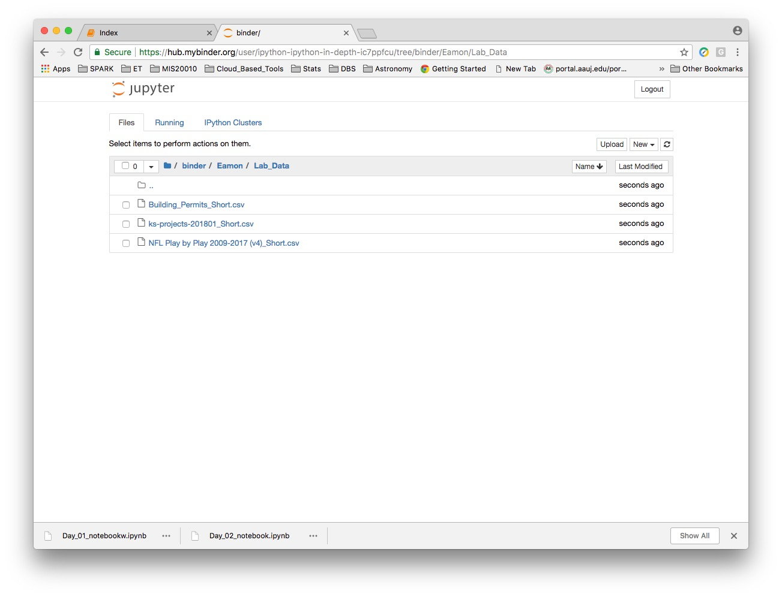
Upload the data files into Lab_Data folder

Slide 11
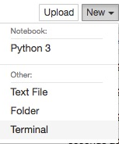
Installing Packages – Open a Terminal

Slide 12
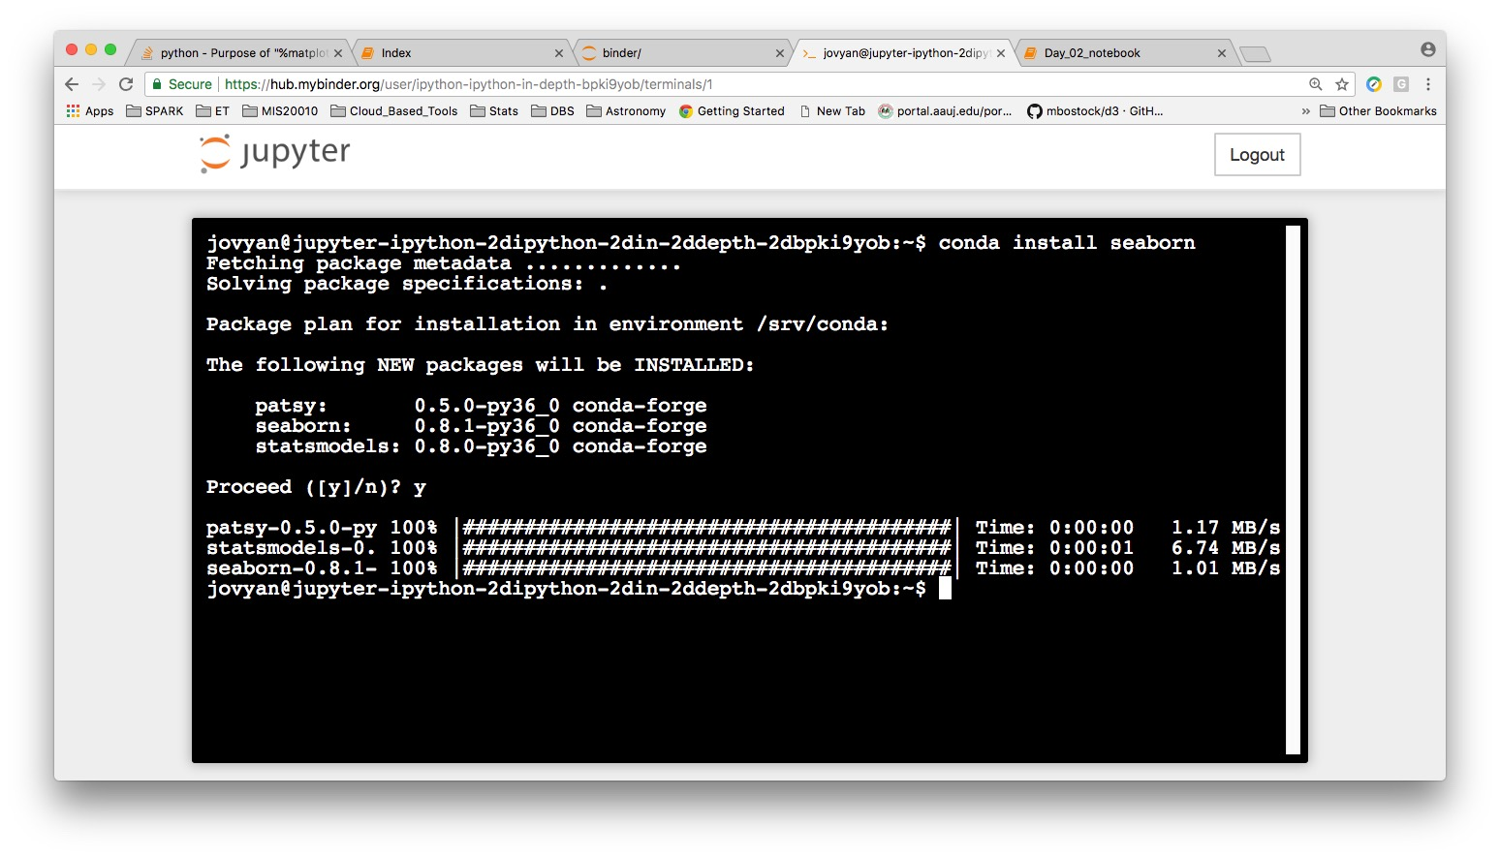
Install Library - seaborn
$ conda install seaborn

Slide 13
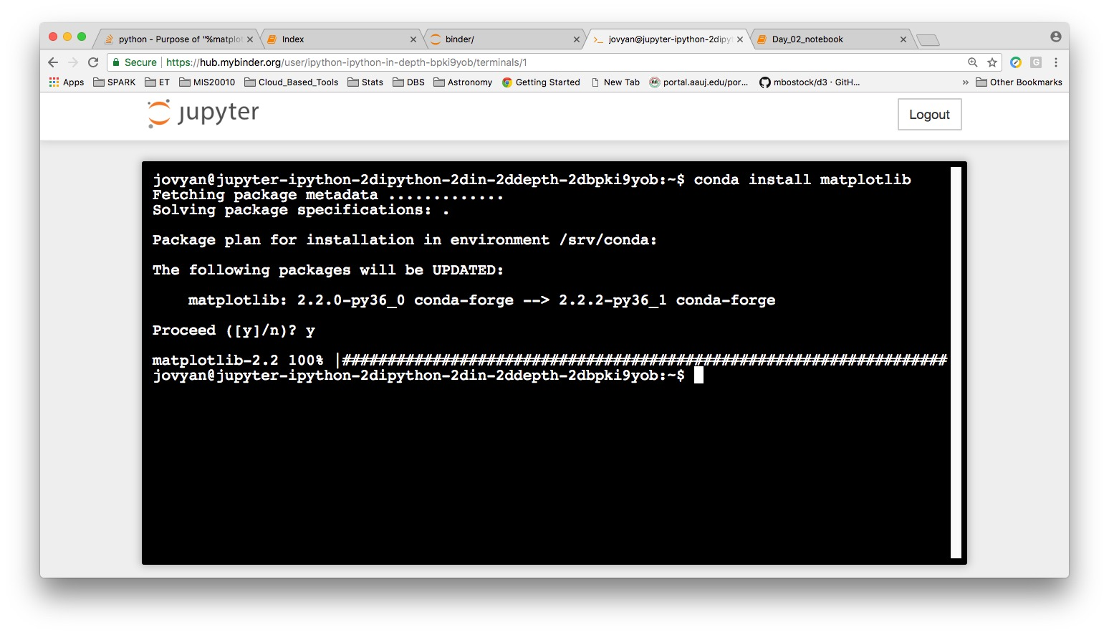
Install Library - matplotlib
$ conda install matplotlib

Slide 14
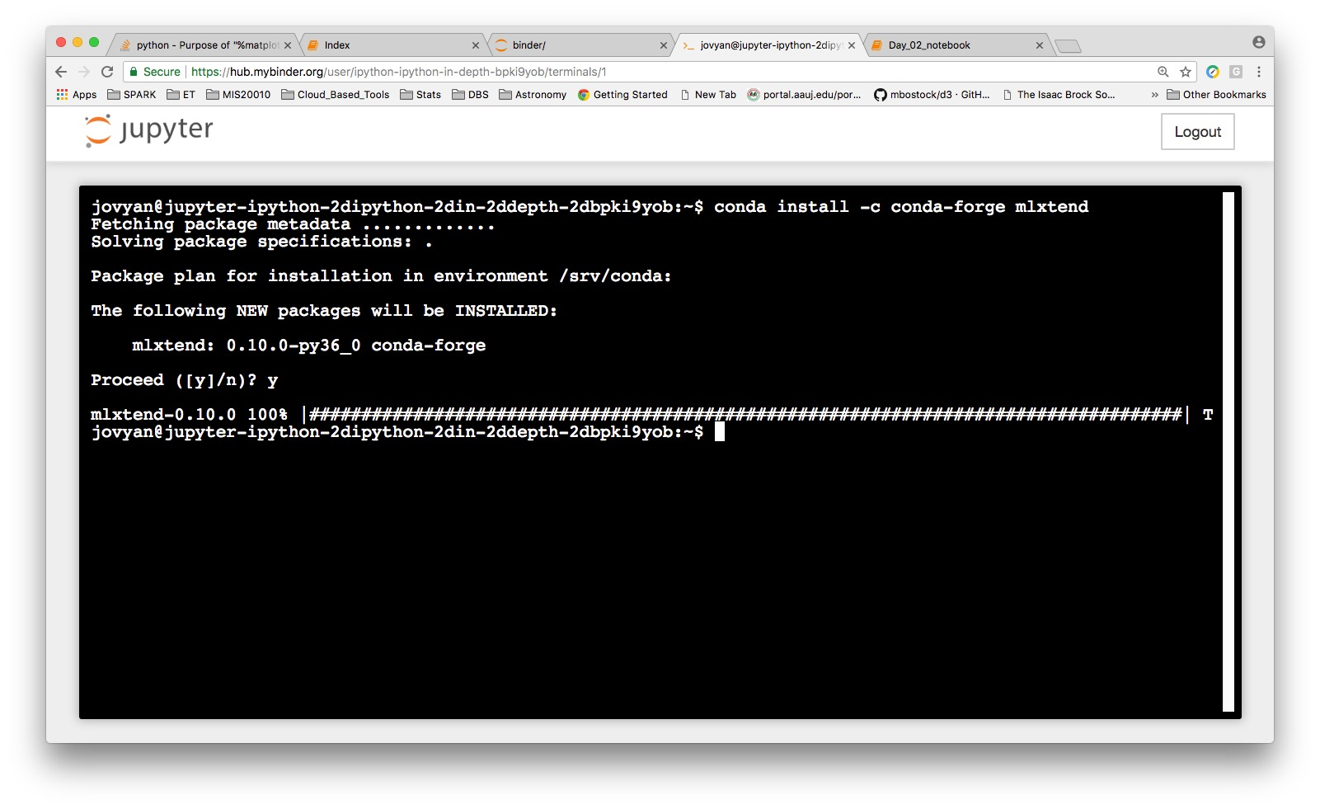
Install Library - mlxtend
$ conda install -c conda-forge mlxtend

Slide 15
Review - Function
A function is a piece of code that is called by name. It can be passed data to operate on (i.e., the parameters) and can optionally return data (the return value). All data that is passed to a function is explicitly passed.
def sum(num1, num2):
return num1 + num2
sum(2,3)
[]:5

Slide 16
Review - Method
A method is a piece of code that is called by name that is associated with an object. In most respects it is identical to a function except for two key differences. It is implicitly passed for the object for which it was called. It is able to operate on data that is contained within the class (remembering that an object is an instance of a class - the class is the definition, the object is an instance of that data).
class Dog:
def my_method(self):
print (“I am a Dog" )
dog = Dog()
dog.my_method() # Prints "I am a Dog” a Dog"
(this is a simplified explanation, ignoring issues of scope etc.)

Slide 17
Mixing Languages in a Notebook
While a notebook has a default language, you can mix languages by using the language magic command.
%python
%sql
%r
%scala
%md
%fs
...

Slide 18
Some setup to run outside Kaggle env.
% autosave 0
IPython has a set of predefined ‘magic functions’ that you can call with a command line style syntax. There are two kinds of magics, line-oriented and cell-oriented. Line magics are prefixed with the % character and work much like OS command-line calls: they get as an argument the rest of the line, where arguments are passed without parentheses or quotes. Lines magics can return results and can be used in the right hand side of an assignment. Cell magics are prefixed with a double %%, and they are functions that get as an argument not only the rest of the line, but also the lines below it in a separate argument.
% matplotlib inline
With this backend, the output of plotting commands is displayed inline within frontends like the Jupyter notebook, directly below the code cell that produced it. The resulting plots will then also be stored in the notebook document.

Slide 19
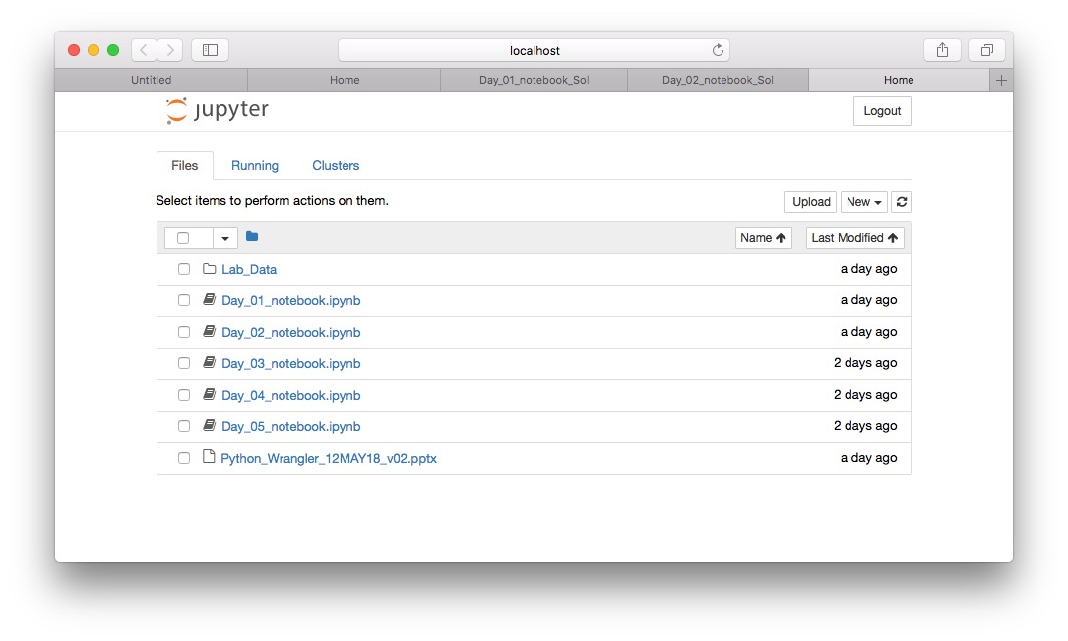
Select Day_01_notebook

Slide 20
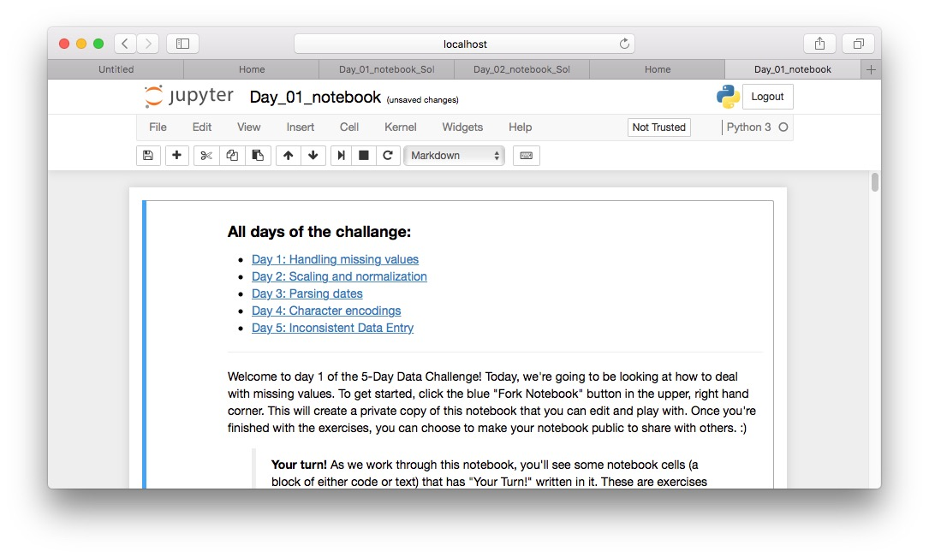
Jupyter - Python Notebook running

Slide 21
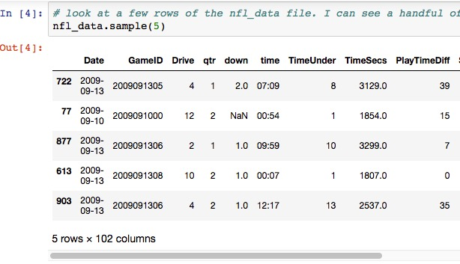
NFL Data Sample

Slide 22
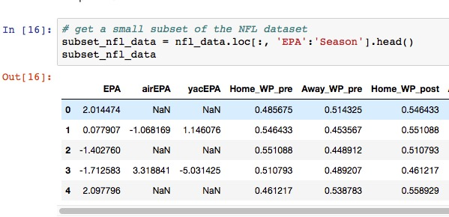
NFL Data Sample (NaN – Not a Number)

Slide 23
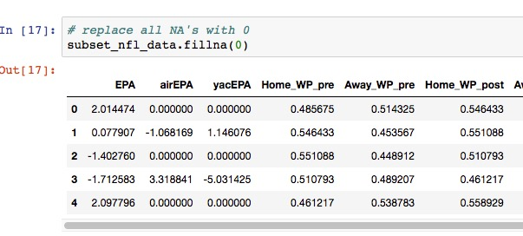
Replace NaN with Zero

Slide 24
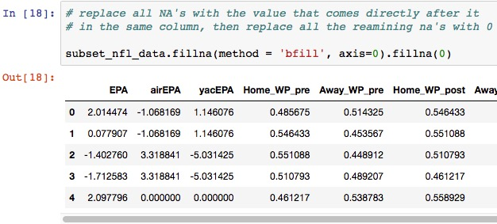
Impute numbers with backfill

Slide 25
Select Day_02_notebook

Slide 26
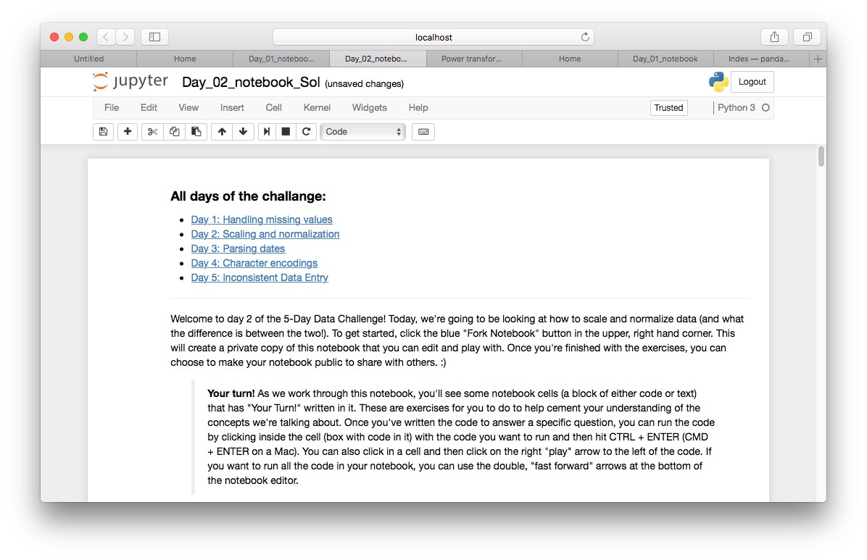
Day_02_notebook

Slide 27
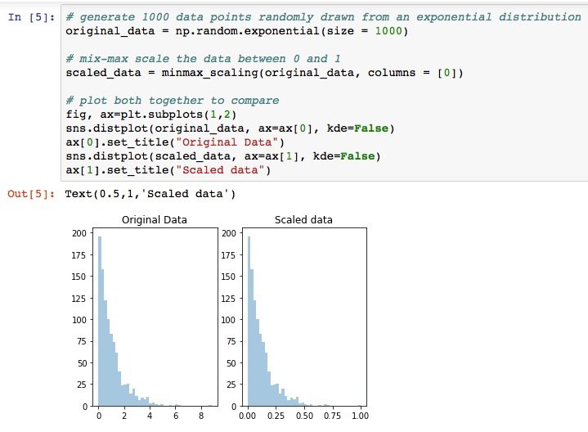
Scaling

Slide 28
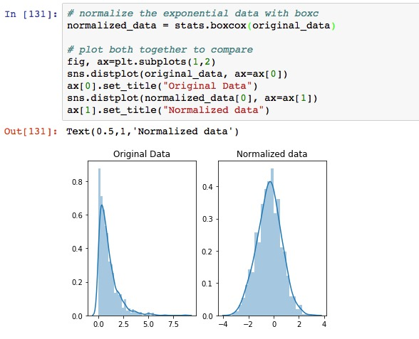
Normalizing

Slide 29
Q & A
Thanks

Slide 30
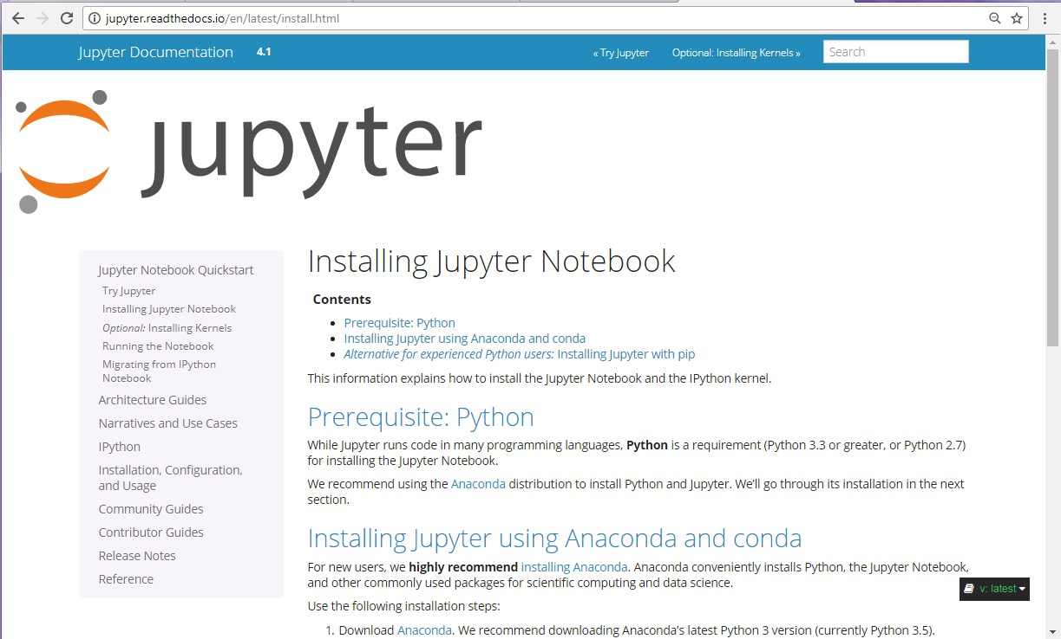
Installing Jupyter on your local machine
http://jupyter.readthedocs.io/en/latest/install.html

Slide 31
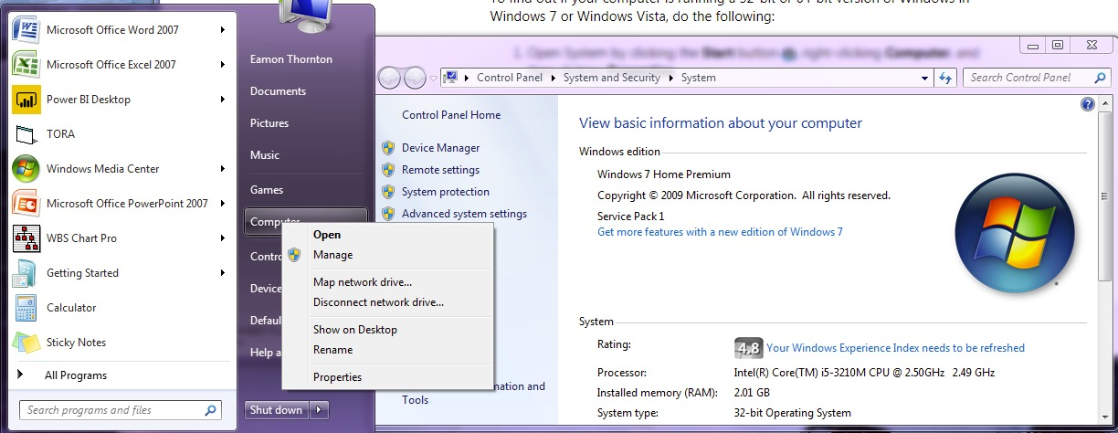
Check for 32-bit or 64-bit Operating Sys

Slide 32
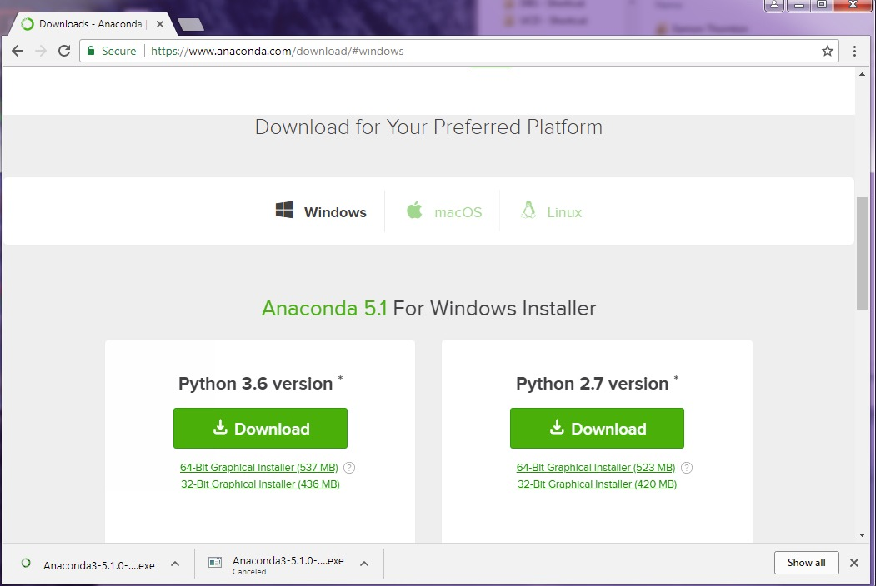
Install Anaconda/Python 3.6 version

Slide 33
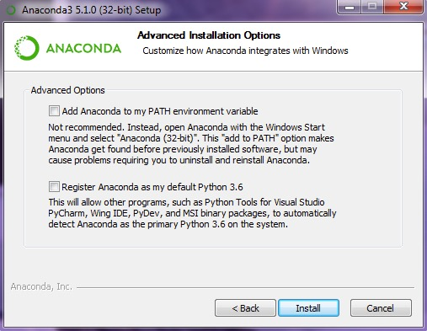
Not recommended to tick the 1st box!

Slide 34
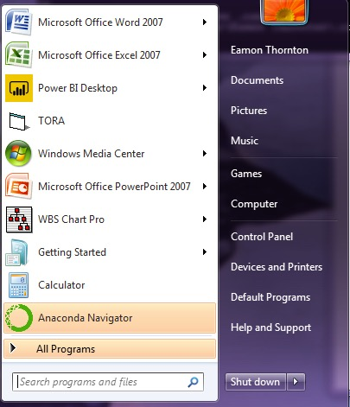
Run Anaconda from the Start Menu

Slide 35
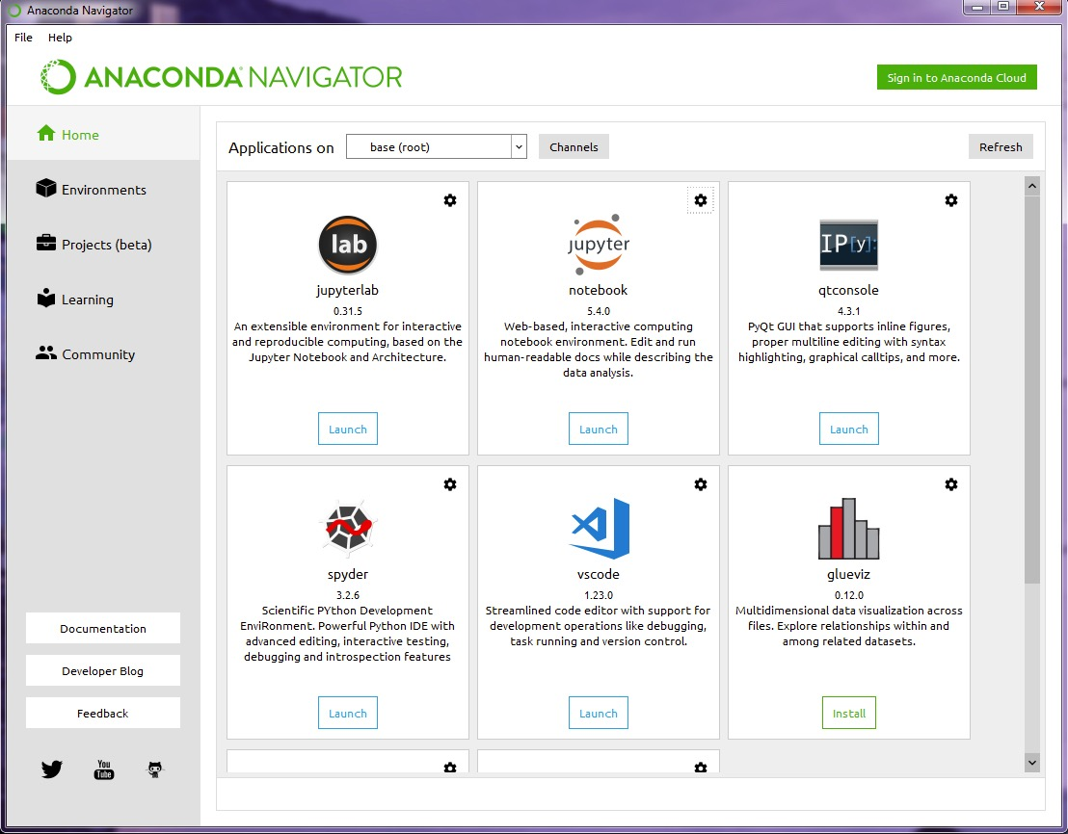
Launch Jupyter

Slide 36
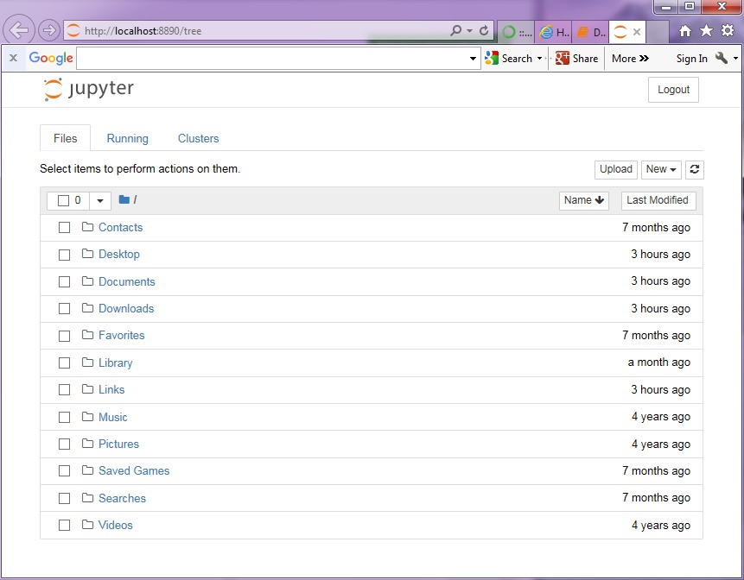
Jupyter – Local Machine

Slide 37
TEMPLATE
Some Text
Additional Text
...
Text

Slide 38
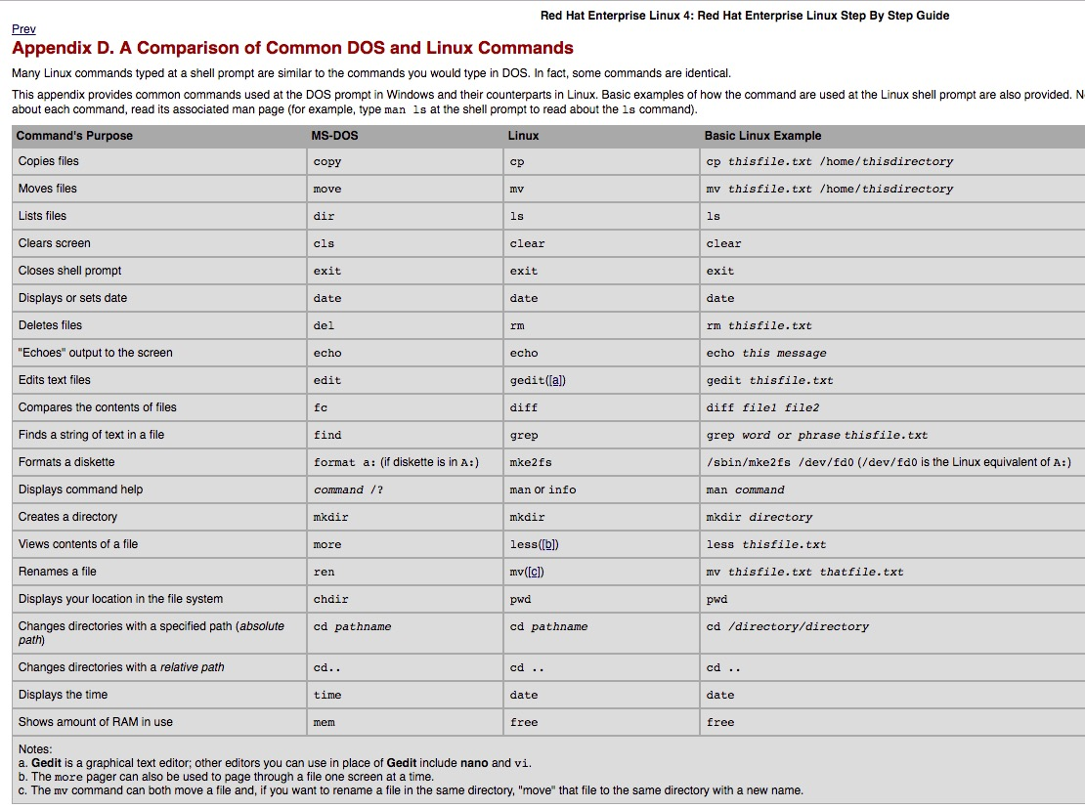
MS-DOS vs Linux Commands

Slide 39
DataFrames
The Dataset
The Dataset is Apache Spark's newest distributed collection and can be considered a combination of DataFrames and RDDs. It provides the typed interface.
The DataFrame
The DataFrame is a immutable collection of distributed Row types. These provide a flexible interface and are similar in concept to the DataFrames in Python and R. Unlike an RDD, data is organized into named columns, like a table in a relational database. DataFrame allows developers to impose a structure onto a distributed collection of data, allowing higher-level abstraction; it and makes Spark accessible to a wider audience, beyond specialized data engineers.
The RDD (Resilient Distributed Dataset)
Apache Spark's first abstraction was the RDD or Resilient Distributed Dataset. While this is the original data structure made available, new users should focus on Datasets as those will be supersets of the current RDD functionality.

Slide 40
DataFrames - Typed and Un-typed APIs
Note: Since Python and R have no compile-time type-safety, we only have un-typed APIs, namely DataFrames.
Language | Main Abstraction
Scala | Dataset[T] & DataFrame (alias for Dataset[Row])
Java | Dataset[T]
Python* | DataFrame
R* | DataFrame

