Slide 1
Edward Street Market
By: Dave S, Sasha A, Chris C, Sergiu E

Slide 2
Client Background
Edward Street Market
Company runs on a three tier business model:
Market
Bistro
Catering
The company’s main sellers are meat and cheese items and pre packaged grocery items

Slide 3
Project Purpose
Difficulties with running a three tier business
Asset tracking
Budget management
Identifying losses
The stakeholders of Edward Street Market want to allocate 30% revenue to each tier
Update their database to be relational and easily expandable

Slide 4
Project Goals
Loose less product
Cut excessive spending
Monitor incoming/outgoing money
Profitability reports
Increase efficiency for business by managing purchase orders

Slide 5
Feasibility Evaluation
The system must have value to Edward Street Market
Must integrate with their existing business practices
Complements their existing systems
Deployment of the system should not affect business operations

Slide 6
Requirements
Requirement gathering process:
Team meetings
Mock ups for Edward Street Market
Observation of running business
Tool research such as MySql and Javascript for easy deployment and ease of use

Slide 7
Functionality
Functionality of our system is three fold:
Inventory tracking starting point
Supplier tracking system
Data mining product usage and purchases
Our system lets Edward Street create virtual purchase orders for easy purchase tracking
Room for growth in the future with paperless inventory

Slide 8
Functionality - Users
Create/Edit/Delete users available to administrators
Every user is able to change their passwords and see what access they have.
Not all users are able to create items and other objects

Slide 9
Functionality - Suppliers
Create/Edit/Delete suppliers available to administrators
Items can be linked to suppliers and will be selectable from auto populated drop downs
Users who can create Items will be able to add new suppliers and edit existing ones

Slide 10
Functionality - Items
Items are the central aspect of the system
Items can be modified, created, and deleted and then used by purchase orders and suppliers
Items are created relationally and have links to suppliers and purchase orders.

Slide 11
Functionality - Purchase Orders
Purchase orders allow users to create new purchase orders for a created supplier
Provides a convenient way to see items and suppliers coming together for better tracking
Orders will be able to receive and send back if bad quality

Slide 12
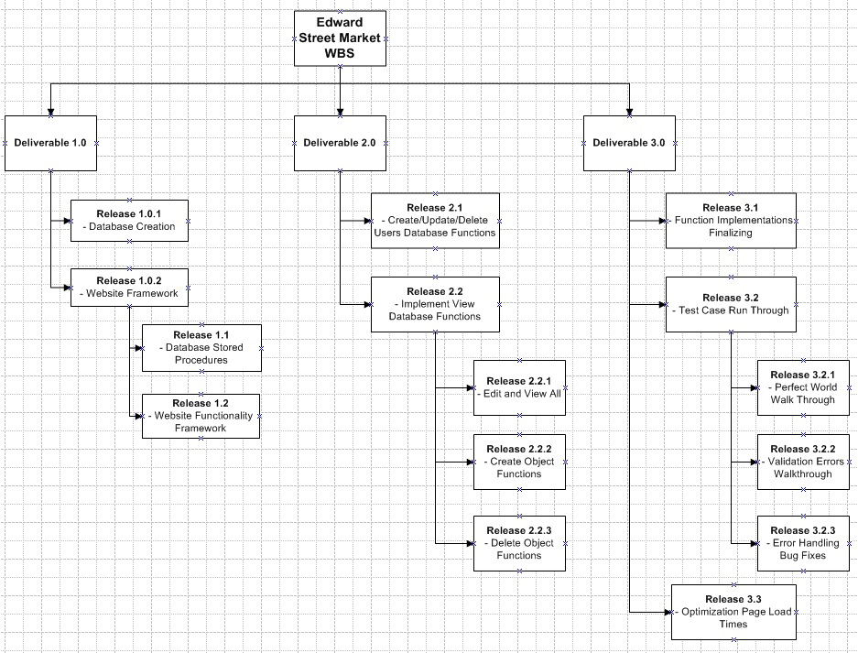
Data Modeling
Visio WBS diagram

Slide 13
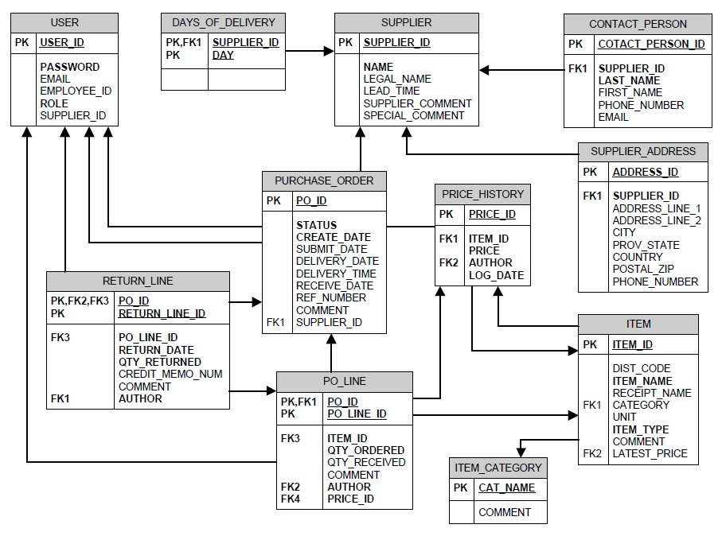
Data Modeling
Entity Diagram

Slide 14
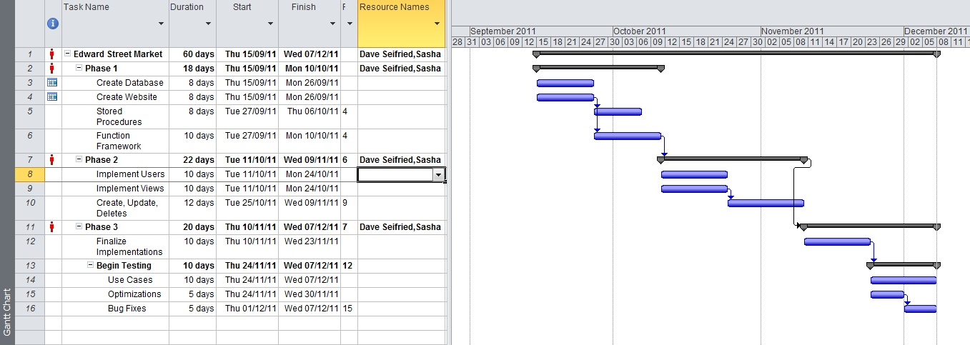
Project Timeline
EDST MS Project timeline

Slide 15
Conclusion
We believe that our system will be beneficial to Edward Street Market
Allows tracking of finances
Tracking of products
Tracking of suppliers
Thanks for watching!

