Slide 1
Data Engineering Project
Interactive Flight-Data Analysis
Dennis Ssekamaanya

Slide 2

Delayed-Flight Data:
Flight delays happen everyday but still remain a surprise occurrence
Passengers never know / are worst affected
Airlines mast delay track-records
Airports do the same
Could customers know in advance ? Damage limitation

Slide 3
The Project Task
Build a data pipeline feeding into a client dash-board
Data Source –> Cleaning –> Interact with Data

Slide 4
The Data
2015 Flights data from kaggle.com
5m records plus
Airlines, Airports, Flights, Longitude & Latitude

Slide 5
Tools
- Python: PSQL, Pyspqrk,
- PySpark
- Pandas,
- Streamlit
- Matplotlib, Seaborn,

Slide 6
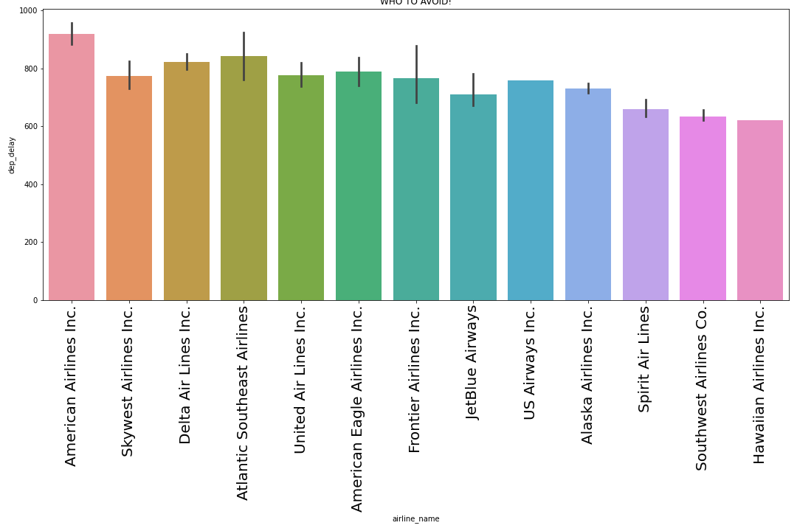
EDA:Airline To Avoid ..

Slide 7
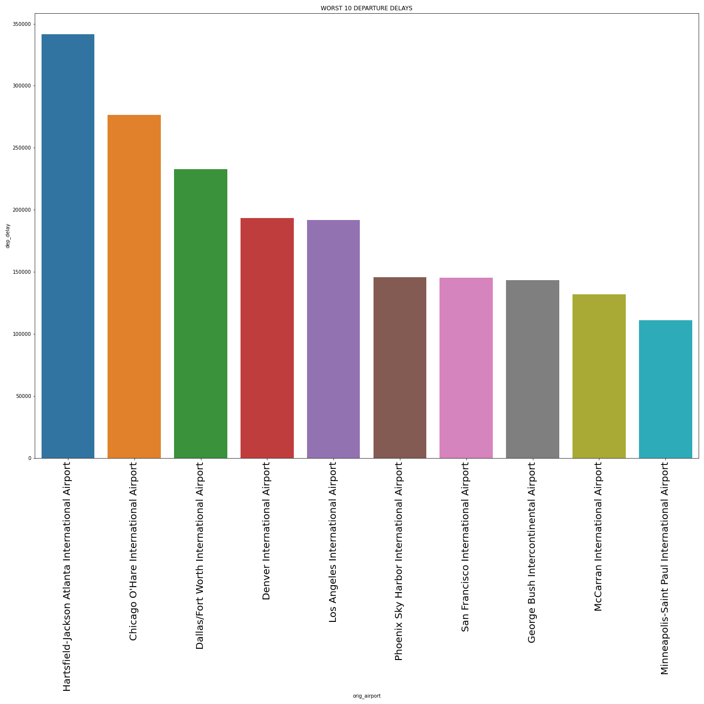
EDA: Worst Departure Delays

Slide 8
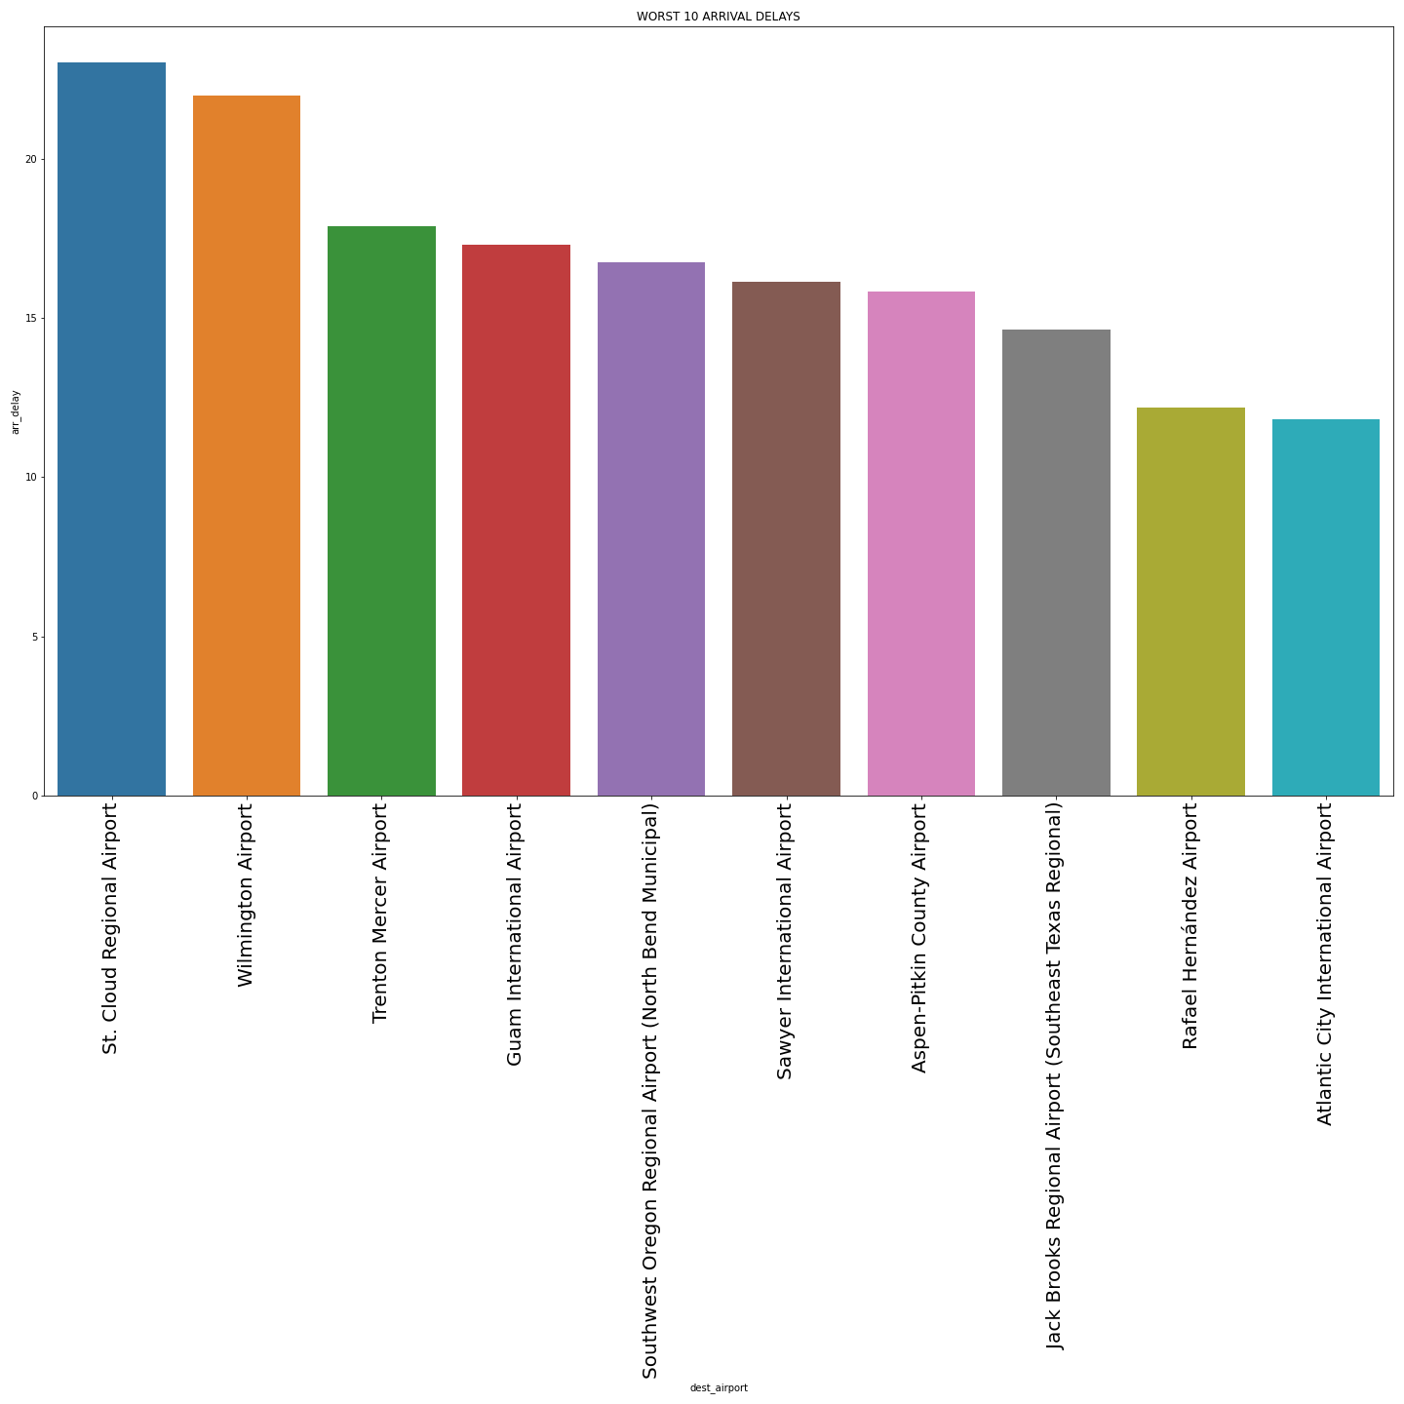
Worst 10 Arrival Delays

Slide 9
App Demo

Slide 10
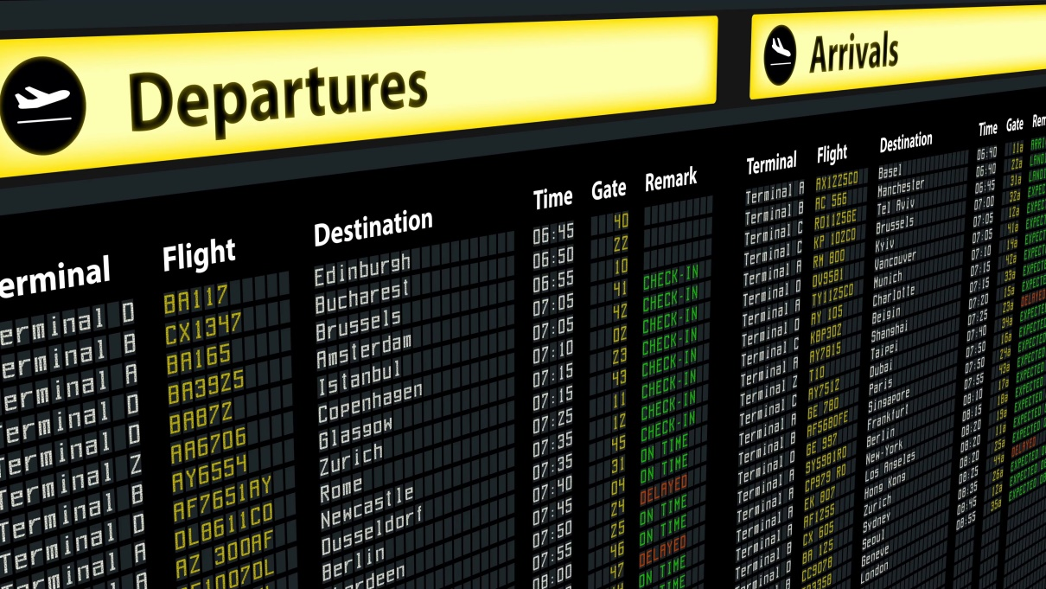
conclusion..
Interactive app does make data come more alive
Better real-time utilization of data e.g. prediction
Thank you.
Dennis Sseamaanya

