Slide 1





USE OF KERNEL HILBERT SPACES FOR ONLINE DATA ANALYSIS IN MARKET RESEARCH SYSTEMS
Thesis Defense By Dan Serbanoiu

Slide 2

Table of Contents
01
02
03
04
Introduction
Literature Review
+ Problem;
+ Objectives;
+ Life cycle;
+ Risks;
+ Project plan.
+ Developments;
+ Controversies;
+ Breakthrough;
+ Previous research;
+ Background theory.
Implementation
Conclusion
+ Requirements;
+ System Architecture;
+ Results.
+ Final considerations;
+ Reflection.

Slide 3

Introduction
Let’s describe the general characteristics of an AI enabled market research system, detail a list of aims and objectives, describe the adopted life cycle model, present a risk analysis and offer a project plan.

Slide 4
Problem
Small firms don’t know what to search for when doing marketing research, struggle to find appropriate sources or lack the digital tools to properly analyze and make use of information. They cannot compete with bigger companies which have their own reporting systems;
The purpose of this thesis is to build a general purpose MRS that can aggregate market-related data from a variety of data sources (documents, logs, APIs, websites, online surveys etc.) and analyses it to generate marketing insights that firms can use to improve competitiveness;
Marketing data is non stationary data. This thesis wants to show how to analyze such data using kernel machines and unsupervised learning.

Slide 5
Study Objectives
Develop a prototype of a Web-based Market Research System that leverages AI, ML and Big data technologies to produce valuable insights;
Implement a Search Module;
Create an Aggregator module;
Build an Analyzer tool that performs data analysis using k-means and KRLS methods;
Build a data visualization dashboard;
Configure a database to store, process and query existing market research data.

Slide 6
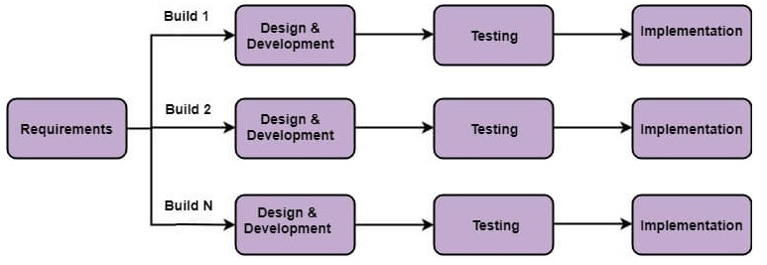
Incremental Life Cycle Model

Slide 7
Risks
Technological Risks;
Hardware Failures;
Poor planning;
Misunderstanding Requirements;
Conflict with stakeholders.

Slide 8
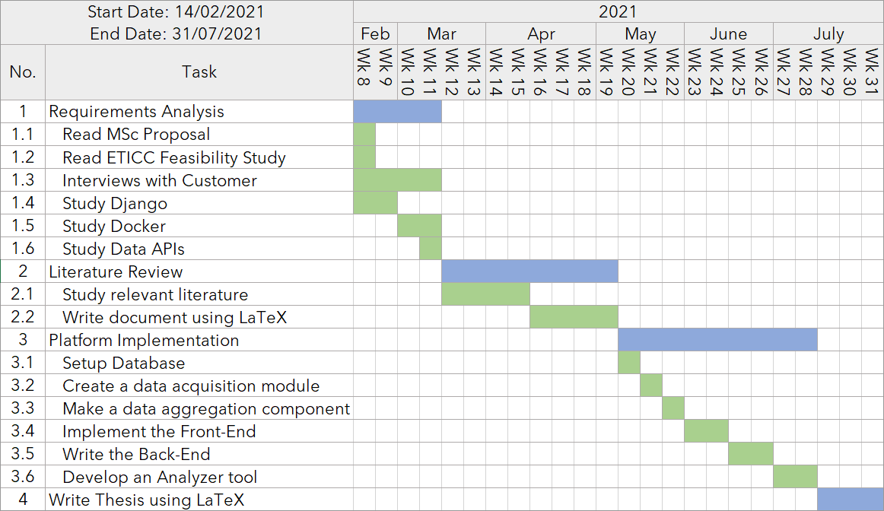
Planning

Slide 9

Literature Review
Let’s talk about the subject areas relevant to the project including current developments, controversies, breakthrough, previous research and
relevant background theory.

Slide 10





Literature Review
Market Research Systems
AI, ML and Big Data
ML workflow
KRLS methods
Tools and Techniques
Hashing
For Queries

Slide 11
Market Research Applications # 1
Product planning and development such as when evaluating the need for a new product or its positioning in the market;
Advertising and copy testing;
Pricing expectations of consumers and their reactions and responses to different price levels of products. This can help calculating the sales potential of the company’s products and the evolution of the company’s sales performance;
The forces operating in a market the market trends, the size of present and the potential markets of a company.

Slide 12
Market Research Applications # 2
Identify existing and potential distribution channels;
A study conducted by the Alibaba Group in China has also shown a way of calculating the impact of brands on society, by combining the impact brands have on the media, the government Impact and the personal impact.

Slide 13
Other Market Research Systems
Google Analytics which tracks websites usage and provides businesses with products trends, users behavior information, custom reports etc. [development such as when evaluating the need for a new product or its positioning in the market;
QuantCloud can calculate the seasonal volatility of log returns for grouped data, the Autoregressive-moving average (ARMA) copy testing or to identify existing and potential distribution channels.

Slide 14
AI, ML, Big Data
Supervised Learning: Statistical Models, Neural Networks, Kernel Machines, Support Vector Machines;
Unsupervised Learning: Hierarchical Clustering, K-means, K nearest neighbor;
Reinforcement Learning: Monte Carlo methods, Markov chain processes.

Slide 15
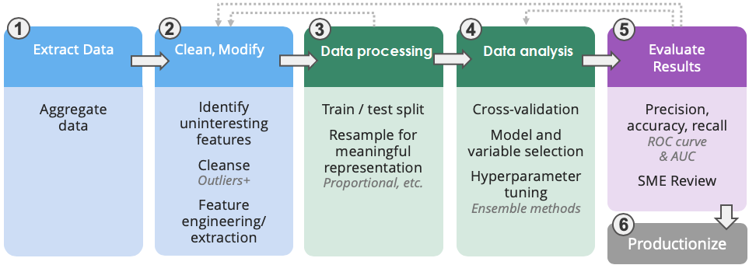
ML workflow

Slide 16



KRLS methods Theory # 1
Marketing data is non-stationary which means that it is affected by several implicit variables; some data points might belong to different distributions or they might be affected by seasonal patterns and other external influences. Because of this it is very difficult to model marketing data and perform accurate forecasting;
A linear regression model can be reformulated into a convex optimization problem . In this reformulation the kernel function can be interpreted as inner products in a high-dimensional feature space (more formally called Hilbert space) kernel-based prediction model is:

Slide 17

KRLS methods Theory # 2
Because the solution to the least-squares problem is expressed as a linear combination of the training data and in terms of the parameter vector w and the kernel function k, it does not matter how complex the feature vector ϕ(x) is and it can even have infinite dimensionality if that suits the problem at hand;
When a new point arrives, the updated solution α(n) is obtained by recursively by applying:
The algorithm can be optimized by using a sliding window (dictionary).

Slide 18

KRLS methods Theory # 3 – Greater Accuracy
It’s possible to improve accuracy further by using a Gaussian process model
which has a zero mean GP prior on f(x) and a Gaussian prior on r. The posterior over the latent vector f is which means that the result of this model gives not only the mean value for the predicted solution but also its entire posterior distribution. The recursive updates become:
Because the KRLS-T method takes into account the distribution of the previous points at every prediction it was found to be suitable for modelling marketing data and its performance was further analyzed in this thesis.

Slide 19
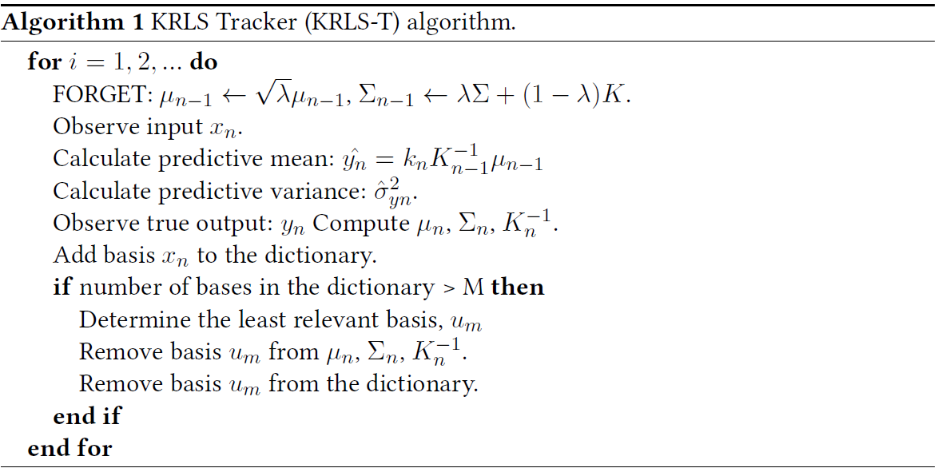
KRLS methods Algorithm

Slide 20




Tools and Techniques
Aurelia
Django
Front-End JS Framework used to code user interface
Back-End Python framework used to code the server
Spark
Docker
Python framework for fast data analysis
Containerization tool

Slide 21

Implementation
Let’s talk about the functional requirements of the application, explain the architecture of the developed research platform and present some meaningful results and some steps forwards.

Slide 22
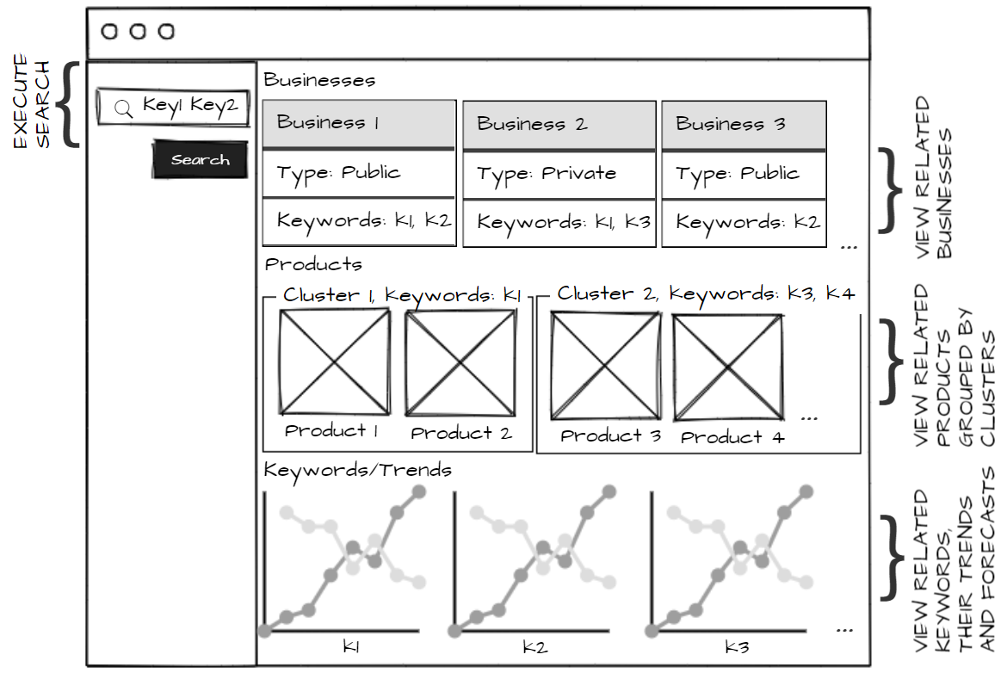
Requirements

Slide 23
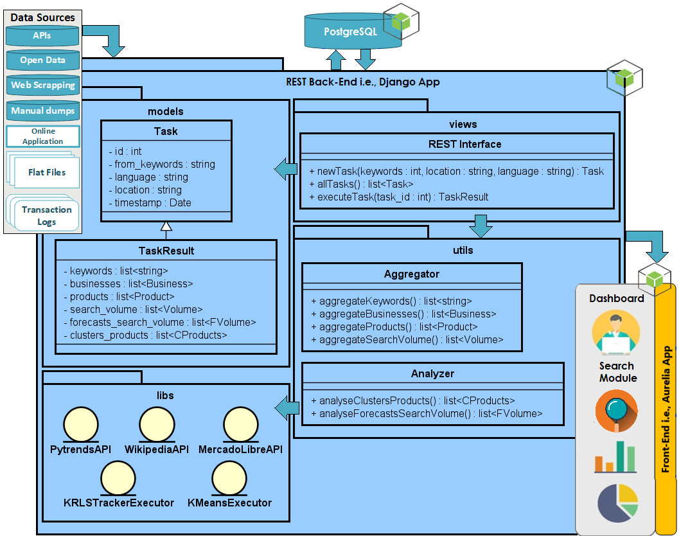
Architecture

Slide 24
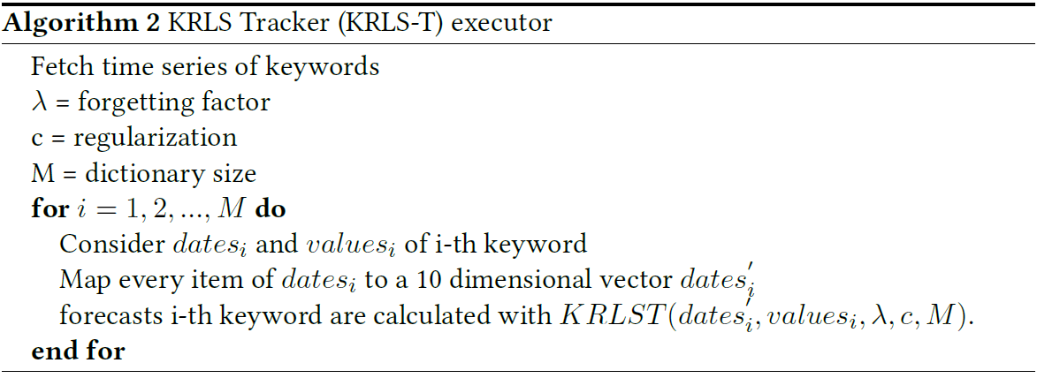
Forecasting with KRLS methods Methodology
The system applies KRLS regression to each 5 years time series associated with a certain keyword and derives the values of these trends 2 years into the future. Before being given to the algorithm the data needs to be prepared by mapping the dates dimension to 10 dimensions which achieve time representation through shifting each successive value by 1.

Slide 25
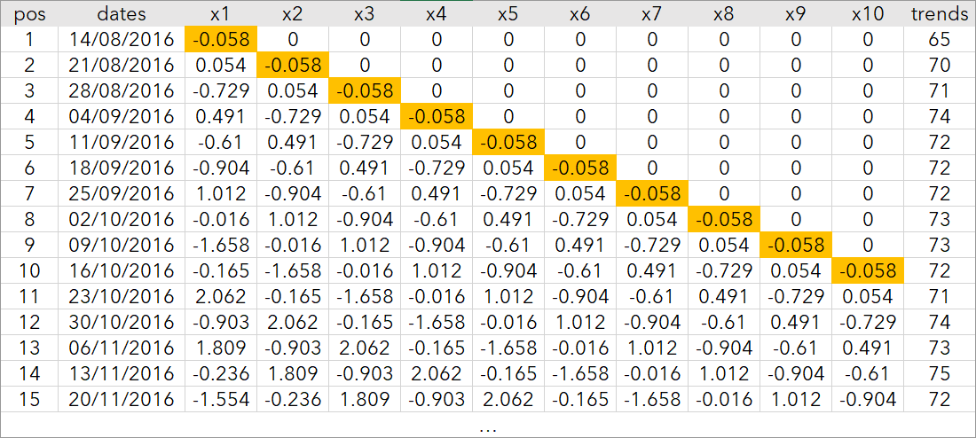
Forecasting with KRLS methods Data Preparation

Slide 26
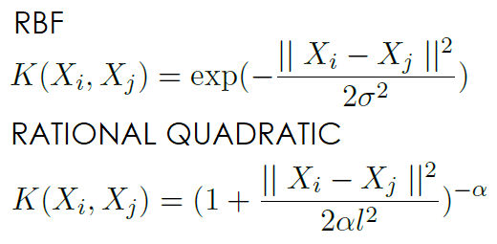
Forecasting with KRLS methods Testing with Different Parameters
The MSEs were calculated using a training set of 200 points and a test set of 60 points. Every time a new training point was added to the algorithm, the MSE was calculated by subtracting the estimated values and the actual values of the test set;
Two kernels were used: RBF, RQ
Forgetting factor or no forgetting factor;
Different dictionary sizes;
The demand of the keyword ‘food’ is analyzed with different parameters.

Slide 27
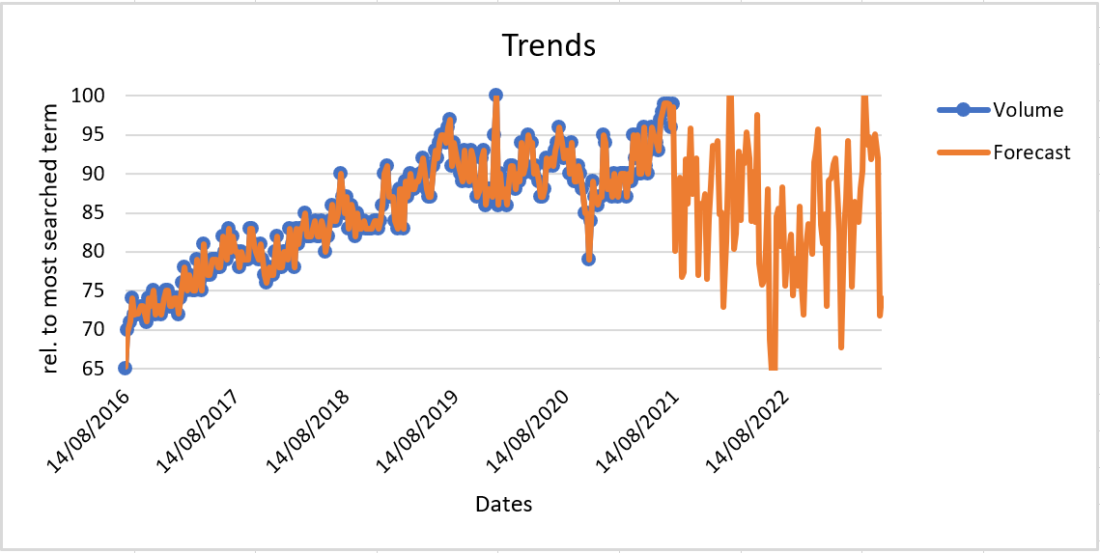
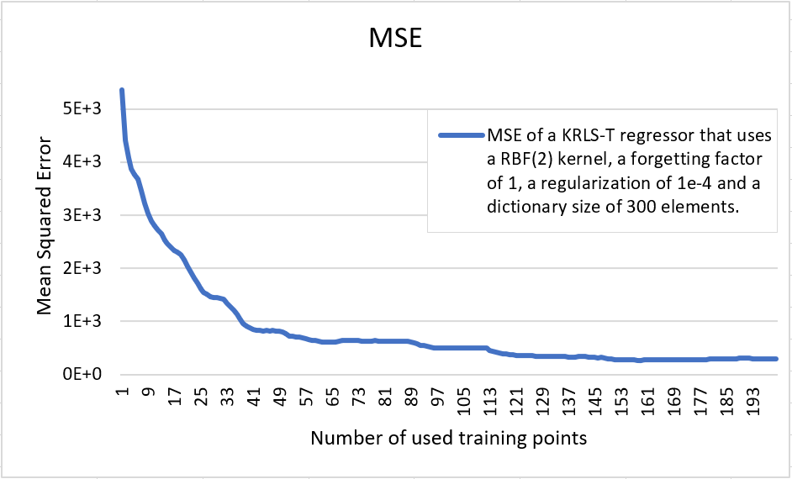
Forecasting with KRLS methods Experiment # 1

Slide 28
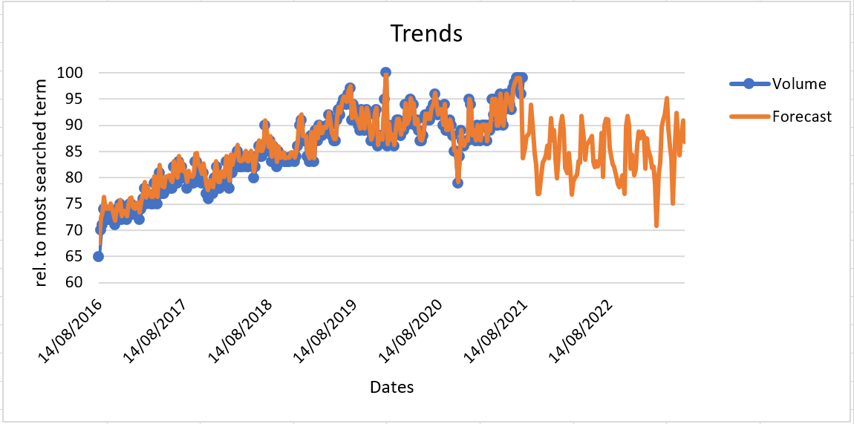
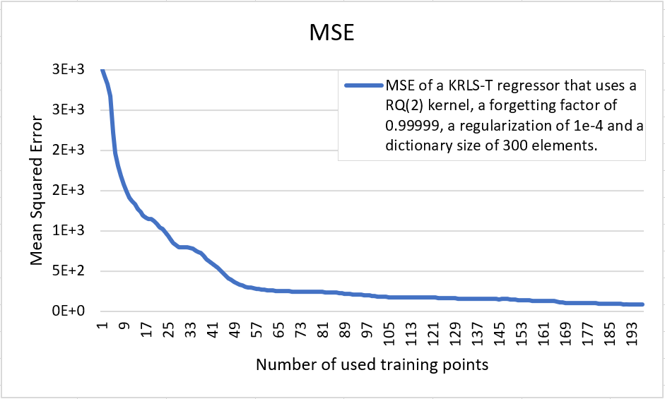
Forecasting with KRLS methods Experiment # 2

Slide 29
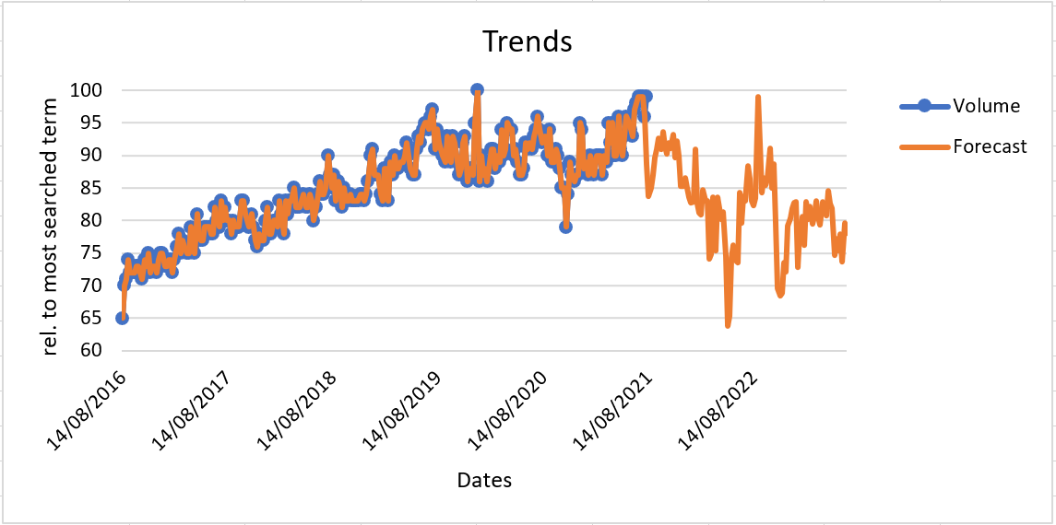
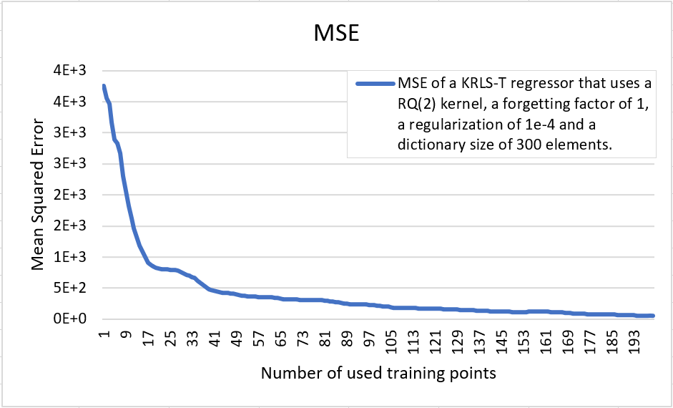
Forecasting with KRLS methods Experiment # 3

Slide 30
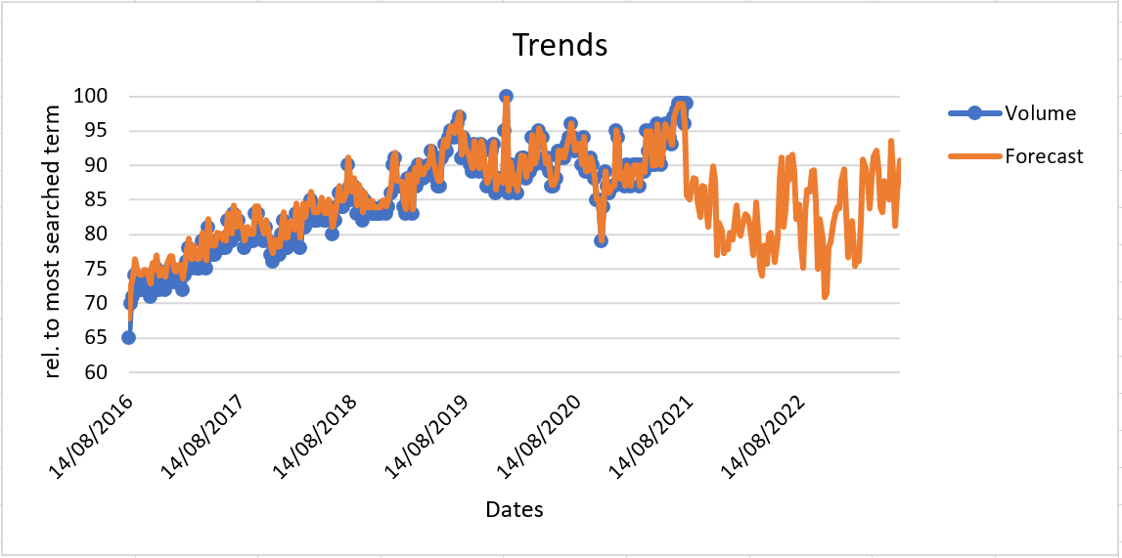
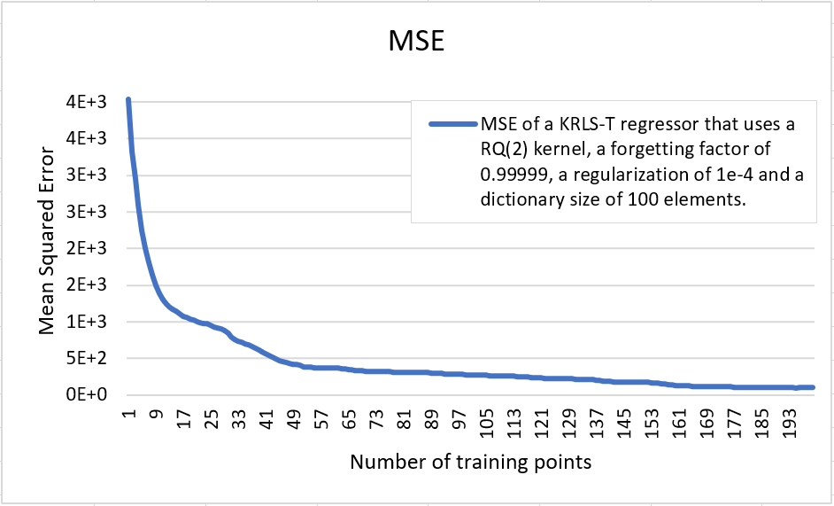
Forecasting with KRLS methods Experiment # 4

Slide 31
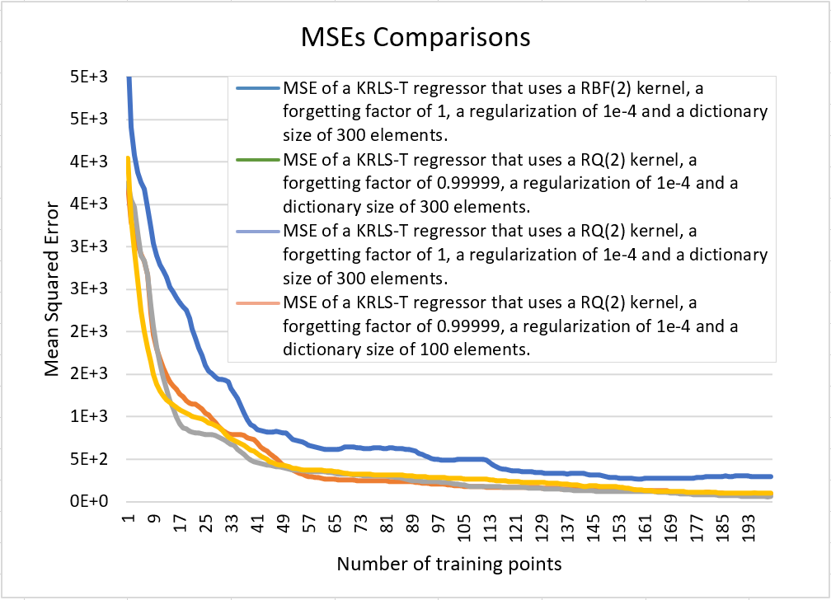
Forecasting with KRLS methods Comparing Experiments

Slide 32
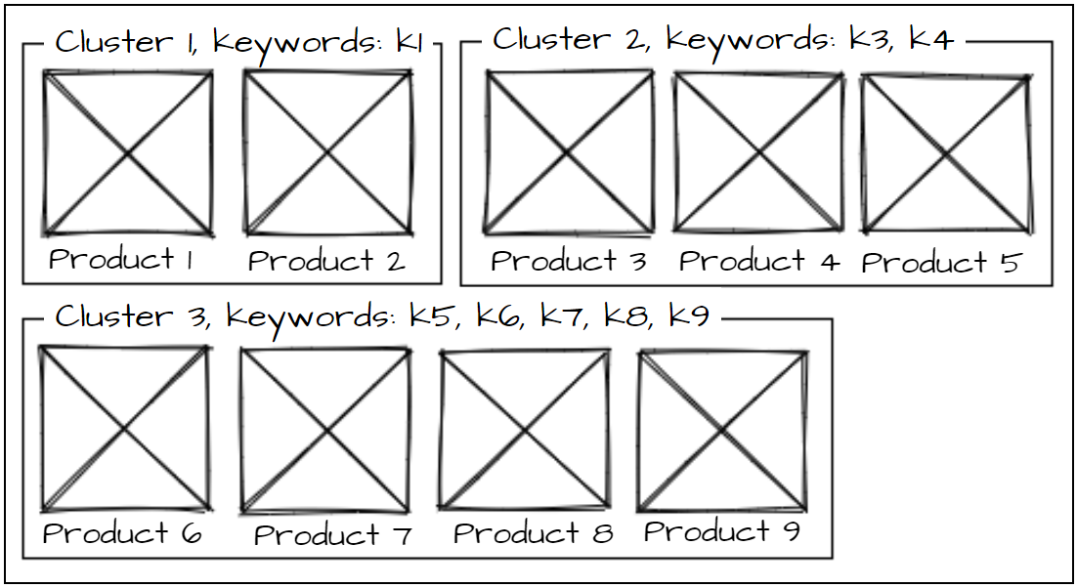
Clustering products with k-means Methodology
Every product item is converted to a set of words and then again to a word frequency vector using the Python scikit-learn library TfidfVectorizer;
It is possible to cluster the vectorized representation of the products into the Euclidean space with a k-means algorithm.;
The algorithm produces a list of clusters similar to the following:

Slide 33
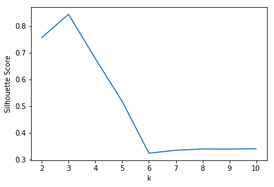



Clustering products with k-means Silhouette Score Optimal k
To understand which is the optimal number of clusters k the Silhouette Score was used, value that measures how similar a point is to its own cluster compared to other clusters;
The optimal k is the value for which the Silhouette Score reaches its global maximum. In this case the optimal k is k = 3

Slide 34
Future Work
Apply the KRLS algorithms on all trends at once in a MIMO fashion;
Data gathering can be made much faster by utilizing data sources that are local to the server rather remote. Another way of improving speed is by clustering cached data;
Data APIs should be used instead of web scrapers because current websites change the DOM structure dynamically;
More research analytics can be calculated and in more specific areas of marketing;

Slide 35

Conclusion
Let’s present some evaluations and considerations regarding the completion of the set objectives and offer a summary and reflection on the research.

Slide 36
Considerations
The implemented MRS is currently able to gather some data using some web scrapers and can analyze this data to produce forecasts and clusters for products. It should be optimized a lot, currently it does the data gathering and analysis quite slowly;
This thesis shows a way to model non stationary data and perform accurate forecasting using kernel machines;
The KRLS-T algorithm achieves the lowest MSE when using a rational quadratic kernel, no forgetting factor and a large dictionary size. The choice of the kernel is the factor that affects performance the most.

Slide 37

Thanks!
Do you have any questions?
mail@danserbanoiu.com
+39 345 859 5173

