Slide 1
GS-Quantify 2017
Predicting Garbage Collector
Roopkishor | Gaurav | Harsh
Team Name - Analytics_rangers
Team Handle - ds_rangers
(IIT Roorkee)

Slide 2
Approach
Data Understanding
Baseline Model
Exploratory Data analysis
Data Pre-processing
Model Validation & Hyperparameter Tuning
Model Implementation
Feature Engineering
Notes:
Baseline

Slide 3
Techniques Used
Linear regression is used to predict Initial free memory.
Tree based models doesn’t work well because if there is a linear relationship between dependent & independent variable then linear regression will outperform the tree based models.
After addition of some features & result of initial free memory in the given data, we have predicted gcRun using Logistic regression.
This is an imbalanced data, that is why a different threshold is required.
Threshold is selected using ROC curve.

Slide 4
Assumptions and Limitations
Looking at the trend of the initialFreeMemory, we assumed it to be a time series.
We have assumed that test data will follow the similar trend as of train data from starting, considering the initial values given.
In cross validation of gcRun, we didn’t incorporated the effect of GC trigger in the vicinity of the actual GC trigger.

Slide 5
Feature Engineering
“query token” is converted into continuous variable by replacing each token with median of finalUsedMemory - initialUsedMemory.
To incorporate the effect of time dependency, we have created a new feature as serial number.
Created a feature for estimating the CPU time taken by each row ( cpuTimeTaken of this row - cpuTimeTaken of previous row).
Notes:
Why continuous is beneficial compared to categorical here.
Label encoding is not preferred in linear regression.

Slide 6
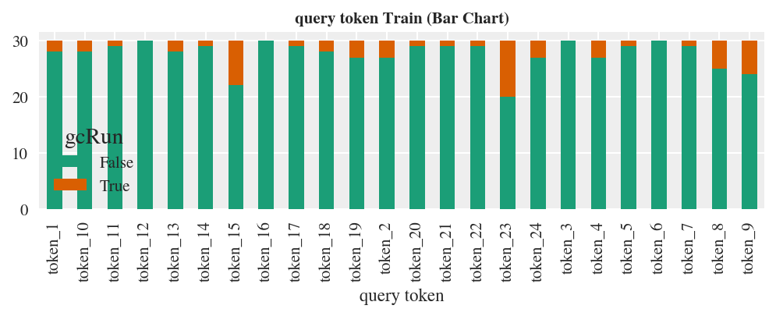
Further Improvements(Feature Engineering)
Count of gcRun(True) corresponding to a token.

Slide 7
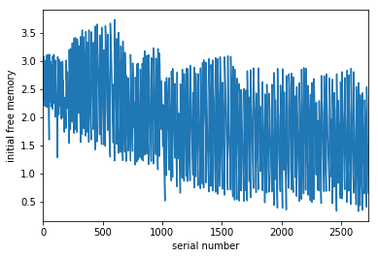
Further Improvements(Feature Engineering)
Serial number can be replaced by square root of index.
P

Slide 8
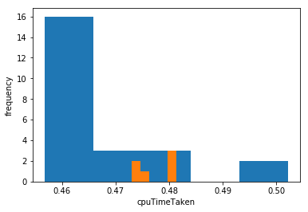
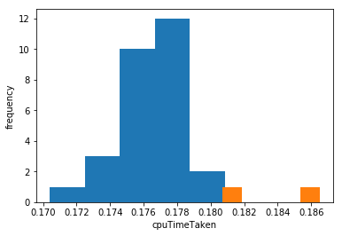
Further Improvements(Feature Engineering)
Cumulative cpuTimeTaken can also be used for time dependency.
CpuTimeTaken deviation from corresponding token’s mean time can be used as a feature.
Token 9
Token 18

Slide 9
Model Selection
Algorithm | RMSE Score | RMSE Score Ranking
Linear Regression | 0.62 | 1st
Random Forest | 0.64 | 2nd
Xgboost | 0.68 | 3rd
Support Vector Machine | 0.70 | 4th
Decision tree | 0.84 | 5th
Linear Regression is giving us highest score.
Tree based algorithms and SVM is not performing good in this dataset.

Slide 10
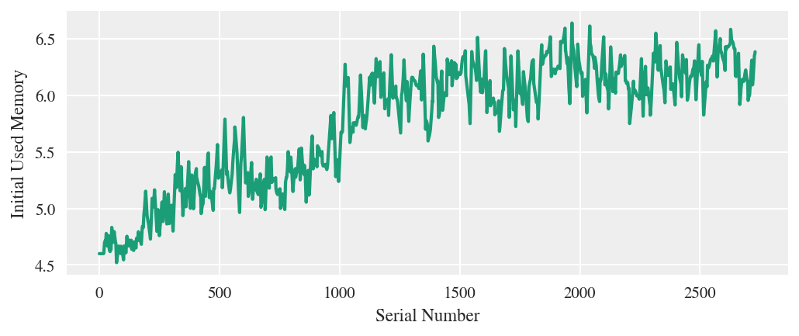
Further Improvements(Model Selection)
Moving average of initial used memory show increasing trend initially followed by stagnation.
LSTM was also tried to handle sequencing data but it doesn’t trained well due to lack of large data.
Ensemble model of Linear regression and XGboost should be used.

Slide 11
Cross Validation
Evaluation metric used were:
Recall score
ROC AUC
We created our own evaluation metric in which we gave more weightage to False Negative as it is more unfavorable in our case:
E = 1*FalsePositive + 3*FalseNegative

Slide 12
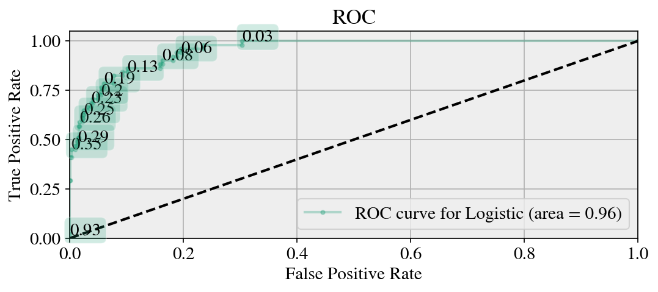
ROC-AUC

Slide 13
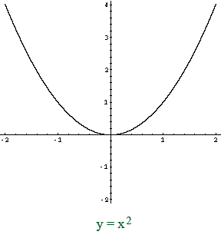
Better Evaluation Metric
We have to predict the GC trigger in the vicinity of the actual GC trigger in the test set, that would be counted in the calculation of the true positives in precision and recall calculation.
For each actual GC trigger, we will find the distance of nearest neighbour which have triggered gcRun in the predicted set.
Error = ∑ (Minimum distance between actual GC trigger and predicted GC trigger)²

Slide 14
Thank You !
Any Question

Slide 15
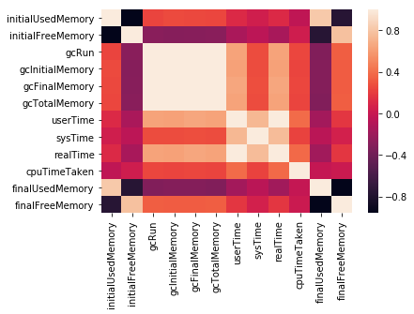
Appendix:
Correlation Plot
There is strong correlation between initial used memory and initial free memory.
gcRun and other gc variables are also correlated with Initial Free Memory.
Strong relationship between final used memory and final free memory

