Slide 1
GS-Quantify 2017
Predicting Garbage Collector
Team Name - Analytics_rangers
Team Handle - ds_rangers
(IIT Roorkee)

Slide 2
Methodology Followed
Understanding the dataset
Exploratory Data Analysis
Feature Engineering
Building a suitable model
Cross validation the result to enhance accuracy

Slide 3
Understanding the Data
There are 2730 query containing 91 tokens in training data.
Training data contains 11 columns like Initial_Free_Memory, CPU_Time_Taken, GC_Run etc .
Test data contains 1625 query but has only 2 columns query token & cpu time and starting value of Initial_Used_Memory, Initial_Free_Memory.
We have to predict GC_Run and Inital_Free_Memory for each query token.
There is no missing value in training data and no requirement for missing value imputation.

Slide 4
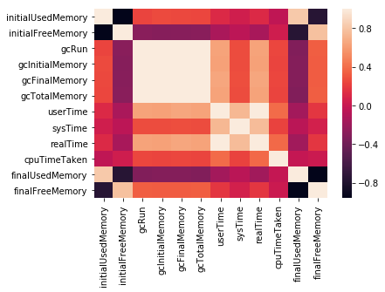
Correlation Plot
There is strong correlation between initial used memory and initial free memory.
gcRun and other gc variables are also correlated with Initial Free Memory.
Strong relationship between final used memory and final free memory

Slide 5
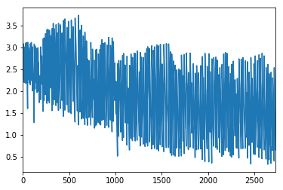
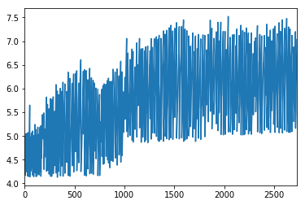
Initial Free memory vs sequence index
Trend shows that as sequence index increases the Initial free memory decreases and Used memory increases.
Initial Used memory vs sequence index

Slide 6
Feature Engineering
A new feature is created difference between final_Used_Memory - initial Used_Memory which resembles memory consumption by token.
For each token we have calculated the median of memory consumption & merged it with training data & testing data with token wise memory consumption.
To incorporate the effect of time-series means sequencing data, we have created a new feature as serial Number
Created a feature for estimating the CPU time taken by each row ( cpu time of this row - CPU time of previous row)
Encoded the token text column into numerical data in each train and test data.
Rolling average of Initial Free Memory & Cpu time with window 5 rows was also used but it does not contribute significantly in accuracy.

Slide 7
Cross Validation
We used stratified 5-fold cross validation technique.
Evaluation metric used were:
ROC AUC
Recall score
We created our own evaluation metric in which we gave more weightage to False Negative as it is more unfavorable in our case: 1*FalsePositive + 3*FalseNegative

Slide 8
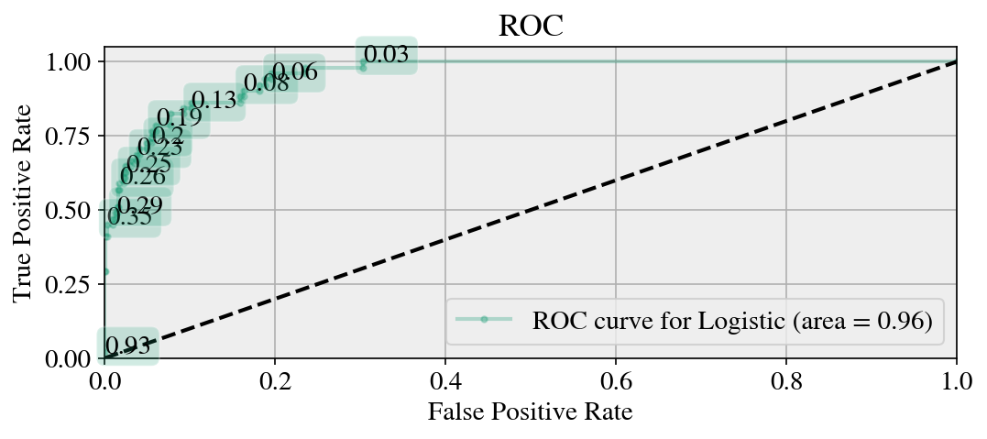
ROC-AUC

Slide 9
Techniques Used
Decision Tree does not work well as there is trend and Correlation present in the data. If the relationship between dependent & independent variable is well approximated by a linear model, linear regression will outperform tree based model.
Linear regression is used to predict Initial free memory.
Result of initial free memory is also used in prediction of GC Run.
Logistic regression is used to predict the gcRun with a different threshold.
This is an imbalanced data, that is why a different threshold is required.
Threshold is selected using ROC curve.

Slide 10
Future Aspect
If time permits, We also want to try LSTM as this is sequencing problem.
More features can be created by encapturing pattern in data.
Ensemble the model with other Machine learning algorithms like Support Vector Machine, XGBoost, neural network etc.
Other time series method can also be incorporated.

