Slide 1
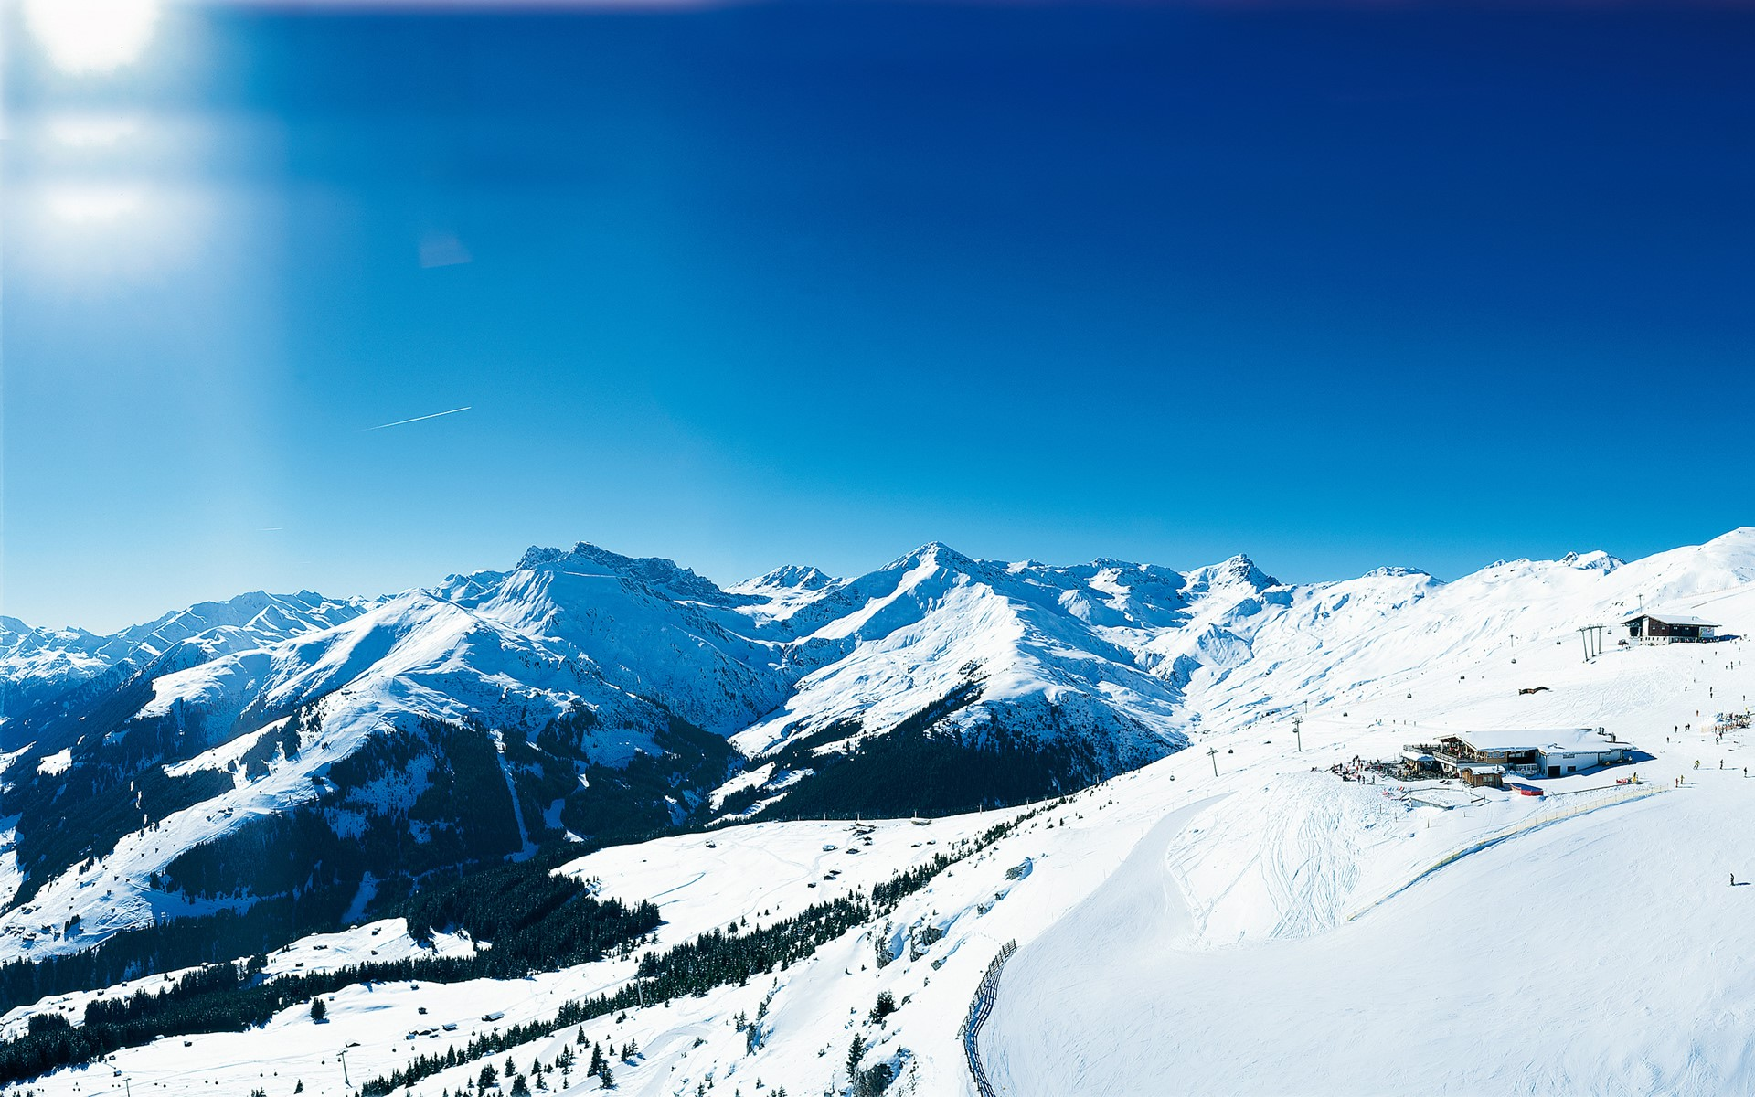

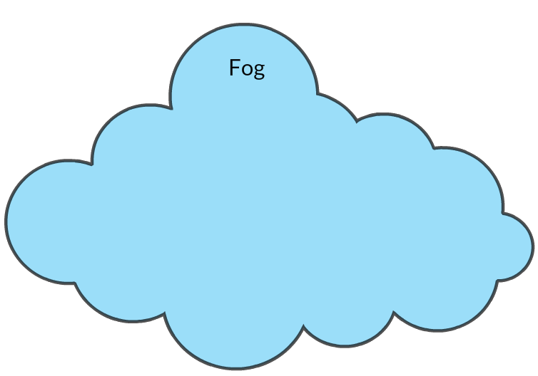

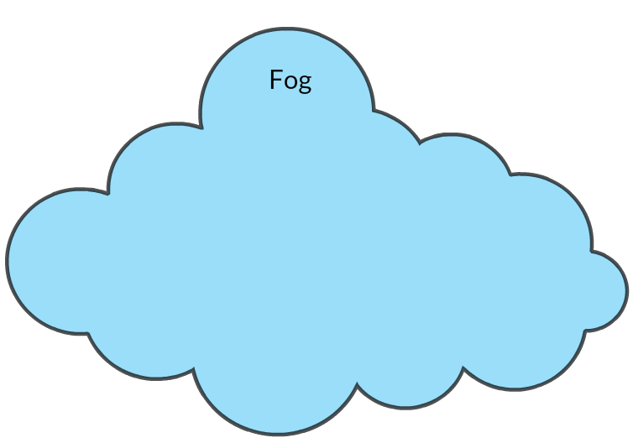
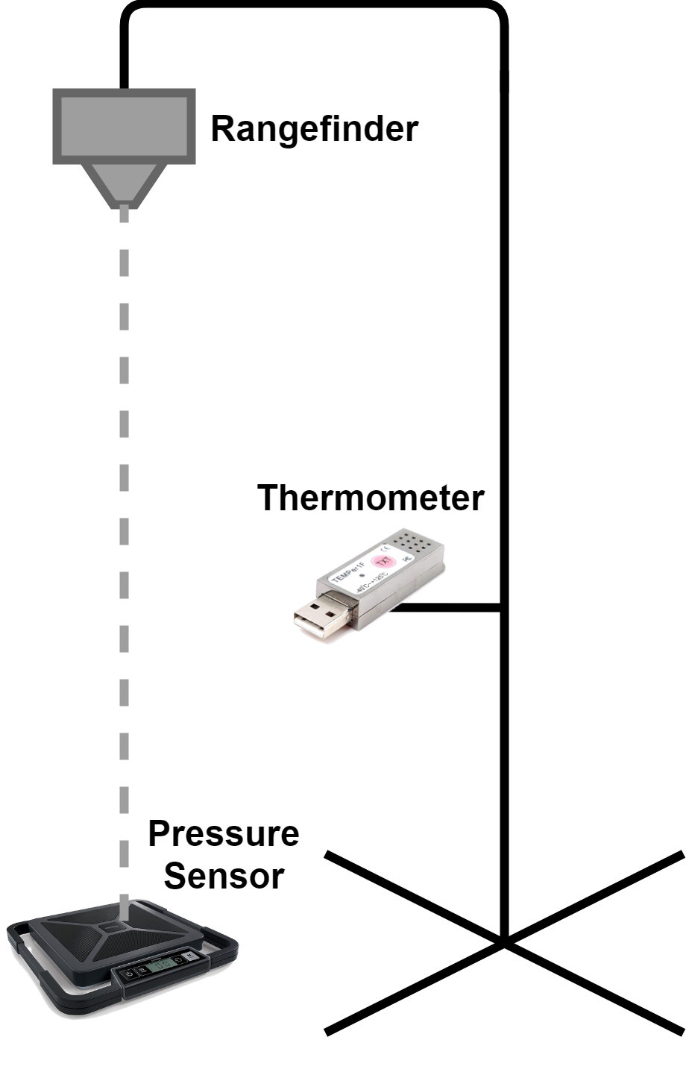

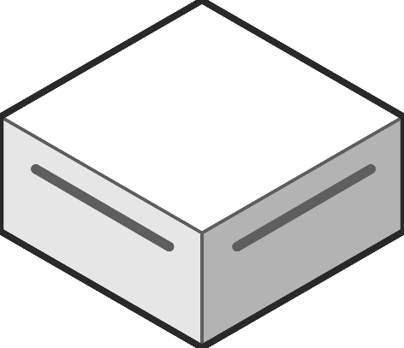
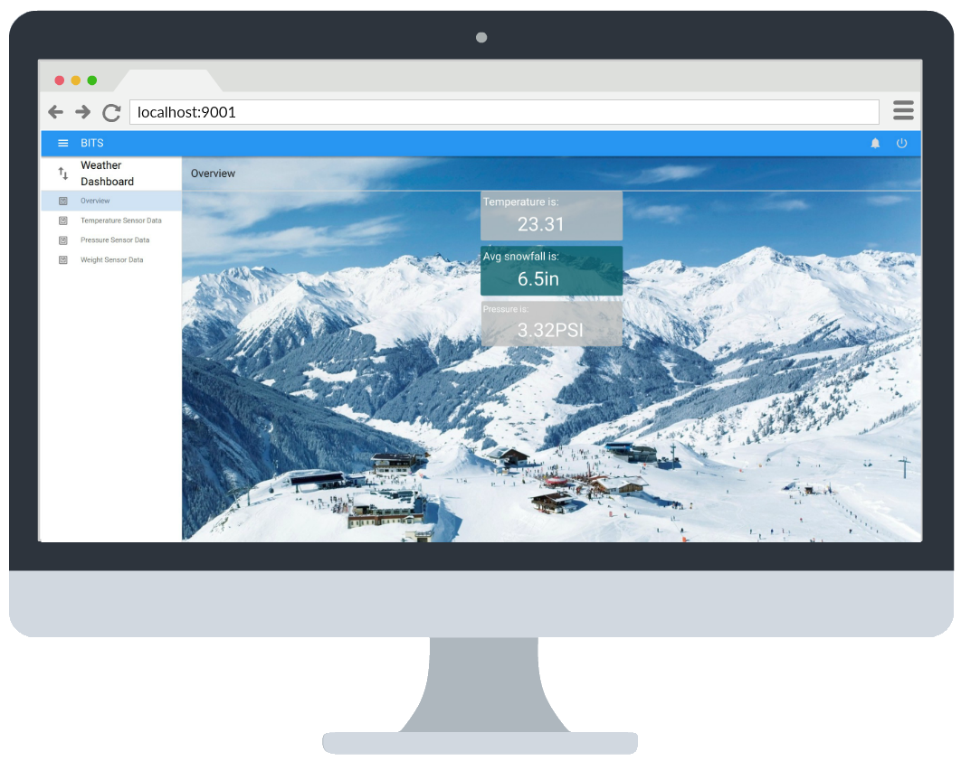
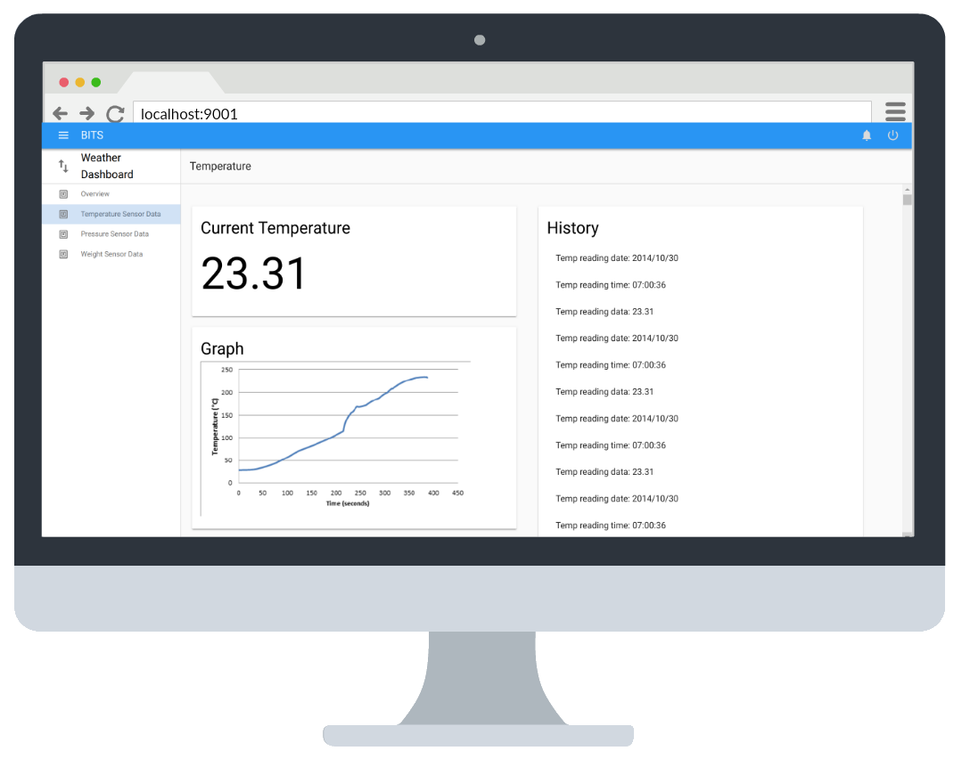


Smart Ski Slope
System of fog nodes to display real time weather and snow conditions for a ski slope on a user-friendly dashboard
Sponsor: LGS Innovations
Team: Samuel Anoff, Jack Dinkel, Kelsey Dowd, Derek Gorthy, Callie Jones
Purpose
LGS has developed a smart device framework, BITS (BITS Integrated Technology System). This project is a demonstration and practical application of this new framework.
Challenges
Integrate with BITS without open source module examples
Hardware Drivers
Inexperience with event driven design
Project Budget
Dependency Versioning
Future Work
Build network
Snow density layer models
Camera integration
Slope population density reports
Skier safety monitoring
Real time notifications
CS Senior Projects 2017-18

