Slide 1


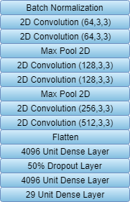
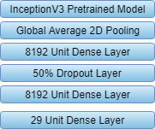
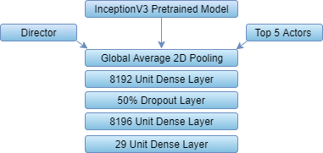






Feature Film Features: Applying machine learning to movie genre identification
CSCI 5622 Group L: Grant Baker, John Dinkel, Derek Gorthy, Jeffrey Maierhofer, Luke Meszar
Project Overview
Goal
Apply machine learning techniques to the problem of identifying movie genres based off of promotional posters.
Justification
Machine learning has had success with image recognition and classification. An effective method of determining poster genre trends could lead to more sophisticated advertisement and marketing campaigns, allowing advertisers to better reach their target audiences.
Dataset
The dataset was obtained using IMDb and the IMDbPY Python package. We obtained a total of 37,928 movie titles, along with links to a thumbnail of the poster, IMDb rating, director, and top five actors.
Approach
We developed a total of four models:
Logistic Regression on a Histogram of Colors
Convolutional Neural Network
Convolutional Neural Network with Inception-v3 pre-trained feature extraction layers utilizing transfer learning
Convolutional Neural Network with Inception-v3 feature extraction and additional movie metadata (Actors and Director)
Histogram of Colors
As a baseline, we converted each image into a histogram of its RGB pixel values and fed this to a Logistic Regression algorithm. This yielded a testing accuracy of 24%.
Human Baseline
In order to get a human baseline, we gave poster images to friends and asked them to guess three genres from the same list as our models. We averaged an f-score of 0.32. It is a small sample size of 12 people, but it is fairly clear that humans are not very good at this problem.
CNN
Our CNN model is described in the diagram We achieved an f-score of 0.27.
Conclusion
The best model is the Inception-v3 pre-trained model. This is unsurprising, as it utilizes transfer learning and a powerful feature extractor. We are hopeful that our meta-data model can perform even better.
We recognize that although our best model did not achieve a perfect f-score, due to the nature of the metric, f-scores of partially correct predictions are moderately low, so our model is able to partially solve the problem. Our current conclusion is that neural networks do not perfectly solve this problem.
Challenges
Sparse classification → Sparsemax loss function
Sparse classification → F-score accuracy metric
A lot of movies are Dramas
Training data is mostly unknown, atypical movies
Future Work
A larger dataset containing higher resolution images might help with feature identification.
Additional Meta-Data might also be useful. Examples include Title, Producers, Budget, etc.
Other models architectures could lead to improved performance.
Weighing classic movies of a genre higher could increase performance.
Inception-v3
Our pretrained CNN uses transfer learning with Google's Inception-v3 model as a feature extractor, training on the final layers. We achieved an f-score of 0.40.
For our meta-data approach, we concatenated director and actor information to the Inception-v3 model. We have yet to finish training this model.
Inception-v3 with Meta-Data
Guess
Drama
Animation
Comedy
Actual
Adventure
Animation
Comedy
Guess
Drama
Comedy
Sport
Actual
Adventure
Horror
Thriller
Guess
Drama
Documentary
Sport
Actual
Drama
Family
Guess
Drama
Comedy
Romance
Actual
Crime
Drama
Guess
Drama
Mystery
Thriller
Actual
Action
Drama
Mystery
Guess
Drama
Comedy
Horror
Actual
Action
Adventure
Fantasy
References
Martins, Andre, and Ramon Astudillo. "From softmax to sparsemax: A sparse model of attention and multi-label classification." International Conference on Machine Learning. 2016.
Ivasic-Kos, Marina, Miran Pobar, and Ivo Ipsic. "Automatic Movie Posters Classification into Genres." ICT Innovations 2014. Springer, Cham, 2015. 319-328.
Notes:
Small section for f-score and sparsemax?

