Slide 1
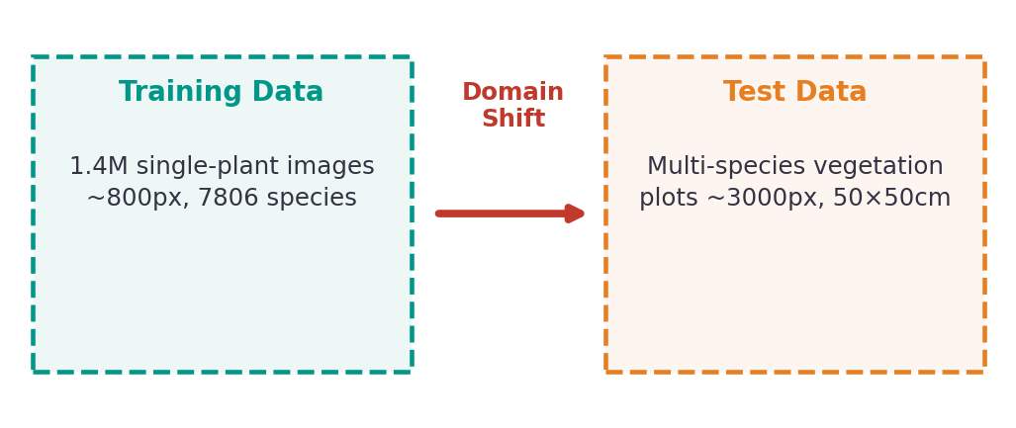
PlantCLEF 2026 — Problem Overview
Multi-label plant species identification in vegetation plot photographs
▸ Train on single-plant close-ups, test on multi-species plots
▸ 7,806 candidate species — extreme long-tail distribution
▸ ~2,105 test images; 76% multi-visit, 24% single-visit
▸ Evaluation: multi-label F1 (Kaggle public leaderboard)
Our Approach
Current Best
▸ DINOv2 ViT-B/14 pretrained embeddings (no fine-tuning)
▸ Multi-scale tiling (77 tiles) to bridge resolution gap
▸ kNN retrieval + softmax ensemble with temporal location prior
F1 = 0.418
+48.6% over baseline (0.281)

Slide 2
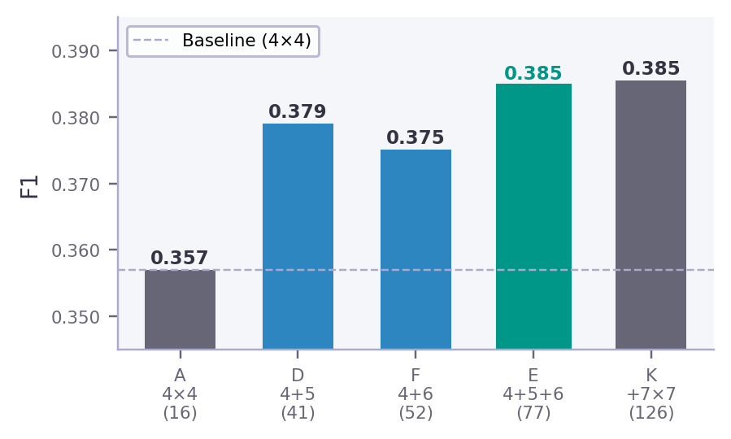
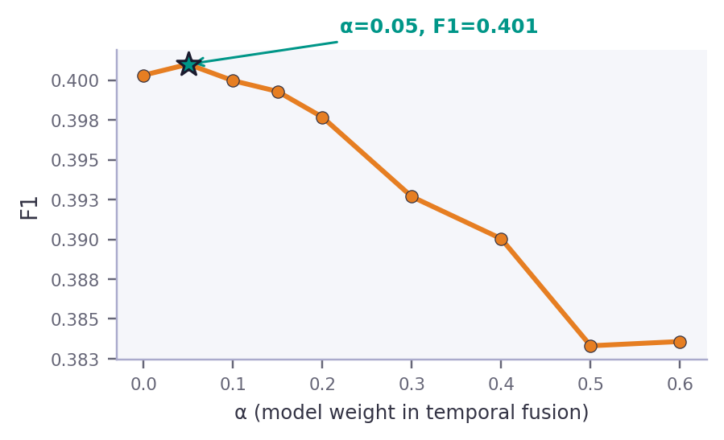
Threshold Optimization & Multi-Scale Tiling
Exp-6 / Exp-7 / Exp-8
Tiling Scheme Comparison
Location Prior Weight (α)
Key Findings
▸ Fine scales (4×4, 5×5, 6×6) capture individual plants; coarse scales (1×1–3×3) introduce false positives
▸ 3 complementary scales outperform any 2 — optimal ~3 species/image, not 10
▸ 77 tiles = more noise → location prior shifts from 40% to 95% of final prediction | F1: 0.357 → 0.401 (+12.3%)

Slide 3
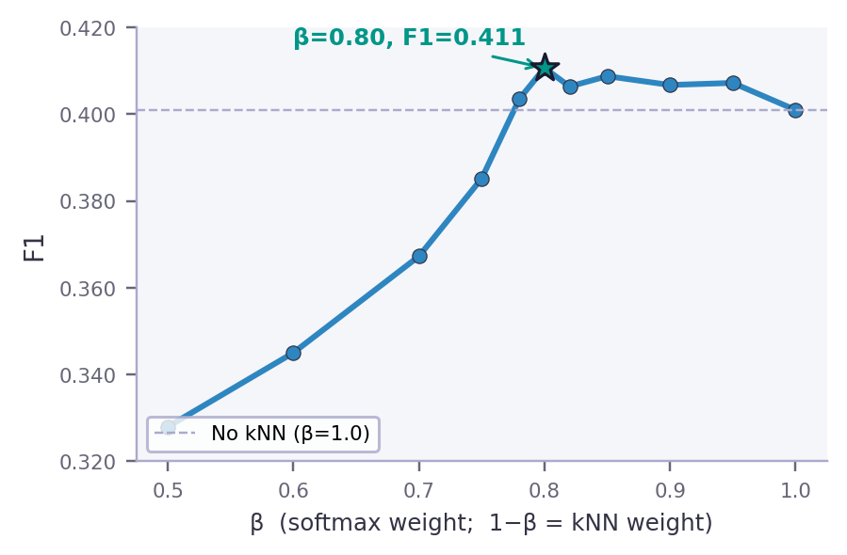
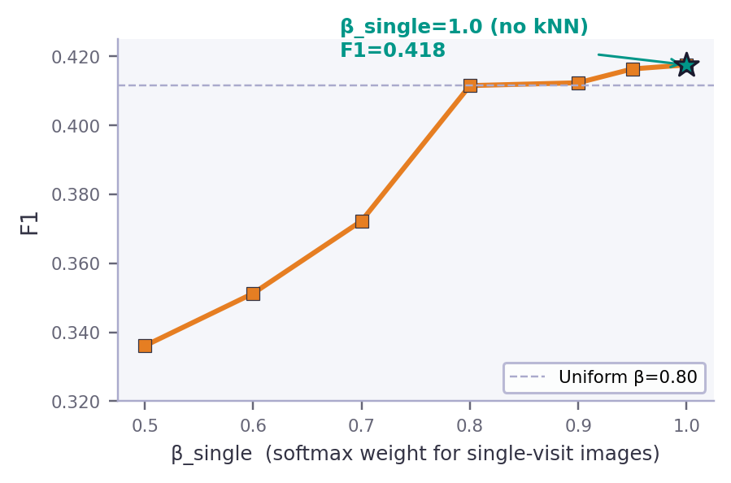
kNN Retrieval Ensemble
Exp-9: FAISS-based kNN blended with softmax | F1: 0.401 → 0.418 (+4.1%)
Softmax vs kNN Weight
Single-Visit vs Multi-Visit
Key Findings
▸ kNN only helps when temporal prior acts as safety net (multi-visit); pure softmax is best for single-visit images
▸ Optimal: β_multi=0.80 (20% kNN), β_single=1.00 (no kNN) — FAISS IndexFlatIP, 860K embeddings, k=20
▸ Rare species boosting (inverse frequency weighting) hurts — too few quality training samples for tail species

Slide 4
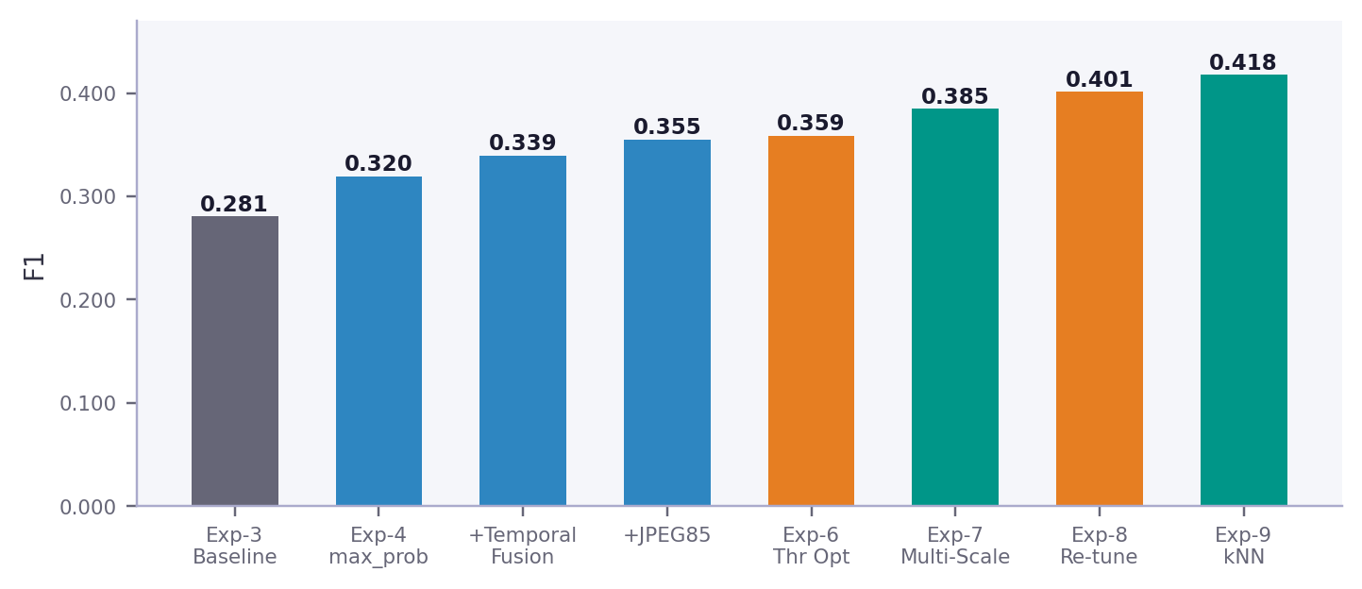
Results Summary
F1: 0.281 → 0.418 (+48.6% relative) | Public Leaderboard
Top Techniques
+0.044 Multi-Scale Tiling
+0.039 max_prob Aggregation
+0.020 Temporal Fusion
+0.017 kNN Ensemble
+0.016 JPEG85 Preproc
Final Configuration
Next Steps
Tiling: 4×4+5×5+6×6 (77 tiles) Model: DINOv2 ViT-B/14
▸ Knowledge distillation / noisy student
▸ Fine-tune DINOv2 (LoRA)
▸ Ensemble multiple architectures
kNN: FAISS k=20, β_multi=0.80, β_single=1.00
Aggregation: max_prob → temporal fusion (α=0.15) → thr=0.100

