Slide 1

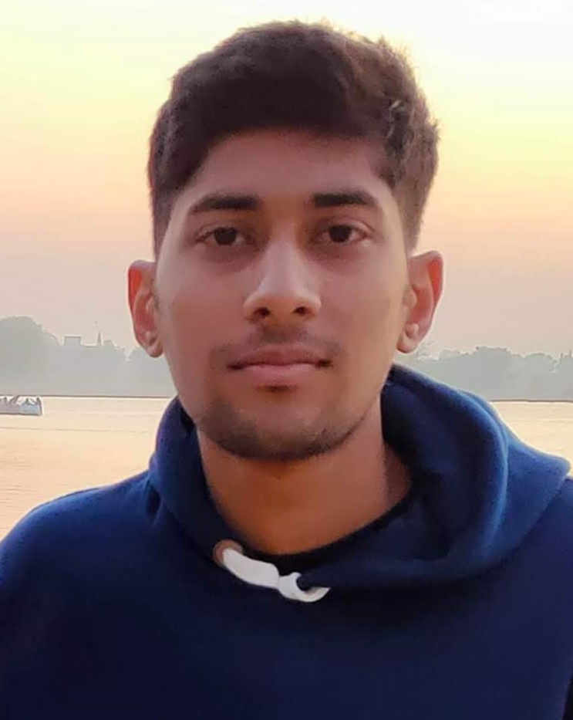
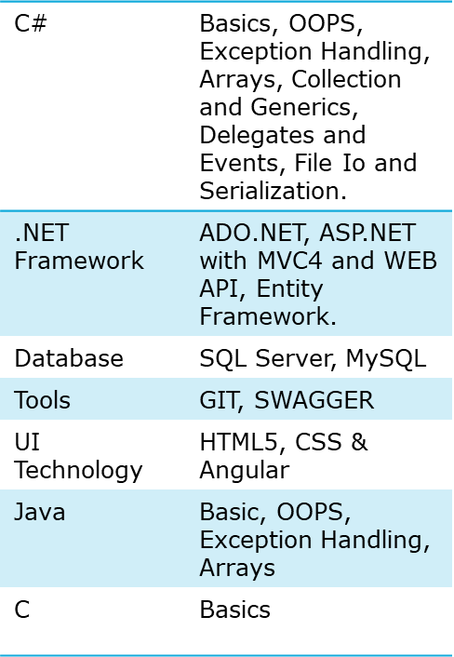



Devendra Sharma
Education and certificates
Bachelor of Technology Computer Science : 2018 – 2022
Senior Analyst/Software Engineer
I-Transform Premier Talent Batch
Base Location: Mumbai
Skills
Email ID: devendra.b.sharma@capgemini.com
Mobile No: 9462277780
Grade: A5
Strengths
A self driven learner with Front-End and Back-End knowledge. Passionate about implementing and launching new projects.
Ready to learn new technologies/Frameworks and implement them to further improve my knowledge.
A team player with good communication skill always ready to work for the enrichment of knowledge.
Understanding of RDBMS concepts using SQL Server. Practical understanding of C#
Hands on experience in developing applications using .NET Framework, Entity Framework and ADO.NET .
Also Implemented .NET Core API and Angular in case study and upskilling day by day.
Achivement
Crop Deal Application
Completed case study on Crop Deal which is a Web-based System where farmers can sell their crops to dealers. The farmer can register with all the details and can post his crops for sale here. The dealers can buy the crops that he/she is interested from the list of crops published by farmers and also make the payment through the portal.
Completed end to end case study of Crop Deal Application along with JWT authentication, Swagger using .NET Core Web API with Entity Framework. Angular used for user interface.
Technologies used:
ANGULAR
ASP.NET CORE
Microsoft SQL Server
Check out my work on GitHub
Presentation Title | Author | Date © Capgemini 2017. All rights reserved | 1

