Slide 1
All the pipelines – Journey through the GPU
Lou Kramer, Developer Technology Engineer, AMD

Slide 2

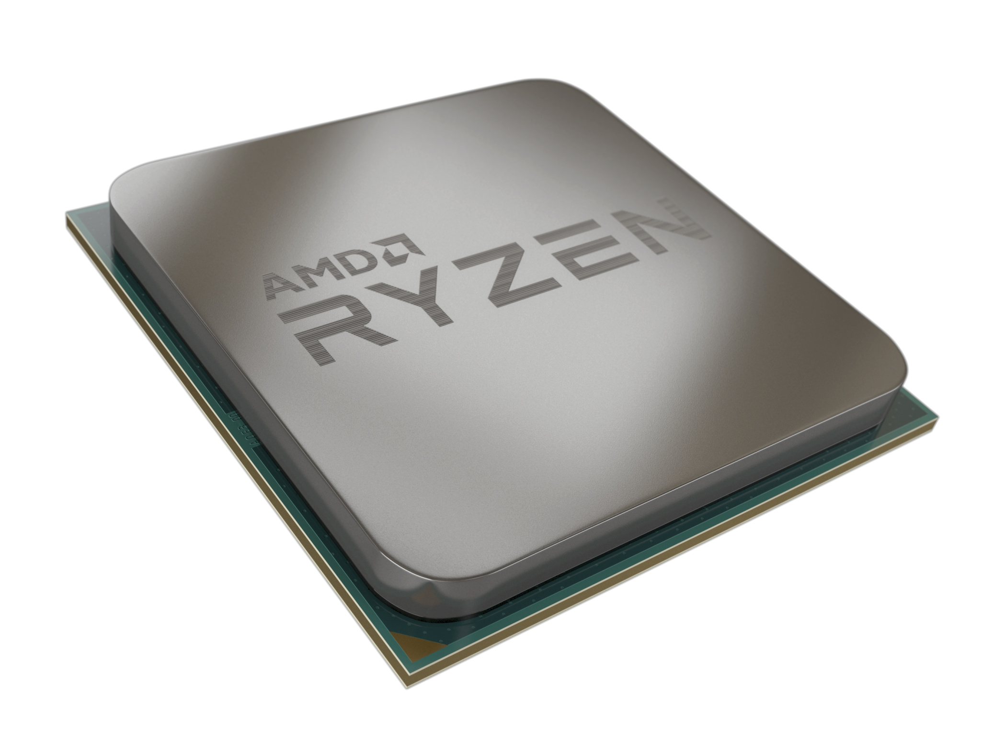



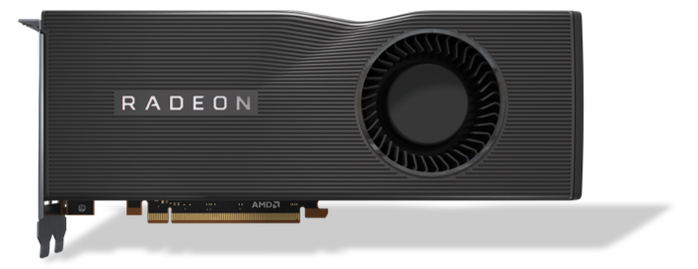

Overview
…

Slide 3
Content Creation
Some 3d model created via your software of choice
(e.g., Blender - www.blender.org).
This model is represented by a bunch of triangles.
Each triangle is defined by 3 vertices.
Vertices can have a number of attributes:
Position
Normal Vector
Texture coordinate
…

Slide 4
Content Creation
.dae
.abc
.3ds
.fbx
.ply
.obj
.x3d
.stl
<custom>
Export
Positions
Normal Vectors
Texture Coordinates
Connectivity Information
…

Slide 5

Content Creation
.dae
.abc
.3ds
.fbx
.ply
.obj
.x3d
.stl
<custom>
Import
Game Engine of your choice

Slide 6
Rendering – Preparation on the CPU
Geometry
Engine Specific format
Render
Front End
Abstraction
Layer
Graphics
APIs
Mesh Creation:
Vertex Buffers.
Index Buffers.
Textures.
…
Visibility Testing
The less work the GPU needs to do the better.
…
Vulkan® (vkCmdDrawIndexed,vkCmdDispatch, …)
D3D12
(DrawIndexedInstanced,Dispatch, …)
D3D11
…
MyDraw
MyDispatch
…
Buffers in
System Memory (CPU)
List of Commands

Slide 7
Render Front End
Data (Buffers, Textures …)
PCIe®
System memory
Video memory

Slide 8
GPU Commands
List of Commands
vkCmdBindPipeline
vkCmdBindVertexBuffers
vkCmdBindIndexBuffer
vkCmdDrawIndexed
…
Send a batch of commands to the GPU so the GPU is busy for quite a while.
Every command list submission takes some time!

Slide 9
GPU Commands
List of Commands
vkCmdBindPipeline
vkCmdBindVertexBuffers
vkCmdBindIndexBuffer
vkCmdDrawIndexed
…
Send a batch of commands to the GPU so the GPU is busy for quite a while.
Every command list submission takes some time!
vkCmdBindPipeline: Sets the GPU into the correct state. → Contains the settings for the different stages of the graphics pipeline.
vkCmdBindVertexBuffers: Tells the GPU which vertex buffers to access for the next drawcalls.
vkCmdBindIndexBuffer: Tells the GPU which index buffer to access for the next draw calls.
vkCmdDrawIndexed: The actual draw call → will process the specified vertices according to the state of the GPU.

Slide 10
The Graphics Pipeline
Input Assembler
Vertex Shader Stage
Tesselation Stage
Geometry Shader Stage
Rasterizer
Pixel Shader Stage
Output Merger

Slide 11
The Compute Pipeline
Compute Shader Stage

Slide 12
The Logical Pipelines
Input Assembler
Vertex Shader Stage
Tesselation Stage
Geometry Shader Stage
Rasterizer
Pixel Shader Stage
Output Merger
e.g.: Compute Lighting Shader
Compute Shader Stage

Slide 13
On the RDNA Architecture
Vertices,
Textures
and
Buffers
Constants
Frame Buffer
Command
List
Indices
Color Backend /
Depth Backend
Shader Processor Input
Command Processor
Geometry Engine
Shader Export
Primitive Assembler
Scan Converter
Dual Compute Unit
Vertex Pipeline
Pixel Pipeline
Compute Pipeline

Slide 14
On the RDNA Architecture
Vertices,
Textures
and
Buffers
Constants
Frame Buffer
Command
List
Indices
Color Backend /
Depth Backend
Shader Processor Input
Command Processor
Geometry Engine
Shader Export
Primitive Assembler
Scan Converter
Dual Compute Unit
Command Processor (CP)
Processes the list of commands received by the CPU.
Sets the GPU in the correct ‚state‘ to execute the commands.
Vertex Pipeline
Pixel Pipeline
Compute Pipeline

Slide 15
On the RDNA Architecture
Vertices,
Textures
and
Buffers
Constants
Frame Buffer
Command
List
Indices
Color Backend /
Depth Backend
Shader Processor Input
Command Processor
Geometry Engine
Shader Export
Primitive Assembler
Scan Converter
Dual Compute Unit
Geometry Engine (GE)
Knows about topology (points, lines, triangles) / connectivity.
?
Vertex Pipeline
Pixel Pipeline
Compute Pipeline

Slide 16
On the RDNA Architecture
Vertices,
Textures
and
Buffers
Constants
Frame Buffer
Command
List
Indices
Color Backend /
Depth Backend
Shader Processor Input
Command Processor
Geometry Engine
Shader Export
Primitive Assembler
Scan Converter
Dual Compute Unit
Shader Processor Input (SPI)
Accumulates work items. For a vertex shader, one work item is one vertex.
Sends them in waves to the Dual Compute Unit.
A wave consists of 32 or 64 work items.
Vertex Pipeline
Pixel Pipeline
Compute Pipeline

Slide 17
On the RDNA Architecture
Vertices,
Textures
and
Buffers
Constants
Frame Buffer
Command
List
Indices
Color Backend /
Depth Backend
Shader Processor Input
Command Processor
Geometry Engine
Shader Export
Primitive Assembler
Scan Converter
Dual Compute Unit
Dual Compute Unit (Dual CU)
Executes shader programs.
Can read and write to memory.
First run is through the vertex pipeline → one work item represents one vertex.
Vertex Pipeline
Pixel Pipeline
Compute Pipeline

Slide 18
On the RDNA Architecture
Vertices,
Textures
and
Buffers
Constants
Frame Buffer
Command
List
Indices
Color Backend /
Depth Backend
Shader Processor Input
Command Processor
Geometry Engine
Shader Export
Primitive Assembler
Scan Converter
Dual Compute Unit
Shader Export (SX)
Handles special output from the Dual CU.
Vertex Pipeline
Pixel Pipeline
Compute Pipeline

Slide 19
On the RDNA Architecture
Vertices,
Textures
and
Buffers
Constants
Frame Buffer
Command
List
Indices
Color Backend /
Depth Backend
Shader Processor Input
Command Processor
Geometry Engine
Shader Export
Primitive Assembler
Scan Converter
Dual Compute Unit
Primitive Assembler (PA)
Accumulates vertices that span a triangle.
Forwards triangles to Scan Converter.
Vertex Pipeline
Pixel Pipeline
Compute Pipeline

Slide 20
On the RDNA Architecture
Vertices,
Textures
and
Buffers
Constants
Frame Buffer
Command
List
Indices
Color Backend /
Depth Backend
Shader Processor Input
Command Processor
Geometry Engine
Shader Export
Primitive Assembler
Scan Converter
Dual Compute Unit
Scan Converter (SC)
Determine pixels covered by each triangle.
Forwards them to Shader Processor Input (SPI).
Vertex Pipeline
Pixel Pipeline
Compute Pipeline

Slide 21

On the RDNA Architecture
Vertices,
Textures
and
Buffers
Constants
Frame Buffer
Command
List
Indices
Color Backend /
Depth Backend
Shader Processor Input
Command Processor
Geometry Engine
Shader Export
Primitive Assembler
Scan Converter
Dual Compute Unit
SPI, Dual CU, SX – Pixel Pipeline
One work item represents one pixel (also called fragment).
Vertex Pipeline
Pixel Pipeline
Compute Pipeline

Slide 22
On the RDNA Architecture
Vertices,
Textures
and
Buffers
Constants
Frame Buffer
Command
List
Indices
Color Backend /
Depth Backend
Shader Processor Input
Command Processor
Geometry Engine
Shader Export
Primitive Assembler
Scan Converter
Dual Compute Unit
Color Backend / Depth Backend
Discard occluded pixels based on depth / stencil.
Write colored pixels to render targets.
Vertex Pipeline
Pixel Pipeline
Compute Pipeline

Slide 23
Logical Pipeline → Hardware
Color Backend /
Depth Backend
Command Processor
Geometry Engine
Shader Processor Input
Shader Export
Primitive Assembler
Scan Converter
Shader Processor Input
Shader Export
Dual Compute Unit
Dual Compute Unit
Input Assembler
Vertex Shader
Tesselation
Geometry Shader
Rasterizer
Pixel Shader
Output Merger

Slide 24
Logical Pipeline → Hardware
Color Backend /
Depth Backend
Command Processor
Geometry Engine
Shader Processor Input
Shader Export
Primitive Assembler
Scan Converter
Shader Processor Input
Shader Export
Dual Compute Unit
Dual Compute Unit
Input Assembler
Vertex Shader
Tesselation
Geometry Shader
Rasterizer
Pixel Shader
Output Merger
Retrieves indices from index buffer.
Knows about the topology.
Triangles, line, point.
Holds a cache for vertex reuse.
Avoid shading vertices multiple times.
Forwards index to Shader Processor Input (SPI).
0 | 1 | 2 | 2 | 3 | 0 | 1 | 5 | 6 | 6 | 2 | 1 | 7 | 6 | 5 | 5 | 4 | 7

Slide 25
Logical Pipeline → Hardware
Color Backend /
Depth Backend
Command Processor
Geometry Engine
Shader Processor Input
Shader Export
Primitive Assembler
Scan Converter
Shader Processor Input
Shader Export
Dual Compute Unit
Dual Compute Unit
Input Assembler
Vertex Shader
Tesselation
Geometry Shader
Rasterizer
Pixel Shader
Output Merger
Waits until there are enough indices before bothering the Dual Compute Unit.
Chooses a Dual CU.
Configures Dual CU.
Reserves resources in Dual CU.
Loads address of vertex shader program into the program counter (PC).
Initializes scalar and vector registers in Dual CU.
Kicks off work for Dual CU.
Dual CU
Shader Processor Input
PC
Vector Registers
Scalar Registers

Slide 26

Logical Pipeline → Hardware
Color Backend /
Depth Backend
Command Processor
Geometry Engine
Shader Processor Input
Shader Export
Primitive Assembler
Scan Converter
Shader Processor Input
Shader Export
Dual Compute Unit
Dual Compute Unit
Input Assembler
Vertex Shader
Tesselation
Geometry Shader
Rasterizer
Pixel Shader
Output Merger
Usually transforms vertices from object space to clip space.
Attaches additional vertex attributes.
Usually same transformations for every vertex in the mesh.
→ Parallelizable.
Double CU

Slide 27
Dual Compute Unit
Dual Compute Units are designed to execute parallel workloads!
The number of Dual CUs depends on the card, e.g. Radeon™ RX 5700 XT has 20 Dual CUs.
Dual CU
Dual CU
Dual CU
Dual CU
Dual CU
SIMD
SIMD
Dual CU
Dual CU
Dual CU
Dual CU
Dual CU
SIMD
SIMD
32 threads per SIMD
One vector register (VGPR) holds one value per thread. One scalar register (SGPR) holds one value per wave.
Dual CU
Dual CU
Dual CU
Dual CU
Dual CU
4 x 32-wide SIMDs per Dual CU
Dual CU
Dual CU
Dual CU
Dual CU
Dual CU

Slide 28


Dual Compute Unit
Dual Compute Units are designed to execute parallel workloads!
Example Pseudo-Code:
…
if (vertex == tail) {
// Do something fox tail specific
}
else {
// Do something else 💃
}
…
Skipped!!!
Idle

Slide 29
Logical Pipeline → Hardware
Color Backend /
Depth Backend
Command Processor
Geometry Engine
Shader Processor Input
Shader Export
Primitive Assembler
Scan Converter
Shader Processor Input
Shader Export
Dual Compute Unit
Dual Compute Unit
Input Assembler
Vertex Shader
Tesselation
Geometry Shader
Rasterizer
Pixel Shader
Output Merger
Double CU
Hull Shader
Tesselator
Domain Shader
Optional. It can be used to further transform the geometry.

Slide 30
Logical Pipeline → Hardware
Color Backend /
Depth Backend
Command Processor
Geometry Engine
Shader Processor Input
Shader Export
Primitive Assembler
Scan Converter
Shader Processor Input
Shader Export
Dual Compute Unit
Dual Compute Unit
Input Assembler
Vertex Shader
Tesselation
Geometry Shader
Rasterizer
Pixel Shader
Output Merger
Double CU
Gets transformed vertices from the Dual CUs.
Decides if we forward to the Color Backend / Depth Backend or to the Primitive Assembler.
→ On the vertex pipeline, it forwards to the Primitive Assembler.

Slide 31

Logical Pipeline → Hardware
Color Backend /
Depth Backend
Command Processor
Geometry Engine
Shader Processor Input
Shader Export
Primitive Assembler
Scan Converter
Shader Processor Input
Shader Export
Dual Compute Unit
Dual Compute Unit
Input Assembler
Vertex Shader
Tesselation
Geometry Shader
Rasterizer
Pixel Shader
Output Merger
Uses the connectivity info stored by the Geometry Engine earlier.
Waits for 3 connected vertex positions to appear.
Transforms vertices to screen space.
View Frustum Culling.
Backface Culling.
Forwards triangle to Scan Converter.

Slide 32
Logical Pipeline → Hardware
Color Backend /
Depth Backend
Command Processor
Geometry Engine
Shader Processor Input
Shader Export
Primitive Assembler
Scan Converter
Shader Processor Input
Shader Export
Dual Compute Unit
Dual Compute Unit
Input Assembler
Vertex Shader
Tesselation
Geometry Shader
Rasterizer
Pixel Shader
Output Merger
Determine all pixels that overlap the triangle. On a fine level (4x4 pixels) test against the triangle edges.
Rasterization
Scan Conversion only on a coarse level.
Forwards quads to the Shader Processor Input.

Slide 33
Logical Pipeline → Hardware
Color Backend /
Depth Backend
Command Processor
Geometry Engine
Shader Processor Input
Shader Export
Primitive Assembler
Scan Converter
Shader Processor Input
Shader Export
Dual Compute Unit
Dual Compute Unit
Input Assembler
Vertex Shader
Tesselation
Geometry Shader
Rasterizer
Pixel Shader
Output Merger
Gets enough quads from the Scan Converter.
Chooses Dual Compute Unit, sets it up.
A work item is now a pixel / fragment!

Slide 34
Logical Pipeline → Hardware
Color Backend /
Depth Backend
Command Processor
Geometry Engine
Shader Processor Input
Shader Export
Primitive Assembler
Scan Converter
Shader Processor Input
Shader Export
Dual Compute Unit
Dual Compute Unit
Input Assembler
Vertex Shader
Tesselation
Geometry Shader
Rasterizer
Pixel Shader
Output Merger
A lot of small triangles covering only a single pixel → a lot of threads are masked out:
Pixels within the quad not covered by the triangle lead to inactive threads!
Export finished pixels / fragments via Shader Export.

Slide 35
Logical Pipeline → Hardware
Color Backend /
Depth Backend
Command Processor
Geometry Engine
Shader Processor Input
Shader Export
Primitive Assembler
Scan Converter
Shader Processor Input
Shader Export
Dual Compute Unit
Dual Compute Unit
Input Assembler
Vertex Shader
Tesselation
Geometry Shader
Rasterizer
Pixel Shader
Output Merger
This time, the Shader Export forwards the fragments to the Color Backend / Depth Backend instead of the Primitive Assembler.

Slide 36
Logical Pipeline → Hardware
Color Backend /
Depth Backend
Command Processor
Geometry Engine
Shader Processor Input
Shader Export
Primitive Assembler
Scan Converter
Shader Processor Input
Shader Export
Dual Compute Unit
Dual Compute Unit
Input Assembler
Vertex Shader
Tesselation
Geometry Shader
Rasterizer
Pixel Shader
Output Merger
Color Blending.
Writes the fragment color to the bound render targets.
MSAA resolve.
Compression.
…

Slide 37

Logical Pipeline → Hardware
Color Backend /
Depth Backend
Command Processor
Geometry Engine
Shader Processor Input
Shader Export
Primitive Assembler
Scan Converter
Shader Processor Input
Shader Export
Dual Compute Unit
Dual Compute Unit
Input Assembler
Vertex Shader
Tesselation
Geometry Shader
Rasterizer
Pixel Shader
Output Merger
Use this rendertarget as input for the next pass.
Do some calculations.
Output another rendertarget with same size.
Every pixel of the output render target needs to be modified.

Slide 38
Logical Pipeline → Hardware
Color Backend /
Depth Backend
Command Processor
Geometry Engine
Shader Processor Input
Shader Export
Primitive Assembler
Scan Converter
Shader Processor Input
Shader Export
Dual Compute Unit
Dual Compute Unit
Input a triangle spanning over the whole output render target.
The rasterizer will then forward every pixel to the pixel shader.

Slide 39

Logical Pipeline → Hardware
Color Backend /
Depth Backend
Command Processor
Geometry Engine
Shader Processor Input
Shader Export
Primitive Assembler
Scan Converter
Shader Processor Input
Shader Export
Dual Compute Unit
Dual Compute Unit
Input a triangle spanning over the whole output render target.
The rasterizer will then forward every pixel to the pixel shader.
If the triangle is not spanning over the whole output render target, only a part of the output render target will be modifed!

Slide 40
The Compute Pipeline
Command Processor
Textures,
Buffers,
and
Constants
Shader Processor Input
Dual Compute Unit
Remember: Dual Compute Units can
read and write to memory.
Compute Shader Stage
Do some calculations using the data from the Input texture using a compute shader.
Dispatch as many threads as the texture has pixels.
For compute shaders, the number of threads is explicitly specified.
Input: render target from previous pass.
Output: writable texture.

Slide 41
Presentation
Wait until the render target is done and send it over to the screen.
DisplayPort™
HDMI®
…

Slide 42
Q&A
lou.kramer@amd.com
GPUOpen.com
Special thanks to Dominik Baumeister and his talk "Triangles Are Precious – Let‘s Treat Them With Care".

Slide 43
Disclaimer & Attributes
Disclaimer:
The information presented in this document is for informational purposes only and may contain technical inaccuracies, omissions, and typographical errors. The information contained herein is subject to change and may be rendered inaccurate for many reasons, including but not limited to product and roadmap changes, component and motherboard version changes, new model and/or product releases, product differences between differing manufacturers, software changes, BIOS flashes, firmware upgrades, or the like. Any computer system has risks of security vulnerabilities that cannot be completely prevented or mitigated. AMD assumes no obligation to update or otherwise correct or revise this information. However, AMD reserves the right to revise this information and to make changes from time to time to the content hereof without obligation of AMD to notify any person of such revisions or changes.
THIS INFORMATION IS PROVIDED ‘AS IS.” AMD MAKES NO REPRESENTATIONS OR WARRANTIES WITH RESPECT TO THE CONTENTS HEREOF AND ASSUMES NO RESPONSIBILITY FOR ANY INACCURACIES, ERRORS, OR OMISSIONS THAT MAY APPEAR IN THIS INFORMATION. AMD SPECIFICALLY DISCLAIMS ANY IMPLIED WARRANTIES OF NON-INFRINGEMENT, MERCHANTABILITY, OR FITNESS FOR ANY PARTICULAR PURPOSE. IN NO EVENT WILL AMD BE LIABLE TO ANY PERSON FOR ANY RELIANCE, DIRECT, INDIRECT, SPECIAL, OR OTHER CONSEQUENTIAL DAMAGES ARISING FROM THE USE OF ANY INFORMATION CONTAINED HEREIN, EVEN IF AMD IS EXPRESSLY ADVISED OF THE POSSIBILITY OF SUCH DAMAGES.
©2020 Advanced Micro Devices, Inc. All rights reserved. AMD, the AMD Arrow logo, Radeon, Ryzen and combinations thereof are trademarks of Advanced Micro Devices, Inc. Vulkan and the Vulkan logo are registered trademarks of the Khronos Group Inc. PCIe and PCI Express are registered trademarks of the PCI-SIG Corporation.
Other product names used in this publication are for identification purposes only and may be trademarks of their respective companies.

