Slide 1
NLP : GROUP PROJECT COMP 262 : Natural Language & Recommender System
TEAM – 3
Devanshi Shah (301175169)
Hitesh Dharmadhikari (301150694)
Jefil Tasna John Mohan (301149710)
Nestor Romero (301133331)
Shrikant Kale (301150258)

Slide 2
Introduction:
To construct a sentiment analysis model for products based on customers’ textual reviews, using both a Lexicon approach and a machine learning approach
As group 3 we are working with a Musical Instruments Review dataset.

Slide 3
Phase 1
Dataset data exploration
Text basic pre-processing
Text representation
Modeling (Sentiment Analysis) Lexicon approach
Testing

Slide 4
Data Exploration
5 | 6938
4 | 2084
3 | 772
2 | 250
1 | 217
Total number of columns: 9
Total number of rows: 10261
Ratings are given from 1 (lowest) to 5 (highest)
The overall review mean is also 4.4887
For the dataset, we have 7 columns of type object and two columns of integer type.
Column reviewerName column with 27 values missing

Slide 5
Data Preprocessing
We have created labels on the basis of rating and created a new column named it as ratings.
If the rating > 3 then, labeled it as Positive → 9022
If the rating < 3 then, labeled it as Negative → 772
If the rating = 3 then, labeled it as Neutral → 467
We have removed/dropped a few columns such as reviewerName, Helpful, reviewTextLength, unixReviewTime, reviewTime.

Slide 6
Data Cleanup
Lowercase: : It will decrease the number of unique words in the corpus which eventually increase efficiency.
Remove punctuation: - In the case of sentiment analysis, many punctuations like full stops, commas are not required and those can be removed
Lemmatization: - It decreases the size of the corpus and increases efficiency. Converting the same words in a different format to its base word can lead to a better understanding of many models which helps to increase accuracy.

Slide 7
Data Modeling
Sentiment Analysis – Lexicon Approach
Lexicon-based approaches are based on a rule-based approach. It has a certain set of rules for its model.
Lexicon-based approaches can be implemented by setting and manually deriving rules and they can be also implemented by importing the existing packages
Here we have used 2 different types of lexicon-based approaches for sentimental analysis
1) Valence Aware Dictionary and Sentiment Reasoner (VADR)
VADR (Valence Aware Dictionary for Sentiment Reasoning) is a text sentiment analysis model that takes into account both the polarity (positive/negative) and the intensity (strong) of emotion.
This package includes an understanding of punctuation, word-shape, negations, contractions as negations, slang, and emojis, all of which helps in accurately predicting much more text.
The compound score is the sum of positive, negative & neutral scores which is then normalized between -1(most extreme negative) and +1 (most extreme positive).
2) SentiWordNet
SentiWordNet uses WordNet's database for its operations. It also includes the ability to assess positivity, negativity, or neutrality, which is essential for Sentiment Analysis.
The dataset must be preprocessed, which includes the removal of stopwords and punctuation marks.
While using SentiWordNet, it is important to find out the Parts of Speech for each word present in the dictionaries. Parts of Speech require the use of WordNet syntax.

Slide 8
VADR
Valence Aware Dictionary and Sentiment Reasoner
It is a text sentiment analysis model that takes into account both the polarity (positive/negative) and the intensity (strong) of emotion.
This package includes an understanding of punctuation, word shape, negations, contractions as negations, slang, and emojis, all of which help in accurately predicting much more texts.
VADR can be used in a variety of languages.
Because it has been specifically adjusted to assess sentiments conveyed in a social media text, it is widely utilized in analyzing sentiment on social media text (as per the linked docs).
It is now included in the Natural Language Toolkit, or NLTK.

Slide 9
SentiWordNet
SentiWordNet uses WordNet's database for its operations.
It also includes the ability to assess positivity, negativity, or neutrality, which is essential for Sentiment Analysis.
While using SentiWordNet, it is important to find out the Parts of Speech for each word present in the dictionaries. Parts of Speech require the use of WordNet syntax.
Noun (n) Verb (v) Adjective (a) Adverb Preposition Conjunction Pronoun Interjection The first three are the most used while reviewing sentiments of a sentence
The polarity of each word, in context with POS tagging, is found out using the sentiwordnet functions — pos_score(), neg_score() and obj_score().

Slide 10
Testing results summary-Phase 1
Results for VADR
Result for SentiWordNet
Accuracy | 0.527
Precision score | 0.446
Recall score | 0.527
F1 score | 0.405
Accuracy | 0.43
Precision score | 0.366
Recall score | 0.366
F1 score | 0.334
From the results is evident that VADR performed better for the task at hand with the highest accuracy for the configuration of the experiment. Also notable is the very low recall score from SentiWordNet that indicates a difficulty to accurately predict true positives in the dataset.

Slide 11
Phase 2
Modeling (Sentiment Analysis) Machine Learning approach
Testing
Grid search model
Comparison
Research
Conclusion

Slide 12
Support vector machine
Support Vector Machine (SVM) is a supervised machine learning algorithm model that is used to solve Classification and Regression problems.
The algorithm creates a line or hyperplane which separates the data into classes.
An N-dimensional hyperplane that separates the data into two categories can be used for NER.
SVM models can categorize new text after being given sets of labeled training data for each category.
SVMs can carry out their learning with all combinations of given features without increasing computational complexity by introducing the Kernel function.
Conventional algorithms cannot handle these combinations efficiently, thus, we usually select important combinations heuristically by taking the trade-off between accuracy and computational complexity into consideration.
They have two key advantages over newer algorithms like neural networks: greater speed and better performance with a limited number of samples (in the thousands).

Slide 13
SVM
Modeling | Accuracy | Precision score | Recall score | F1 score
Svm rbf kernel | 0.583 | 0.468 | 0.583 | 0.518
Svm poly kernel | 0.52 | 0.415 | 0.52 | 0.461
Svm sigmoid kernel | 0.573 | 0.464 | 0.573 | 0.512

Slide 14
Logistic Regression
In our approach we are using Multinomial logistic regression
Multinomial logistic regression extends the approach for situations where the independent variable has more than two categories.
As per the dataset we have three categories Positive, Negative, and neutral.
Multinomial Logistic Regression uses a Cross-Entropy as a loss function and predicts a multinomial probability distribution to solve the problem.
As an extension to Logistic Regression and with a change in the loss function used, the idea behind Multinomial Logistic Regression is to produce a probability for each class in a multiclass problem as if the observations were modeled as a Multinomial Probability Distribution.
The final selection of the predicted class could be translated as the argmax value of the probability result array.

Slide 15
Logistic regression
Modeling | Accuracy | Precision score | Recall score | F1 score
Logistic Regression | 0.596 | 0.48 | 0.596 | 0.53

Slide 16
Grid search model
Grid search builds a model for every combination of hyperparameters specified and evaluates each model.
Tuning technique that attempts to compute the optimum values of hyperparameters.
It is an exhaustive search that is performed on the specific parameter values of a model. The model is also known as an estimator.
Grid search exercises can save us time, effort, and resources.

Slide 17
Grid search model results
SVM
Logistic Regression
Accuracy | 0.5733
Precision | 0.521
Recall | 0.573
F1 | 0.522
Best Parameters | {'C': 1.0, 'decision_function_shape': 'ovo', 'degree': 1, 'kernel': 'linear'}
Accuracy | 0.56
Precision | 0.529
Recall | 0.56
F1 | 0.536
Best Parameters | {'C': 0.5, 'max_iter': 1200, 'solver': 'saga'}
From the results is evident that Logistic performed better for the task at hand with the highest accuracy for the configuration of the experiment.

Slide 18
Comparison:
Modeling | Accuracy | Precision score | Recall score | F1 score
Svm rbf kernel | 0.583 | 0.468 | 0.583 | 0.518
Svm poly kernel | 0.52 | 0.415 | 0.52 | 0.461
Svm sigmoid kernel | 0.573 | 0.464 | 0.573 | 0.512
Logistic Regression | 0.596 | 0.483 | 0.596 | 0.532
VADR | 0.527 | 0.446 | 0.527 | 0.405
SentiWordNet | 0.43 | 0.366 | 0.366 | 0.334

Slide 19
Comparison:

Slide 20
Research
How to enhance the rating values of your data using the review data
pseudo-codes

Slide 21
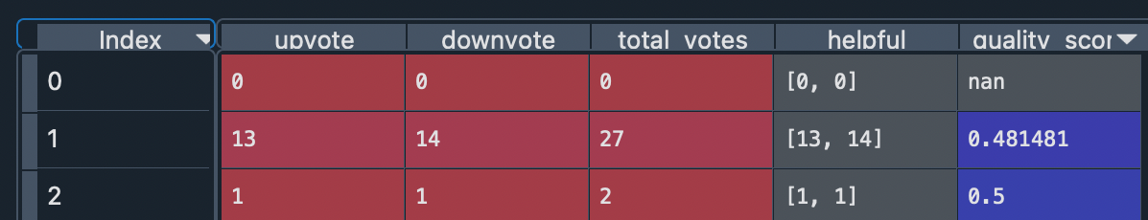
Approach to enhance rating values using reviews
In the paper, “Recommender systems based on user reviews”, several approaches to enhance the rating values have been discussed.
Approach: Considering review helpfulness. Why ?: Presence of ‘helpful’ column in the dataset and good performance with regards to RMSE
Step 1: Computing upvotes, down_votes and total votes using the helpful column of the dataset
Quality score = Number of helpful votes / Total number of votes

Slide 22
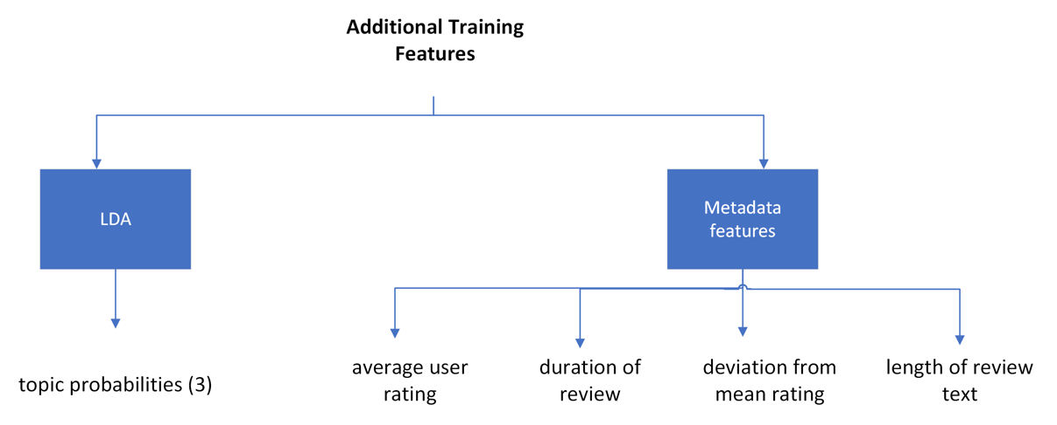
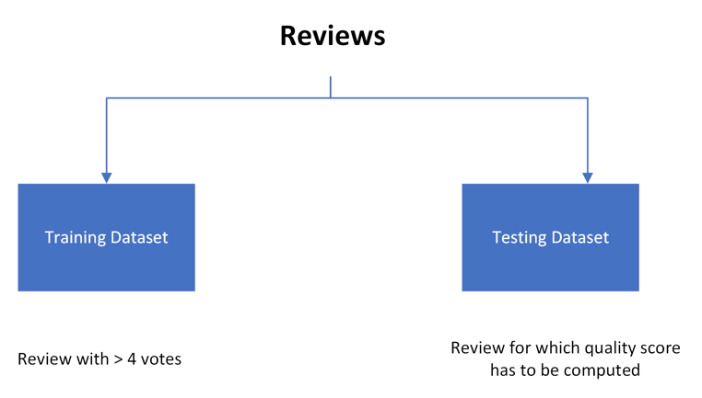
Enhancing rating value
Step 2: Compute quality score for reviews that do not have votes
We will first split our dataset into training and testing
Additional features required for training set are extracted using LDA and metadata features

Slide 23
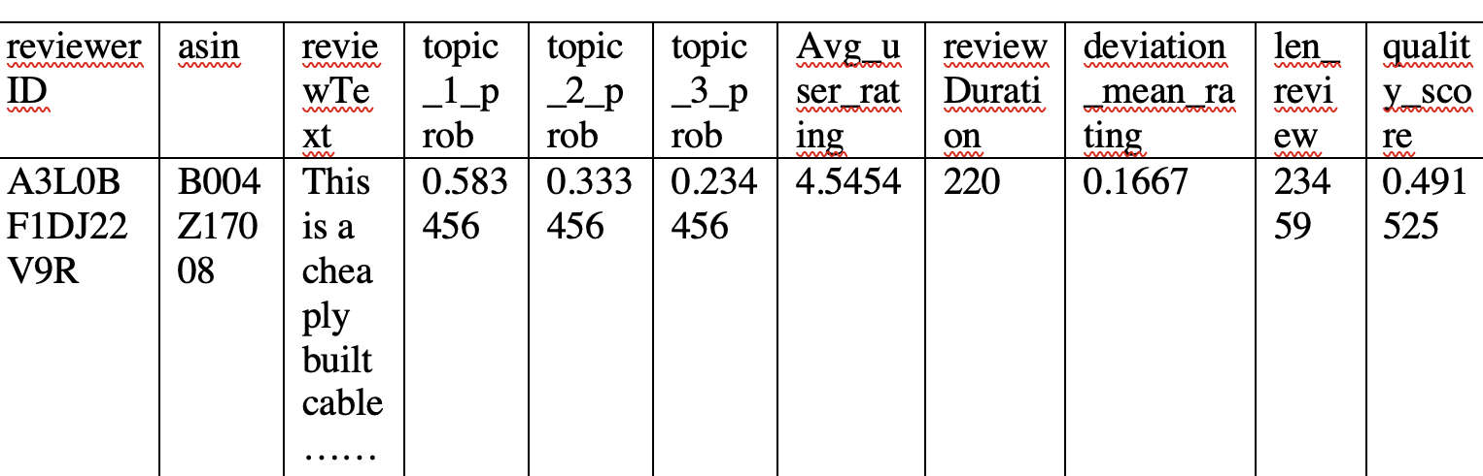
Enhancing rating value (Continued)
Step 3: Use features computed to predict ‘quality score’ using Logistic Regression
x_test = df_without_quality_score
x_train = df_with_quality_score.drop[‘quality_score’]
y_train = df[‘quality_score’]
logreg = LogisticRegression()
logreg.fit(x_train, y_train)
y_pred = logreg.predict(xtest)
Python Pseudo Code for training Logistic Regression
Feature Space and Target variable for training LRM

Slide 24
Enhancing rating value (Continued)
The quality score computed are taken as weight and assigned to rating in probabilistic matrix factorization (PMF) framework to predict enhanced rating values
 | Product 1 Rating | Product 1 Quality Score | Product 2 Rating | Product 2 Quality Score | Product 3 Rating | Product 3 Quality Score
User 1 | 1 | 0.4915 | 4 | 0.8978 | 3 | 0.8978
User 2 | 4 | 0.2378 | 3 | 0.4915 | 3 | 0.5687
User 3 | 5 | 0.8978 | 4 | 0.3389 | 1 | 0.8978
User 4 | 2 | 0.3345 | 1 | 0.5678 | 5 | 0.4915
 | Product 1 | Product 2 | Product 3
User 1 | 2.9989 | 3.8933 | 2.2928
User 2 | 4.2782 | 4.6722 | 4.6734
User 3 | 5 | 2.1234 | 1.2293
User 4 | 3.92020 | 3.2673 | 4.9990
Input to PMF
Result with enhanced rating values

Slide 25
Conclusions
Throughout the exercise the sensitivity of all the models towards unbalanced data was quite noticeable. The results, even if not high values, were obtained with a more balanced dataset that allows to further trust the predictors with the best performance
In general, the Machine Learning approaches outperformed the Lexicon approaches with better scores across the board. The Precision and Recall levels seem quite similar but still the results are low values just as with the accuracy achieved. The amount of data used for training the model was not large, limiting the vector representations similarity measures for both Lexicon and Machine Learning approaches.
Specialized libraries and resources such as Spacy and Wordnet allow for the rapid development of an entry-level sentiment analysis model. With improved data preprocessing and a pipeline to orchestrate the entire process, an average model could be initially deployed and be further improved by feedback loops to achieve better results with a larger corpus and more accurate text representations aligned with the business case.

Slide 26
References
Chen, L., Chen, G., & Wang, F. (2015). Recommender systems based on user reviews: the state of the art. User Modeling and User-Adapted Interaction, 25(2), 99–154. https://doi.org/10.1007/s11257-015-9155-5
Raghavan, S., Gunasekar, S., Ghosh, J.: Review quality aware collaborative filtering. In: Proceedings of the 6th ACM Conference on Recommender systems, Dublin, Ireland, ACM, RecSys’12, pp 123–130 (2012)
Support Vector Machines (SVM) algorithm explained. MonkeyLearn Blog. (2017, June 22). Retrieved April 19, 2022, from https://monkeylearn.com/blog/introduction-to-support-vector-machines-svm/
Pupale, R. (2019, February 11). Support vector machines(svm) - an overview. Medium. Retrieved April 19, 2022, from https://towardsdatascience.com/https-medium-com-pupalerushikesh-svm-f4b42800e989
6.8. pairwise metrics, affinities and kernels. scikit. (n.d.). Retrieved April 19, 2022, from https://scikit-learn.org/stable/modules/metrics.html

Slide 27

Thank You

