Slide 1
REAL TIME INTRUSION DETECTION
GUIDED BY:
Dr. NATRAJAN S
Professor Dept Of ISE
PESIT
PRESENTED BY:
DARSHAN D SHAH 1PI11IS035
GANESH CHANDRA 1PI11IS038

Slide 2
PROBLEM FORMULATION
The current intrusion detection systems use infrared cameras to detect the intruders in a house. As this system uses heat to detect humans, the system can be falsely triggered and the human cannot be identified. With the improvements in the image processing in the past decade we can now not only detect humans but also identify them with the help of simple cameras.

Slide 3
MOTIVATION
The system being developed uses motion detection coupled with human detection and face recognition which will help solve the current problem in the intrusion detection systems. Also the cost of an infrared cameras are high. Our system uses webcams to execute the same.

Slide 4
LITERATURE SURVEY
Image difference threshold strategies and shadow detection
Paul L. Rosin and Tim Ellis at Proceeding BMVC '05 Proceedings of the 2005 British conference
on machine vision (Vol. 1)
Histograms of Oriented Gradients for Human Detection
Navneet Dalal and Bill Triggs Computer Vision and Pattern Recognition, 2005. CVPR 2005. IEEE Computer Society Conference.

Slide 5
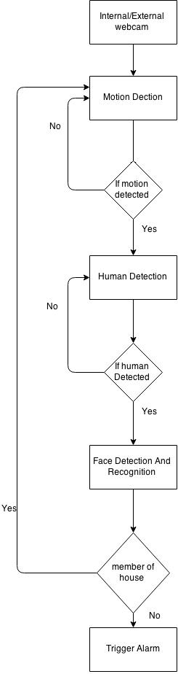
SYSTEM DESIGN
Intel Core I3 processor
4GB Ram
Internal /External Webcam.

Slide 6
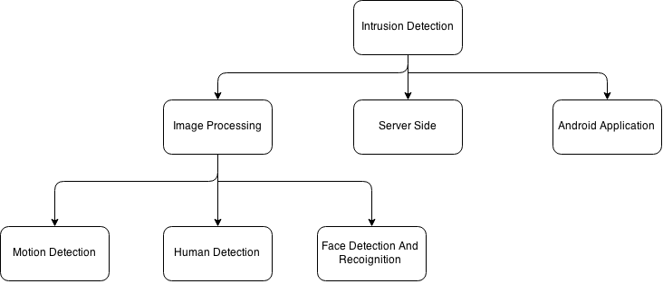
PSEUDO CODE
The developed system consists of three parts, they are:

Slide 7
IMAGE PROCESSING:MOTION DETECTION
Capture the video feed through a webcam
Applying image differencing on the consecutive frames for the motion
Checking for the considerable motion by keeping a threshold.
If motion is detected
{
frame is captured and stored
}

Slide 8
IMAGE PROCESSING:HUMAN DETECTION
Train the HOG SVM and build a classifier
For each image saved
{
The svm predicts the presence of human
if(human is detected)
crop part of the image where human is present and saved.
}

Slide 9
IMAGE PROCESSING:FACE RECOGNITION
Train the Haar classifier with the data set.
for each image that is cropped
{
the trained haar classifier will first detect the presence of a face
if face is present
{
Compare the detected face with the train classes of images to recognize the face.
if face is not recognised
{
Store the face as an intruder.
}
}
}

Slide 10
SERVER SIDE PROGRAMMING
Check the drive for any new intruder images
if any new images present
{
Upload all the new images to the server
Notify the user to check his android application to find out the suspicious activity going on in
his house
}

Slide 11
ANDROID APPLICATION
Check if the user is registered
if the user is not registered
{
prompt the user to sign up using his email id
}
if the user is registered
{
Display the images of the intruder present in the server
}

Slide 12
DEMONSTRABLE RESULTS
We have done the testing of the system with a 20 second video recording
When there has been considerable motion, it has been recorded
The human present in those frames has been detected.
The face of the human has been detected and recognised
When the person is recognised as a member of the house, his images are not stored and the motion detection continues.
When the user has been recognised as an intruder, the images are stored in the database and the owner is notified.
The images have been displayed correctly to the owner on his android application.

Slide 13
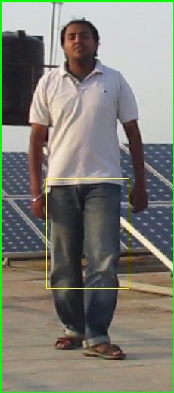
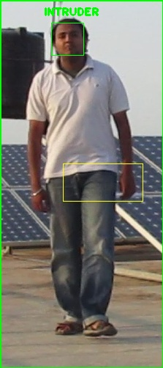
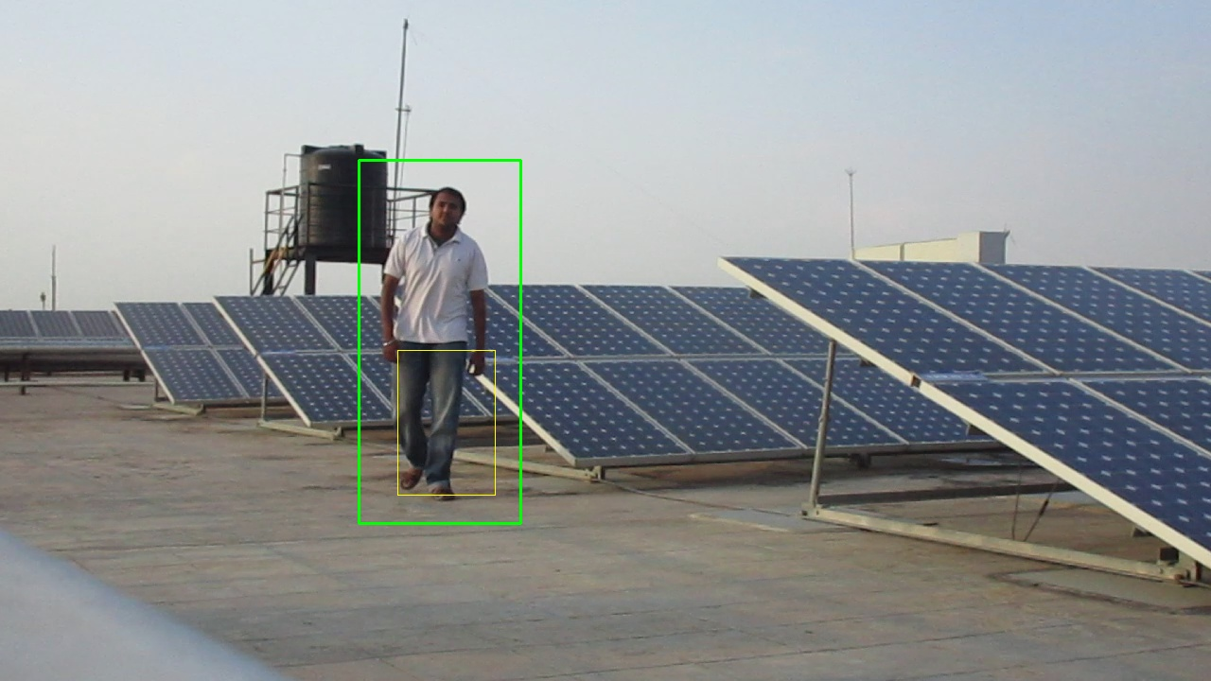
OUTPUT SNAPSHOTS:

Slide 14
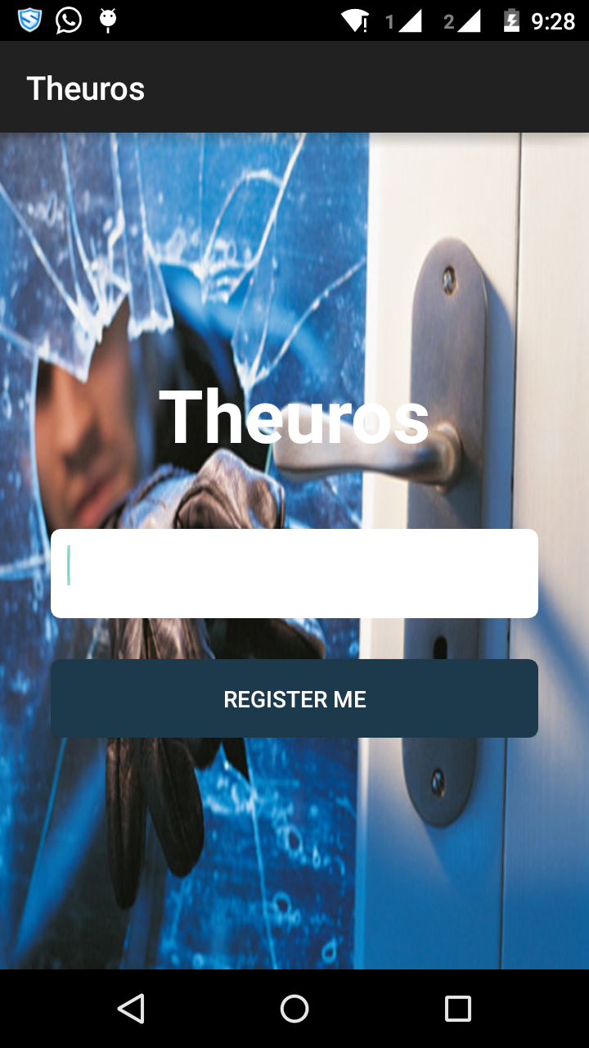

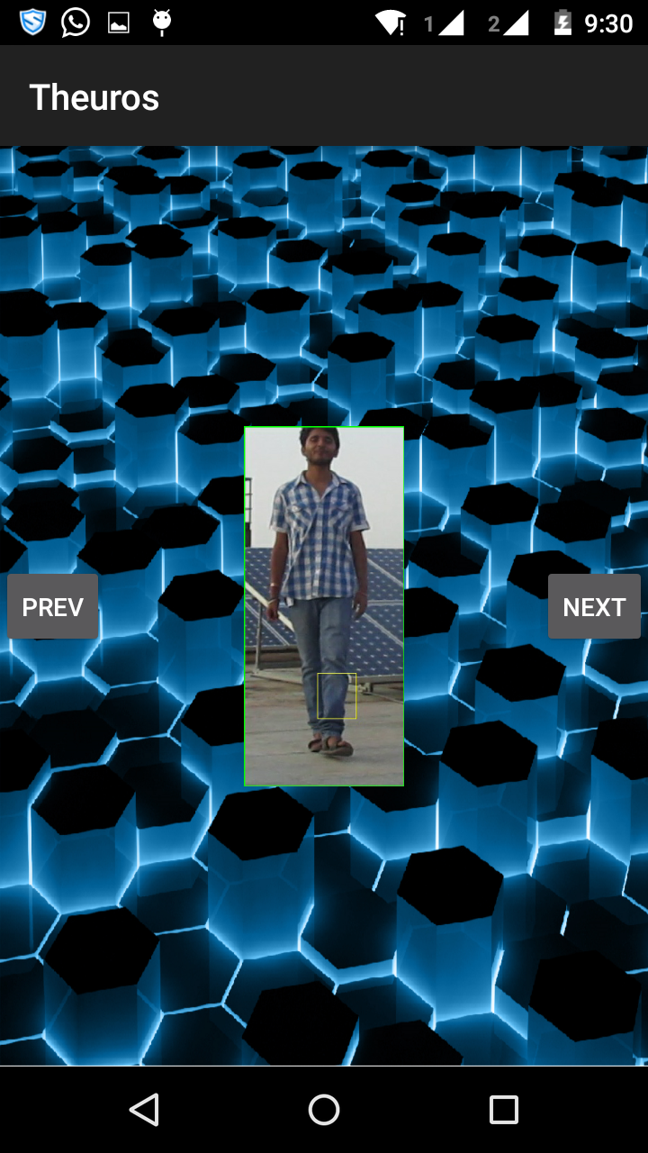
CONTINUED...

Slide 15
FUTURE WORK
Running the entire system on raspberry pi.
Increasing the efficiency of all the modules.

Slide 16
THANK YOU

