Slide 1
PerfMap
A Google-Style C++ Performance Workshop Diar Shakimov | SFU GDSC

Slide 2
One-Line Pitch
Build a custom hash map, measure it honestly, and leave with a project you can actually defend.
Real workload story
Real benchmark numbers
Real trade-offs, not fake perfection
Notes:
Open hard and fast. Tell them this is not a toy “we coded a hashmap from scratch” talk. The point is to show how a small systems project becomes resume-grade when it has measurement, iteration, and a believable use case.

Slide 3
Quick Room Check
Who here has coded in C++?
Who has used a hash map without knowing how it works underneath?
What makes a project feel impressive in 2026?
What makes a project feel tutorial-tier?
Notes:
This is your first candy slide. Ask for hands, then cold-call one or two short answers. If someone says “real users,” “benchmarks,” “trade-offs,” or “depth,” reward that immediately because it sets up the rest of the talk.

Slide 4
What Makes A Project Stand Out In 2026
It solves a real problem or models a believable workload
It shows iteration, not just one lucky final result
It has measurable evidence
It uses AI intentionally, not invisibly
It is specific enough that you can explain the hard parts
Notes:
This slide comes straight from your raw IDEAS.md. Frame the modern bar clearly: the differentiator is not “I shipped code.” The differentiator is “I can explain why this design exists, what I tried, what failed, and what the numbers say.”

Slide 5
What Makes A Project Feel Tutorial-Tier
Generic CRUD with no real constraints
No metrics, no benchmarks, no users, no feedback loop
No honest loss or trade-off anywhere
AI did the whole thing and you cannot explain the decisions
Surface area everywhere, depth nowhere
Notes:
Do not sound bitter here. The point is not to shame simple projects. The point is to explain why reviewers default to skepticism when they see familiar project shapes with no evidence behind them.

Slide 6
Where Good Project Ideas Usually Come From
coursework where you go beyond the assignment
labs, research groups, startups, and hackathons
repeated pain points you actually felt yourself
niches with real constraints: latency, memory, scale, correctness
follow-on iterations after a first version already works
Notes:
This is where you can briefly tell the “find real opportunities” story. Keep it practical: clubs, professors, labs, startup work, hackathons, and personal pain are all credible project sources because they come with constraints.

Slide 7
Why PerfMap Is A Good Workshop Project
small enough to understand in one session
deep enough to talk about caches, memory layout, and trade-offs
benchmarkable with one command
easy to extend toward cloud, ML infra, or advanced C++
strong because it includes both wins and losses
Notes:
Say explicitly that the project works because it is narrow. It is one data structure, but it opens the door to systems thinking, benchmark rigor, and resume storytelling.

Slide 8
What PerfMap Actually Is
open-addressing hash map in C++17
flat std::vector<Slot> storage
linear probing and tombstone-aware deletion
power-of-two capacity and bitmask indexing
absl::Status / absl::StatusOr plus FindPtr() for hot paths
Notes:
Do not drown them in syntax yet. The important message is that memory layout is the main character, not the data structure name.

Slide 9
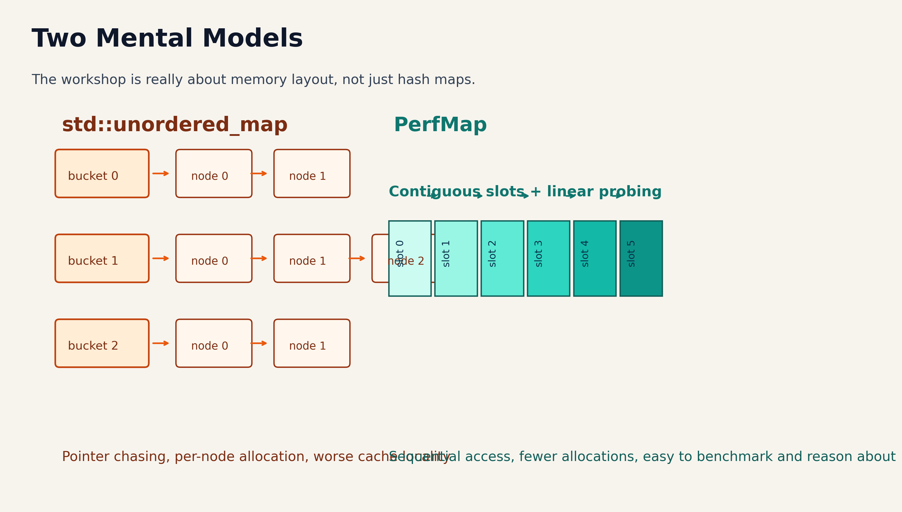
Why Flat Storage Can Win

Slide 10
fewer pointer jumps
more contiguous memory access
easier hardware prefetch behavior
cleaner benchmark story
Notes:
Ask: “Why might the flat array beat a chained map even if both are O(1) on paper?” Wait for someone to say cache locality or pointer chasing. This is another candy moment.

Slide 11
One Repo, Multiple Workloads
HashMap: balanced baseline
ReadHeavyHashMap: lower load factor for faster lookups
ChurnHeavyHashMap: more aggressive tombstone cleanup
SpaceEfficientHashMap: tighter memory budget
IndirectHashMap: better for large payloads
Scratch* variants: built for repeated clear-and-rebuild cycles
Notes:
This slide helps you avoid the “one benchmark wonder” criticism. The repo is not just one container; it is a small lab for workload-aware design.

Slide 12
The Benchmark Rules
same deterministic key sets for every implementation
same adapter contract for STL, Abseil, and PerfMap
setup excluded from steady-state lookup and erase timing
reserved benchmarks pre-size every container fairly
separate “where we lose” benchmarks kept in the repo on purpose
Notes:
Ask the room what would make a performance claim feel fake. Then show that fairness rules are part of the engineering, not presentation polish. This is where you define regression tracking, benchmark harnessing, and honest methodology in simple language.

Slide 13
The Honest Result
perfmap::ScratchIndirectHashMap is the strongest real win
at 16,384 entries it runs around 53.0M items/s
that is about 7.3x faster than std::unordered_map
absl::flat_hash_map still wins broad large-value lookup
the honest loss is part of why the repo is credible
Notes:
Use exact numbers from the March 31, 2026 spot check. Say them slowly. Then immediately say the broader large-value case still loses badly to Abseil on misses and still loses on hits too. That honesty is what makes the win worth listening to.

Slide 14
The Winning Workload Story
think: per-batch document enrichment cache
each batch contains many records and large metadata blobs
build a temporary lookup structure for that batch
query it hard during the batch
clear it and rebuild for the next batch
Notes:
This is the real-world scenario you were asking for in IDEAS.md. High level: “temporary cache for one batch.” Technical level: “large values plus repeated rebuilds, so O(1) clear and indirect storage matter.” That makes the niche understandable without sounding fake.

Slide 15
Why Google-Style C++ Matters Here
explicit error handling
boring naming and formatting
correctness before optimization
benchmark after the code is defensible
code another engineer can read at 2 a.m.
Notes:
Make the two-space-indent joke once and move on. The real point is team-readable C++, not style cosplay. Tie StatusOr, tests, and file organization back to “production-minded code.”

Slide 16
Live Demo Plan
cd project/perfmap/build cmake .. -DCMAKE_BUILD_TYPE=Release make -j8 ./perfmap_tests ./perfmap_bench
show slot.h, hash_map.h, tests, and benchmark harness
ask why tombstones exist before revealing the answer
ask why FindPtr() exists before showing the miss-path cost
Notes:
This is where you slow down and teach. The two best demo moments are: 1. a tombstone preserving the probe chain 2. a tiny API decision changing benchmark behavior

Slide 17
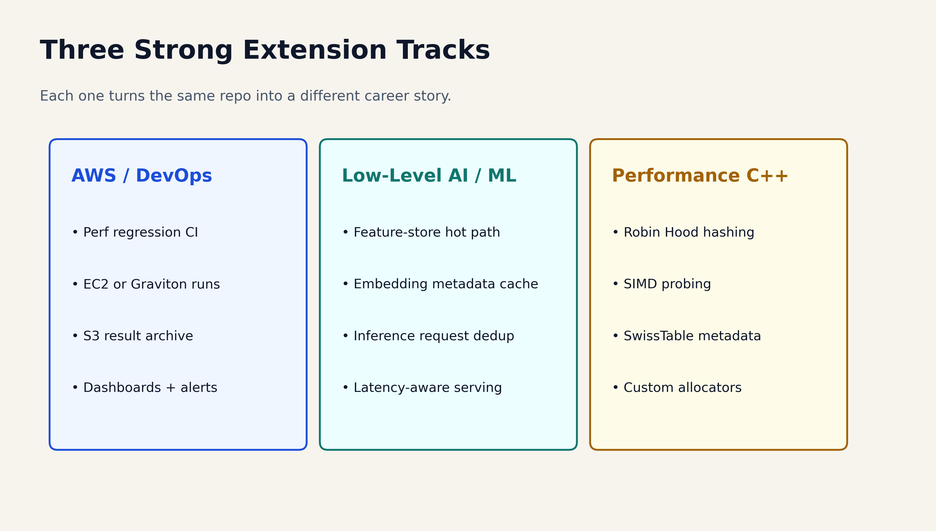
What Students Can Build Next
Notes:
This slide lets you branch by audience interest. If the room is cloud-heavy, talk CI and Graviton. If the room is ML-heavy, talk feature-serving metadata caches. If the room is systems-heavy, talk Robin Hood hashing and metadata bytes.

Slide 18
Starter Repo For Attendees
clone the incomplete starter from starter/perfmap-10d
fill in the core open-addressing behavior
make the tombstone test pass
make rehashing work
then benchmark your version against the completed repo
Notes:
Tell them you are giving them the “workshop version,” not the full polished repo. That starter is intentionally incomplete so they get to build the important ideas themselves.

Slide 19
Mini Challenge
improve one metric without lying about the result
explain one design choice clearly
document one honest loss
add one extension only if it makes the repo more measurable or more useful
Notes:
This is a strong place to mention follow-up prizes, shout-outs, GitHub stars, or post-workshop submissions if you want. Keep the judging criteria concrete so nobody mistakes “more features” for “better engineering.”

Slide 20
Questions For The Room And The Guests
What do you think matters more: novelty, depth, or measurable impact?
If you had one more week, which extension would you ship first?
What makes a benchmark claim believable in an interview?
What turns a student repo into something recruiters actually remember?
Notes:
End by bringing the audience back into the conversation. The closing line should be some version of: “The point is not to build a hash map forever. The point is to learn how to do technical work that is measurable, explainable, and hard to fake.”

