Slide 1

AMAZON API GATEWAY

Slide 2
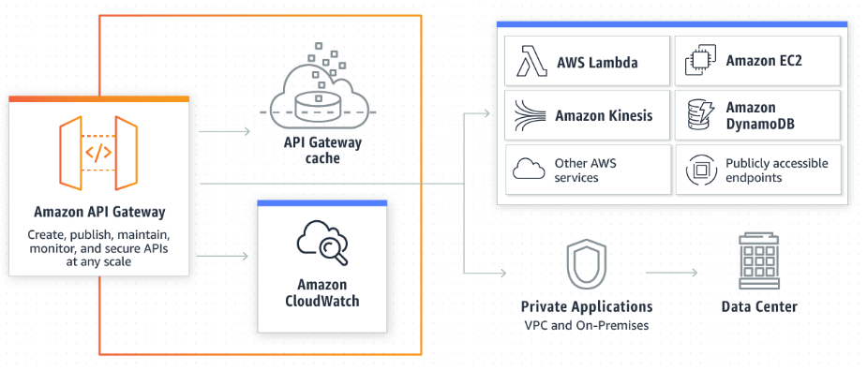
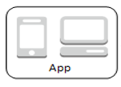
AMAZON API GATEWAY
“Amazon API Gateway is a fully managed service that makes it easy for developers to create, publish, maintain, monitor, and secure APIs at any scale.”

Slide 3

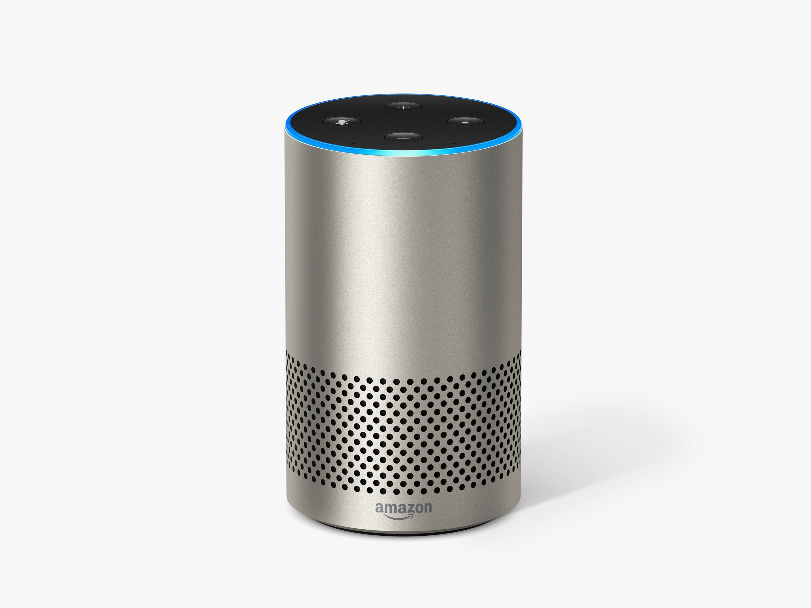

API – Application Programming Interface (Software intermediary that allows two applications to talk to each other)
Integration Request
User (Method) Request
Hey Weather Man
How’s the weather?
Hey Buddy,
How’s the Weather?
Does it Matter?
You are staying Home!
Hey mate, It’s the same as yesterday?
Integration Response
User(Method) Response

Slide 4
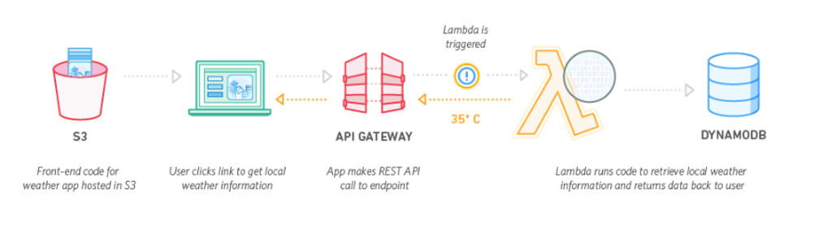

Slide 5
Demo Create AWS API – via Console

Slide 6
SWAGGER - Standard Approach to define An API
Is an open-source software framework that helps developers design, build, document, and RESTful Web services
Also know as “Open API Specification”
We will use Swagger based approach to define
Our API
Integrate API with Lambda Function
Use SAM to deploy the API and the related Lambda function
Let’s take a look at a simple swagger file which defines a couple of ‘Env Booking API’

Slide 7
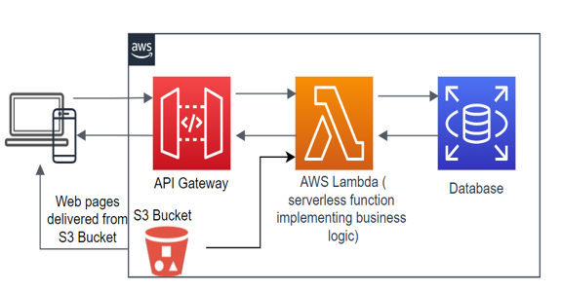
Let’s Build an Env Booking Portal using SAM

Slide 8
SAM - AWS Serverless Application Model (The open-source framework for building serverless applications)
SAM Templates are used to define resources such as APIs, lambda functions, databases, and event source mappings.
A look at our SAM Template which when deployed will create the following resources:
An API Gateway for Env Booking with 2 methods
A simple table in DynamoDb NoSQL database
2 lambda functions corresponding to the 2 API methods
2 IAM roles, defining permission for each lambda function

Slide 9
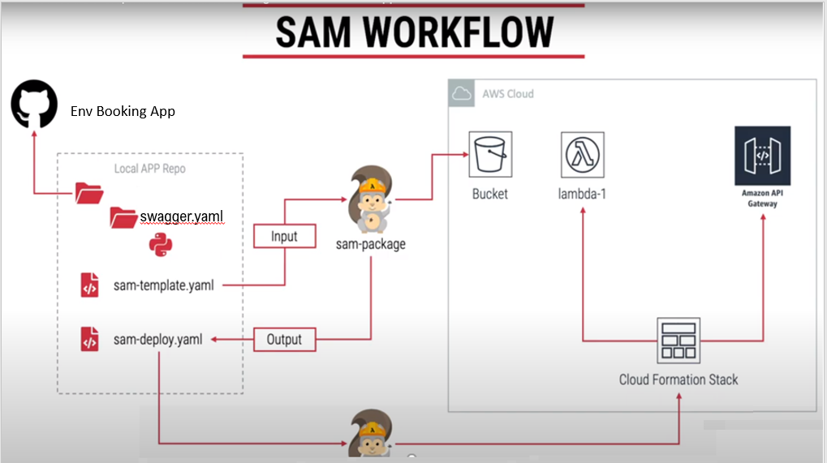
Env Booking App
swagger.yaml

Slide 10
Step 1 – Package Artefacts
SAM needs an s3 bucket – Let’s create One
aws s3 mb s3://damz-demo-sam --region ap-southeast-2
cd ~/demo-sam/env-booking-api
sam package \
--template-file sam-template.yaml \
--output-template-file sam-template-out.yaml \
--s3-bucket damz-demo-sam
#Generates a CloudFormation Template sam-template-out.yaml

Slide 11
Step 2 – Deploy CloudFormation Template
sam deploy \
--template-file sam-template-out.yaml \
--stack-name env-booking-api-stack \
--capabilities CAPABILITY_IAM \
--region ap-southeast-2
(note: CAPABILITY_IAM is specified is used to specify that you are OK creation of IAM related resources)

