Slide 1

David Sharratt

Slide 2
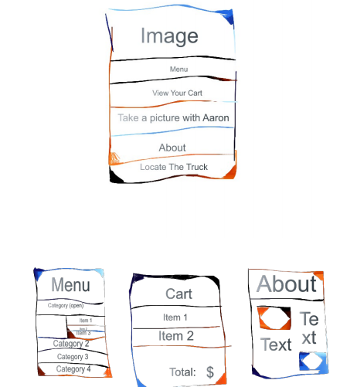
Proposal
Menu
Categories
Sub-Items
Cart
Item Inventory
$Total
Built in Camera
Link to Face/Twitter
GPS Locator
Food Truck Moves
About Section

Slide 3
Achieved
Menu
Categories
Sub-Items
Cart
Item Inventory
$Total
Built in Camera
Link to Face/Twitter
GPS Locator
Food Truck Moves
About Section
I achieved a generous ~30% of what I had “quickly” thought up for the proposal.

Slide 4
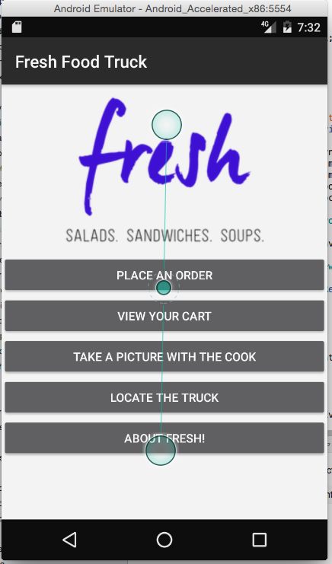
Ta-da!
Each tab surprisingly functions and takes you to a new Activity.
(Just don’t ask about the bottom three.)

Slide 5
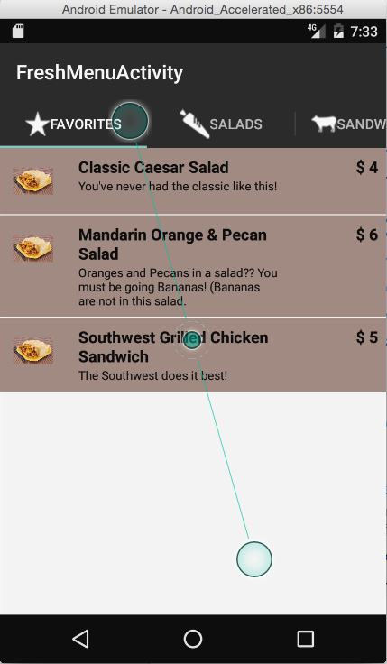
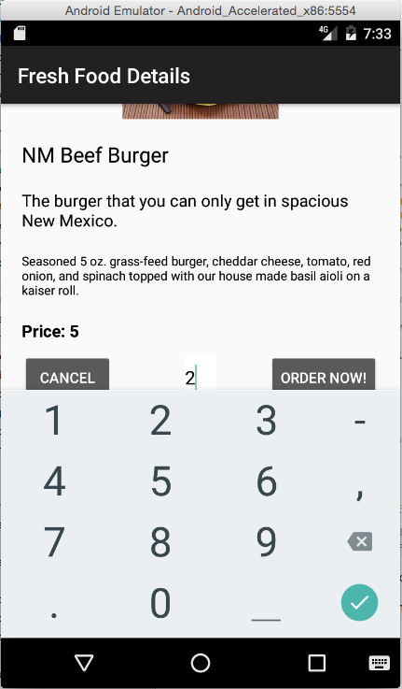
Menu
3 sections (2 types, 1 Specialty)
Each Item displays Image/Short Description/Price.
Item
Image
Name
Short/Long Description
Price
Number of Items Ordered

Slide 6
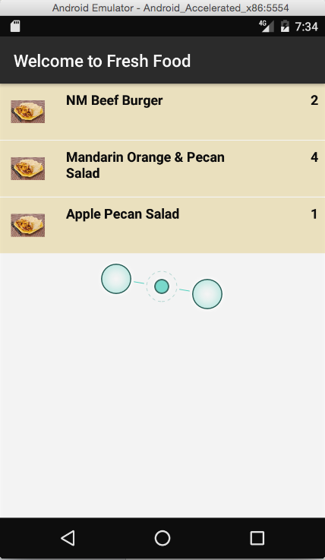
Last but not least we have thee cart!
Same design as the menu sections but instead of price currently it only keeps tracks of how many of each item was ordered.

