Slide 1
IML Assignment: Factors affecting Attrition
Submitted By:
Deepak Sharma (Roll No: D20011)
Eric Gonsalves (Roll No: D20012)
Shreyansh Bhalodiya (Roll No: D20033)

Slide 2
Summary of Data
Dataset Structure: 1470 observations (rows), 20 features (variables)
Missing Data: Luckily for us, there is no missing data! this will make it easier to work with the dataset.
Data Type: We only have two data types in this dataset: factors and integers
Label/Output: Attrition is the label in our dataset and we would like to find out why employees are leaving the organization!
Imbalanced dataset: 1237 (84% of cases) employees did not leave the organization while 237 (16% of cases) did leave the organization making our dataset to be considered imbalanced since more people stay in the organization than they actually leave.
Variable:
Age, Business Travel, Department, Education field, Environment Satisfaction, Gender, Job involvement, Job level, Job satisfaction, Marital Status, Monthly Income, Over time, Total working Hours, Work life-balance, Years at company, Years in current role, Years since last promotion, Years with current manager, Distance from home.

Slide 3
Analysis Chart
JOB LEVEL
Avg. Monthly Income
Years with company
Marital Status, Distance from Home
Age Gender, Marital Status,
Monthly Income, Distance From Home Over Time
DEPARTMENT
Enviroment Satigfactio. Gender, WorkLife balance, Job Level, Distance From Home, Business Travel

Slide 4
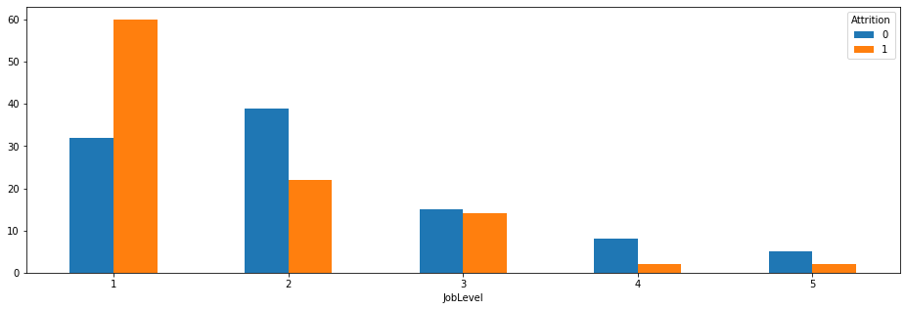
JOB LEVEL
Row Labels | Average of Years At Company | Average of Monthly | Average of Distance | Average of Years Since Last Promotion | Average of TotalWorking | Average of Years With Company | Average of WorkLife
0 | 4.24 | 2854 | 8.33 | 1.21 | 6.26 | 2.69 | 2.73
1 | 3.08 | 2598 | 9.48 | 1.15 | 4.85 | 1.89 | 2.67

Slide 5
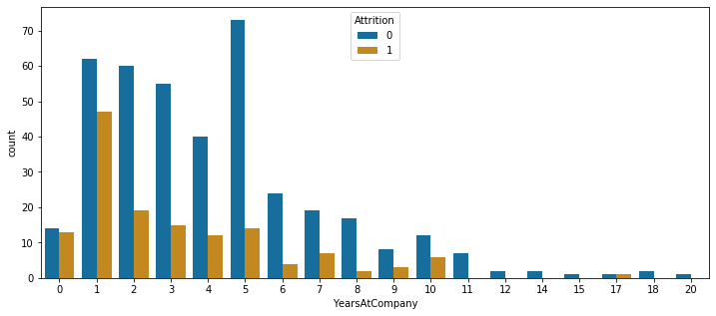
JOB LEVEL 1 AND YEARS WITH COMPANY

Slide 6
Marital Status and Job Level of past employees
majority of single left company more than anyone else
majority of single were working at level 1
75% of singles were below 35 years and their total working years avg. is 6 so may be for better opportunity they left company.
75% of singles monthly income is below 5331 so we can say that majority of singles may left company because of monthly income and also their total working years avg. is 6 so for better income or opportunity they may have left

Slide 8
Years Working with Manager
30% Attrition in Dept > Job level 1> less than 2 year with manager
Out of 237 employees who left the company 133 were from R& D department and 92 from sales department
Out of 133 from R&D, 101 left at the initial Job level 1.
Out of 101, 70 has left in first 2 years of working under manager.
Department|JobLevel|YatCM | Average of YearsWithCurrManager
Department|JobLevel|YatCM | Attrition 0 | Attrition 1
Human Resources|1|0-2 | 1.36 | 0.6
Research & Development|1|0-2 | 1.23 | 0.7
Sales|1|0-2 | 1.25 | 0.8

Slide 9
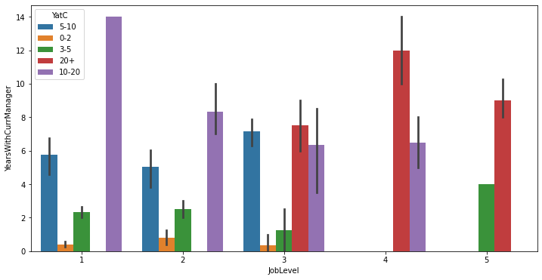
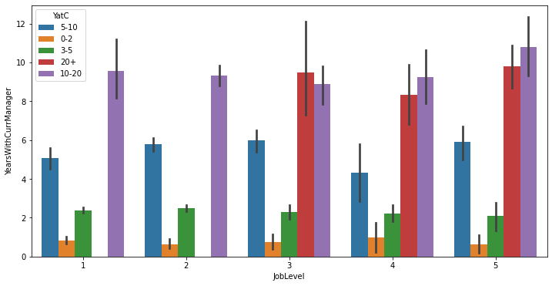
Job Level , Year with Manager and Years at Company
Employee with Attrition 1
Employee with Attrition 0

Slide 10
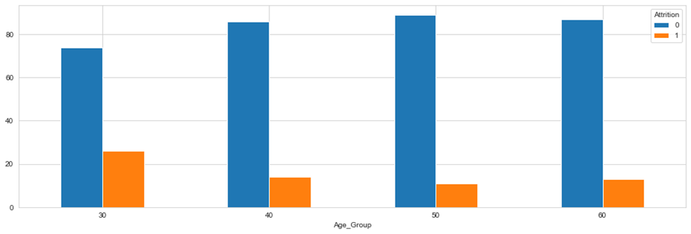
Age and Age Group
Mean distribution of Age by Attrition for Male and Female is:
Bivariate Analysis on Age group and Attrition: Maximum Attrition is seen in Age group below 30 years, followed by age group 30-40 years.

Slide 11
Analysis Flow Chart
Age Group
Male
Female
Single
Married
Divorce
Single
Married
Divorce
Monthly Income
Monthly Income
Monthly Income
Monthly Income
Monthly Income
Monthly Income
Over Time
Over Time
Over Time
Over Time
Over Time
Over Time
Distance From Home
Distance From Home
Distance From Home
Distance From Home
Distance From Home
Distance From Home

Slide 12
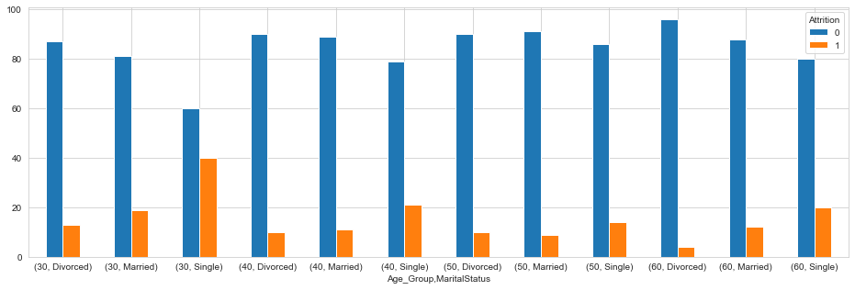
Age Vs Gender Vs Marital Status
Analysis of Attrition on Age group and gender:
Attrition is evenly spread between Gender without in major difference.
But Monthly Salary is one of the major factors affecting attrition in The Age Group below 30 and 30 to 40.
In age group below 30, there is around 26% of salary gap between the employee who has left the company and who still in company.
Since Attrition is evenly distributed, we cannot inferred attrition on the basis of Gender, we need further dive in the data.
Attrition analysis on the basis of Marital Status in different age group in Male and Female: From the above table we can clearly see the Attrition is High for Singles in Age group below 30 (40%) and 30 to 40(21%). Singles are likely to leave company in their early level of Job.

Slide 13
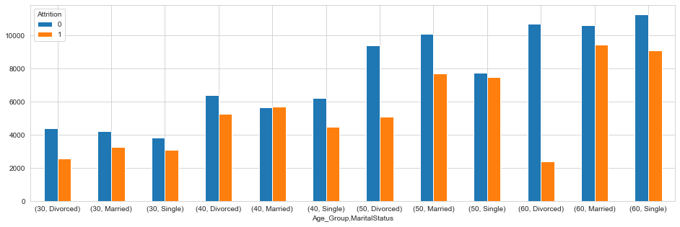
Monthly Income
Conclusion: From the above table we can say that Monthly Income is likely to be the reason for the high attrition in the Age group below 30 and 30 to 40 for singles.

Slide 14
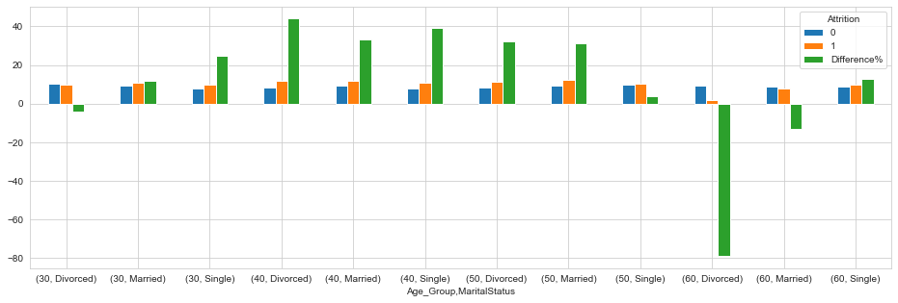
Distance From Home
Conclusion: From the above table and graph we can se that Distance from home is affecting the attrition in all the age group, majorly in below 30 and 30 to 40 Single Male.

Slide 15
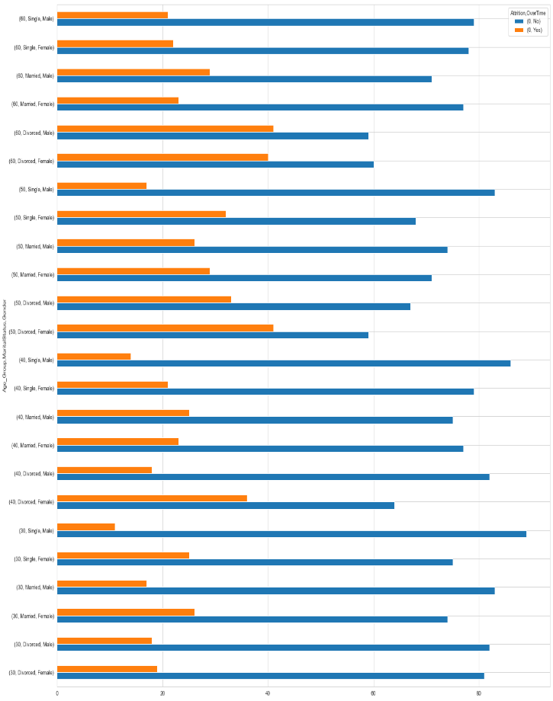
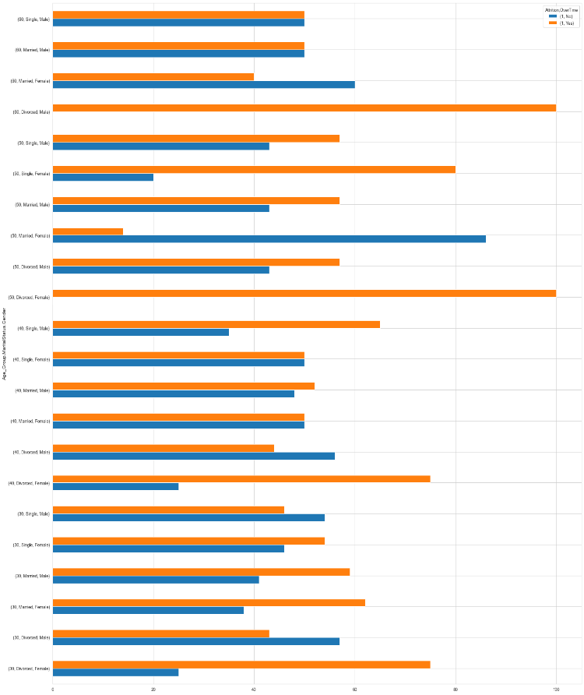
Over Time

Slide 16
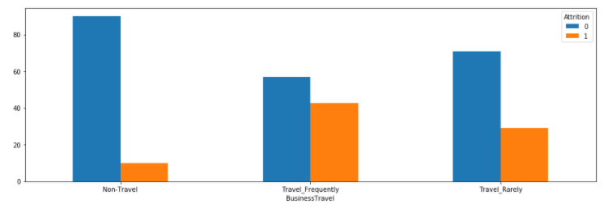
Department
The following Analysis is done on the Sales Dept:
We have seen max Attrition i.e 20.63
We saw that the sales dept is affecting Environment satisfaction the most.(The proportions of low and medium given sales totals to around 41.25% which is higher than the other 2 departments.The proportions of High and very high given sales totals to around 58% which is lesser than the other two Departments.)
Within the Sales Dept we have 29.07% of the people leaving due to low environment Satisfaction.
42.86% attrition of the employees who travel frequently within the sales dept and having low environment satisfaction.

Slide 17
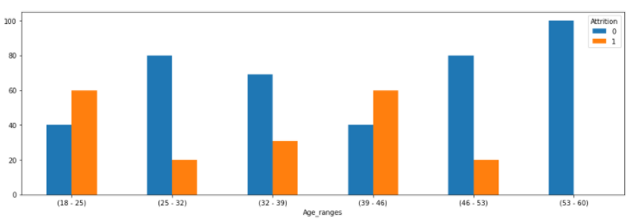
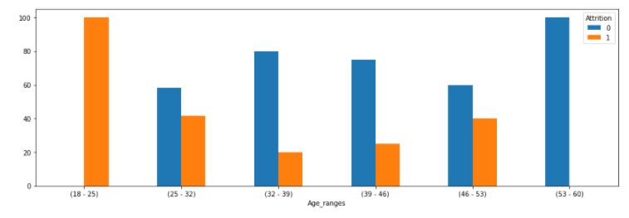
Department ->Environment Satisfaction -> -> Gender -> age range
-> Business Travel -> Gender -> age range
33.33 % of Females & sales department & low environment satisfaction are leaving the company.
Females & sales department & environment satisfaction low & age range of 18-25 are leaving the company the most i.e 60%
This is very unusual as usually women who are more aged should be affected by Environment Satisfaction.
Females & sales department & travel frequently & age range 18-25 are leaving the company the most. i.e There is a 100% attrtion rate. 4/4 employees left.
This is very unusual as the older the employees more difficult it gets for them to travel frequently but here it seems like the older employees leave the company where as the younger employee stay.

Slide 18
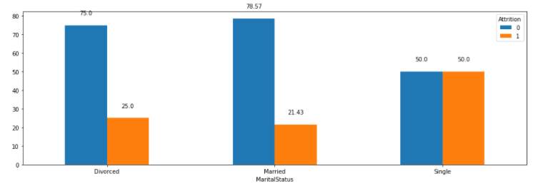
Department -> Work life Balance -> Marital Status
Research and development department is affecting the Worklife balance the most.i.e 30% in the low and Medium worklife balance which is greater than the other 2 depts and 70% in high and very high which is lesser than other two depts.
RnD dept & low worklife balance and are leaving the company is 31.67%.
RnD dept & low worklife balance&Single have an attrition rate of 50%, which is maximum as compared to the other two levels.
This is quite unusual as we may have expected Married employees to affect of worklife balance more as they have more responsibilities.

Slide 19
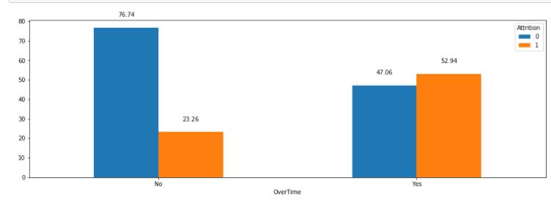
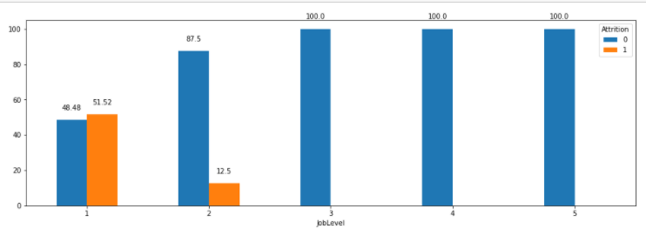
Department -> Work life Balance -> Overtime
-> Work life Balance -> Job level.
52.94% of the within the RnD dept who are suffering from Low Work life balance are leaving the company due to Overtime.
Through this we can conclude that Overtime is affecting the work life balance within the RnD dept due to which the employees are leaving the company.
RnD dept & low work life balance & Job level 1 are leaving the company the most i.e 51.52%

Slide 20
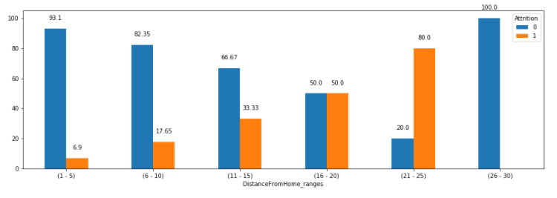
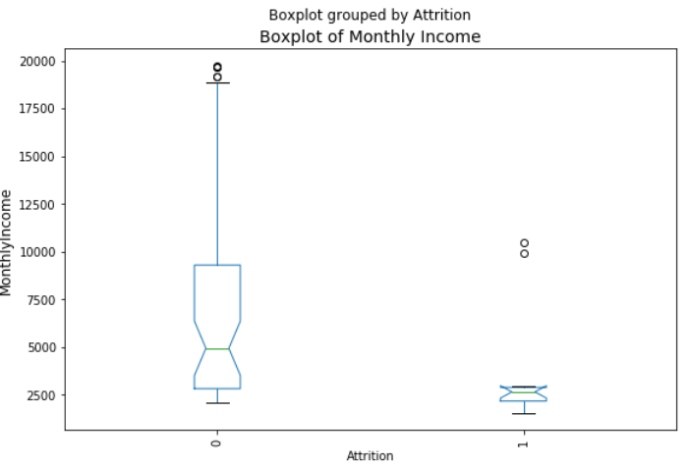
HR Department -> Distance from Home
HR Department ->Monthly Income
HR dept we can see a clear increase in attrition as the distance from home increases.
Employees with distance from home 21-25 kms are seen to leave the company the most.i.e 80 %
In HR dept we can see there is maximum attrition in the employees with salaries less than 3000.

Slide 21
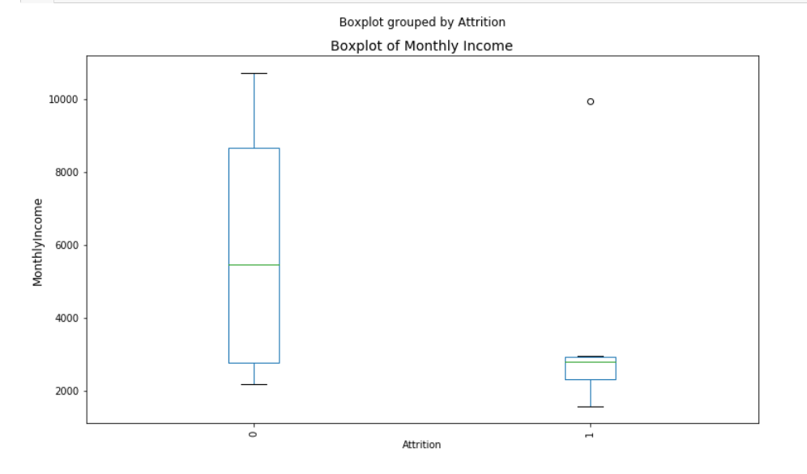
HR department ->Distance from home -> Monthly Income
We have seen maximum attrition in the employees with a distance from home 16-25 kms.
In the HR dept & Distance from home 16-25 & 75% employees with monthly income less than 3000 we can see the maximum attrition.

Slide 22
JOB LEVEL 1
Year Under Current Manager
VARIABLES AFFECTING ATTRITION
Over Time
MONTHLY INCOME
Environment Satisfaction

Slide 23
Thank You

