Slide 1
Lending Club Case Study
Divyesh Sharma
Rahul Pandey

Slide 2
Problem Statement
A Lending Company dataset with details corresponding to Default and Non-Default customers. The target is to figure out the parameters around which a customer can default.

Slide 3
Agenda
Analysing the Data
Cleaning
Categorizing\Visualizing the Data
Filtering & Imputing
Univariate Analysis
Bivariate Analysis
Multivariate Analysis
Conclusion

Slide 4
Analysing & Visualising the Data
We have around 111 columns to analyse data.
On straightforward analysis, there are around 55 columns which has more than 75% of null data.
Hence, we can remove those columns.

Slide 5
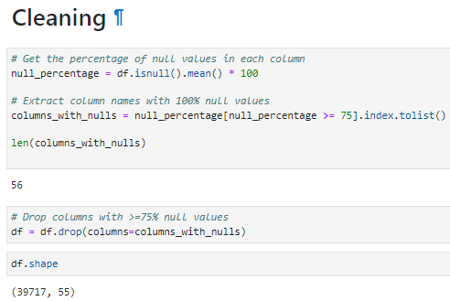
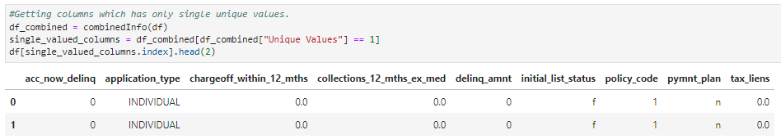
Cleaning
Dropped around 56 columns which were having >=75% of null values.
Also around 9 columns have only one unique value.
After Removing above not required columns only 46 columns remain.

Slide 6
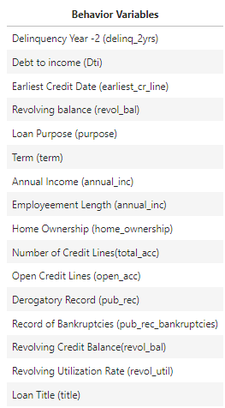
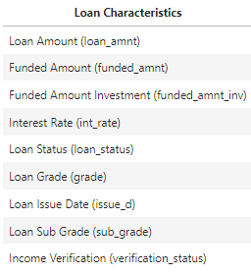
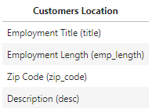
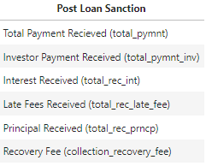
Categorizing\Visualizing the Data

Slide 7
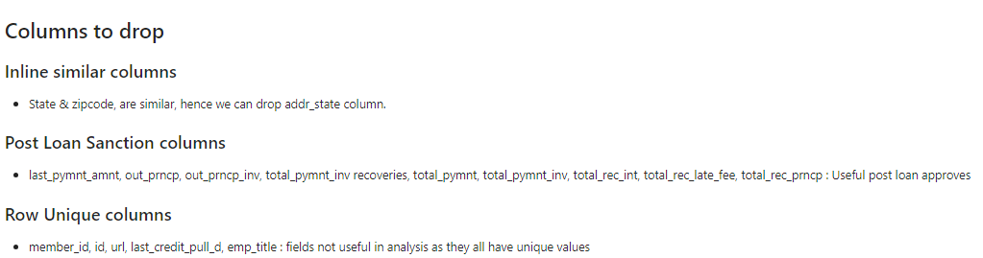
Contd

Slide 8
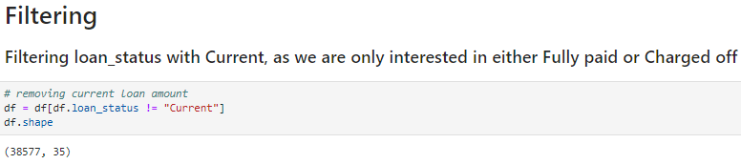
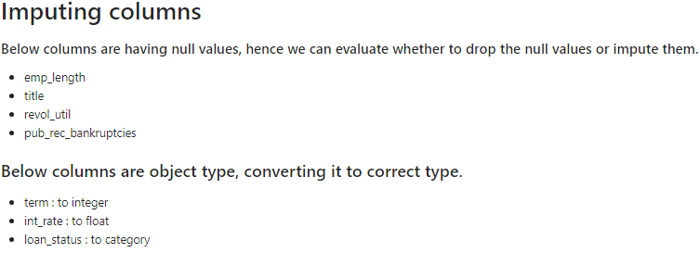
Filtering & Imputing
Filtering data on Current, as we only
need analysis around Fully Paid or
Charged Off Loan

Slide 9
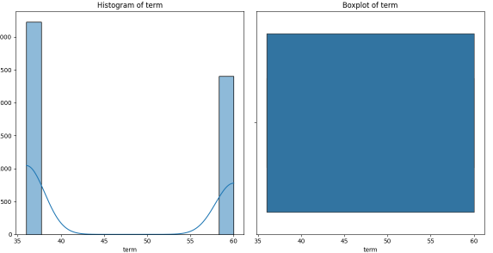
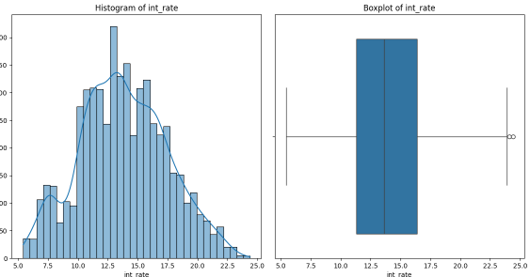
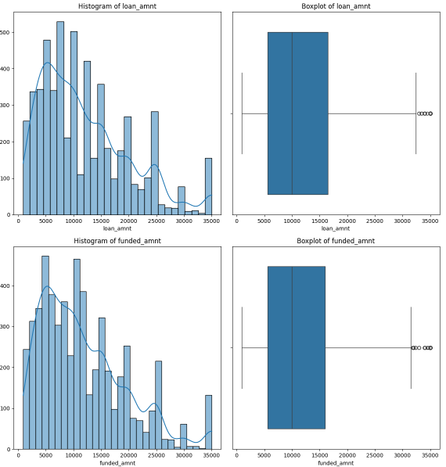
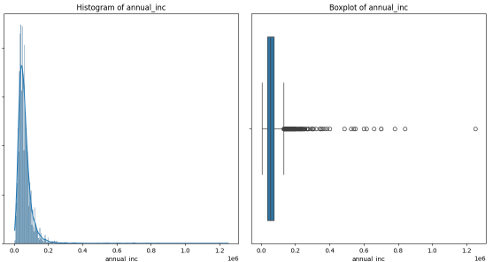
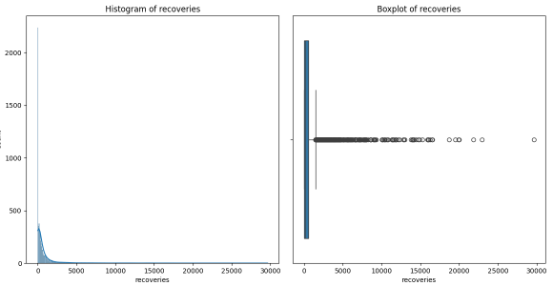
Univariate Analysis - Numerical
Impact creating parameters
Correlated data or Similarly Skewed
Outliers

Slide 10
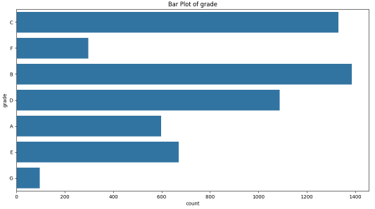
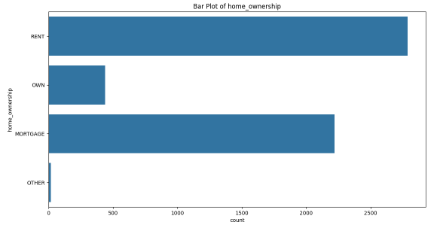
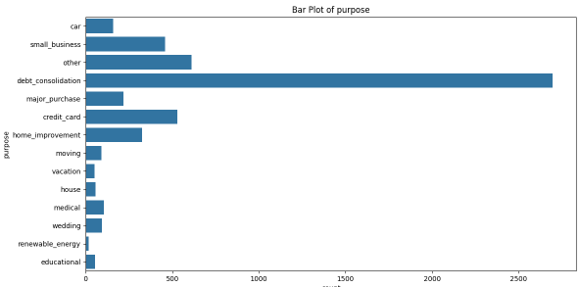
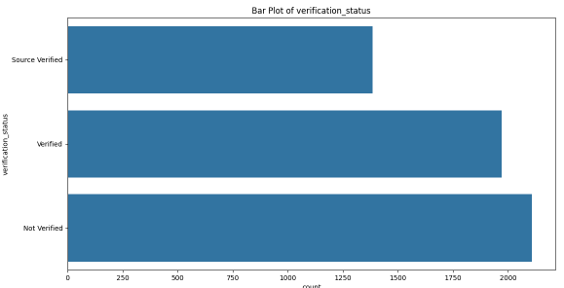
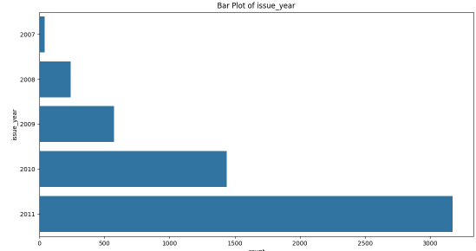
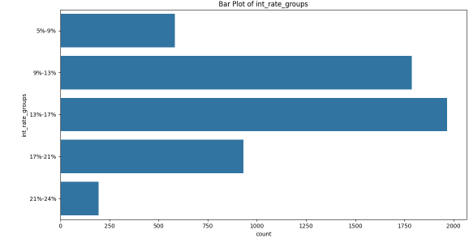
Univariate Analysis - Categorical

Slide 11
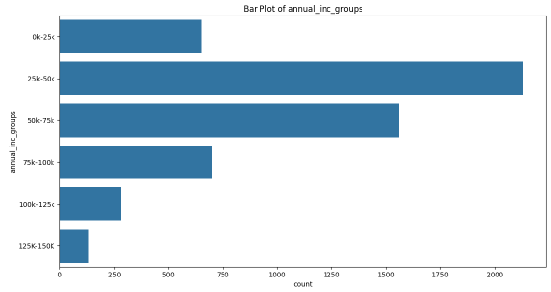
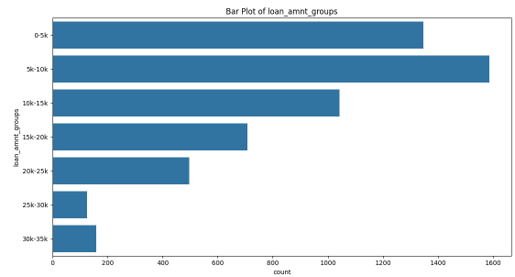
contd
grade : Major contributers are B, C, D
home_ownership : Rent and Mortgage is having more have more defaulters. Rent is the leading.
verification_status : verified and not verified has more contribution in defaulters
purpose : debt_consolidation has the highest defaulting rate.
earliest_credit_line : Need more analysis, as the graph shows some trend on the credit line.
last_credit_date : shows that for one date the defaulter count is more.
issue_d: shows the trend that from jan to dec 2011 more defaulters were there and especially the graph for issue_year shows more in 2011.
int_rate : 9-13% and 13-17% are major contributors
loan amount : 510K loan is a major contributer
annual income: 2530K is a major contributer

Slide 12
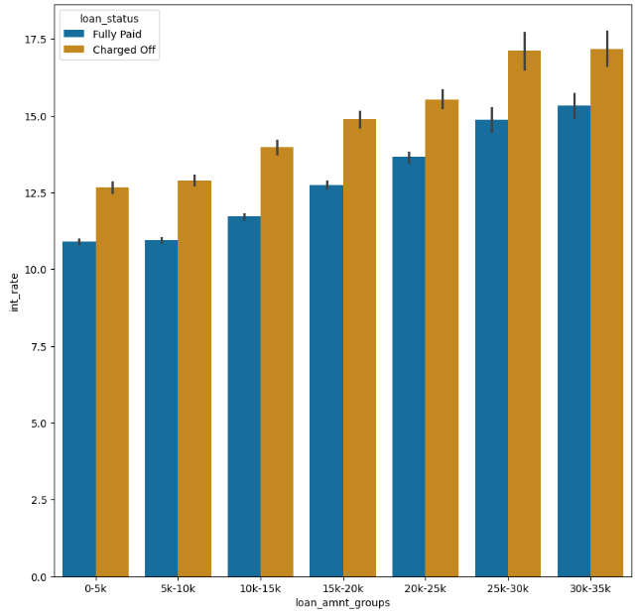
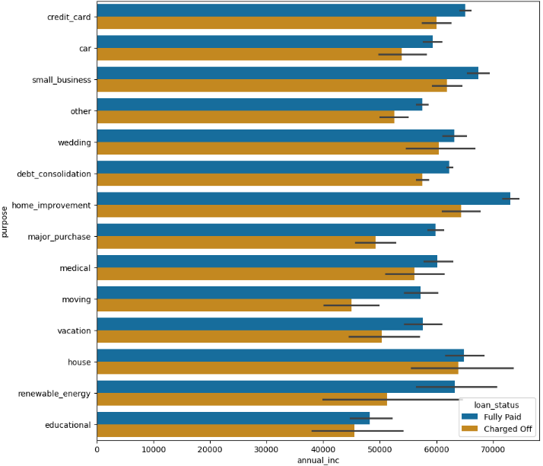
Bivariate Analysis

Slide 13
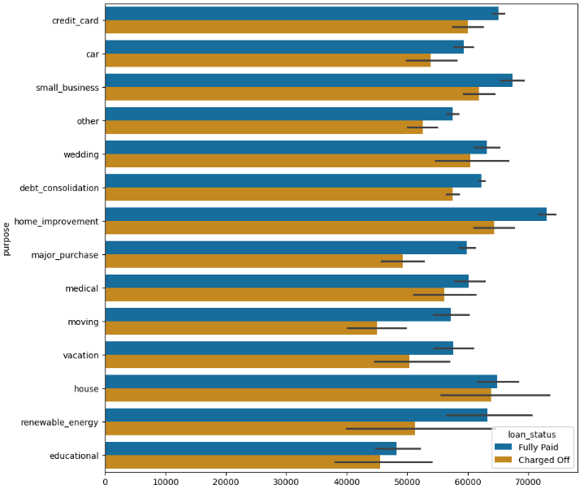
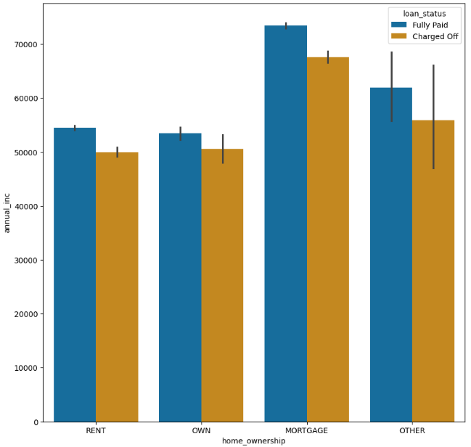
Contd
annual income vs loan_amnt: betwen 3035K with interest rate between 15 to 17.5 (higher side)
annual income vs int rate: interest rate between 2124% and income > 80K.
loan amount vs int rate : loan amount between 3035K and interest rate between 16 to 17.5%
annual income vs purpose: with home_improvement and annual income between 60 to 80K
annual income vs home ownership : ownership type Mortgage and income between 70-80K

Slide 14
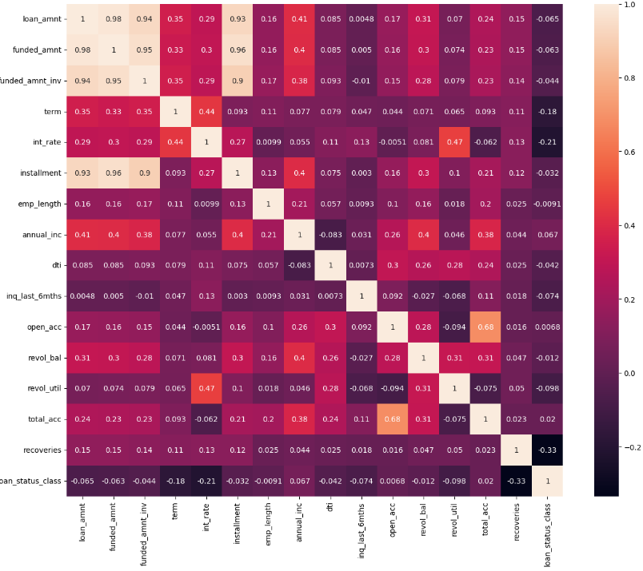
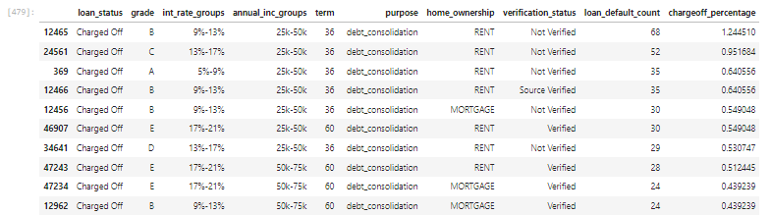
Multivariate Analysis

Slide 15
Conclusion
The chance of a consumer defaulting is more when below conditions are there.
The term is 36
if the grade is B or C
if the purpose is debt_consolidation
home_ownership is RENT or Mortgage
verification_status is Not Verified
loan_amount between 5k-10k
int_rate between 9-17%

