Slide 1

Team 10 Design Presentation

Slide 2
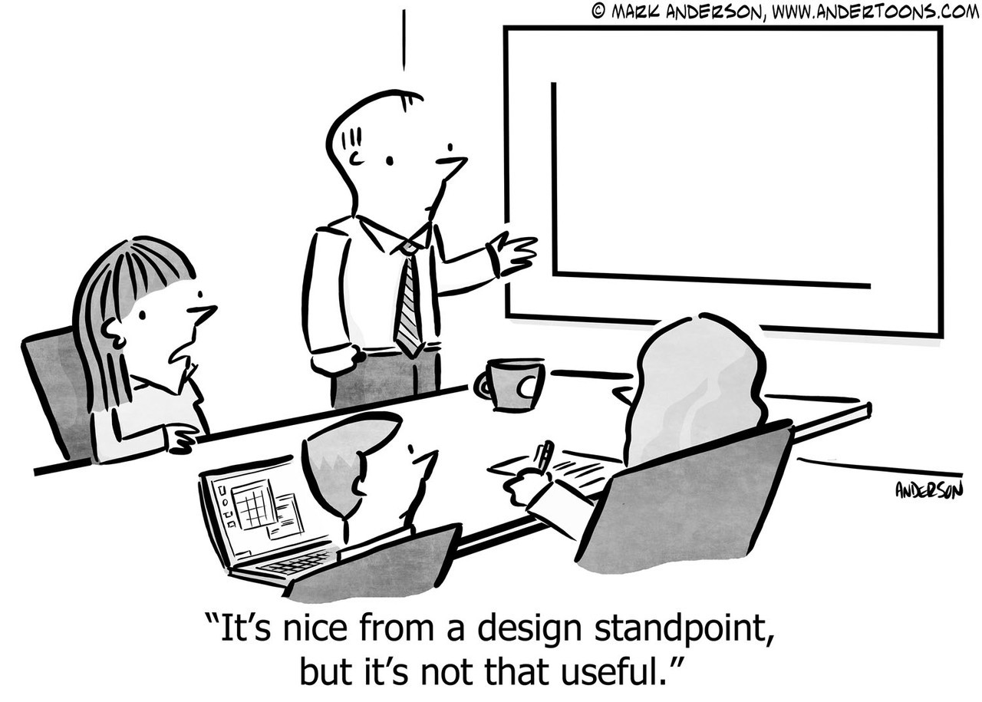
Importance of the Concept Generation Stage
Notes:
Every presentation should start with a joke..
Presentation schedule - problem statement, research, idea generation, morph chart, CAD design, build progress, future work and conclusion

Slide 3
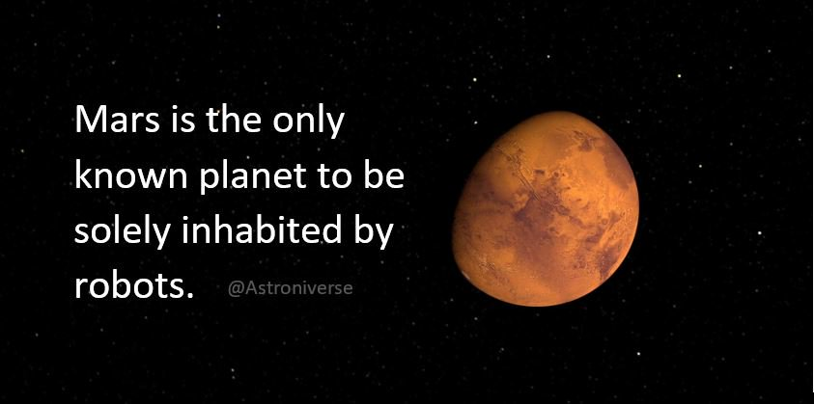
Project Goals
Produce a working prototype of a rover.
The rover must be built in ten weeks.
It must be able to move about on a Mars like surface and collect resources
It must operate continuously and collect as much regolith as possible in 4 minutes.
Design and produce a rover prototype to collect regolith for 3d printing a radiation shelter.
Required to operate in a Martian environment (think sand and rocks), no oxygen etc
A high rate a of collection is better
Notes:
Simplified problem statement - increase population of Mars!

Slide 4

Research
Talked to our mentor (previous champion!)
Read books (technical and general)
Looked at previous years designs

Slide 5
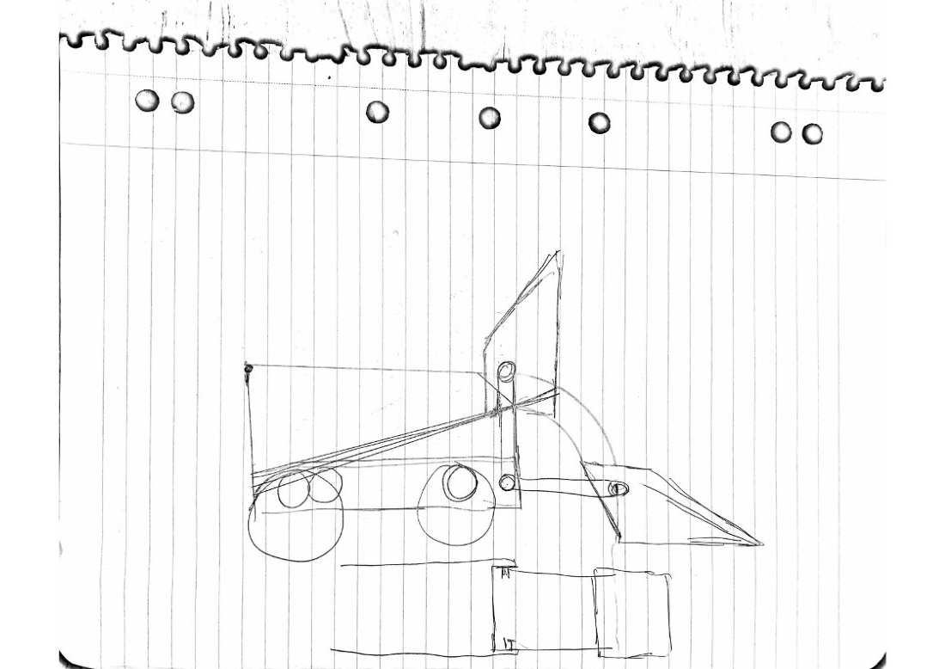
Concept generation & sketches

Slide 6
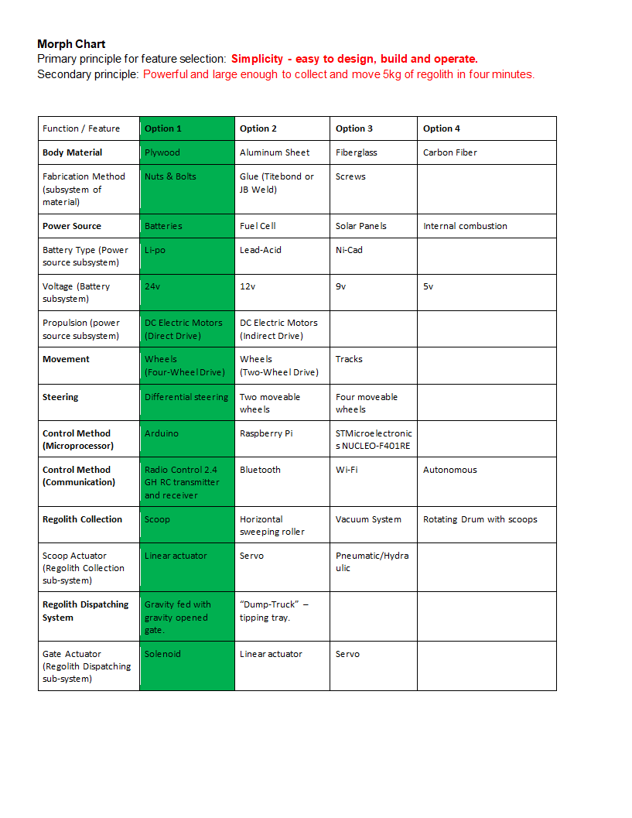
Morph Chart and Analysis
Focus on Simplicity
Few parts - easy to take apart and maintain
Plywood Construction
4 wheel drive with differential steering
Radio controlled
Arduino microprocessor
Scoop for collection
Gravity feed dispatching mechanism
Designed to collect and carry 5kg of regolith
Notes:
Simplified Morph chart - each design choice motivated by simplicity.

Slide 7
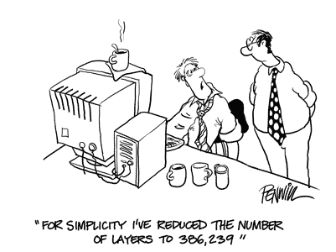
CAD Design
Designed in Fusion 360
Profile sketches easily downloaded for laser cutting
Made geometry of the Scoop easier to visualize and calculate
Renders make communicating design to team and clients easier

Slide 8
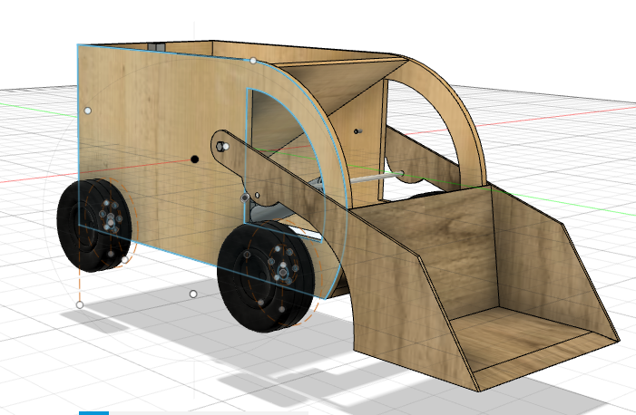

Slide 9

Design Concept Prototype
Light and strong with large capacity (5kg regolith)
Powerful (24 Volt 4 wheel drive and 500N linear actuator)
Easy to maintain and operate

Slide 10
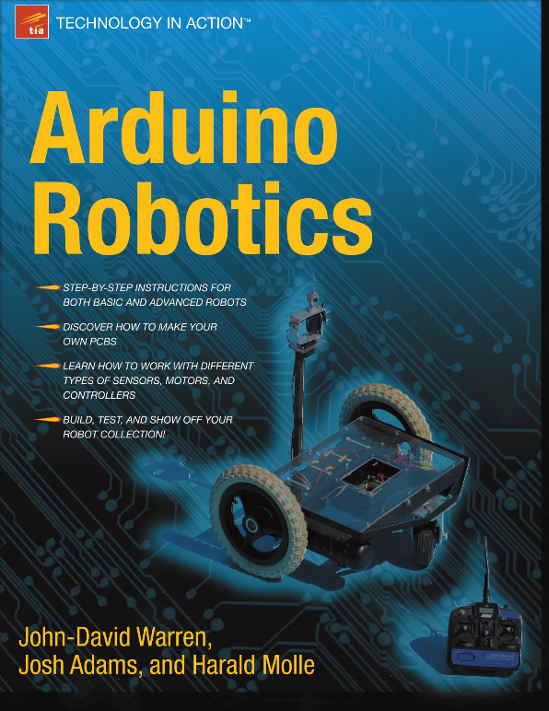
Electronics & Control System
Control system is 2.4 Gh RC transmitter and receiver
Arduino Mega with 3x H-Bridge MOSFET Motor Controllers
128 bit rotary encoder for arm position
RC servo to open dispatching gate
Hall effect current sensor as fuse/ energy use measurement
Code adapted from ‘Arduino Robotics’ (Warren et al. 2011)

Slide 11
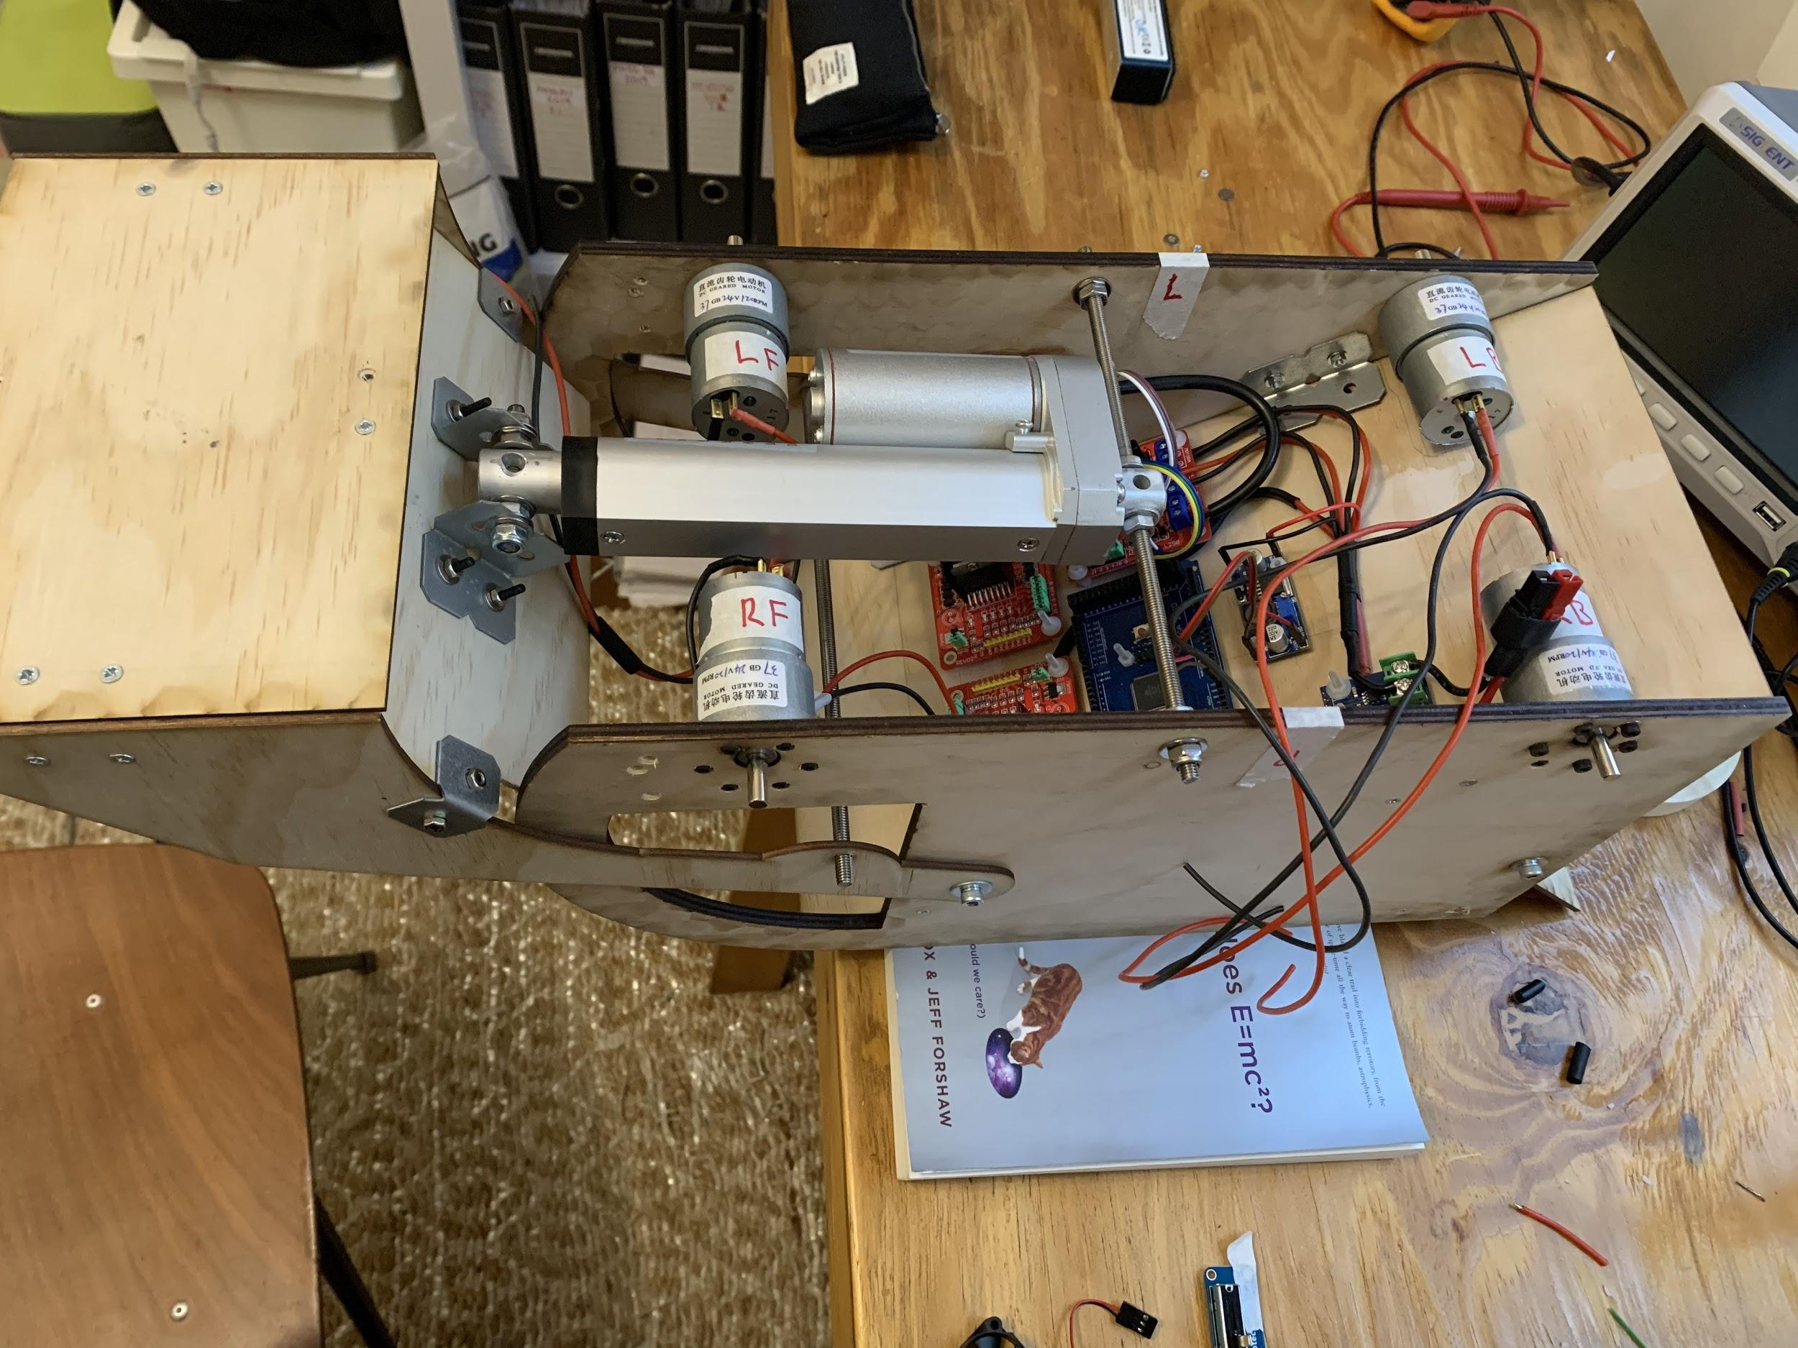
Project update - April 2nd
Body designed and assembled
Electronics installed
Waiting on receiver and wheel shafts
Regolith collection and dispatch testing next week

Slide 12
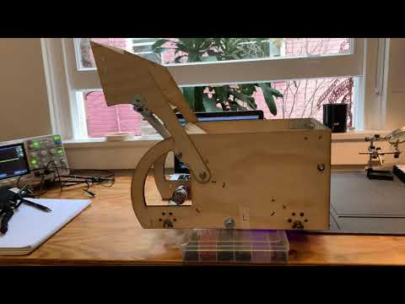
Notes:
Scoop test! Thanks for listening!

