Slide 1











Extract
Transform
Load
Amazon EventBridge
(daily trigger)
S3 bucket
(csv data)
crawler
AWS Glue Data Catalog
Extraction lambda
function
Transform lambda
function
Amazon Athena (analysis)
S3 bucket
(json data)
On object create trigger

Slide 2
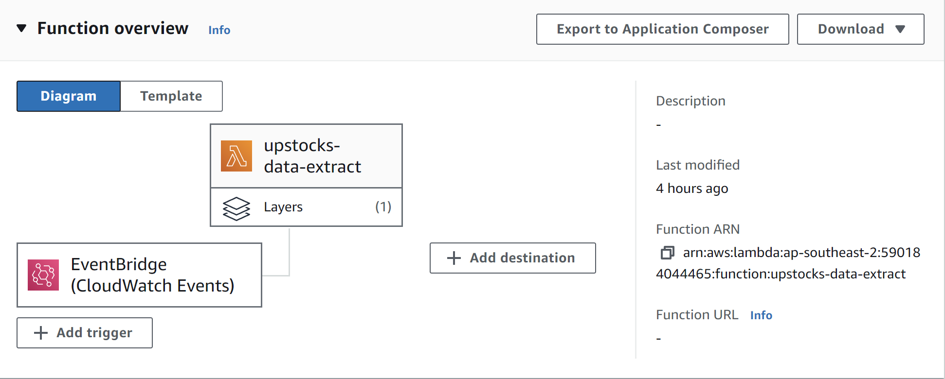

Slide 3
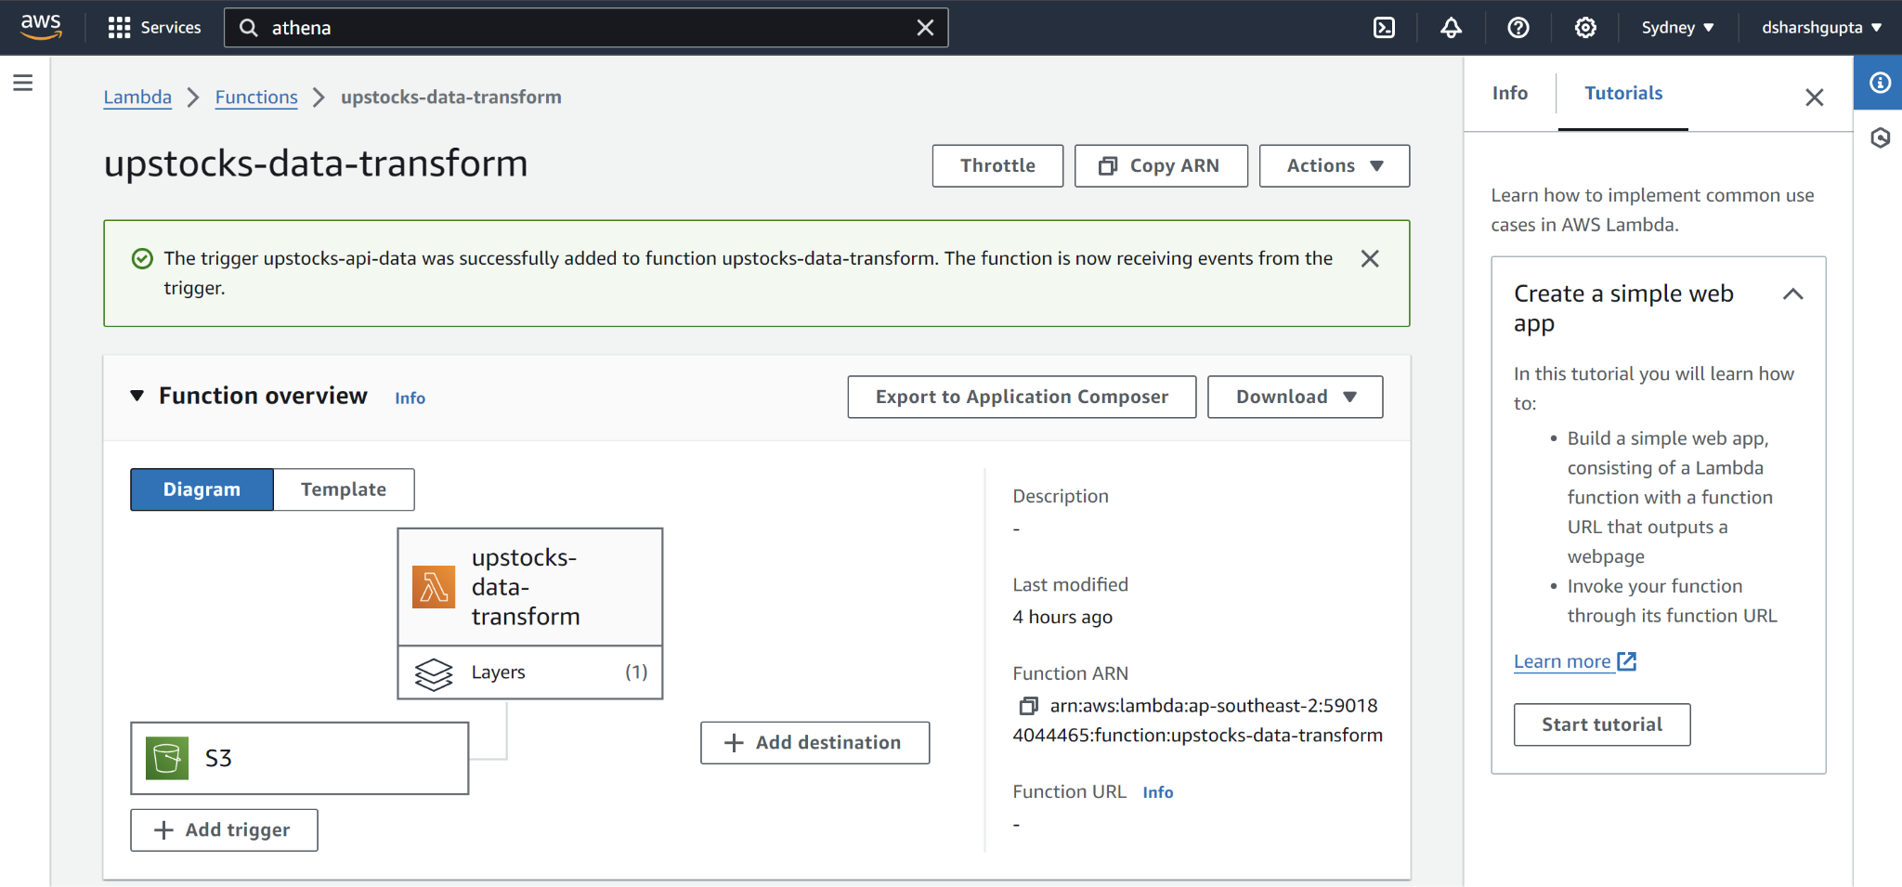

Slide 4
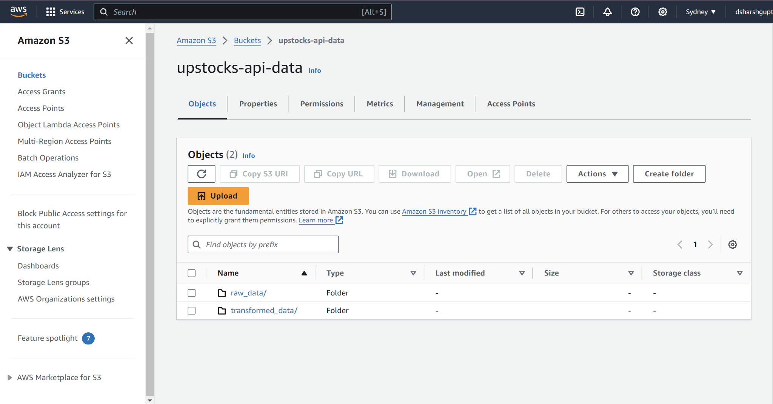

Slide 5
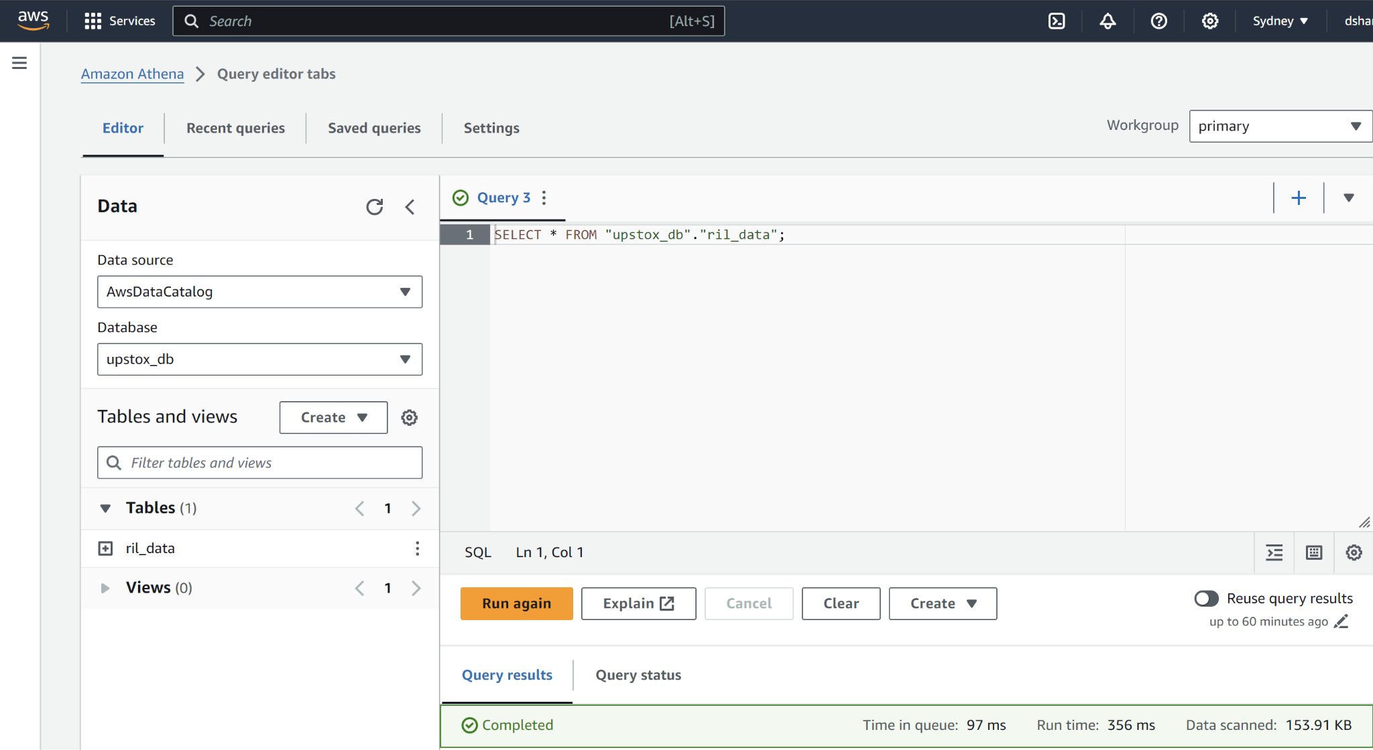

Slide 6
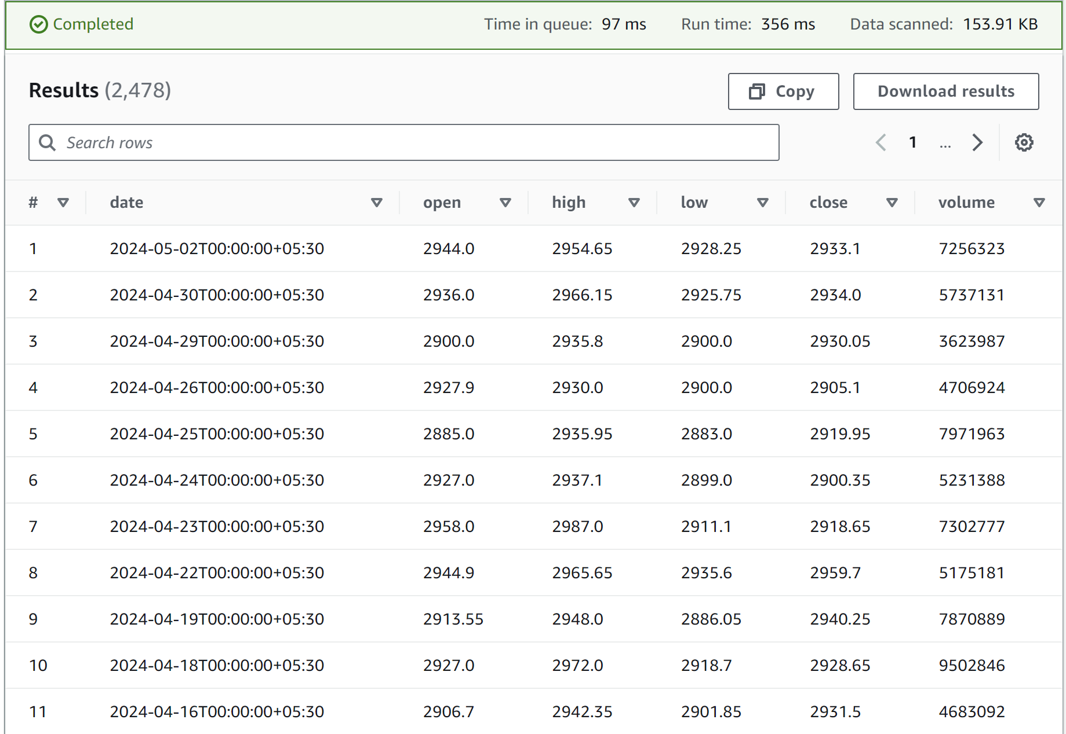

Slide 7
