Slide 1

AGILE PRESENTATION
BY DAVID SHELT
SOUTHERN NEW HAMPSHIRE UNIVERSITY

Slide 2
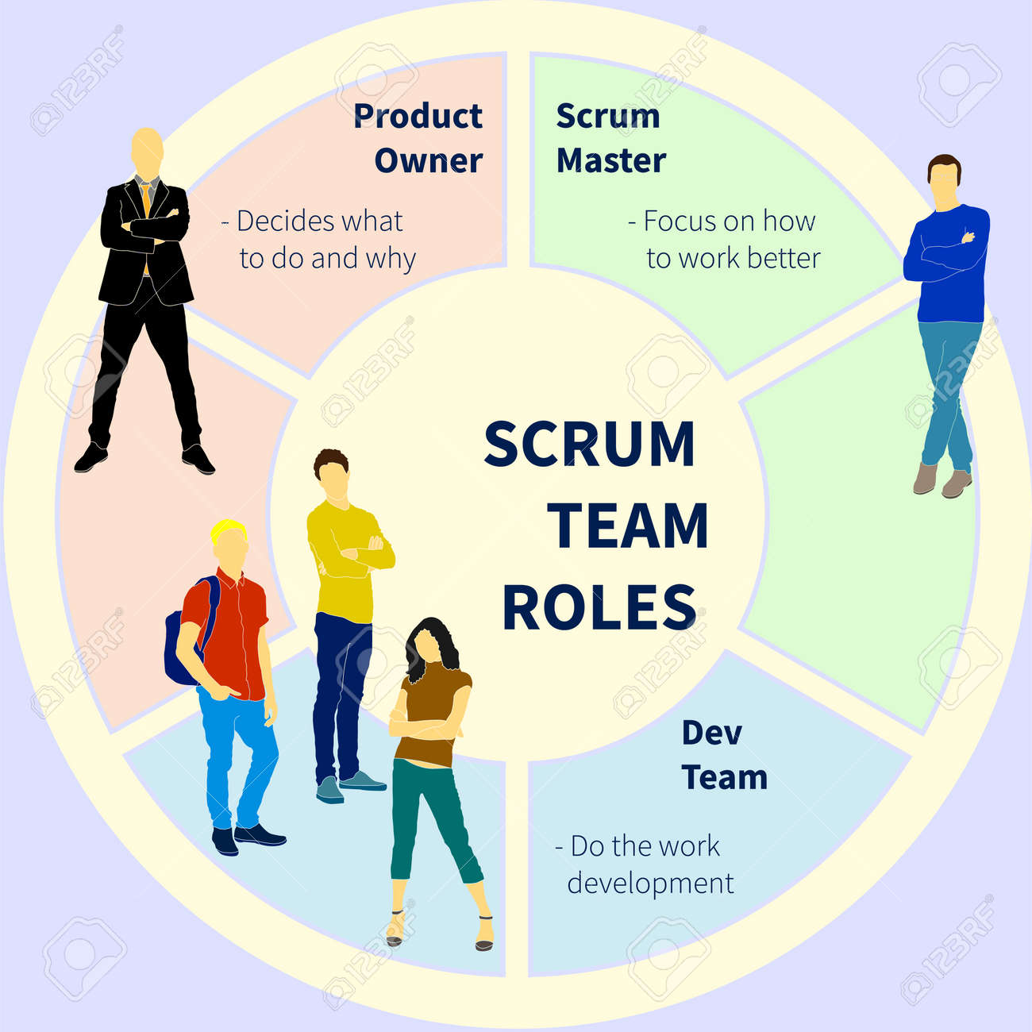
ROLES OF THE SCRUM TEAM
PRODUCT OWNER
SCRUM MASTER
DEVELOPER
TESTER
Photo courtesy of alexeysolovyev

Slide 3
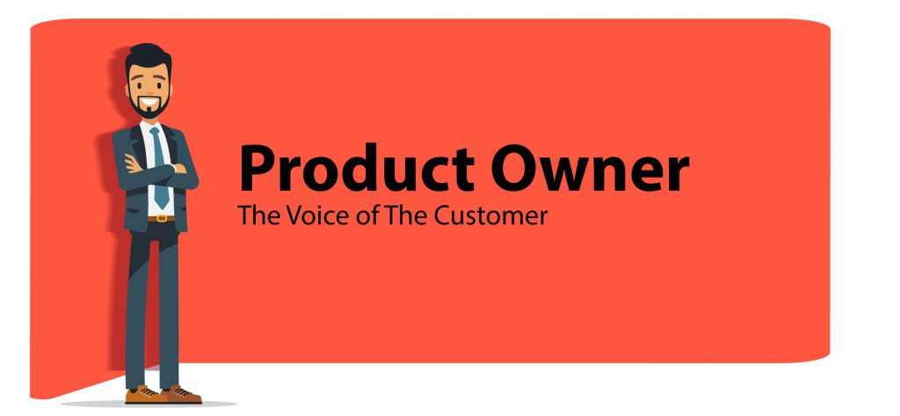
PRODUCT OWNER
The Product Owner acts as the liaison between the clients and the rest of the development team.
The Product Owner collect the requirements of the clients and then creates the user stories for the development team to use in each Sprint.
The Product Owner then prioritizes the product backlog of user stories onto the Scrum board, and this the only person on the team responsible for doing so (Cobb, 2015).
The Product Owner keeps in frequent contact with the client and updates the teams of any changes in the needs of the client.
Image courtesy of SCRUMstudy

Slide 4

SCRUM MASTER
The Scrum Master creates the agile team charter, which are the rules and guidelines to be followed by all team members during the project.
The Scrum Master makes sure that the Scrum method is being properly utilized and that all practices are adhered to to the best of their abilities (Cobb, 2015).
The Scrum master also at times assists the Product Owner with managing or maintaining the product backlog when needed (Cobb, 2015).
The Scrum Master facilitates the team and helps the team members who are facing certain challenges when necessary.
The Scrum Master heads the team meetings such as the Daily Scrum meetings, Sprint Planning, and the Sprint Review. The Scrum Master also participates in these meetings.
Image courtesy of Kissflow

Slide 5

DEVELOPERS
The developer designs the code based on what the client is envisioning for the product.
The developer uses the user stories to develop the programing code based on the user stories on the board.
The developer works with the tester to ensure that the code is functioning properly and free of any defects or bugs.
Image courtesy of Hygger

Slide 6

TESTER
The tester works with the Product Owner to review the user stories that are created in order to set the proper pass and fail measures for the Sprint Tasks.
The tester also works with the developer to know how the code will be designed so the pass and fail measure can be set.
The tester receives the code from the developer once the code is sufficient enough to be tested so that the tester can notify the developer immediately of any bugs or defects in the code.
Image courtesy of Testim

Slide 7
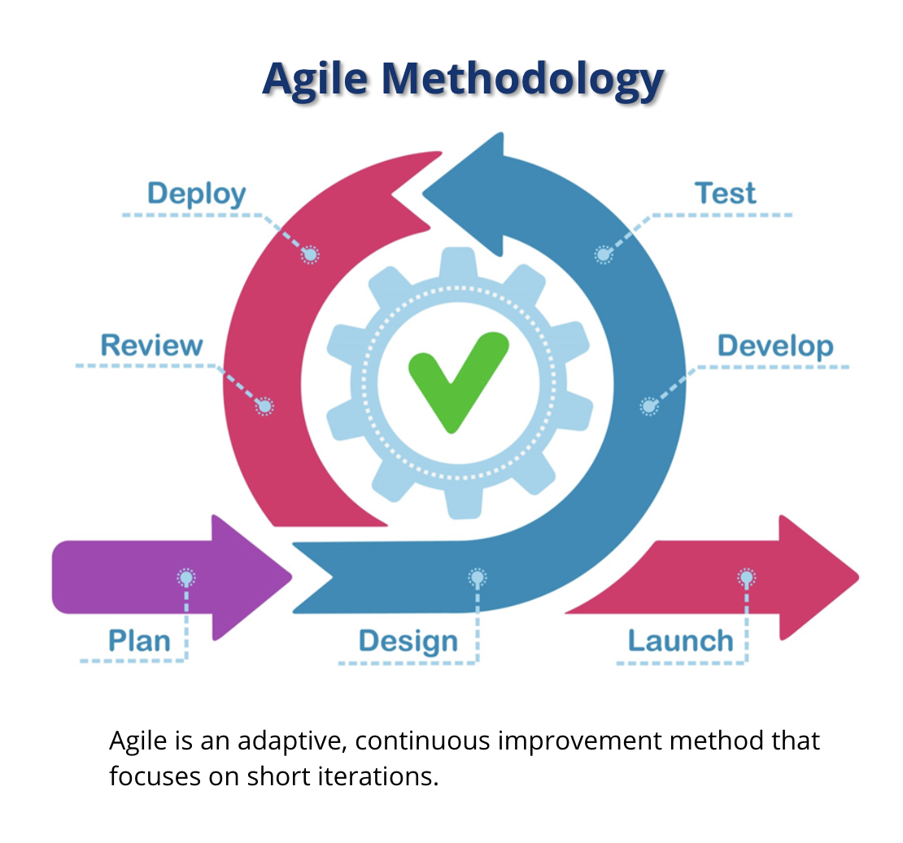
PHASES OF SDLC IN AGILE
Planning
Designing
Developing
Testing
Deployment
Review
Launch
Image courtesy of SNHU

Slide 8
PLANNING
Planning in agile methodology includes meeting the client to gather requirements.
From gathering the client requirements, user stories are then made by the Product Owner and put on the board in order of priority, with the user story with the highest level of priority going on the top of the board.
The user stories on the product backlog part board will also go under grooming from the Product Owner.
Planning also includes deferring planning decisions until the lattest point in time a decision can be made without impacting the outcome of the project (Cobb, 2015).
Planning in agile helps to reduce the level of uncertainty in the project (Cobb, 2015).

Slide 9
DESIGNING
Designing is where multiple approaches are brought to the clients and/or stakeholders, as well as the rest of the development team
After these meetings, the discussions are then documented within a Design Document Specification (DDS) (SDLC Tutorial)
The DDS is then brought the to stakeholders for review and they choose the design approach that fits best on various parameters, such as budget and time constraints (SDLC Tutorial)
In the DDS, the architecture and design of all modules should be defined with the minutest of details in the DDS (SDLC Tutorial)

Slide 10
DEVELOPING
The development phase is where the developer(s) creates the code based on the client requirements and the user stories.
The developer will create the code in a language (i.e. C++, Java, Python) based on the type of software being developed (SDLC Tutorial).
If the design is organized and detailed, then the code can be developed by the developer(s) without much difficulty (SDLC Tutorial).
The developer works with the tester throughout the project or Sprint to make sure the code is free of bugs and defects.

Slide 11
TESTING
The tester works with the developer to ensure the code is free of bugs and defects in the code.
The tester receives the code once it is sufficient to be tested and then reports any bugs, defects, or any other findings to the developer.
If bugs and defects are found, it is sent back to the developer who then fixes the code and send back to the tester for testing before the product’s release (SDLC Tutoria).
The tester also works with the Product Owner to discuss user stories in order to set the pass and fail measures of the Sprint or project.

Slide 12
DEPLOYMENT
Deployment occurs once the product has been tested and deemed to be functional and free of any bugs or defects.
Occasionally, the product is deployed to the client in stages depending on the business strategy of the organizations (SDLC Tutorial).
The client then can release this product in a limited setting and test it to the marketplace (SDLC Tutorial)

Slide 13
REVIEW
In the review, the Product Owner can meet with the stakeholders to receive feedback from the clients as to what are the likes and potential dislikes of the product.
The development team can also review the work that was performed during the Sprints and the overall project to find out what where the areas of strength, and what were the areas of weakness that could be improved upon.
The team then takes this feedback that is received externally from the client and internally from the entire development team and applies is to improve on the next Sprint or project.

Slide 14
LAUNCH
In the launch, the final product is finally presented to the stakeholders or clients.
The clients is free to offer the finished product to their customer base.
Only maintenance and upgrading to the system will have to be occasionally performed in the future.

Slide 15

AGILE VS. WATERFALL APPROACH
Agile:
Agile is an approach to software development that is more adaptive and has multiple teams working in an independent and organized matter (Cobb, 2015).
Works in sprints and is incremental and iterative.
Keeps in frequent contact with customer.
Is flexible and allows for the clients to make changes during the project.
Waterfall:
Waterfall is a linear and sequential approach (Cobb, 2015).
There is no frequent contact with client during waterfall.
Requires documenting and defining a stable set of requirements at the beginning of the project (Almazaydeh, et. al 2022)
Is not flexible and changes cannot be made during project in a waterfall approach.
Image courtesy of Getty Images/iStockPhoto

Slide 16
FACTORS TO CONSIDER WHEN CHOOSING AGILE OR WATERFALL METHOD
Agile:
Agile will be important to use when continuous feedback and delivery are important (Andrei, et. al, 2019). We needed this feedback on how the vacation packages looked to SNHU once they saw it at the end of the sprint.
Agile is preferred hen the user requirements are not well defined (Andre, et. al, 2019). We had a rough idea of how SNHU Travel wanted the interface to look, but we did not have a clear idea until we received feedback from them.
Agile is best used when the clients expects their business needs or focus to evolve during project completion, as was the case when SNHU Travel wanted to change their focus to offering detox and wellness vacation packages.
I would factor in whether the company has used agile in the past, or if it needs to be implemented. This was the case in the module six discussion with Vision Quest Software.
Waterfall:
Waterfall is a method that has all of the upfront requirement and will not change those requirements during the process (Andrei, et. al, 2019).
Waterfall is useful when there is not required collaboration between the team and the clients.
Waterfall is also useful when the project is simple and there are short time constraints with the project.

Slide 17
REFERENCES
Almazaydeh, L., Alsafasfeh, M., Alsalameen, R., & Alsharari, S. (2022). Formalization of the prediction and ranking of software development life cycle models. International Journal of Electrical & Computer Engineering ( 2088-8708), 12(1), 534–540. https://doi- org.ezproxy.snhu.edu/10.11591/ijece.v12i1.pp534- 540
Andrei, B.-A., Casu-Pop, A.-C., Gheorghe, S.-C., & Boiangiu, C.-A. (2019). A STUDY ON USING WATERFALL AND AGILE METHODS IN SOFTWARE PROJECT MANAGEMENT. Journal of Information Systems & Operations Management, 13(1), 125+. https://link.gale.com/apps/doc/A586469729/AONE?u=nhc_main&sid=bookmark- AONE&xid=88ddda84
Charles G. Cobb. (2015). The Project Manager’s Guide to Mastering Agile : Principles and Practices for an Adaptive Approach. Wiley.
SDLC Tutorial, Retrieved from: https://www.tutorialspoint.com/sdlc/sdlc_overview.htm

