Slide 1
Chapter 5 Machine Learning Basics
9/6/2016 Deep Learning Reading Club

Slide 2
5.1.1-3 Learning Algorithms
Some definitions:
Task T can be many things. Classification, anomaly detection, denoising, machine translation, etc.
Performance P can also be several things. Accuracy, error or log probability (or approximation hereof). The important thing is to minimize training and generalization error.
Experience E can be divided into supervised and unsupervised for simplicity. The difference lies in learning the p(x) (unsupervised), or learning how to predict y from x by estimating p(y|x) (supervised).
A design matrix is a useful way of structuring data into examples x features (like in SPM, time x regressors)

Slide 3
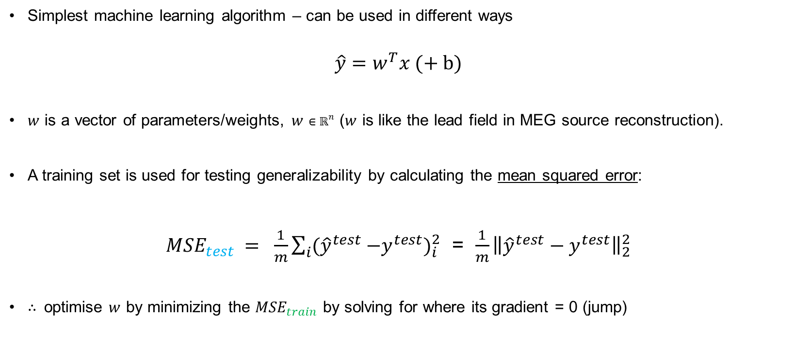
5.1.4 Example: Linear regression
Simplest machine learning algorithm – can be used in different ways
$$\hat{y}=w^{T}x (+ b)$$
$w$ is a vector of parameters/weights, $w∈ℝ^{n}$ ($w$ is like the lead field in MEG source reconstruction).
A training set is used for testing generalizability by calculating the mean squared error:
${MSE}_{test} = \frac{1}{m}\sum_{i}{({\hat{y}}^{test}}{−y^{test})}_{i}^{2}$ = $\frac{1}{m}{\left\|{\hat{y}}^{test}−y^{test}\right\|}_{2}^{2}$
∴ optimise $w$ by minimizing the ${MSE}_{train}$ by solving for where its gradient = 0 (jump)
Notes:
Bias parameter b makes it an affine function, no longer necessarily passes through the origin.
Sidenote: even if the regression itself it not linear with respect to its inputs (e.g.${ x}^{2}$), the output is still a linear function of the parameters w so the normal equations are still valid).

Slide 4

5.2 Capacity, Overfitting and Underfitting
Generalization/minimizing ${MSE}_{test}$ is key
Statistical learning theory: approximate ${MSE}_{test}$ from ${MSE}_{train}$:
Both training and test data are generated by p_{data}
Assume: independent and identically distributed examples (i.i.d.)
→ expected training error = expected test error
Overfitting versus underfitting

Slide 5
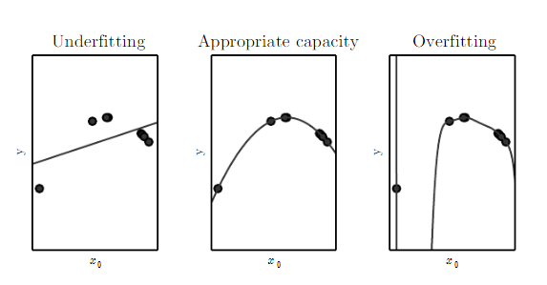
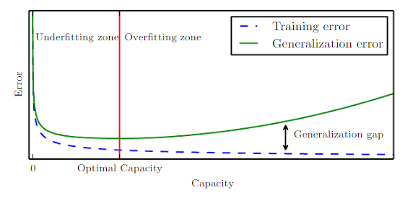

5.2 Capacity, Overfitting and Underfitting
Capacity = model’s ability to fit different functions = hypothesis space. Should match complexity of the task/process.
Controlling the model’s capacity to prevent over- or underfitting.
(Interestingly, selecting the optimal function is rarely done. Significant reduction of ${MSE}_{train}$ is enough)
Need optimal capacity + enough training data. Upper error discrepancy bound depends on both.
Notes:
The discrepancy between training and generalization error has an upper bound which grows as the model capacity grows (ie more different families of functions are possible), and shrinks as the number of training examples $m$ increases. capacity (more=bad) and number of training examples (more=good).

Slide 6
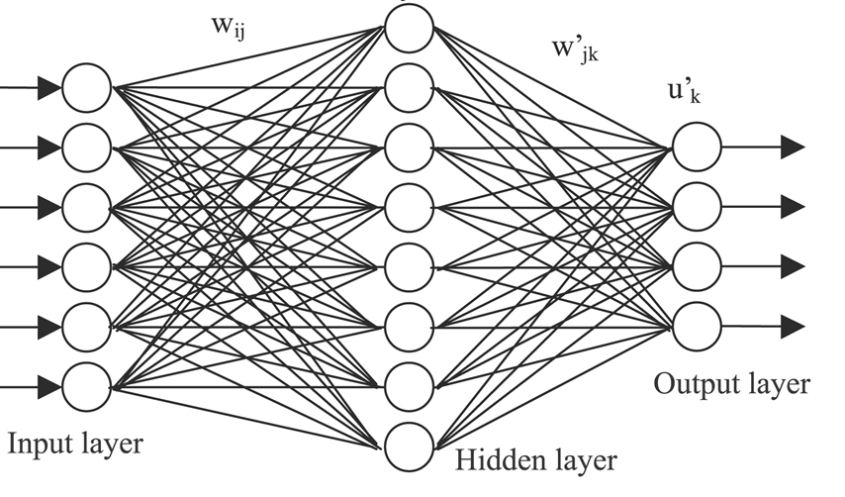
5.2 Capacity, Overfitting and Underfitting
Determining the (effective) capacity is difficult with deep networks
– what is it actually doing?
Non-parametric models: parameter vector w can change size upon observing data. Useful if we want the complexity of the model to be a function of the training set size (neural networks are usually parametric though)
Bayes error: error if an oracle made predictions from the true p(x,y) because of noise in the distribution.
Vapnik-Chervonenkis dimension measures the capacity of a binary classifier. Equates to the largest possible value of input examples for which there exists a training set of m different x points that the classifier can label arbitrarily
Notes:
Quantifying the capacity allows statistical learning theory to make quantitative predictions.
Effective and representational capacity
Principle of parsimony – Occam’s razor
Nearest neighbour regression.

Slide 7
5.2 Capacity, Over- and under- fitting
5.2.1 No Free Lunch Theorem
No machine learning algorithm can classify well previously unobserved data generated by an arbitrary generating distribution.
We thus need:
specific generating distributions
specific algorithms performing well with these.
Notes:
Sophie, my only request is that we make sure we don't over-run.
Chapter 5 is over 60 pages, so how would you like it if, say,
- you did p. 98-116 (up to 'No Free Lunch') and 131-145 (ML up to 'Unsupervised')
- I did 116-131 and 145-164.
... and we each selected where to spend most time according to our marvelous intuition of what the group would most appreciate? I don't think we'll be able to cover everything in detail.

Slide 8
Regularization
Encodes preferences for a specific set of solutions in the hypothesis space over another, other costs being equal
Is intended to reduce generalization rather than training error
Example: preference for small-norm weights in a regression, aka weight decay
λ here cannot and should not be adjusted to reduce error over the training set. (this would overfit)
but it can't be fitted to the test set either (bec. it wouldn't be an independent test any more). What to do?
Notes:
Sophie, my only request is that we make sure we don't over-run.
Chapter 5 is over 60 pages, so how would you like it if, say,
- you did p. 98-116 (up to 'No Free Lunch') and 131-145 (ML up to 'Unsupervised')
- I did 116-131 and 145-164.
... and we each selected where to spend most time according to our marvelous intuition of what the group would most appreciate? I don't think we'll be able to cover everything in detail.

Slide 9
Validation
Randomly split off a small proportion of the training data; call that 'validation set'.
Train on the non-validation set. Look at performance over the validation set.
Minimize validation set error over different settings of the algorithm ('hyperparameters')
It's very easy to cheat (or, it's very hard to look at our data just once).
k-fold cross validation: split into k disjoint subsets, use each one in turn as test set, the rest as training → compute average test error.
Notes:
Sophie, my only request is that we make sure we don't over-run.
Chapter 5 is over 60 pages, so how would you like it if, say,
- you did p. 98-116 (up to 'No Free Lunch') and 131-145 (ML up to 'Unsupervised')
- I did 116-131 and 145-164.
... and we each selected where to spend most time according to our marvelous intuition of what the group would most appreciate? I don't think we'll be able to cover everything in detail.

Slide 10
5.4 Bias vs. Variance
Defnintion of Bias:
Example
has bias
Def. of variance and standard error:
Useful estimators have variance that decreases with m, the number of samples in the dataset. e.g. Errors over a test set → sample mean → CIs for different algorithms
Notes:
Sophie, my only request is that we make sure we don't over-run.
Chapter 5 is over 60 pages, so how would you like it if, say,
- you did p. 98-116 (up to 'No Free Lunch') and 131-145 (ML up to 'Unsupervised')
- I did 116-131 and 145-164.
... and we each selected where to spend most time according to our marvelous intuition of what the group would most appreciate? I don't think we'll be able to cover everything in detail.

Slide 11
5.4 MSE = Bias² + Variance
Defnintion MSE :
Estimator Bias tends to decrease with capacity
Estimator Variance tends to increase with capacity
Notes:
Sophie, my only request is that we make sure we don't over-run.
Chapter 5 is over 60 pages, so how would you like it if, say,
- you did p. 98-116 (up to 'No Free Lunch') and 131-145 (ML up to 'Unsupervised')
- I did 116-131 and 145-164.
... and we each selected where to spend most time according to our marvelous intuition of what the group would most appreciate? I don't think we'll be able to cover everything in detail.

Slide 12
Consistency
Consistency means that
The probability that our point estimator …
… deviates from the true value
… by more than any chosen criterion ε
… converges to zero as the sample size m increases.
Consistency implies that bias will vanish with m, but not vice versa.
Notes:
Sophie, my only request is that we make sure we don't over-run.
Chapter 5 is over 60 pages, so how would you like it if, say,
- you did p. 98-116 (up to 'No Free Lunch') and 131-145 (ML up to 'Unsupervised')
- I did 116-131 and 145-164.
... and we each selected where to spend most time according to our marvelous intuition of what the group would most appreciate? I don't think we'll be able to cover everything in detail.

Slide 13
Over to Sofie …
Notes:
Sophie, my only request is that we make sure we don't over-run.
Chapter 5 is over 60 pages, so how would you like it if, say,
- you did p. 98-116 (up to 'No Free Lunch') and 131-145 (ML up to 'Unsupervised')
- I did 116-131 and 145-164.
... and we each selected where to spend most time according to our marvelous intuition of what the group would most appreciate? I don't think we'll be able to cover everything in detail.

Slide 14
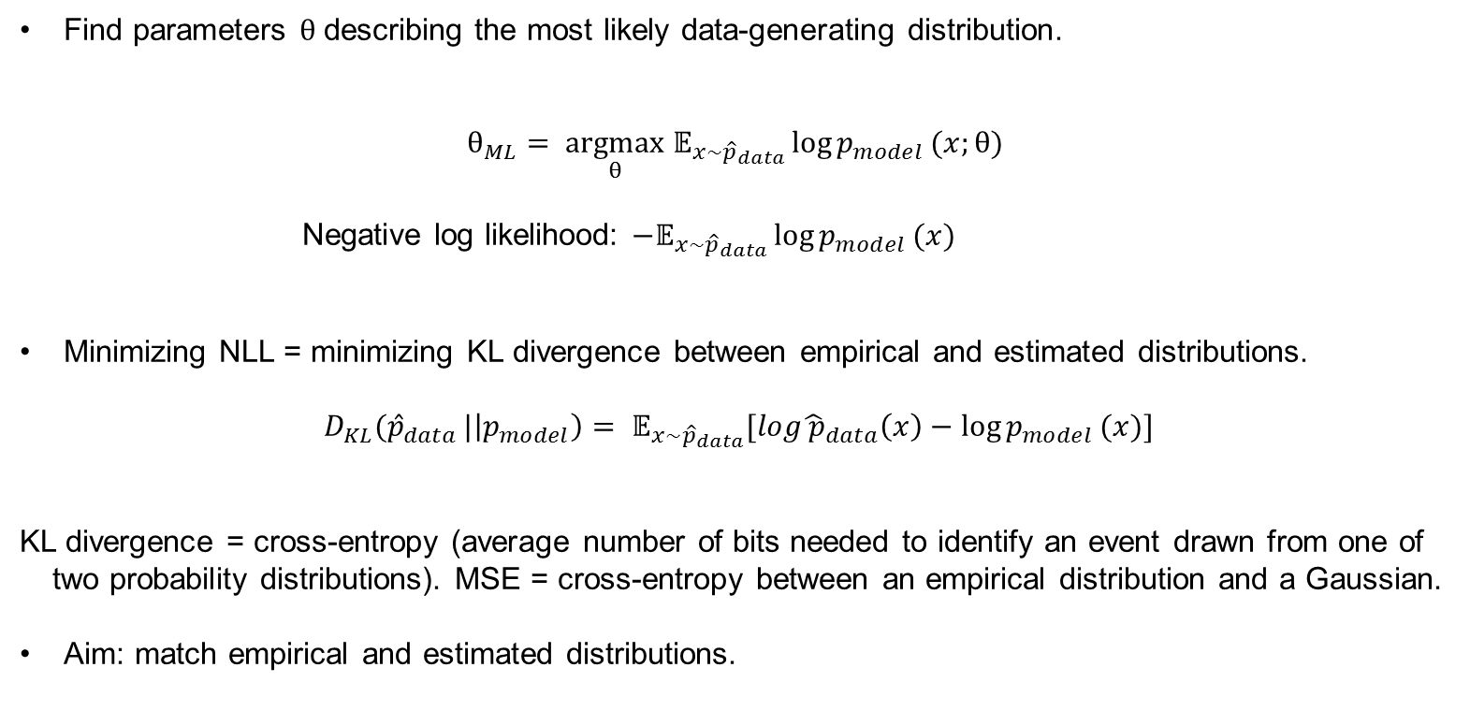
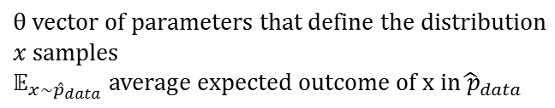
5.5 Maximum Likelihood Estimation
Find parameters $θ$describing the most likely data-generating distribution.
$$θ_{ML}= \underset{θ}{argmax}{ 𝔼}_{x\sim {\hat{p}}_{data}}{\log{p_{model }(x;θ)}}$$
Negative log likelihood: ${−𝔼}_{x\sim {\hat{p}}_{data}}\log{p_{model }(x)}$
Minimizing NLL = minimizing KL divergence between empirical and estimated distributions.
$$D_{KL}({\hat{p}}_{data }|\left|p_{model}\right)= 𝔼_{x\sim {\hat{p}}_{data}}[log{\hat{ p}}_{data}\left(x\right)−\log{p_{model }(x)]}$$
KL divergence = cross-entropy (average number of bits needed to identify an event drawn from one of two probability distributions). MSE = cross-entropy between an empirical distribution and a Gaussian.
Aim: match empirical and estimated distributions.
$$θ vector of parameters that define the distribution$$
$x$samples
$$𝔼_{x\sim {\hat{p}}_{data}} average expected outcome of x in{\hat{ p}}_{data}$$
Notes:
Taking the log protects from underflow and enables summing implicitly in E (rather than multiplying if not taking the log)
Rescaling into log space doesn’t affect the estimation
KL divergence can be 0 which is important.
Always minimize the cost function, whether is KL div or NLL
KL divergence is equivalent to the cross-entropy (average number of bits needed to identify an event drawn from one of two probability distributions). The MSE is the cross-entropy between an empirical distribution and a Gaussian.

Slide 15
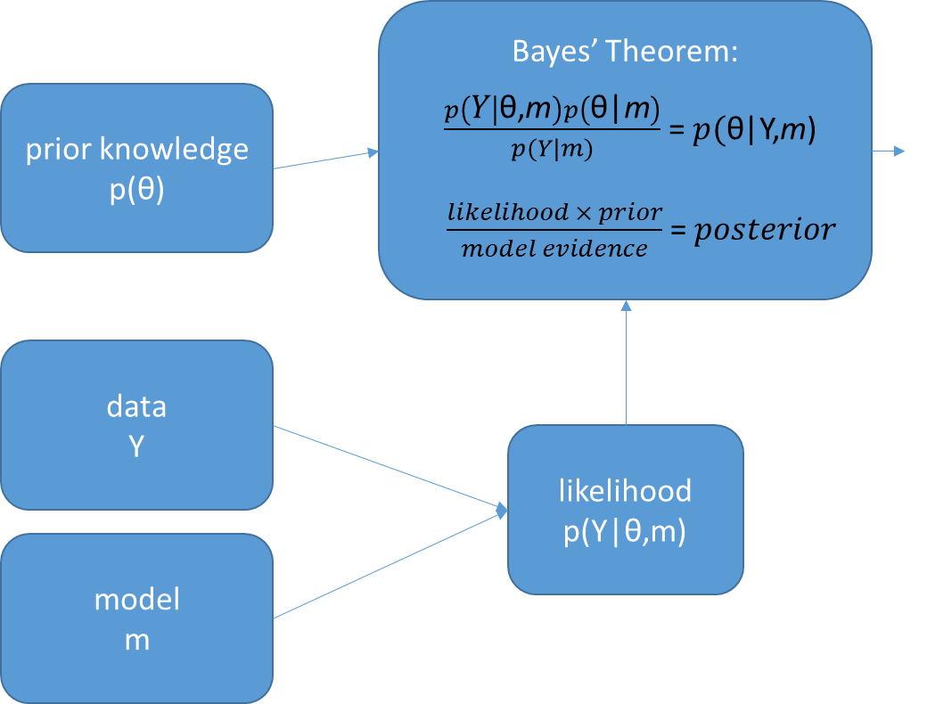
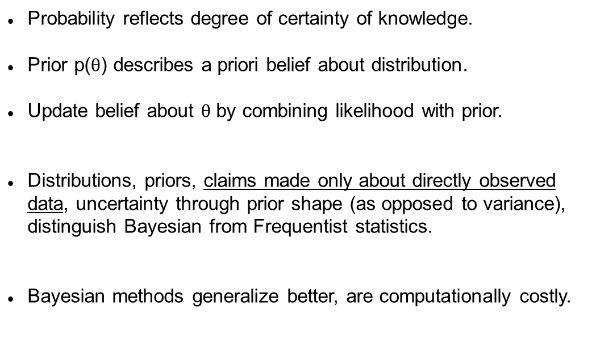
5.6 Bayes
Probability reflects degree of certainty of knowledge.
Prior p($θ$) describes a priori belief about distribution.
Update belief about $θ$ by combining likelihood with prior.
Distributions, priors, claims made only about directly observed data, uncertainty through prior shape (as opposed to variance), distinguish Bayesian from Frequentist statistics.
Bayesian methods generalize better, are computationally costly.

Slide 16
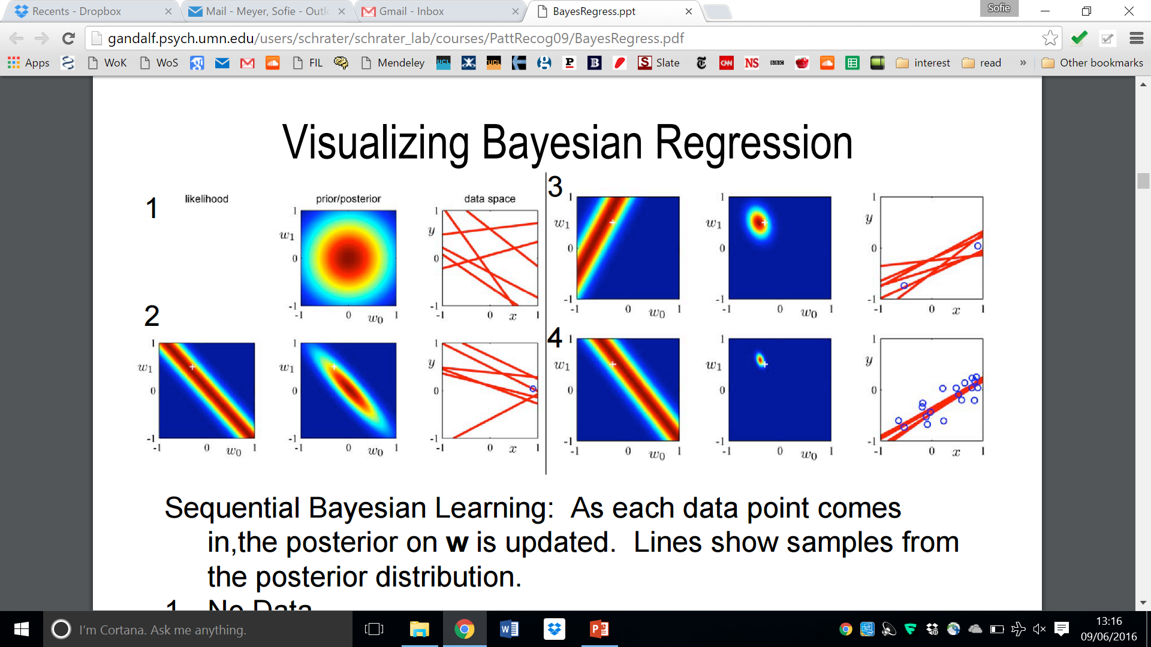
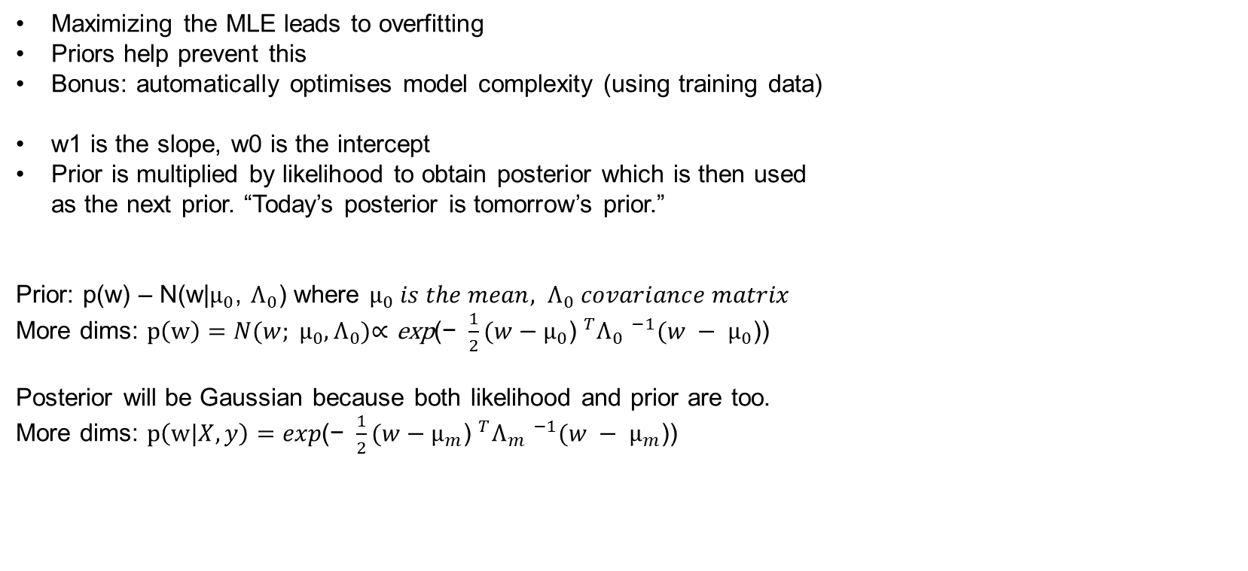
5.6 Bayesian
Example: Linear Regression
w space
Samples from posterior on w
Maximizing the MLE leads to overfitting
Priors help prevent this
Bonus: automatically optimises model complexity (using training data)
w1 is the slope, w0 is the intercept
Prior is multiplied by likelihood to obtain posterior which is then used
as the next prior. “Today’s posterior is tomorrow’s prior.”
Prior: p(w) – N(w|$μ_{0}$, $Λ_{0}$) where $μ_{0} is the mean, Λ_{0} covariance matrix$
More dims: $p\left(w\right)=N(w; μ_{0}, Λ_{0})\text{∝ }\text{exp}\text{(− }\frac{1}{2}{(w−μ_{0}\text{) }}^{T}{Λ_{0} }^{−1}(w − μ_{0}$))
Posterior will be Gaussian because both likelihood and prior are too.
More dims: $p\left(w|X,y\right)=exp\text{(− }\frac{1}{2}{(w−μ_{m}\text{) }}^{T}{Λ_{m} }^{−1}(w − μ_{m}$))
No data
One datapoint
Two datapoints
20 datapoints
From Bishop book
Notes:
Beta is the noise precision parameter
The errors have a normal distribution

Slide 17
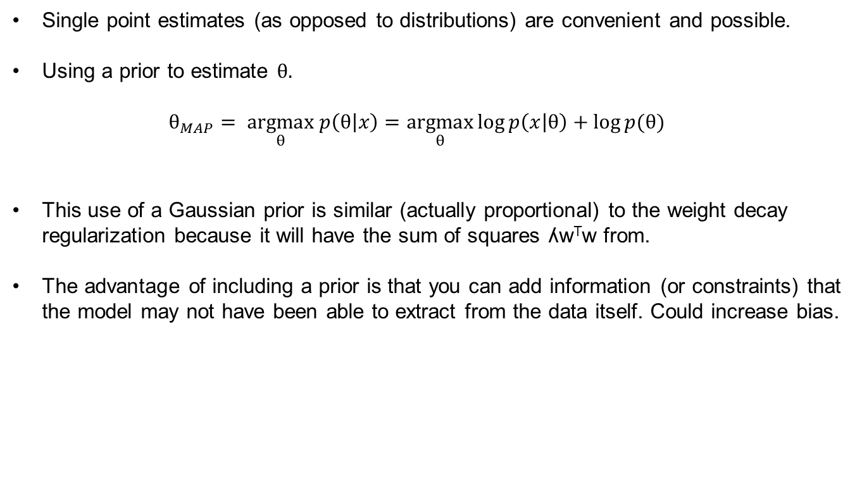
5.6.1 Maximum A Posteriori (MAP) Estimation
MLE with a prior
Single point estimates (as opposed to distributions) are convenient and possible.
Using a prior to estimate $θ.$
$$θ_{MAP}= \underset{θ}{argmax} p\left(θ | x\right)=\underset{θ}{argmax}\log{p\left(x | θ\right)+\log{p(θ)}}{}$$
This use of a Gaussian prior is similar (actually proportional) to the weight decay regularization because it will have the sum of squares ʎw^{T}w from.
The advantage of including a prior is that you can add information (or constraints) that the model may not have been able to extract from the data itself. Could increase bias.
Notes:
Log p (prior) will have the sum of squares wTw form. So if you have a Gaussian prior, this is similar to the weight decay idea.
The advantage of MAP over MLE is that useful information that cannot be found in the training data can be introduced through the prior. This helps reduce variance but increases the bias in the MAP point estimate (if it’s correct).
If we have a Gaussian prior on the weights $θ$, then p($θ$) is proportional to the weight decay penalty ʎw^{T}w, plus a term that doesn’t depend on w/affect learning.

Slide 18
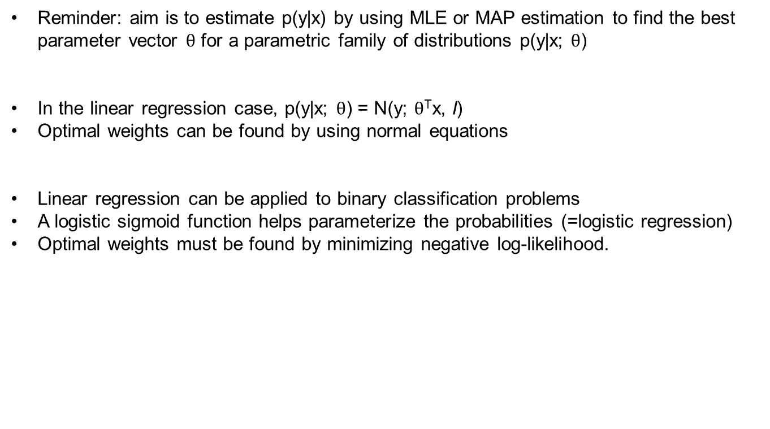
5.7.1 Probabilistic Supervised Learning
Reminder: aim is to estimate p(y|x) by using MLE or MAP estimation to find the best parameter vector $θ$ for a parametric family of distributions p(y|x; $θ$)
In the linear regression case, p(y|x; $θ$) = N(y; $θ$^{T}x, I)
Optimal weights can be found by using normal equations
Linear regression can be applied to binary classification problems
A logistic sigmoid function helps parameterize the probabilities (=logistic regression)
Optimal weights must be found by minimizing negative log-likelihood.
Notes:
Tha Gaussian can be normalized by defining a different family of probability distributions – e.g. two classes (which must sum to 1).
Unit variance along the diagonal to describe the probabilistic spherical distribution around the line fitted
Maybe a picture of the sigmoid
Regression can be done on the transformed version of the Gaussian prob distribution
Which is useful bc it is within 0-1

Slide 19
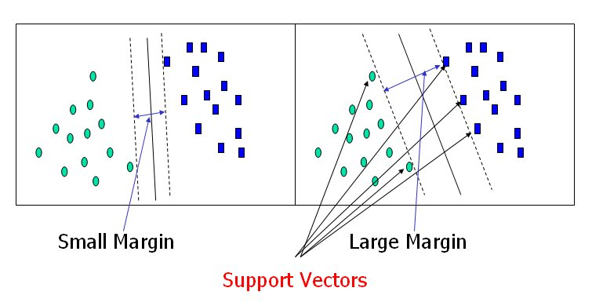
5.7.2 Support Vector Machines
Used for classification problems
Find the best decision boundary by finding the widest margin
Uses the ‘kernel trick’ to reduce the matrix size/dimensionality
Radial Basis Function Kernel to measure the similarity of inputs. Gaussian Kernel if you want a non-linear decision boundary
Notes:
Tha Gaussian can be normalized by defining a different family of probability distributions – e.g. two classes (which must sum to 1).

Slide 20
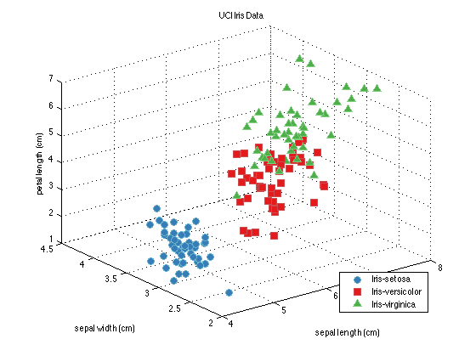
5.8 Unsupervised Algorithms
Roughly, the goal is to find the structure of the data – e.g. its probability density:
‘Structure’ ↔ ‘simpler’ representation
Sparce = many zero features
e.g. [ 1 0 0 0 0] if had 5 clusters
Dimensionality reduction
Statistically independent features
(disentangling)
Notes:
Sophie, my only request is that we make sure we don't over-run.
Chapter 5 is over 60 pages, so how would you like it if, say,
- you did p. 98-116 (up to 'No Free Lunch') and 131-145 (ML up to 'Unsupervised')
- I did 116-131 and 145-164.
... and we each selected where to spend most time according to our marvelous intuition of what the group would most appreciate? I don't think we'll be able to cover everything in detail.

Slide 21
PCA
Data points originally described by N dimensional vectors x_{i} .
So find direction in N dimensional space that maximizes variance along said direction → 1st PC eigenvector → 1st PC scores z_{i}⁽¹⁾
Project the data onto N-1 dim space orthogonal to EV1 → linearly independent subspace → (linear) disentangling.
Repeat → 2nd, 3rd etc. EVs & PCSs.
Orthogonality → proportion of total variance captured simply adds up linearly.
So stop when ‘satisfactory’ amount of variance captured → Dimensionality reduction.
In term of linear algebra, all the above is satisfied if z = x^{T}W
with W derived from the SVD of X, i.e. X = UΣW^{T}
Notes:
Sophie, my only request is that we make sure we don't over-run.
Chapter 5 is over 60 pages, so how would you like it if, say,
- you did p. 98-116 (up to 'No Free Lunch') and 131-145 (ML up to 'Unsupervised')
- I did 116-131 and 145-164.
... and we each selected where to spend most time according to our marvelous intuition of what the group would most appreciate? I don't think we'll be able to cover everything in detail.

Slide 22
Clustering
[1 0 0 ]
Loses all dimensional information
Does not, in general,
‘carve nature at its joints’
Notes:
Sophie, my only request is that we make sure we don't over-run.
Chapter 5 is over 60 pages, so how would you like it if, say,
- you did p. 98-116 (up to 'No Free Lunch') and 131-145 (ML up to 'Unsupervised')
- I did 116-131 and 145-164.
... and we each selected where to spend most time according to our marvelous intuition of what the group would most appreciate? I don't think we'll be able to cover everything in detail.

Slide 23
5.9 Stochastic Gradient Descent (SGD)
The cost function is a function of all data points: N – dimentional !
So is its gradient, which we use e.g. as per
So for each step just use an approximate g, estimated over a minibatch of datapoints n << N uniformly drawn from all
(‘… will converge to best possible test error before sampling every datapoint ... ’)
Notes:
Sophie, my only request is that we make sure we don't over-run.
Chapter 5 is over 60 pages, so how would you like it if, say,
- you did p. 98-116 (up to 'No Free Lunch') and 131-145 (ML up to 'Unsupervised')
- I did 116-131 and 145-164.
... and we each selected where to spend most time according to our marvelous intuition of what the group would most appreciate? I don't think we'll be able to cover everything in detail.

Slide 24
5.10 The recipe
dataset
+ cost function +
+ optimization procedure
+ p_{model}(data)
Notes:
Sophie, my only request is that we make sure we don't over-run.
Chapter 5 is over 60 pages, so how would you like it if, say,
- you did p. 98-116 (up to 'No Free Lunch') and 131-145 (ML up to 'Unsupervised')
- I did 116-131 and 145-164.
... and we each selected where to spend most time according to our marvelous intuition of what the group would most appreciate? I don't think we'll be able to cover everything in detail.

Slide 25
Finally: 5.11 Challenges motivating deep learning
In traditional ML methods, the number of the training examples required is order-of the number of regions we want resolved (e.g. local kernels / curse of dimensionality)
Key insight 1: What if the data was produced by the composition of factors or features? → exponential advantage!
Key insight 2: The probability distribution of the features of ‘valid’ objects (e.g. images of faces) is very highly concentrated in the embedding space …
… and we can ‘move’ fairly smoothly from one object (e.g. face) to another : the manifold(s) hypothesis.
~~ Here endeth Part I of the Book ~~
Notes:
Sophie, my only request is that we make sure we don't over-run.
Chapter 5 is over 60 pages, so how would you like it if, say,
- you did p. 98-116 (up to 'No Free Lunch') and 131-145 (ML up to 'Unsupervised')
- I did 116-131 and 145-164.
... and we each selected where to spend most time according to our marvelous intuition of what the group would most appreciate? I don't think we'll be able to cover everything in detail.

Slide 26
Spare model slide
No machine learning algorithm can classify well previously unobserved data generated by an arbitrary generating distribution.
We thus need:
specific generating distributions
specific algorithms performing well with these.
Notes:
Sophie, my only request is that we make sure we don't over-run.
Chapter 5 is over 60 pages, so how would you like it if, say,
- you did p. 98-116 (up to 'No Free Lunch') and 131-145 (ML up to 'Unsupervised')
- I did 116-131 and 145-164.
... and we each selected where to spend most time according to our marvelous intuition of what the group would most appreciate? I don't think we'll be able to cover everything in detail.

