Slide 1
Deep Q Network
Mnih et al. 2015 NN
DLRG 8/9/16
Eleanor Loh + Dorothea Hammerer

Slide 2
Overview
DQN architecture
Network architecture
Experience replay
Separate networks for learning and action control (target-Q)
Walk-through implementation
DQN representations
Parallels & comparisons with human learning

Slide 3
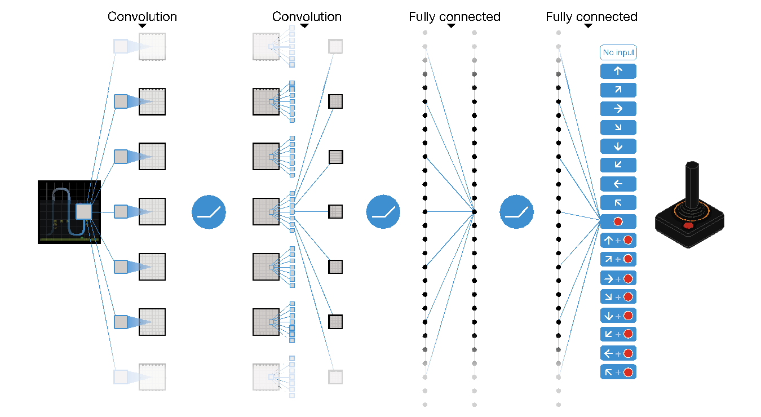
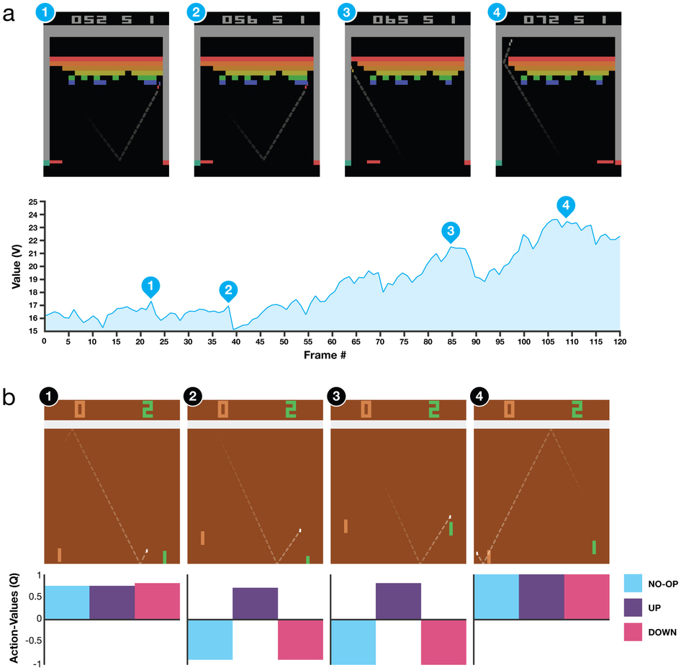
Network Architecture
Preprocessed ATARI frames Φ
Layer | N units | Type | Stride | Activation type
Hidden layer 1 | 32 | Convolutional 8x8 | 4 | Nonlinear rectifier
Hidden layer 2 | 64 | Convolutional 4x4 | 2 | Nonlinear rectifier
Hidden layer 3 | 64 | Convolutional 3x3 | 1 | Nonlinear rectifier
Hidden layer 4 | 512 | Fully connected |  | Rectifier units
Output layer | Single output for each valid action (n=4-8) | Fully connected
End to end
Select actions to maximise cumulative reward functions
Sensory processing vs decision making ??

Slide 4
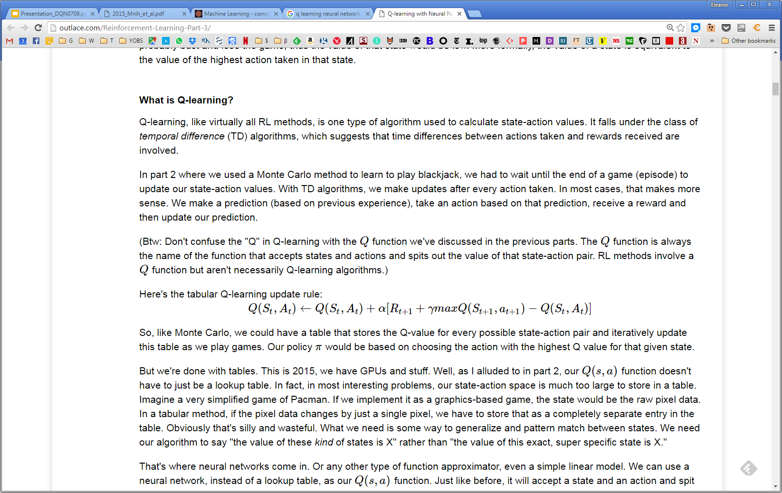
3 components: Learning network, Target network, Data store
Learning Network
Every 4th frame
Compiles minibatch and updates weights
Every 10K steps
Re-sets TN’s weights
Database of experiences
Stores experiences of game play
Target Network
Clone of LN
Controls action selection (every 4th frame)
Gets weights updated every 10K frames
Data store learns value of all possible actions in each state, not just the single chosen action (efficiency)
Learning network (whose weights are being adjusted using backprop) is not used to predict the value of future states, or control action
DQN is a neural network implementation of Q learning
Original Q value (before update)
Learning rate
Typical Q learning update
Experienced reward
Ɣ-discounted value of best possible action, in next state (= state that follows if you choose action a_{t} in state s_{t})

Slide 5
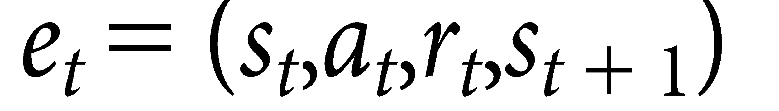
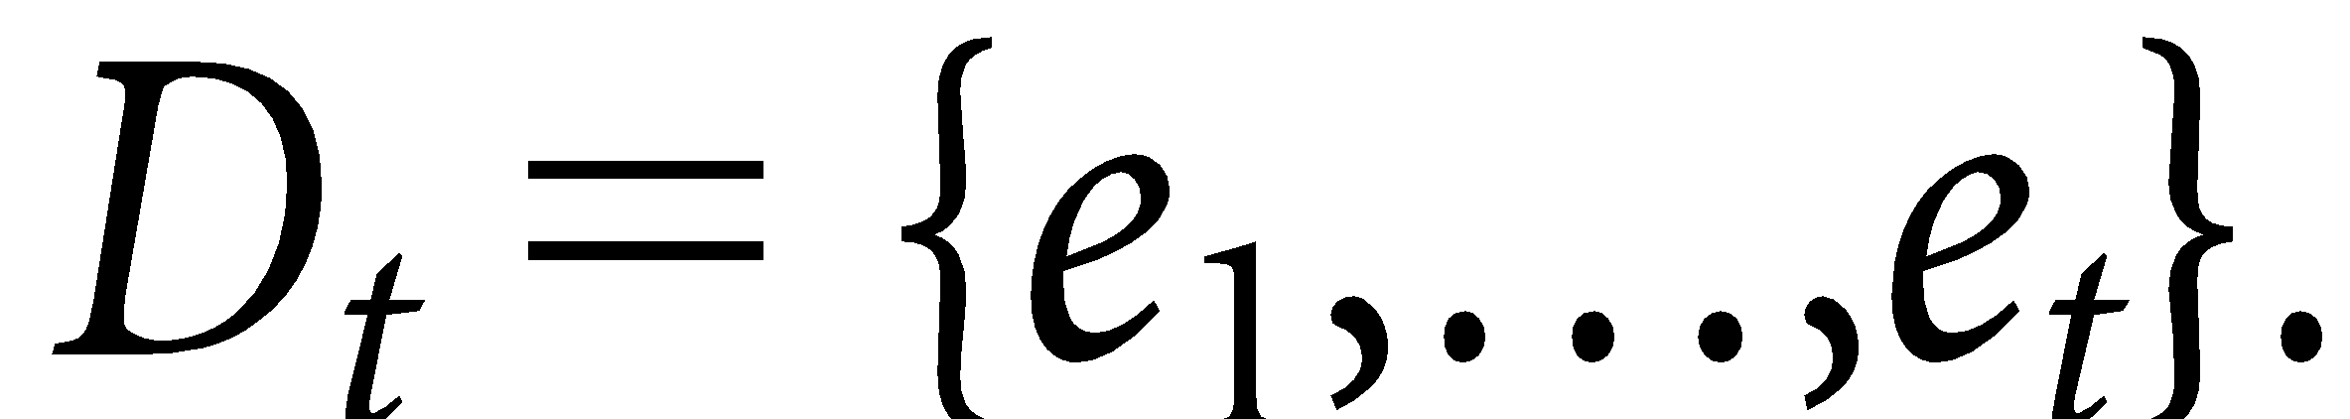
Experience Replay
Experiences stored for each time step t
For each learning (θ-updating) step/iteration, we sample a minibatch
32 experiences (SARS), sampled randomly + uniformly from the last 10⁶ frames

Slide 6
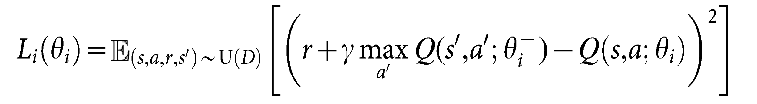
Cost function
Network parameters θ are fit via stochastic gradient descent
LN and TN are separated, in order to allow for decorrelation subsequent frame’s Q values
Learning network (whose weights are being adjusted using backprop) is not used to predict the value of future states
Learning rate
Original Q value (before update)
Typical Q learning update
Experienced reward
Ɣ-discounted value of best possible action, in next state (= state that follows if you choose action a_{t} in state s_{t})
Cost function for the neural network
What Learning Network thinks current state is worth
i = iteration of updating θ
Target network uses parameters θ¯, from previous learning iteration
Learning network uses parameters θ, which are being adjusted via this cost function
Current reward/score
What the Target Network thinks the next state is worth (i.e. value of best available action in next state), Ɣ-discounted
Notes:
- How many random memory updatings (32?)
Hm, why unstable or diverging?
What is the s’?? Sequence of actions and observations, a’ are inherent actions

Slide 7
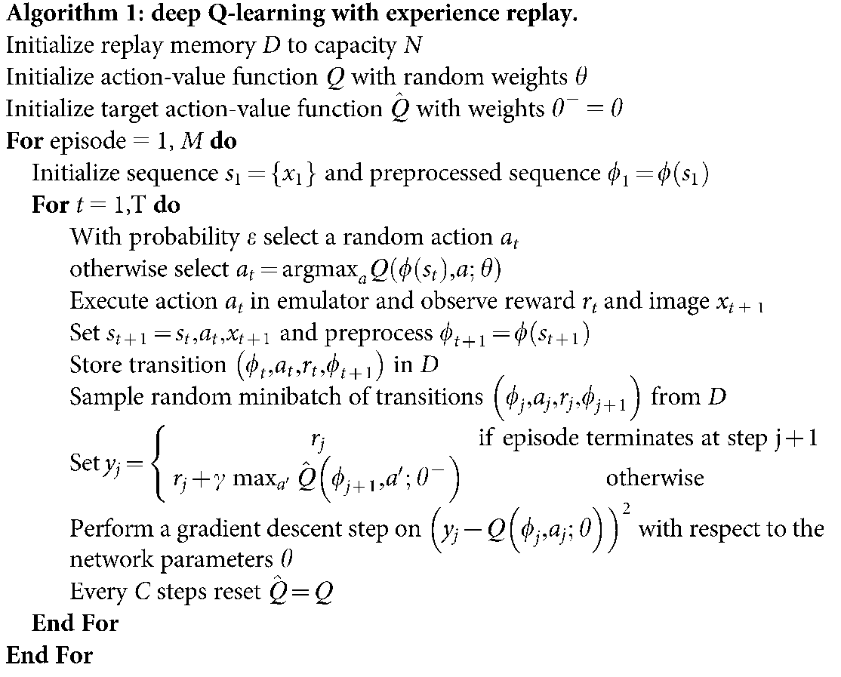
Implementation
Action selection + experience outcome
Storing experience for replay
Update network weights
Update target network (let learning take over action control)
N = 1Million
Initialize 2 networks (Learning and target network (LN, TN))
M = Lifes in game
t = trial in training network
For a long time, just choose more or less randomly (1Mill. trials until .1)
Store experience for replay
Experience replay (32 memories from 1Million)
Determine action of max val. with TN
calculate loss function
Update parameters in LN
Clone LN to new TN every 10K trials

Slide 8
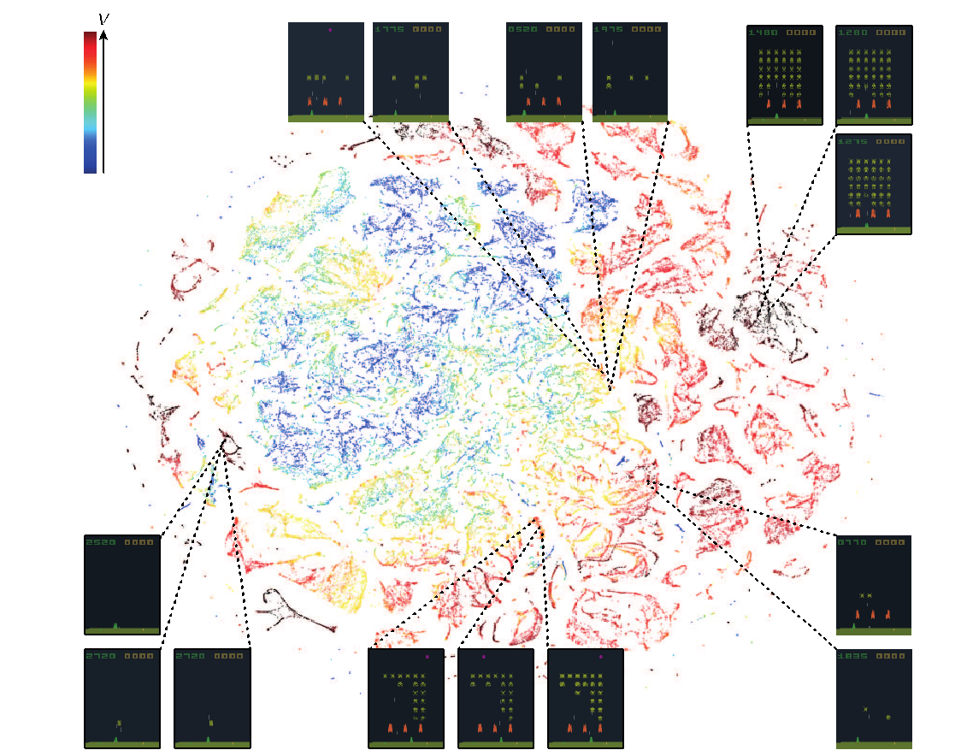
Representational similarity in last hidden layer (values of actions) and related game states
Notes:
T-distributed stochastic neighbour embedding
Hm, first assess similarity of two points based on their dimensions, then compares this to learned map that reflects siilarities, based on KLD????
Not nly perceptually similar states clustered in last layer, also those that appear to be more similar in value?

Slide 9
Comparison with human learning
Potential modifications
Weighting past experiences by saliency
Modulating importance of rewards independent of reward size
relative importance of losses
relative evaluation of outcomes based on how they compare to previous outcomes (losing or winning streaks)
Mimicking suboptimal behaviour
random choices
length of choice history
Relation to brain areas
would the action-value layer be similar to representations in PFC?
benefit of separation of value representation from action selection?
is similarity of representations similarly problematic? (RepSuppr)

Slide 10
To adapt to our RFL tasks:
Structure:
X input units
Usually quite simple inputs (2 options, differing on 2-3 parameters)
Link input to action output via hidden layers
X output units (all possible actions)
Learning:
do action a (best action determined over batch of memory samples)
get reward r,
backpropagate reward to alter network weights

Slide 11
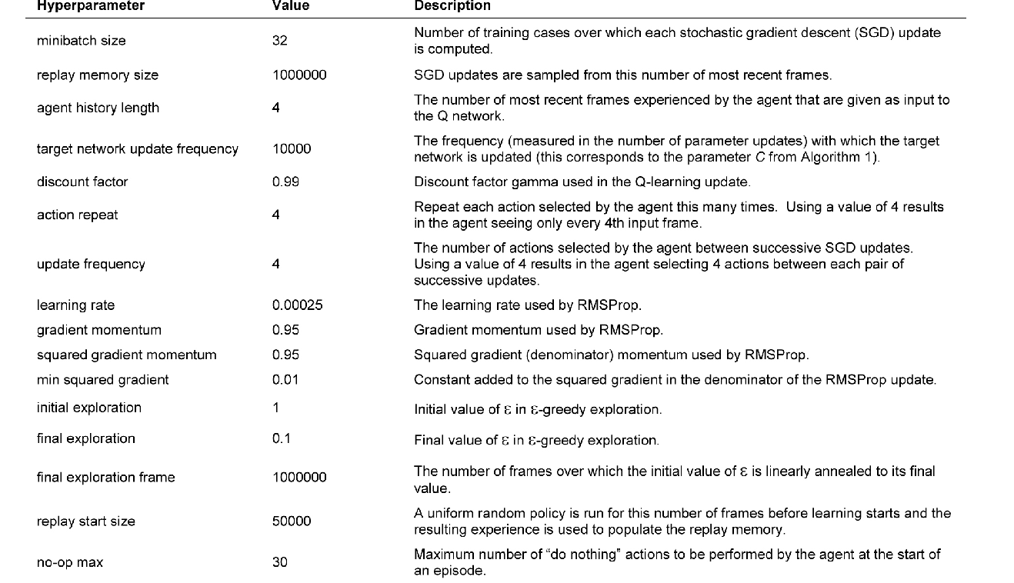
Details

