Slide 1
Hacking Filr 2 with Python and the REST API
David Shepherd
2 November 2015

Slide 2
Hacking Filr 2
Hacking is meant in the kindest of senses
No Filr 2 system was harmed in the production of the this session !
The code discussed here should be considered ALPHA at this stage and only deployed after extensive testing.
See point 1.
Everything you see here is part of a larger experiment. The Filr API is part of the solution but this is an effort to make that API manageable by more of our customers.

Slide 3
Agenda
What is REST?
Filr and the REST API.
Introducing filr.py :The use of Python to wrap the REST API
Installing Filr.py : What are the dependencies
Key File Operations: Create,delete,upload and download.
Key Admin Operations: NetFolder Management.
Introducing pyclient: A portable Filr Client for the Raspberry PI (and other platforms).

Slide 4
The Virtual Machines
OES11FMS.utopia.novell.com (172.17.2.180)
OES Server,DNS, LDAP. Admin is cn=admin,o=system,pw=n0v3ll
FILRUTP.utopia.novell.com (172.17.2.79) admin,n0v3ll
WIN7 Desktop (DHCP) admin,n0v3ll

Slide 5
What is REST?

Slide 6
What is REST ?
Representational state transfer (REST) is an abstraction of the architecture of the World Wide Web; more precisely, REST is an architectural style consisting of a coordinated set of architectural constraints applied to components, connectors, and data elements, within a distributed hypermedia system. REST ignores the details of component implementation and protocol syntax in order to focus on the roles of components, the constraints upon their interaction with other components, and their interpretation of significant data elements. (Wikipedia 29/09/2014)

Slide 7
And that roughly translates to…
REST is based around HTTP operations and URLs:
Post : Submits information to the API
Get: Retrieves Information from the API
Delete: Remove information from the API
REST is a mechanism for interacting with an applications API.
REST is application agnostic
Each application can use rest as a presentation layer for its API.
REST is language agnostic
Many languages and commands can interact with applications that implement a REST API including Python, Perl, Ruby, Bash,Curl etc.

Slide 8
Filr and the REST API

Slide 9
Filr and the REST API
All key Filr functionality is presented as extensions to the following URL: https://filr.xx.xx/rest
All files, folders, and users in Filr have an id number.
By issuing http requests data can be submitted to filr and also data can be retrieved.
Admin operations such as the creation of netfolders and netfolder servers can be automated.

Slide 10
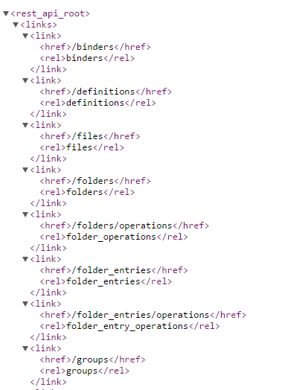
Filr and the REST api…

Slide 11
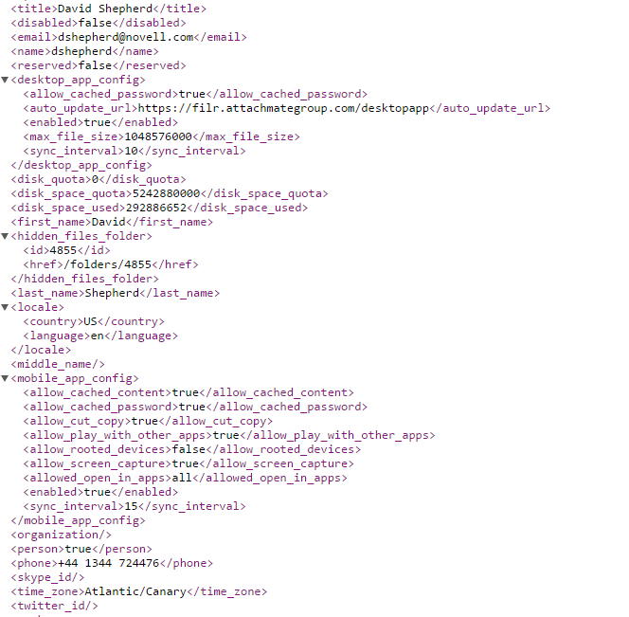
A Simple Example
https://filr.xx.xx/rest/self : Returns information about the currently logged in user.

Slide 12
REST Challenges
REST just provides the pipework to send and receive data.
In this case REST just returns a “blob” of data.
It does not process the results of the call.
This is left to the language or tools used by the initiator of the calls.
So something else is required….

Slide 13
Filr.py helper library dependencies
To install on Windows 7 or later…
Annaconda Python 2.7 64 Bit (https://www.continuum.io/downloads)
Setuptools is installed by default so that the following modules need to be installed via pip install module-name
urrlib3,requests_cache,python_webdav,paramiko,scp
_mysql needs special care. Needs C++ Runtime version 9 and then the .whl file can be downloaded from http://www.lfd.uci.edu/~gohlke/pythonlibs/#mysql-python.
Once the .whl file is download then installed with pip install name-of-file

Slide 14
A Simple Python Example (User.py)
import filr import os os.system("cls") pw=None srv="filr.novell.com" user="dshepherd" user,pw=filr.pw(srv,user,pw) #print user,pw s=filr.auth(user,pw) userinfo=filr.filrapi(srv,"self","","","",0,0,s) print userinfo["title"]

Slide 15
Demonstration

Slide 16
Explanation
The python code imports a python support library called filr.
Making use of “keyring” it uses the Windows Credential Manager to retrieve the Filr client credentials already stored by the Filr Client.
Using the requests library the code starts a persistent session to the filr server. Other calls within the program can make use of the same session handle and avoids the overhead of building a new connection.
Using the requests_cache library the rest responses can be cached on the local client when required.
The response to the REST call is parsed and just the information requested is extracted and displayed

Slide 17
Uploading a File to Filr Over REST
curl -k -u admin:admin -X POST -T image006.gif -H "Content-Type: image/gif" "https://blr8-117-57.labs.blr.novell.com:8443/rest/folders/113/library_files?file_name=image006.gif
Each file and folder in Filr has an id number. Curl is a linux command that lets you issue http requests. The command would let you upload a file called image006.gif. If needed an MD5 checksum can be used to verify the upload.
In this case the folder id is needed. Which is 113 in this case. This will be different unique for each folder.

Slide 18
How to find the folderid ?
Use the Filr Desktop Client
Add a file to synchronized folder
Examine the filr.log fil
C:\users\xxx\appdata\local\novell\filr\filr,log
Look for lines like:
2014-09-30 22:10:34,061 [file-event-processor] [INFO] Completed request for /folders/175043/library_children?count=500&allow_jits=false&first=0 REST resource (GET) (aca.onprem.apiserver.restapi)
The bold number is the folder id for a folder.
There are other options to find the folderid including pyclient.

Slide 19
Uploading a File with REST and filr.py
import filr import os os.system("cls") srv="filr.novell.com" user="dshepherd" user,pw=filr.pw(srv,user,None) print user s=filr.auth(user,pw) folderid="175043" fname=raw_input("Enter Your File Name ?") name=filr.raw(fname) print "Path is "+name data,status=filr.upload(folderid,name,srv,"","",s)

Slide 20
Explanation of the code
The folder id is 17043. This equates to a folder under my home directory.
filr.raw() : Stops python from escaping windows paths
Filr.upload() : Deals with the rest request to upload the file and is responsible for building and taking down the session

Slide 21
Creation of Netfolder Servers and Netfolders Over Rest
Both operations can be scripted
The sample provided here is with python but the principle applies to any number of languages
Allows the easy creation of large numbers of netfolders, and netfolder servers.
Potentially the existing netfolders and netfolder servers could be exported to a file and the file used to recreate them. (futures)
Needs to run as the admin user.

Slide 22
Creation of Netfolders, and Netfolder Servers
import filr import os os.system("cls") srv="filr.novell.com" user=admin user,pw=filr.pw(srv,user,None) print user s=filr.auth(user,pw) Srvunc=filr.raw(“\\192.168.10.220\test”) Status=filr.crnfs("testsrv","oes",srvunc,"nmas","cn=admin,o=home","excalibur1","filr.dyndns-free.com",user,pw,s) rights=["allusers","group","ACCESS","true","false","true","false"] status=filr.crnf("testsrv","nf3","temp","filr.dyndns-free.com",rights,user,pw,s)

Slide 23
Demonstration

Slide 24
Explanation of the Code
Srvunc holds a string that holds the UNC path of the netfolder server.
The following routines are used from filr.py:
Filr.crnfs: Creates the Netfolder Server.
Filr.crnf: Creates the Netfolder
Rights: Are defined in the rights list variable.
Very simple example that could be adapted in many different ways.

Slide 25
Summary

Slide 26
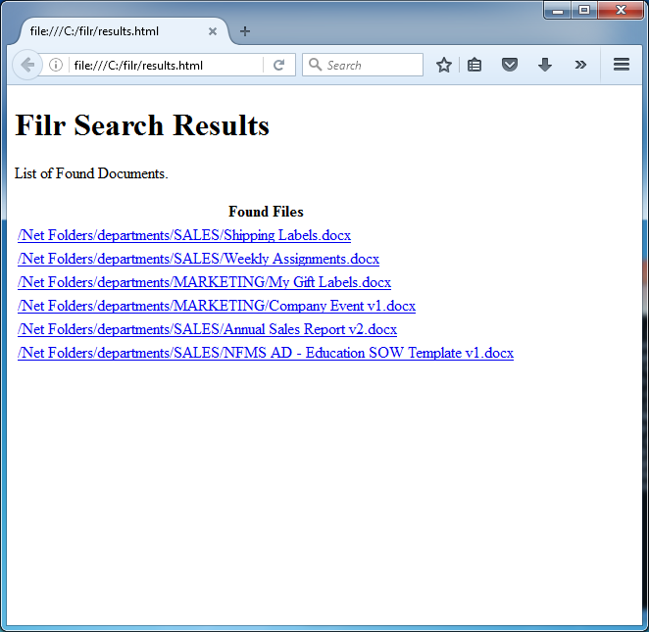
The REST API and Search
The search engine of Filr can be exposed.
Simple example show in search.py
Could be integrated in to a web page as a Quickfinder replacement.

Slide 27
Database Backup from the Command-line (MYSQL)
Dbback.py
Will allow the dump of a live database to a folder on the filr server. This file is then compressed and uses scp to move the file back to the system that called the the script.
Uses a python library called PARAMIKO to use ssh to fire a command to a remote machine and to look at the result.

Slide 28
Database Backup
import os import filr temp=filr.dbback("filrutp.utopia.novell.com","filrutp.utopia.novell.com","filr","n0v3ll","n0v3ll","/root","back.data","c:\\temp")
Will create a database dump for filr and zip the contents and then scp the contents from the server to a named location on the box the command is running on.

Slide 29
Filr and the REST api
Many powerful options available
Much more than has been discussed here including, upload,download, creation and deletion of folders, ldap user sync, netfolder sync and much much more.
The API is planned to be fully documented as part of Filr 2.0
Filr.py is a “helper” library to provide a glue layer (Not currently part of the product)
Can insulate applications from changes to the underlying REST API
Can provide session persistence and caching of rest requests so that the load on filr is reduced and the applications that use this functionality can be simpler.
Python can run on many platforms that are not all supported natively by python and the library can be easily ported to “most” implementations of python 2.6 or later that supports the request and the request_cache library

Slide 30
Introducing PyClient

Slide 31
PyClient
A python based Filr Client that is driven from the command line. This is based on the functionality provided by filr.py.
Portability: Has been tested on SLES,Windows and the Raspberry PI. It takes less than an hour to move to a new platform.
Gives functionality to non-filr platforms to submit and share files with Filr.
Would allow backend applications to submit their report directly to Filr and to share them with users on the Filr System
All commands can be submitted as scripts and be processed by PyClient..

Slide 32
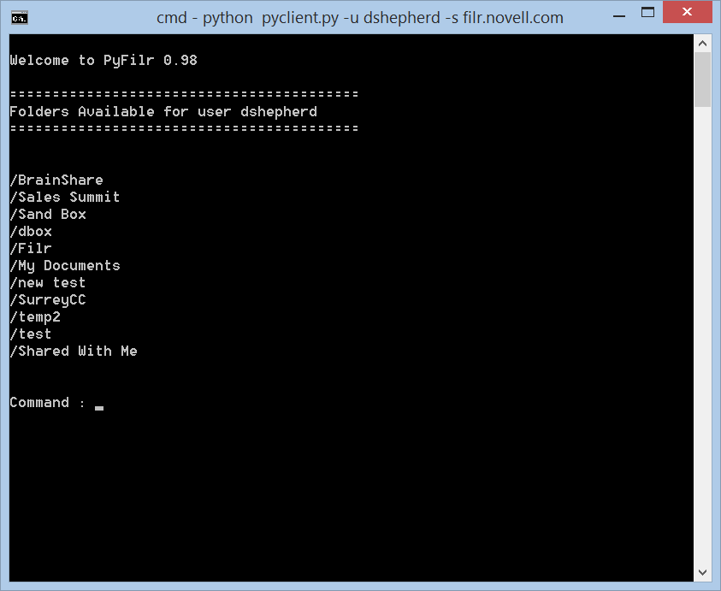
PyClient

Slide 33
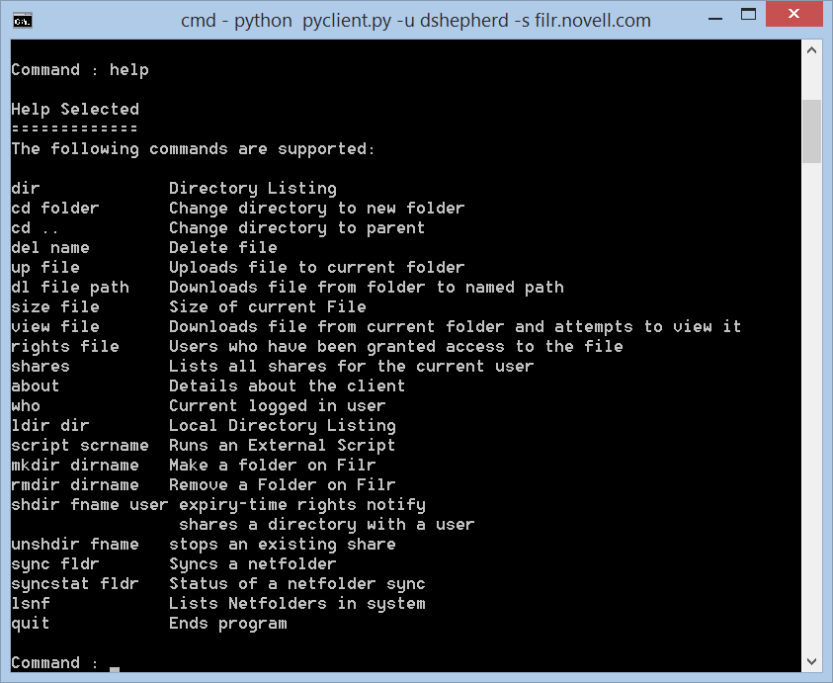
Many but not all commands supported

Slide 34
Demonstration

Slide 35
Why ?
Python is portable
Multiple platforms can be supported
The Internet of Thing gains a method to read and write files to filr
Give a means to make Filr more retentive to a customer
Gives a layer of insulation from the api. So changes to the api just mean the library being rewritten not the app.

Slide 36
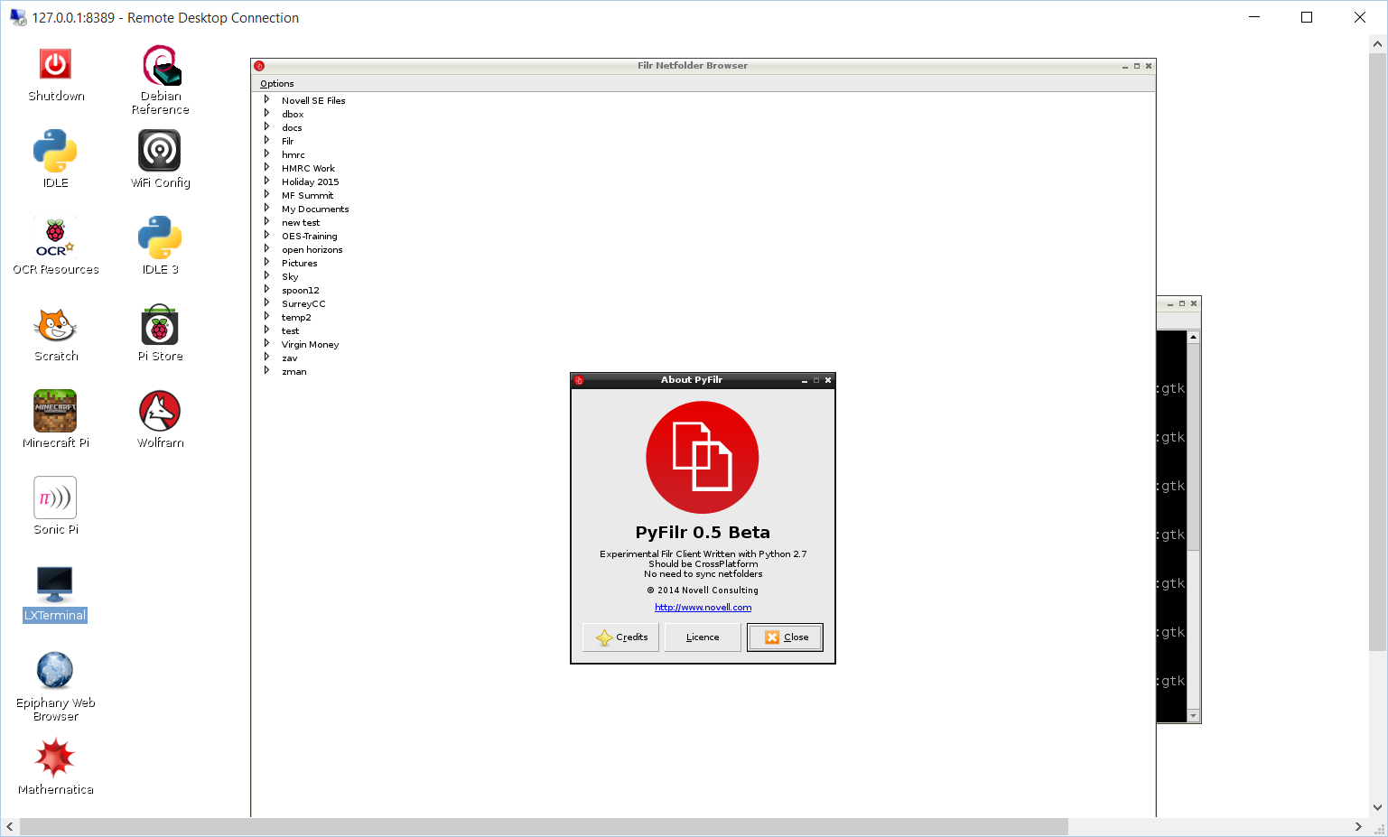
Using the Library On Other Linux Platforms

Slide 37
Future Developments
Biggest single issue with Filr over OneDrive
Filr is not installed by default on Windows
Filr Protocol Gateway
A method to abstract filr with another protocol
SSHD – Allow native putty access to Filr.
IMAP – Any email client becomes a Filr client
Simple example. Nothing to do with engineering so far ….

Slide 38
Future Developments – Pyclient
Admin automation tool
Ability to import and export nf and netfolders
Ability to cron reports that can run and produce pdf files.

Slide 39
Is This Useful ?
What would you like to see
The python helper library is not part of the product
Does it need to be ?
How can it be distributed or supported ?
Any additional functions to include.
Would there be any interest in PyClient as a separate executable with the library embedded. Python supports compiling as an .exe for windows.
Now is the time to ask any other questions ?

Slide 40

Anything else you would like to see ?

Slide 41
Many thanks for listening
David Shepherd
3/04/2016

