Slide 1
Mathematical Theorem Models
Goals:
Determine the most common words in Math Theorems
Find the most similar fields in Mathematics
Build a predictive model to determine the field given words

Slide 2
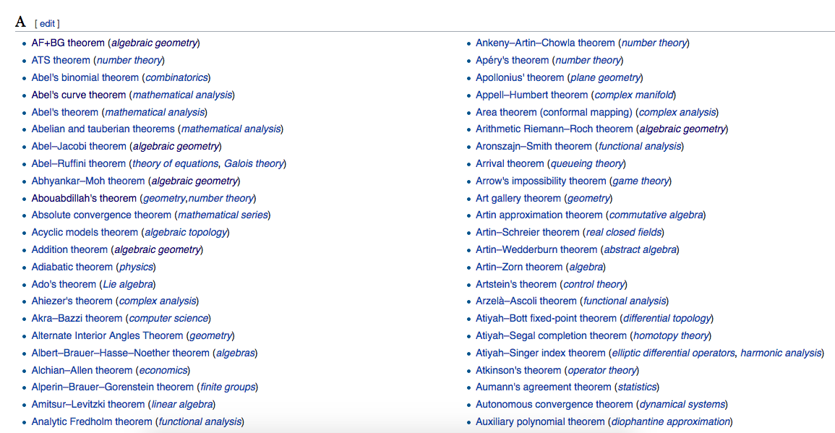
Wikipedia Page

Slide 3
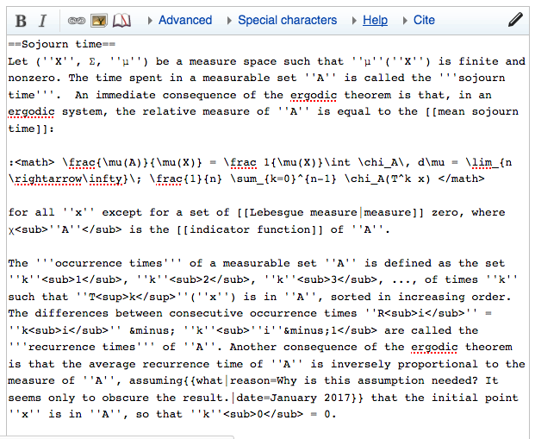
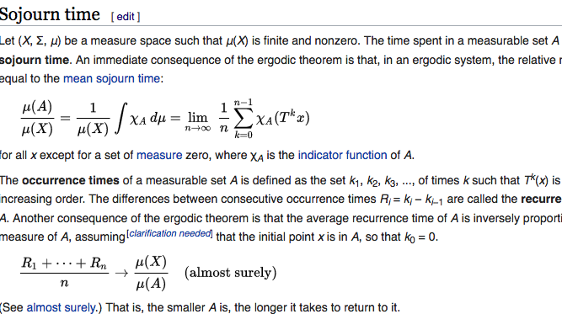


Text Example

Slide 4
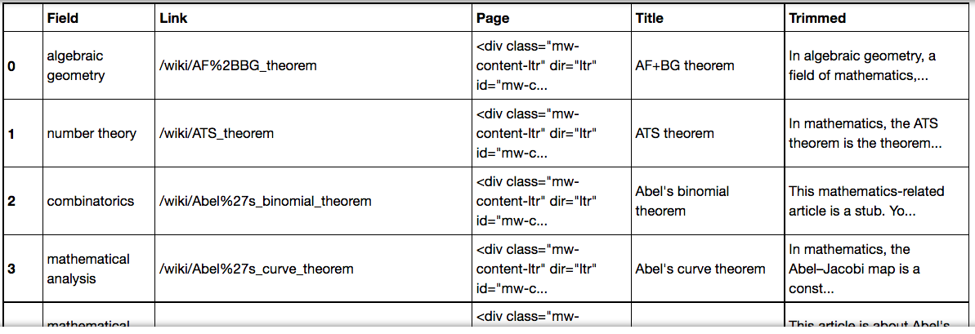
Data Frame

Slide 5
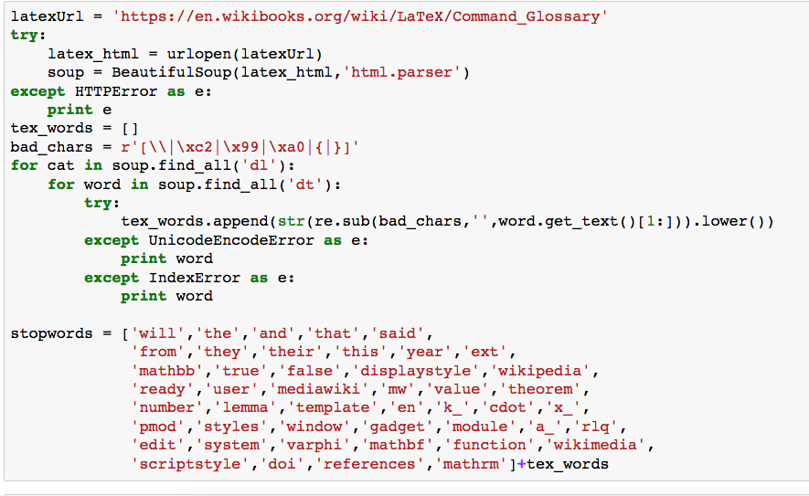

Slide 6
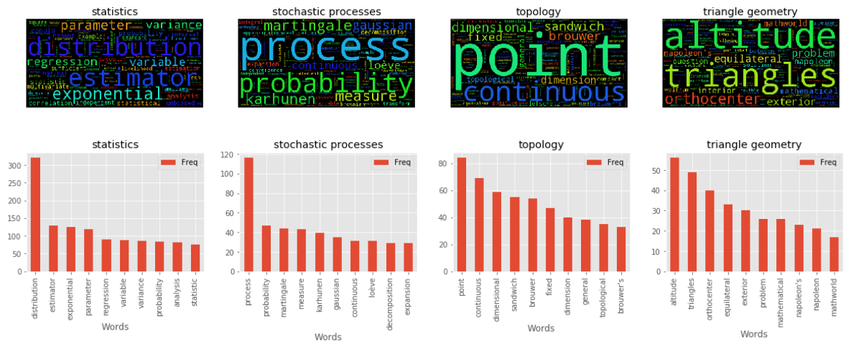
Most Common Words per Field

Slide 7
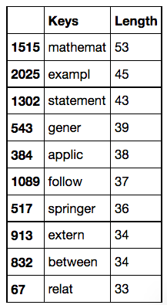
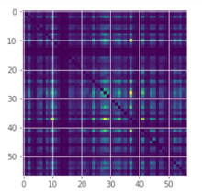
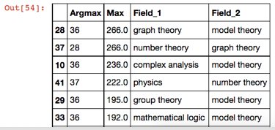
Most Common Words
Similarity Matrix
Most Similar Fields

Slide 8
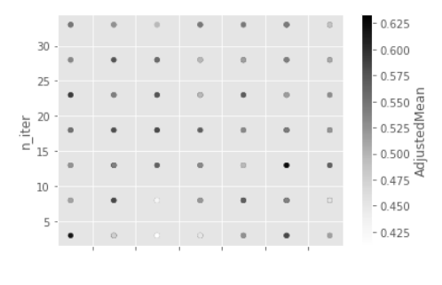
Predictive Models with Bag of Words

Slide 9
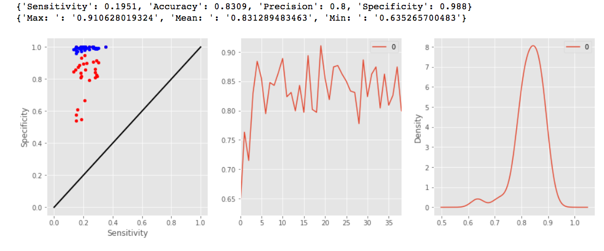
Multinomial Naïve Bayes (Top Words)

Slide 10
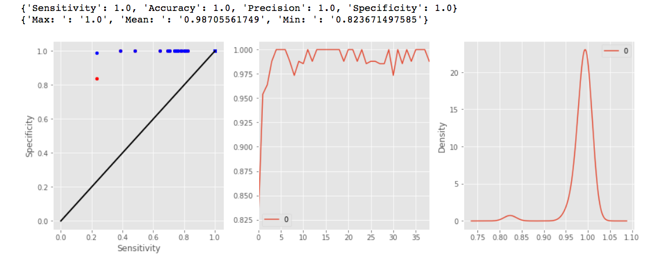
Support Vector Machine (Top Words)

