Slide 1

Math 495 Micro-Teaching
JOINT DENSITY OF
RANDOM VARIABLES
David Sherman
Bedrock, USA

Slide 2

In this presentation, we’ll discuss the joint density of two random variables. This is a mathematical tool for representing the interdependence of two events.
First, we need some random variables.
Lots of those in Bedrock.

Slide 3

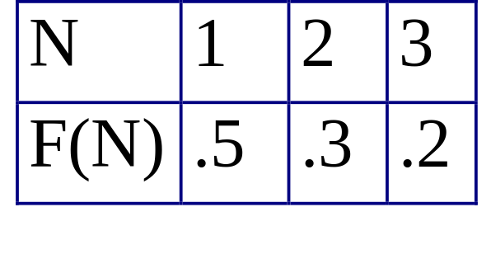
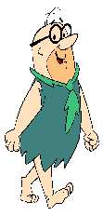
Let X be the number of days Fred Flintstone is late to work in a given week. Then X is a random variable; here is its density function:
Amazingly, another resident of Bedrock is late with exactly the same distribution. It’s...
Fred’s boss, Mr. Slate!

Slide 4
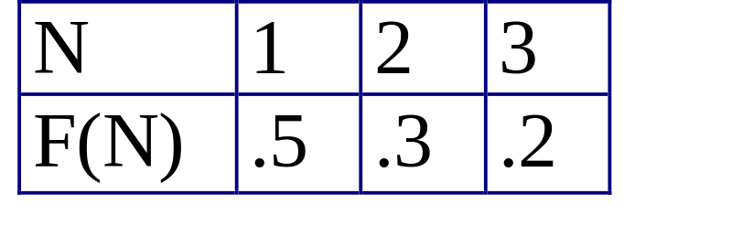
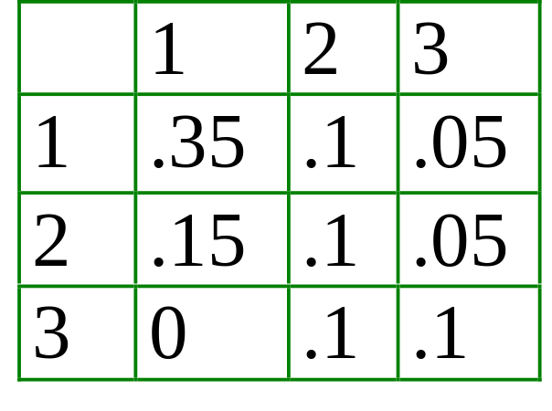
Remember this means that P(X=3) = .2.
Let Y be the number of days when Slate is late. Suppose we want to record BOTH X and Y for a given week. How likely are different pairs?
We’re talking about the joint density of X and Y, and we record this information as a function of two variables, like this:
This means that
P(X=3 and Y=2) = .05.
We label it f(3,2).

Slide 5
The first observation to make is that this joint probability function contains all the information from the density functions for X and Y (which are the same here).
For example, to recover P(X=3), we can add f(3,1)+f(3,2)+f(3,3).
The individual probability functions recovered in this way are called marginal.
.2
Another observation here is that Slate is never late three days in a week when Fred is only late once.

Slide 6

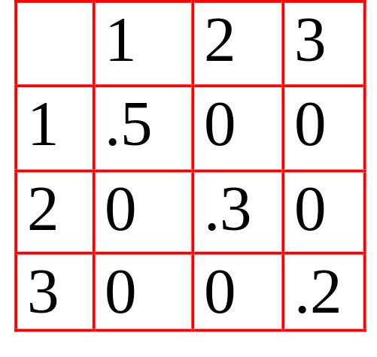
Since he rides to work with Fred (at least until the directing career works out), Barney Rubble is late to work with the same probability function too. What do you think the joint probability function for Fred and Barney looks like?
It’s diagonal!
This should make sense, since in any week Fred and Barney are late the same number of days.
This is, in some sense, a maximum amount of interaction: if you know one, you know the other.

Slide 7

A little-known fact: there is actually another famous person who is late to work like this.
SPOCK!
(Pretty embarrassing for a Vulcan.)
Before you try to guess what the joint density function for Fred and Spock is, remember that Spock lives millions of miles (and years) from Fred, so we wouldn’t expect these variables to influence each other at all.
In fact, they’re independent….

Slide 8
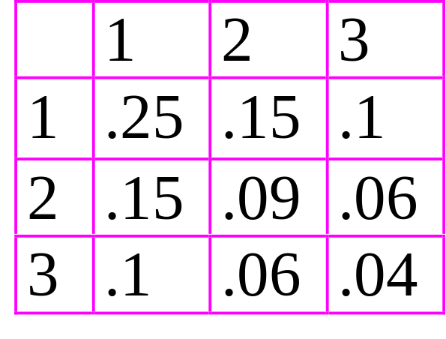
Since we know the variables X and Z (for Spock) are independent, we can calculate each of the joint probabilities by multiplying.
For example, f(2,3) = P(X=2 and Z=3)
= P(X=2)P(Z=3) = (.3)(.2) = .06.
This represents a minimal amount of interaction.

Slide 9

Dependence of two events means that knowledge of one gives information about the other.
Now we’ve seen that the joint density of two variables is able to reveal that two events are independent ( and ), completely dependent ( and ), or somewhere in the middle ( and ).
Later in the course we will learn ways to quantify dependence. Stay tuned….
YABBA DABBA DOO!

