Slide 1
Static Analysis and Source Code Manipulation in TypeScript
David Sherret

Slide 2
Talk Summary
Abstract Syntax Trees (ASTs)
Static Analysis
Code Manipulation
Use Cases

Slide 3
Static Analysis Task - Requirements
Generate a report that prints the names of all the class declarations with an extends expression.
class Class1 {
}
interface Interface1 extends OtherInterface {
}
class Class2 extends Class1 {
}
class Class3 implements Interface1 {
}
class Class4 extends SomeMixin(Class1) {
}
class Class5 extends SomeMixin(Class1) implements Interface1 {
}

Slide 4
Static Analysis Task - Requirements
Generate a report that prints the names of all the class declarations with an extends expression.
class Class1 {
}
interface Interface1 extends OtherInterface {
}
class Class2 extends Class1 {
}
class Class3 implements Interface1 {
}
class Class4 extends SomeMixin(Class1) {
}
class Class5 extends SomeMixin(Class1) implements Interface1 {
}

Slide 5
Static Analysis Task - Requirements
Generate a report that prints the names of all the class declarations with an extends expression.
namespace MyNamespace {
export class MyNestedClass extends Class1 {
}
}
function myFunction() {
class MyNestedClassInFunction extends Class1 {
}
}
const classExpression = class ClassExpression extends Class1 { };

Slide 6
Source File Text
class MyClass extends OtherClass {
prop = 5;
}
function myFunction() {
}

Slide 7
Source File Text
class MyClass extends OtherClass {
prop = 5;
}
function myFunction() {
}

Slide 8
Source File Text
class MyClass extends OtherClass {
prop = 5;
}
function myFunction() {
}

Slide 9
Source File Text
class MyClass extends OtherClass {
prop = 5;
}
function myFunction() {
}

Slide 10
Source File Text
class MyClass extends OtherClass {
prop = 5;
}
function myFunction() {
}

Slide 11
Source File Text
class MyClass extends OtherClass {
prop = 5;
}
function myFunction() {
}

Slide 12
Source File Text
class /* comment */ MyClass extends OtherClass {
prop = 5;
}
function myFunction() {
}

Slide 13
Source File Text
/*
class MyClass extends OtherClass {
prop = 5;
}
function myFunction() {
}
*/

Slide 14
Source File Text
class
// some comment
MyClass
extends /**/OtherClass{prop =
5;}
function myFunction
() {}

Slide 15
Source File Text
AST
class MyClass
extends OtherClass {
prop = 5;
}
function myFunction() {
}
Source File
Parser
ClassDeclaration
Name: MyClass
Extends: OtherClass
FunctionDeclaration
Name: myFunction
PropertyDeclaration
Name: prop
Initializer: 5

Slide 16
TypeScript Compiler
tsc MyClass.ts
Parsing
Binding
Type Checking
Emitting

Slide 17
TypeScript Compiler API
import * as ts from "typescript";

Slide 18
TypeScript Compiler API
import * as ts from "typescript";
const sourceFile = ts.createSourceFile(
"MyClass.ts",
"class MyClass extends OtherClass {\n}",
ts.ScriptTarget.Latest,
true,
ts.ScriptKind.TS);

Slide 19
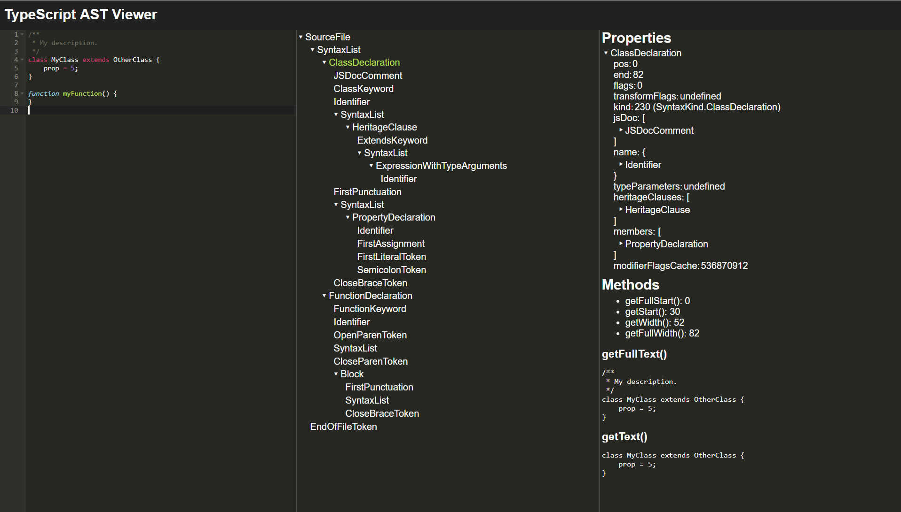
ts-ast-viewer.com

Slide 20
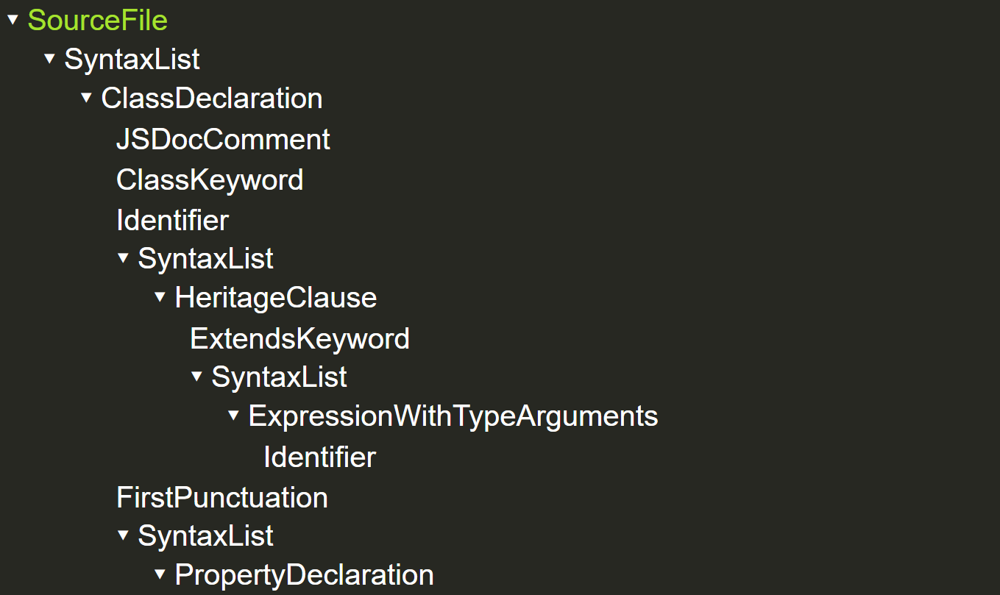

Slide 21
ts-ast-viewer.com

Slide 22
Static Analysis
Programmatically inspecting source files

Slide 23
Static Analysis Task - Requirements
Generate a report that prints the names of all the class declarations with an extends expression.

Slide 24
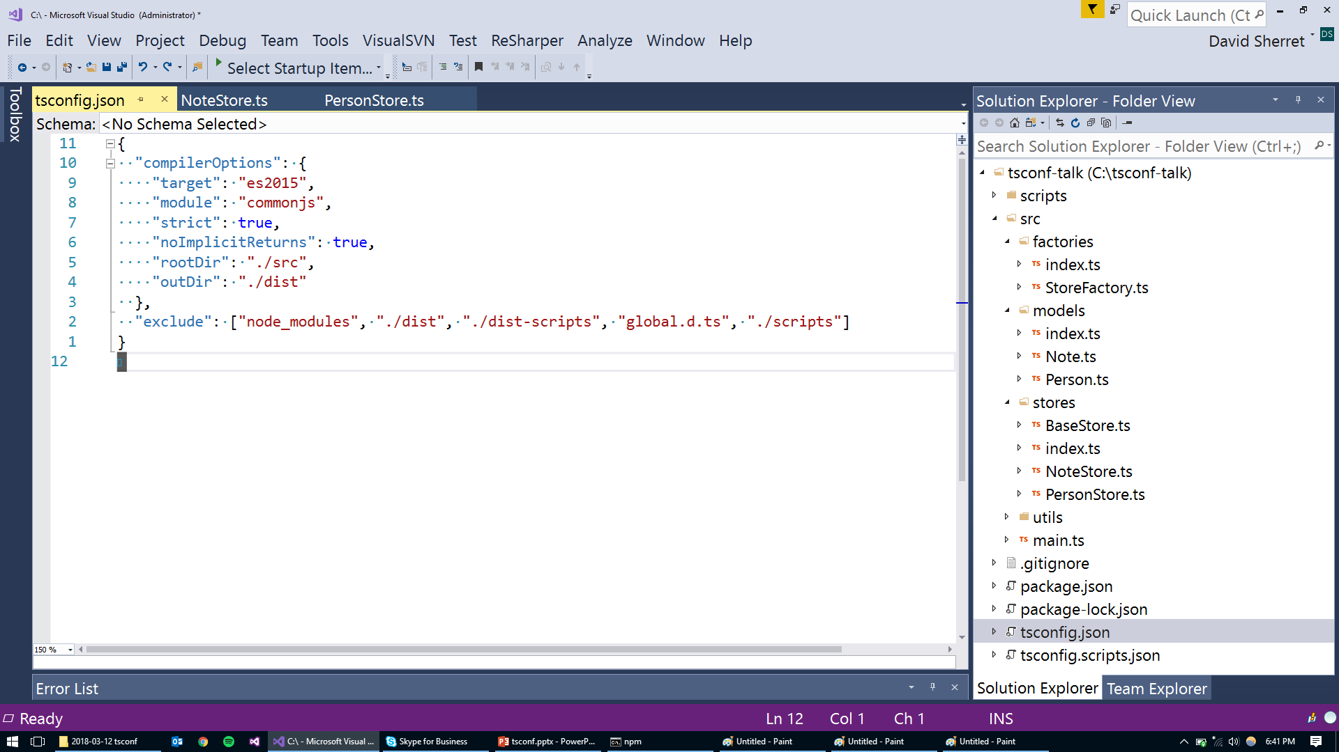

Slide 25
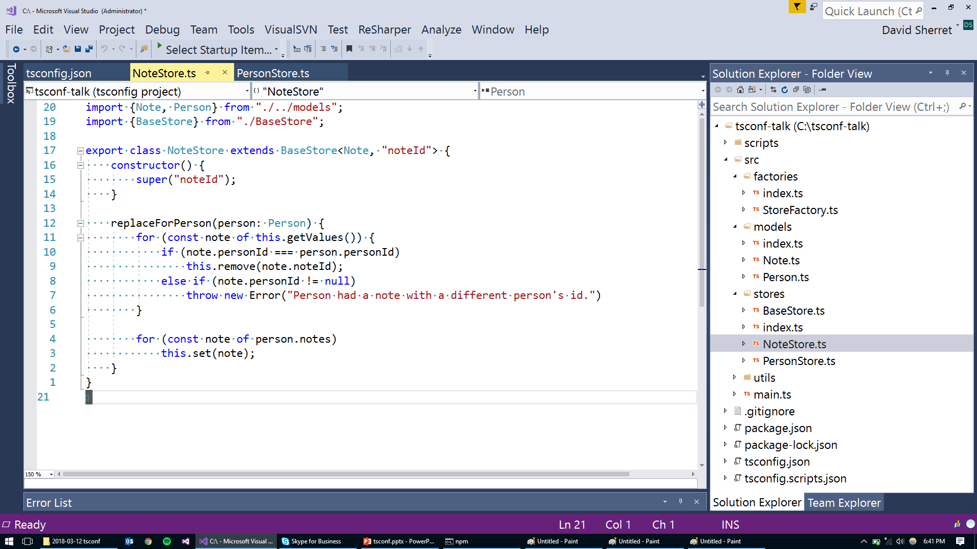

Slide 26
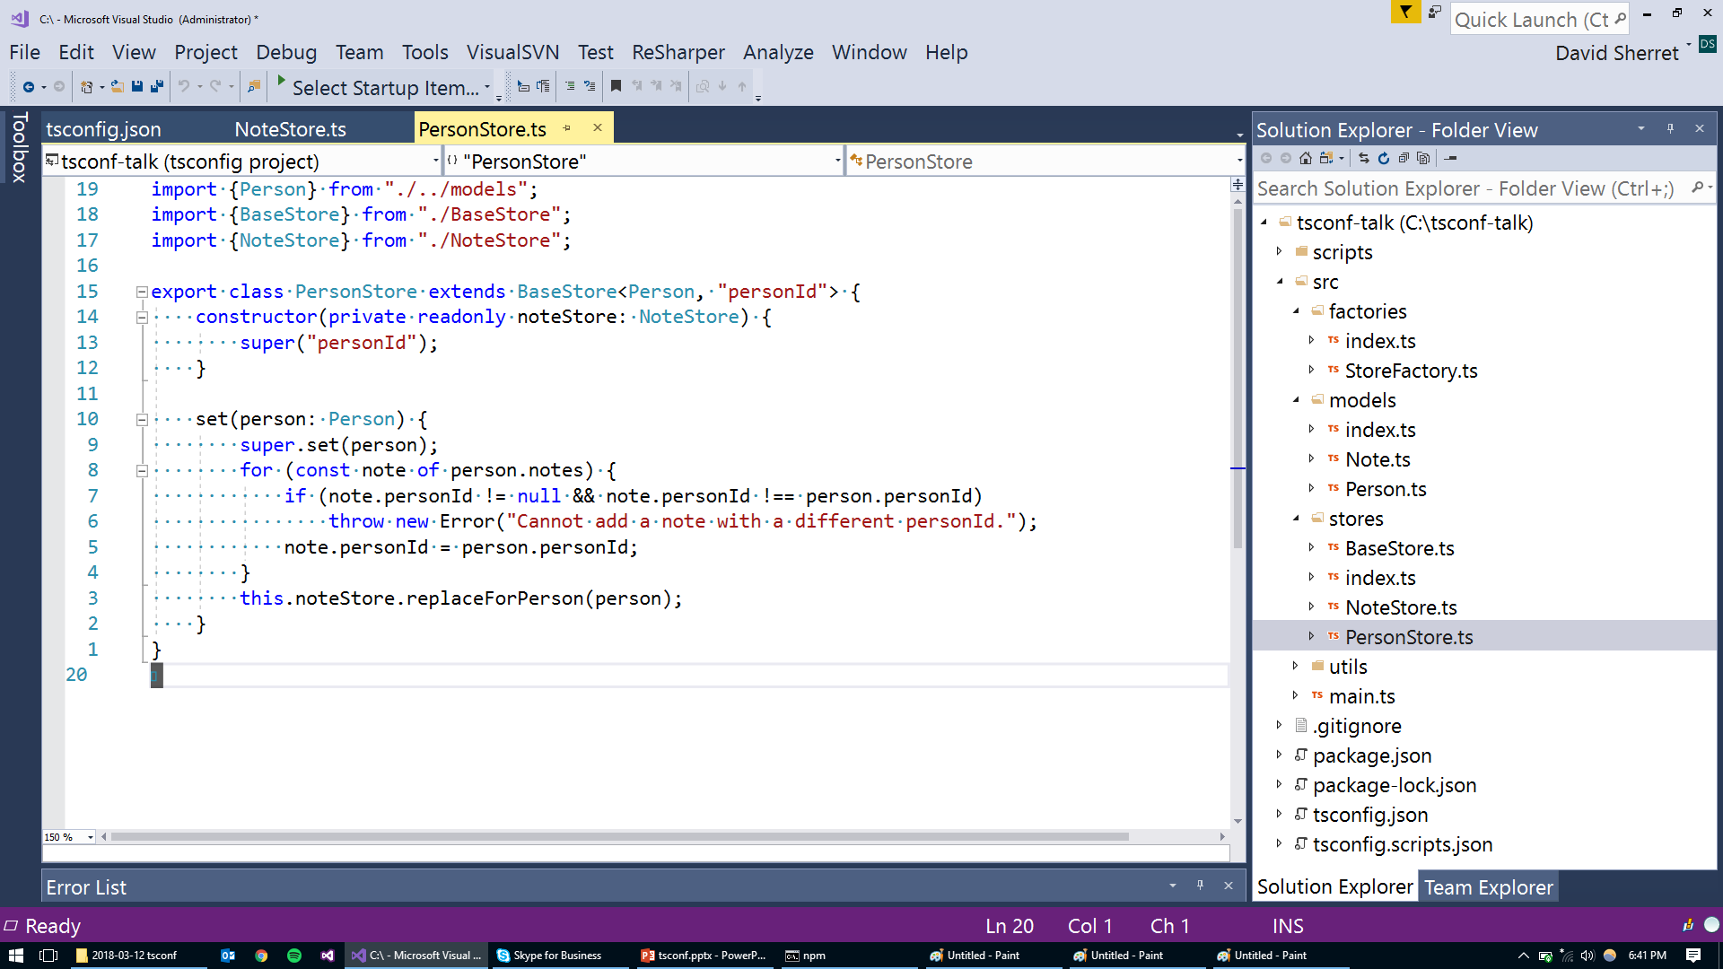

Slide 27
Static Analysis Task - Requirements
Generate a report that prints the names of all the class declarations with an extends expression.

Slide 28
ts-simple-ast
Wraps the TypeScript compiler API
Nodes, Symbols (Binding), Types
Program, Language Service, Type Checker, Emitter
Ability to fall back to the compiler API
Adds code manipulation
Edits text directly based on AST
npm install --save-dev ts-simple-ast

Slide 29
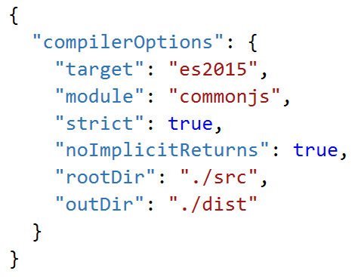
import Project from "ts-simple-ast";
// setup
const project = new Project({
tsConfigFilePath: "tsconfig.json"
});

Slide 30
import Project from "ts-simple-ast";
// setup
const project = new Project({
tsConfigFilePath: "tsconfig.json",
addFilesFromTsConfig: false
});

Slide 31
import Project from "ts-simple-ast";
// setup
const project = new Project({
tsConfigFilePath: "tsconfig.json"
});

Slide 32
import Project from "ts-simple-ast";
// setup
const project = new Project({
compilerOptions: {
}
});

Slide 33
import Project from "ts-simple-ast";
// setup
const project = new Project({
compilerOptions: {
allowJs: true
}
});
project.addExistingSourceFiles("src/**/*.js");

Slide 34
import Project from "ts-simple-ast";
// setup
const project = new Project({
tsConfigFilePath: "tsconfig.json"
});

Slide 35
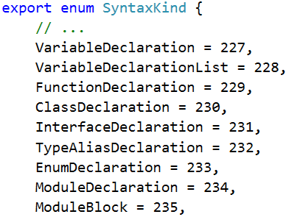
import Project, {SyntaxKind} from "ts-simple-ast";
// setup
const project = new Project({
tsConfigFilePath: "tsconfig.json"
});
// find and log
for (const sourceFile of project.getSourceFiles("src/**/*.ts")) {
for (const classDec of sourceFile.getDescendantsOfKind(SyntaxKind.ClassDeclaration)) {
if (classDec.getExtends() !== undefined)
console.log(`[${sourceFile.getFilePath()}]: ${classDec.getName()}`);
}
}

Slide 36
import Project, {SyntaxKind} from "ts-simple-ast";
// setup
const project = new Project({
tsConfigFilePath: "tsconfig.json"
});
// find and log
for (const sourceFile of project.getSourceFiles("src/**/*.ts")) {
for (const classDec of sourceFile.getDescendantsOfKind(SyntaxKind.ClassDeclaration)) {
if (classDec.getExtends() !== undefined)
console.log(`[${sourceFile.getFilePath()}]: ${classDec.getName()}`);
}
}

Slide 38
Static Analysis – Real Example
API Conformance: Finding methods that could have a corresponding “OrThrow” method.
const srcDirectory = project.getDirectory("src");
if (srcDirectory === undefined)
throw new Error("Could not find src directory.");

Slide 39

Static Analysis – Real Example
API Conformance: Finding methods that could have a corresponding “OrThrow” method.
const srcDirectory = project.getDirectory("src");
const srcDirectory = project.getDirectoryOrThrow("src");

Slide 40
// for each public class declaration in our source files...
for (const method of classDec.getInstanceMethods()) {
}

Slide 41
// for each public class declaration in our source files...
for (const method of classDec.getInstanceMethods()) {
if (method.getReturnType().isNullable()
&& classDec.getInstanceMethod(method.getName() + "OrThrow") === undefined)
{
console.warn(`Expected method ${classDec.getName()}.${method.getName()} ` +
`to have a corresponding OrThrow method.`);
}
}

Slide 42
// for each public class declaration in our source files...
for (const method of classDec.getInstanceMethods()) {
if (method.getReturnType().isNullable()
&& classDec.getInstanceMethod(method.getName() + "OrThrow") === undefined)
{
console.warn(`Expected method ${classDec.getName()}.${method.getName()} ` +
`to have a corresponding OrThrow method.`);
}
}

Slide 43
Code Manipulation
Programmatically manipulating source files

Slide 44
Code Manipulation Task
snake_case
PascalCase -> snake_case

Slide 45
Code Manipulation Task
Programmatic refactor – Changing coding standards
Requirements:
All class declaration names should be converted to snake_case
Ex. MyClass -> my_class
If the source file has an exported class declaration of the same name, then the source file name should be converted to snake case
Ex. MyClass.ts -> my_class.ts

Slide 46
import Project, {SyntaxKind} from "ts-simple-ast";
const project = new Project({ tsConfigFilePath: "tsconfig.json" });
for (const sourceFile of project.getSourceFiles("src/**/*.ts")) {
}

Slide 47
import Project, {SyntaxKind} from "ts-simple-ast";
const project = new Project({ tsConfigFilePath: "tsconfig.json" });
for (const sourceFile of project.getSourceFiles("src/**/*.ts")) {
// rename all class declaration names to snake case
for (const classDec of sourceFile.getDescendantsOfKind(SyntaxKind.ClassDeclaration)) {
}
}

Slide 48
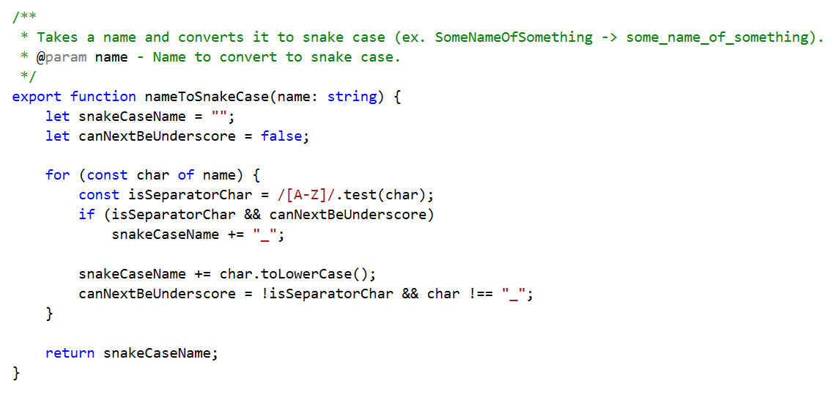
import Project, {SyntaxKind} from "ts-simple-ast";
import {nameToSnakeCase} from "./utils";
const project = new Project({ tsConfigFilePath: "tsconfig.json" });
for (const sourceFile of project.getSourceFiles("src/**/*.ts")) {
// rename all class declaration names to snake case
for (const classDec of sourceFile.getDescendantsOfKind(SyntaxKind.ClassDeclaration)) {
}
}

Slide 49
import Project, {SyntaxKind} from "ts-simple-ast";
import {nameToSnakeCase} from "./utils";
const project = new Project({ tsConfigFilePath: "tsconfig.json" });
for (const sourceFile of project.getSourceFiles("src/**/*.ts")) {
// rename all class declaration names to snake case
for (const classDec of sourceFile.getDescendantsOfKind(SyntaxKind.ClassDeclaration)) {
const snakeCaseName = nameToSnakeCase(classDec.getName());
classDec.rename(snakeCaseName);
}
}

Slide 50
import Project, {SyntaxKind} from "ts-simple-ast";
import {nameToSnakeCase} from "./utils";
const project = new Project({ tsConfigFilePath: "tsconfig.json" });
for (const sourceFile of project.getSourceFiles("src/**/*.ts")) {
// rename all class declaration names to snake case
for (const classDec of sourceFile.getDescendantsOfKind(SyntaxKind.ClassDeclaration)) {
const snakeCaseName = nameToSnakeCase(classDec.getName());
classDec.rename(snakeCaseName);
}
}

Slide 51
import Project, {SyntaxKind} from "ts-simple-ast";
import {nameToSnakeCase} from "./utils";
const project = new Project({ tsConfigFilePath: "tsconfig.json" });
for (const sourceFile of project.getSourceFiles("src/**/*.ts")) {
// rename all class declaration names to snake case
for (const classDec of sourceFile.getDescendantsOfKind(SyntaxKind.ClassDeclaration)) {
const snakeCaseName = nameToSnakeCase(classDec.getName());
classDec.rename(snakeCaseName);
}
// rename the source file if it contains an exported class with the same name
const baseNameAsSnakeCase = nameToSnakeCase(sourceFile.getBaseNameWithoutExtension());
const classSameName = sourceFile.getClass(baseNameAsSnakeCase);
if (classSameName !== undefined && classSameName.isExported())
sourceFile.move(baseNameAsSnakeCase + sourceFile.getExtension());
}

Slide 52
import Project, {SyntaxKind} from "ts-simple-ast";
import {nameToSnakeCase} from "./utils";
const project = new Project({ tsConfigFilePath: "tsconfig.json" });
for (const sourceFile of project.getSourceFiles("src/**/*.ts")) {
// rename all class declaration names to snake case
for (const classDec of sourceFile.getDescendantsOfKind(SyntaxKind.ClassDeclaration)) {
const snakeCaseName = nameToSnakeCase(classDec.getName());
classDec.rename(snakeCaseName);
}
// rename the source file if it contains an exported class with the same name
const baseNameAsSnakeCase = nameToSnakeCase(sourceFile.getBaseNameWithoutExtension());
const classSameName = sourceFile.getClass(baseNameAsSnakeCase);
if (classSameName !== undefined && classSameName.isExported())
sourceFile.move(baseNameAsSnakeCase + sourceFile.getExtension());
}
project.save();

Slide 54

Code Manipulation – Real Example
Manipulating declaration files.
const classDeclarations =
sourceFile.getDescendantsOfKind(SyntaxKind.ClassDeclaration);
getDescendantsOfKind(kind: SyntaxKind): Node<ts.Node>[];

Slide 55
Code Manipulation – Real Example
Manipulating declaration files.
const classDeclarations =
sourceFile.getDescendantsOfKind(SyntaxKind.ClassDeclaration)
as ClassDeclaration[];

Slide 56
Code Manipulation – Real Example
Manipulating declaration files.
const classDeclarations =
sourceFile.getDescendantsOfKind(SyntaxKind.ClassDeclaration);
const interfaceDeclarations =
sourceFile.getDescendantsOfKind(SyntaxKind.InterfaceDeclaration);

Slide 57
export declare class Node<NodeType extends ts.Node = ts.Node> {
// ...omitted...
/**
* Gets the descendants that match a specified syntax kind.
* @param kind - Kind to check.
*/
getDescendantsOfKind(kind: SyntaxKind): Node<ts.Node>[];
/**
* Gets the children that match a specified syntax kind.
* @param kind - Kind to check.
*/
getChildrenOfKind(kind: SyntaxKind): Node<ts.Node>[];
// ...omitted...
}

Slide 58
This note was added after the talk.
Don’t do this. As I mentioned in the talk and Anders confirmed, this can be represented with mapped types. After the talk, I ended up generating a mapped type and used that rather than having multiple overloads. My mapped type skills weren’t so great, but you get the idea—I had to automatically inspect the code to figure out how SyntaxKind related to Nodes and then this is now automatically maintained into the future.
export declare class Node<NodeType extends ts.Node = ts.Node> {
// ...omitted...
/**
* Gets the descendants that match a specified syntax kind.
* @param kind - Kind to check.
*/
getDescendantsOfKind(kind: SyntaxKind): Node<ts.Node>[];
/**
* Gets the descendants that match a specified syntax kind.
* @param kind - Kind to check.
*/
getDescendantsOfKind(kind: SyntaxKind.ClassDeclaration): ClassDeclaration[];
/**
* Gets the children that match a specified syntax kind.
* @param kind - Kind to check.
*/
getChildrenOfKind(kind: SyntaxKind): Node<ts.Node>[];
// ...omitted...
}

Slide 59
export declare class Node<NodeType extends ts.Node = ts.Node> {
// ...omitted...
/**
* Gets the descendants that match a specified syntax kind.
* @param kind - Kind to check.
*/
getDescendantsOfKind(kind: SyntaxKind): Node<ts.Node>[];
/**
* Gets the descendants that match a specified syntax kind.
* @param kind - Kind to check.
*/
getDescendantsOfKind(kind: SyntaxKind.ClassDeclaration): ClassDeclaration[];
/**
* Gets the descendants that match a specified syntax kind.
* @param kind - Kind to check.
*/
getDescendantsOfKind(kind: SyntaxKind.ArrowFunction): ArrowFunction[];
/**
* Gets the descendants that match a specified syntax kind.
* @param kind - Kind to check.
*/
getDescendantsOfKind(kind: SyntaxKind.AsExpression): AsExpression[];
/**
* Gets the descendants that match a specified syntax kind.
* @param kind - Kind to check.
*/
getDescendantsOfKind(kind: SyntaxKind.AwaitExpression): AwaitExpression[];
/**
* Gets the descendants that match a specified syntax kind.
* @param kind - Kind to check.
*/
getDescendantsOfKind(kind: SyntaxKind.BinaryExpression): BinaryExpression[];
/**
* Gets the descendants that match a specified syntax kind.
* @param kind - Kind to check.
*/
getDescendantsOfKind(kind: SyntaxKind.Block): Block[];
/**
* Gets the descendants that match a specified syntax kind.
* @param kind - Kind to check.
*/
getDescendantsOfKind(kind: SyntaxKind.BreakStatement): BreakStatement[];
// ...etc...
/**
* Gets the children that match a specified syntax kind.
* @param kind - Kind to check.
*/
getChildrenOfKind(kind: SyntaxKind): Node<ts.Node>[];
// ...omitted...
}

Slide 60
export declare class Node<NodeType extends ts.Node = ts.Node> {
// ...omitted...
/**
* Gets the descendants that match a specified syntax kind.
* @param kind - Kind to check.
*/
getDescendantsOfKind(kind: SyntaxKind): Node<ts.Node>[];
/**
* Gets the descendants that match a specified syntax kind.
* @param kind - Kind to check.
*/
getDescendantsOfKind(kind: SyntaxKind.ClassDeclaration): ClassDeclaration[];
/**
* Gets the descendants that match a specified syntax kind.
* @param kind - Kind to check.
*/
getDescendantsOfKind(kind: SyntaxKind.ArrowFunction): ArrowFunction[];
/**
* Gets the descendants that match a specified syntax kind.
* @param kind - Kind to check.
*/
getDescendantsOfKind(kind: SyntaxKind.AsExpression): AsExpression[];
/**
* Gets the descendants that match a specified syntax kind.
* @param kind - Kind to check.
*/
getDescendantsOfKind(kind: SyntaxKind.AwaitExpression): AwaitExpression[];
/**
* Gets the descendants that match a specified syntax kind.
* @param kind - Kind to check.
*/
getDescendantsOfKind(kind: SyntaxKind.BinaryExpression): BinaryExpression[];
/**
* Gets the descendants that match a specified syntax kind.
* @param kind - Kind to check.
*/
getDescendantsOfKind(kind: SyntaxKind.Block): Block[];
/**
* Gets the descendants that match a specified syntax kind.
* @param kind - Kind to check.
*/
getDescendantsOfKind(kind: SyntaxKind.BreakStatement): BreakStatement[];
// ...etc...
/**
* Gets the children that match a specified syntax kind.
* @param kind - Kind to check.
*/
getChildrenOfKind(kind: SyntaxKind): Node<ts.Node>[];
// ...omitted...
}

Slide 61
Use Cases
Existing and potential

Slide 62
Use Cases
Automated enforcement of…
Application specific rules
API conformance
Identifying API changes.
Additions
Breaking changes
Determining next semantic version

Slide 63
Use Cases
Programmatic refactors
Documentation compile errors
Identifying documentation gaps
Documentation generation from source code
Compodoc
Metrics on code complexity

Slide 64
Use Cases
Source code transformations between versions of a library.
Release a new version with transformations.
Convert AngularJS projects to Angular.
Source code transformations between JavaScript and TypeScript.
TypeWiz
react-javascript-to-typescript-transform

Slide 65


Slide 66
Use Cases
Automatically generating client-side code from server-side code
Manipulating TypeScript declaration files
Many more waiting to be discovered…

