Slide 1
Findings on topk activations

Slide 2
VITL16 Model results

Slide 3
ToDo
Further investigate fourier transform analysis
Find better error/noise measure
Investigate connection between topk value and quality of heatmap, as the plots suggest no linear trend with high volatility

Slide 4
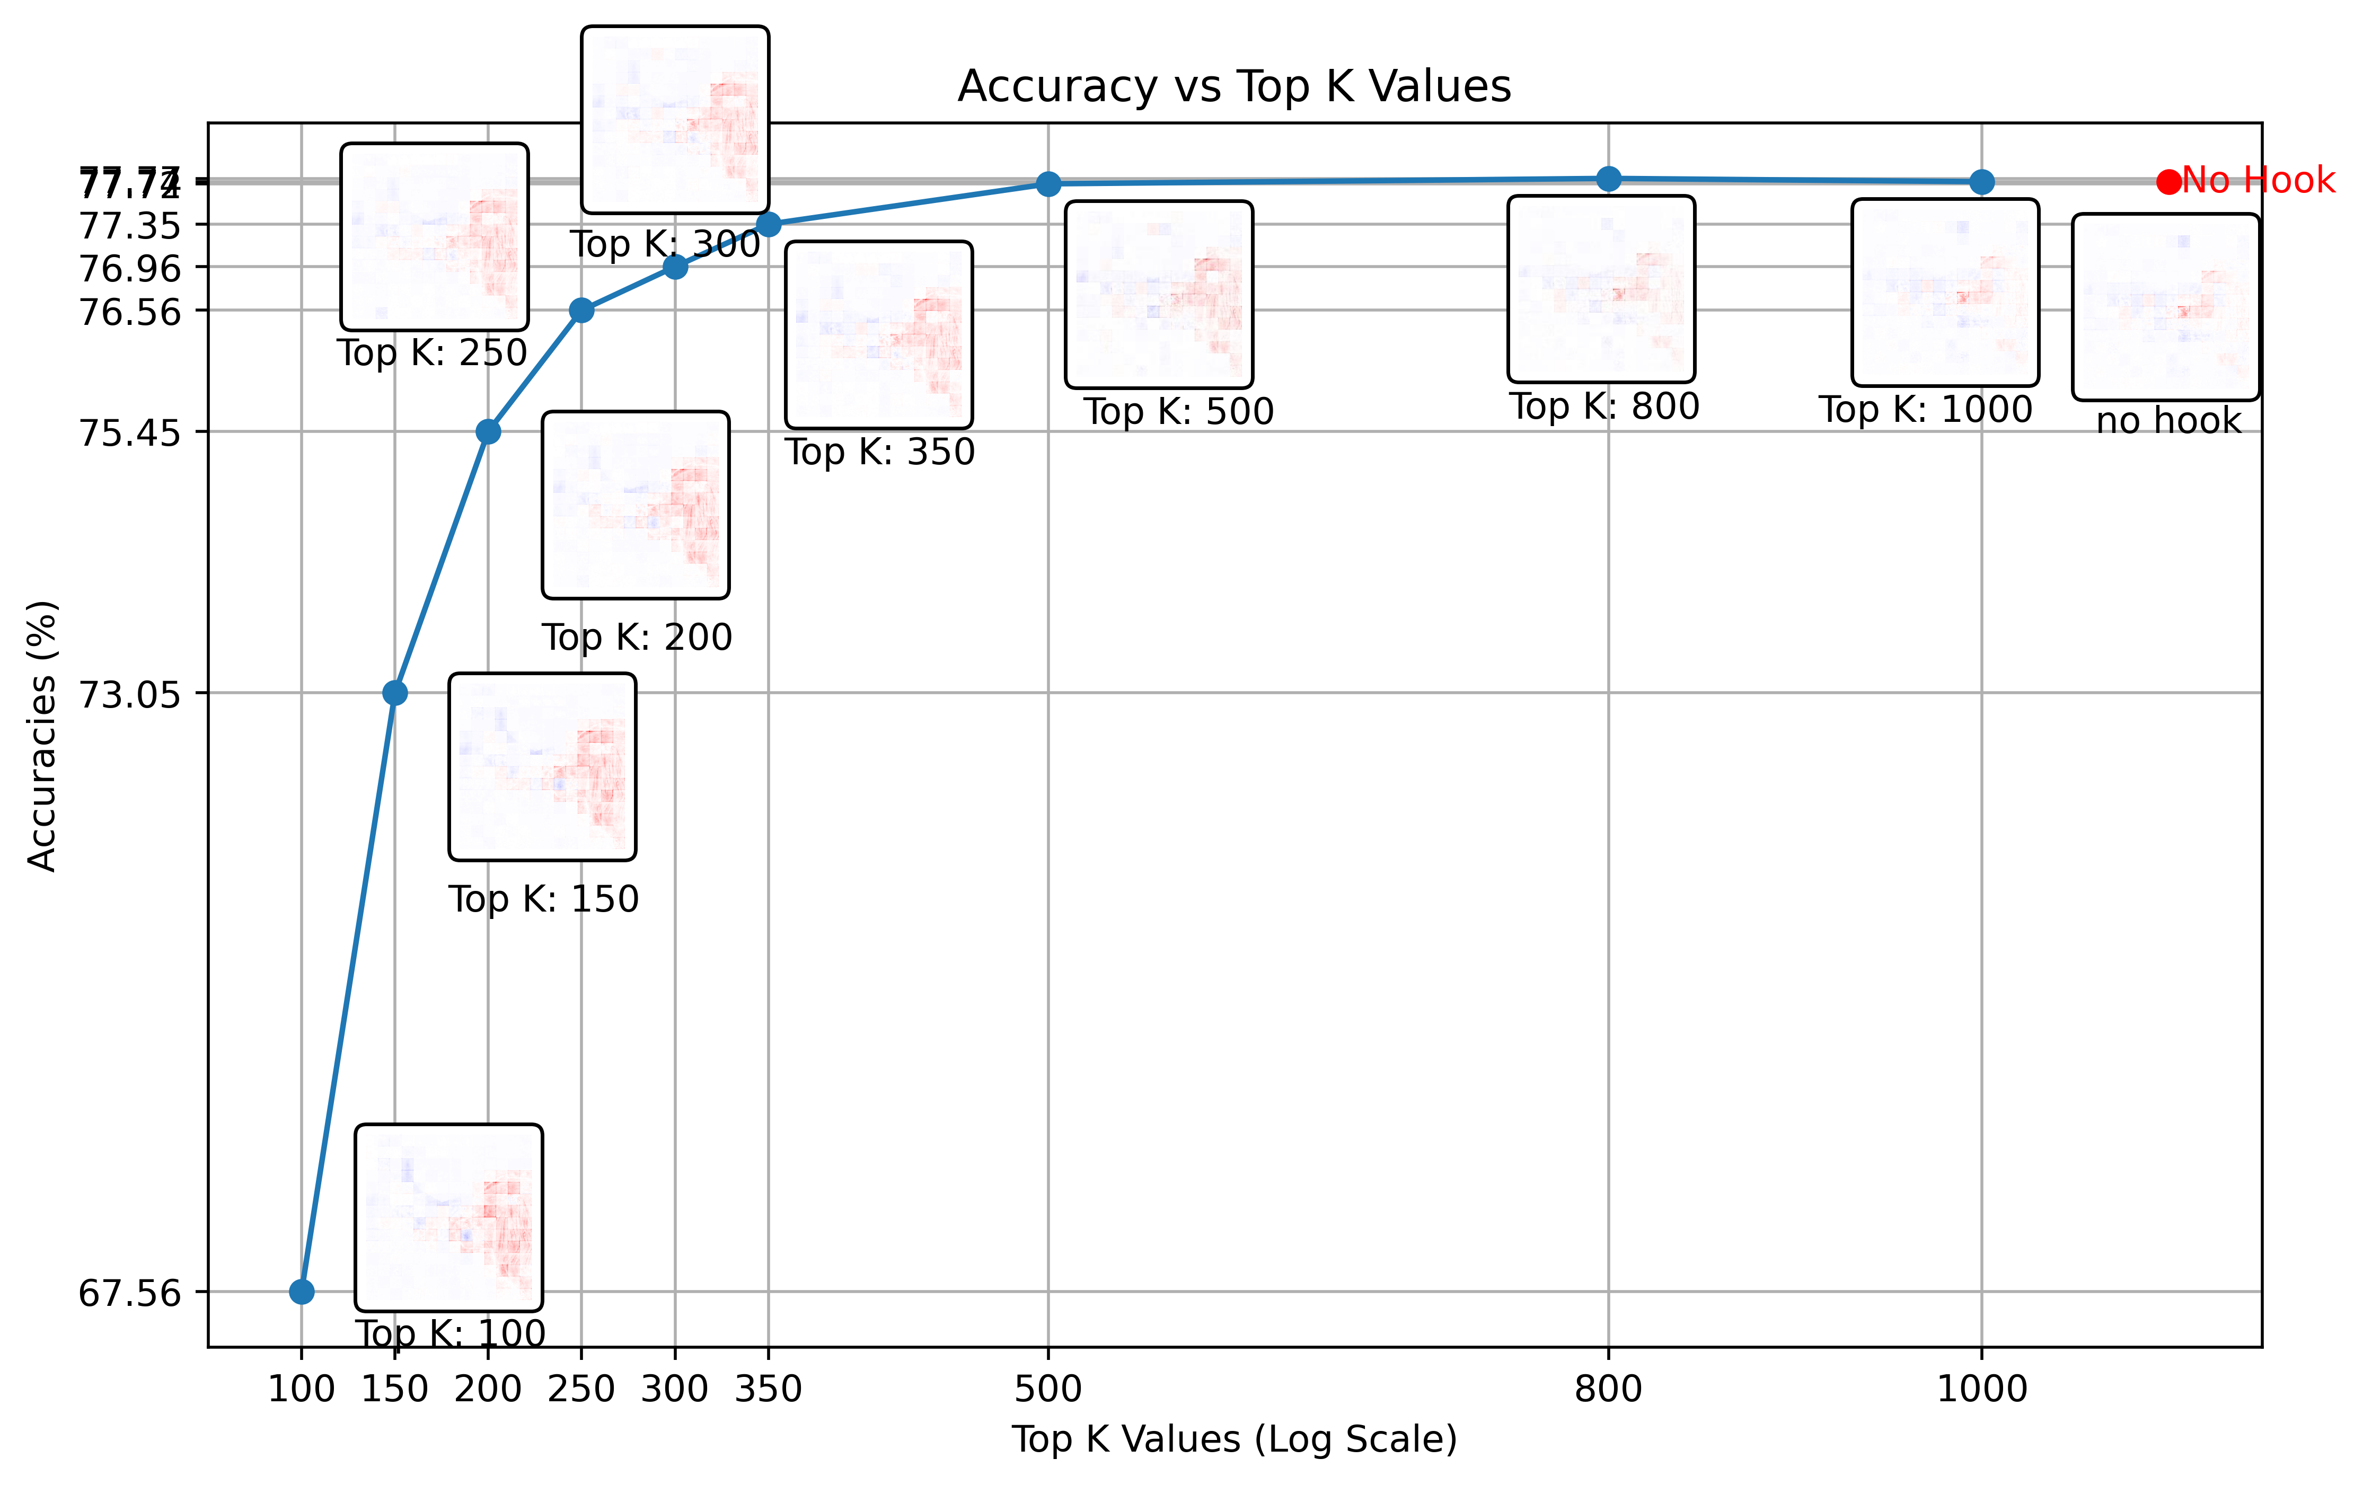
VIT L 16 Model accuracy (Tested on imagenet val set (6.4GB))

Slide 5
VIT L 16 Model heatmaps with different k values

Slide 6

VIT L 16 Model heatmaps noise
Idea: choose reference image with “good” relevances
→ heatmap obtained with gamma rule
Calculate MSE between reference image
and topk produced images to get some
measure of “noise” or “quality” of
heatmap
Reference image

Slide 7
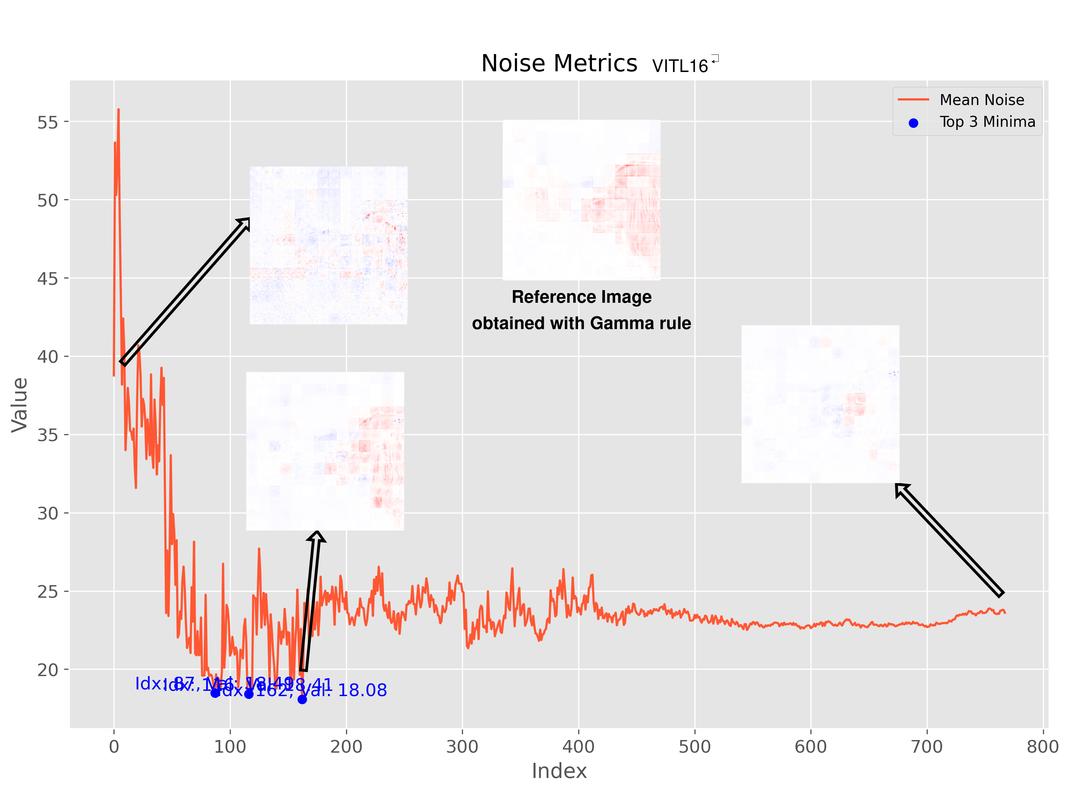
VIT L 16 Model noise

Slide 8
VITB16 Model results

Slide 9
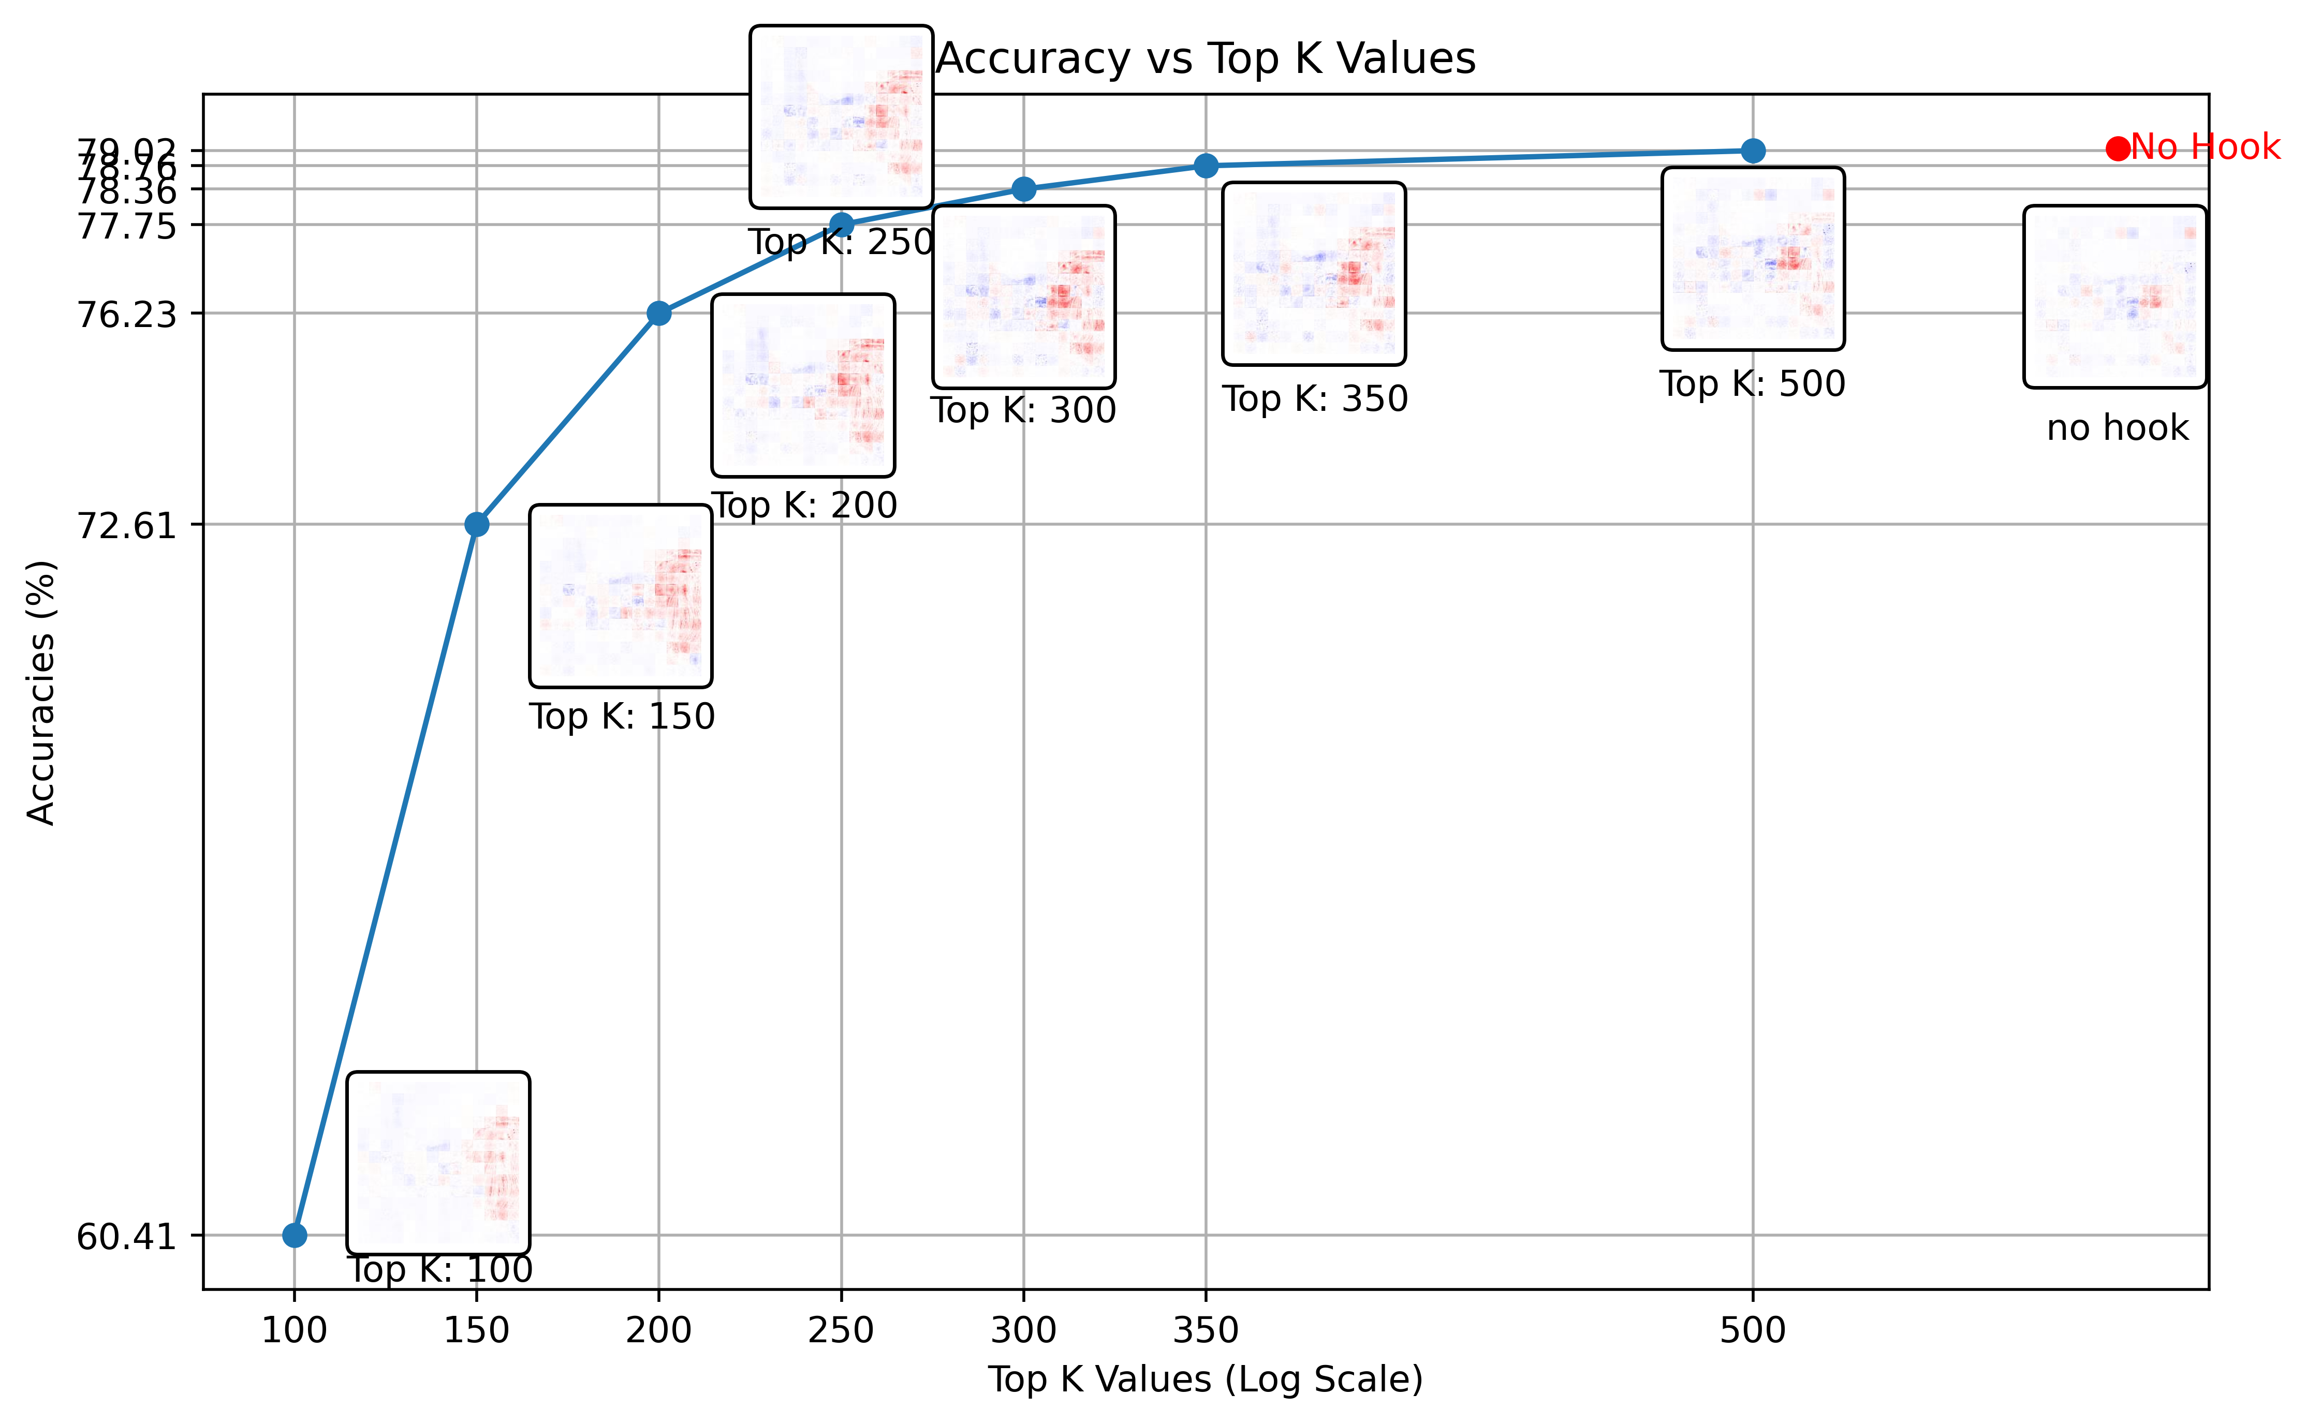
VIT B 16 Model accuracy (Tested on imagenet val set (6.4GB))

Slide 10
VIT B 16 Model heatmaps with different k values

Slide 11
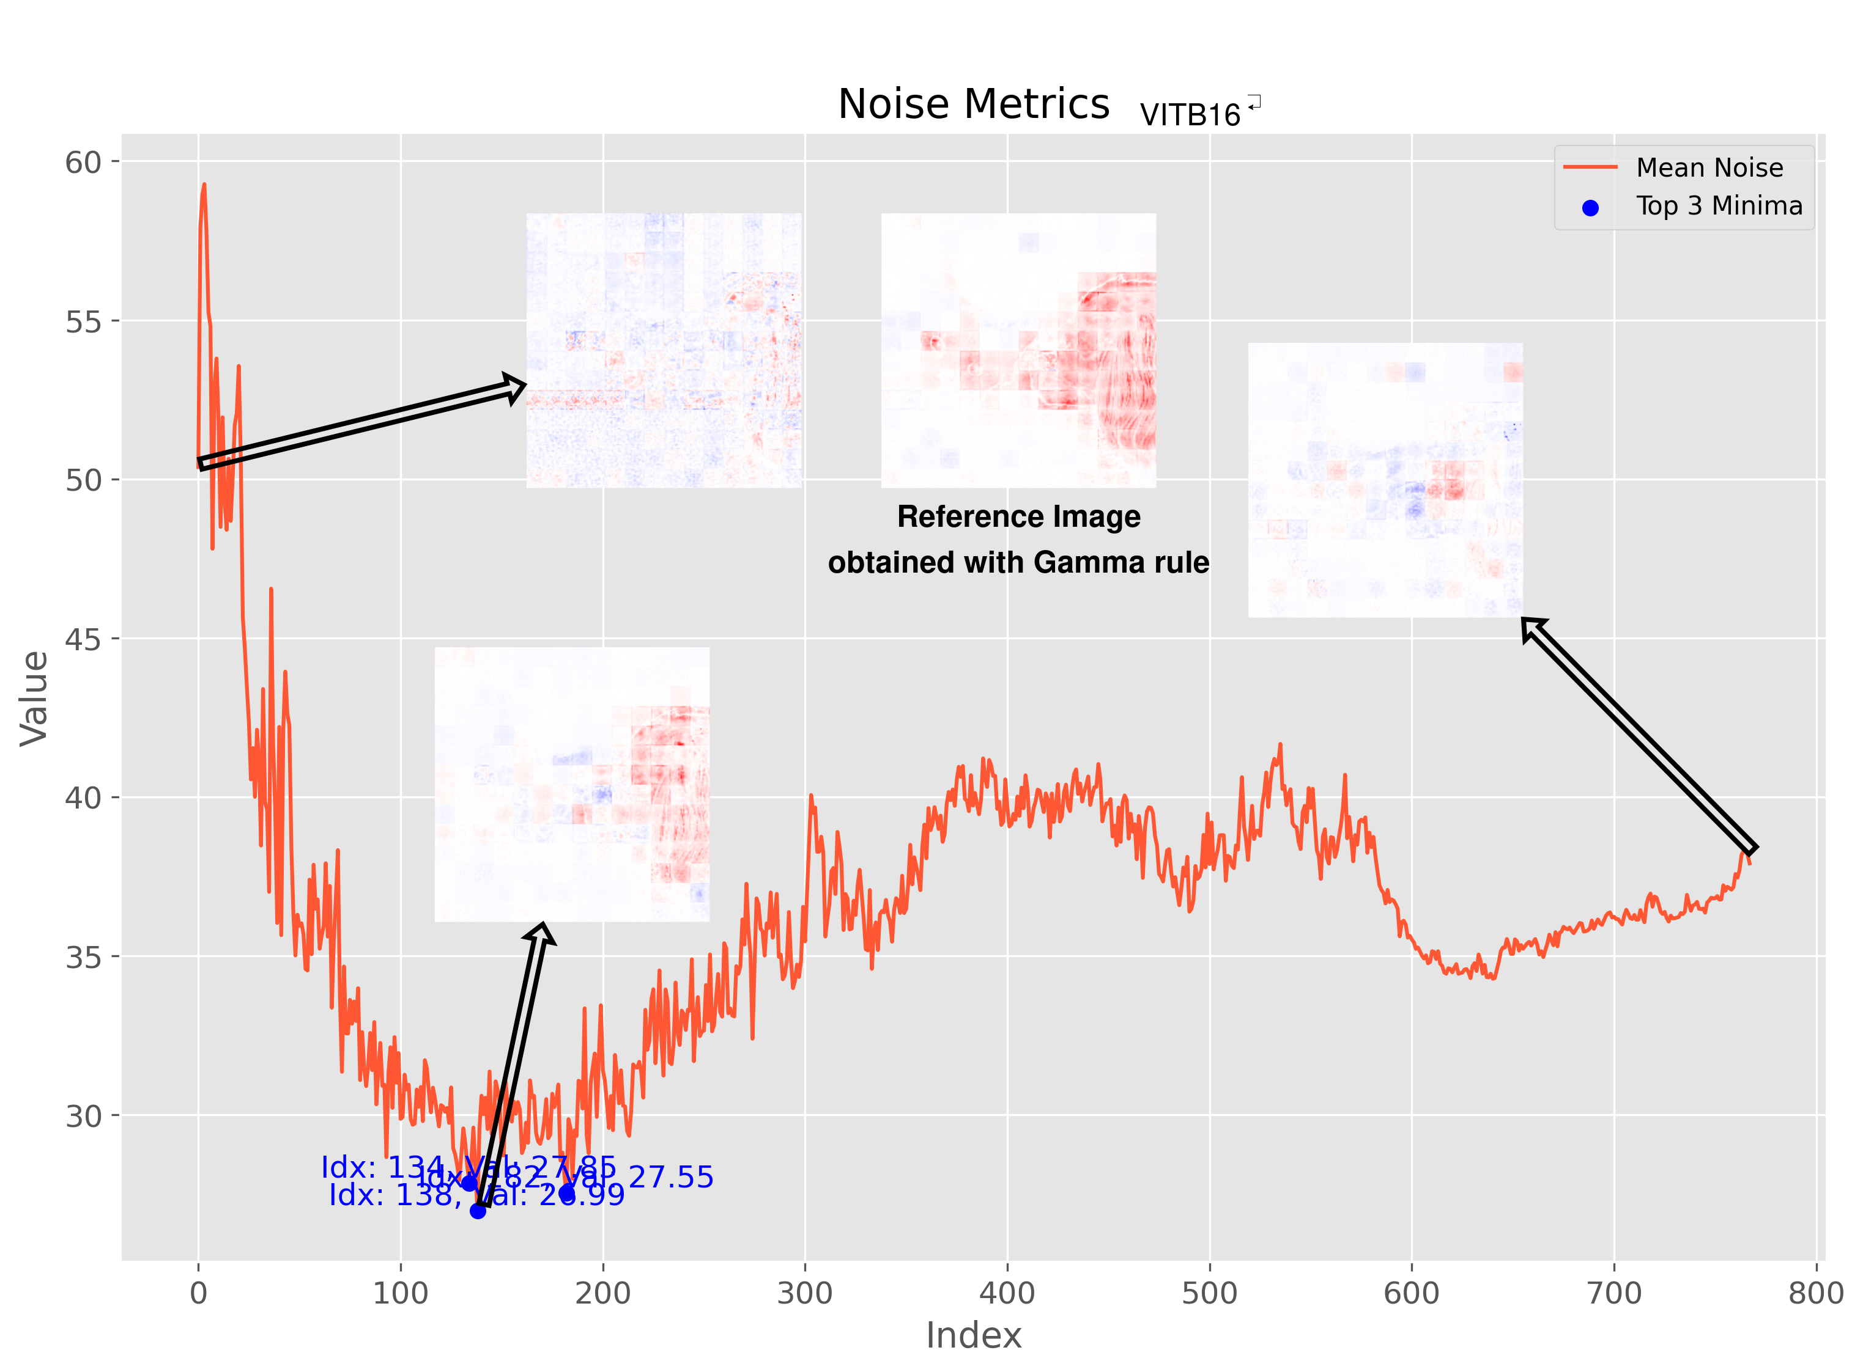
VIT L 16 Model noise

