Slide 1

Meta Platforms, Inc., formerly known as Facebook, Inc., is a technology company that focuses on building social networking services, virtual reality, and augmented reality products.

Slide 2
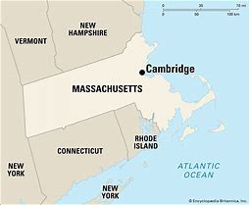
Start up date of the company.
Founded - January 4, 2004; 21 years ago in Cambridge, Massachusetts, U.S.

Slide 3

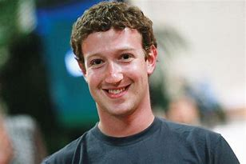



Founders and Cofounders of the Company.
• Mark Zuckerberg
• Andrew McCollum
• Chris Hughes
• Eduardo Saverin
• Dustin Moskovitz

Slide 4
Size of the company.
Meta is a multinational American Company with headquarters located in Menlo Park, California with a total of 66,185 employees in the year 2023 an increase of 20.9% from 2022.

Slide 5
Product based/ Service based company
Meta Platforms, Inc. is primarily a product-based company, but it also offers various services. Here's a breakdown:
Product-Based Aspects
Social Media Platforms: Facebook, Instagram, and WhatsApp are core products that enable social networking and communication.
Virtual Reality Devices: Meta Quest (formerly Oculus) VR headsets.
Smart Devices: Meta Portal smart displays and Ray-Ban Stories smart glasses.
Horizon Worlds: A social VR platform for creating and exploring virtual environments.
Service-Based Aspects
Advertising Services: Meta provides advertising services through its platforms, allowing businesses to reach a wide audience.
Business Tools: Meta Business Suite and Meta Ads Manager offer tools for managing and running ad campaigns.
Workplace: A collaboration platform for businesses to connect and work together.
Customer Support Services: Meta offers support services for its products and platforms.
In essence, Meta combines both product-based and service-based elements to create a comprehensive ecosystem of digital experiences and tools.

Slide 6
Capital investment.
Meta Platforms plans to invest between $60 billion and $65 billion in capital expenditures in 2025. This significant investment is aimed at expanding their AI infrastructure, including the construction of a massive new data center1. CEO Mark Zuckerberg has emphasized that 2025 will be a defining year for AI, with Meta's AI assistant expected to serve over 1 billion people1.
CEO Mark Zuckerberg posted on Facebook 14 Feb 2025.
Zuckerberg said Meta will build an AI data center “so large it would cover a significant part of Manhattan.”
Analysts said they expect the functionality of Meta AI's Llama 4 large language model to ramp up this year.
Shares of Meta climbed to an all-time high 14 Feb 2025, and have gained close to 65% over the past 12 months.

Slide 7
Application / Tools / Skills
Applications
Programming Languages:
Python, C++, and Java.
Machine Learning and AI:
machine learning algorithms, deep learning frameworks, and natural language processing (NLP).
Data Analysis:
data analysis, statistical modeling, and data visualization.
AR/VR Development:
augmented reality (AR) and virtual reality (VR) development
Cloud Platforms:
cloud platforms and AI infrastructure.
Ethical AI:
AI technologies and responsible AI development4.
Facebook
Instagram
Whatsapp
Messenger
Meta Quest
Meta Portal
Ray-Ban Stories
Horizon Worlds:
Workplace:
Meta Ads Manager:
Meta Business Suite:
Skills

Slide 8
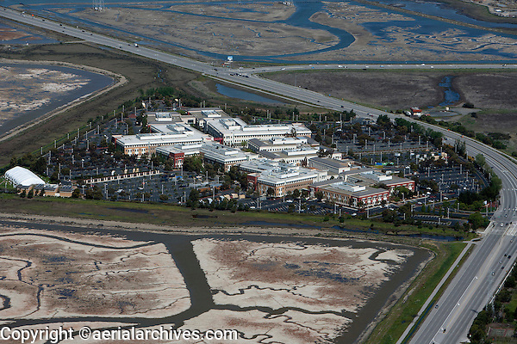
Location / State/ Country
Meta Platforms, Inc. is headquartered in Menlo Park, California, USA2. The address is 1 Hacker Way, Menlo Park, CA 94025.

Slide 9
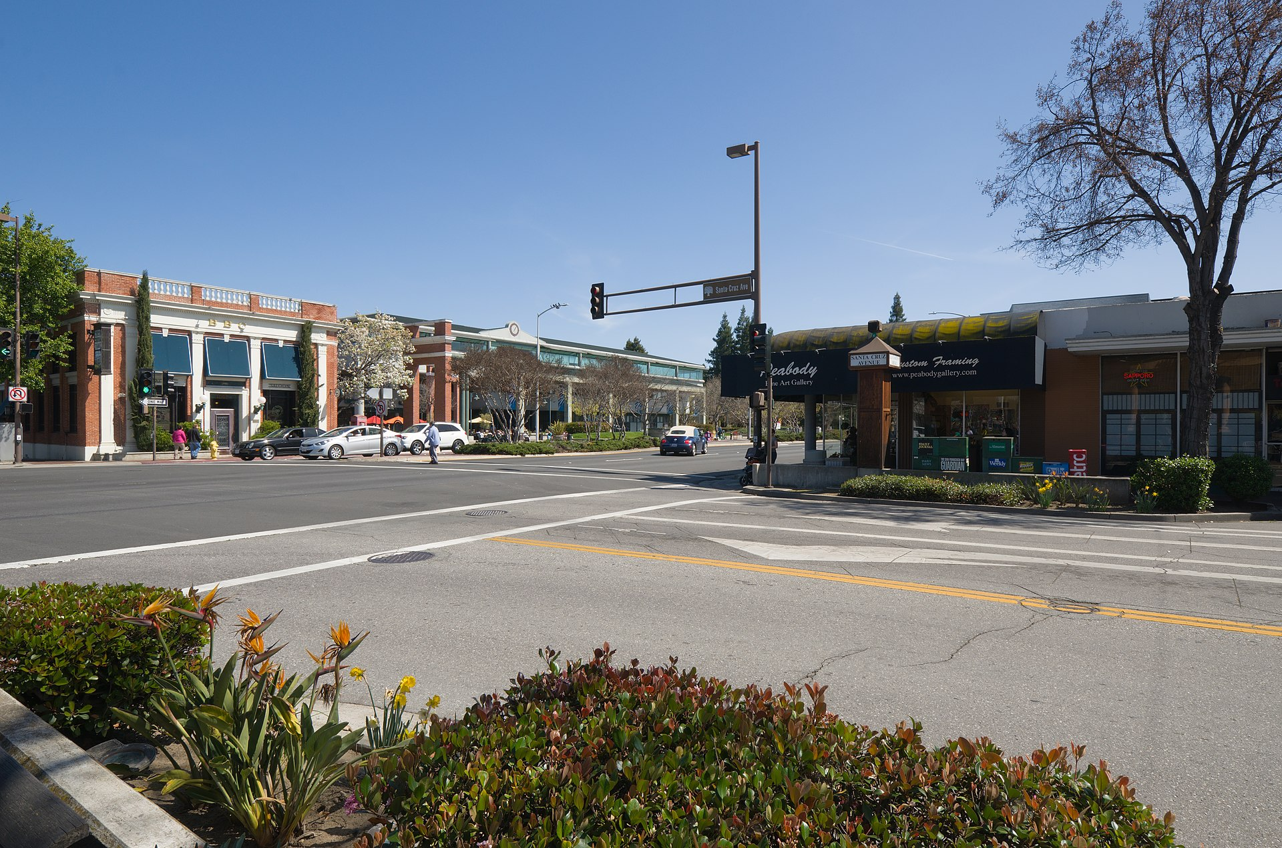
Headquarters
Menlo Park, California, U.S.

Slide 10
Franchise (Branches)
Meta Platforms, Inc. has several offices and branches around the world. Here are some key locations:
United States
Headquarters: Menlo Park, California
Other Offices: New York, Seattle, Austin, and more
India
Gurgaon: DLF Horizon Building, Sector 43, Gurugram, Haryana 122022
Mumbai: One BKC, Bandra Kurla Complex, Bandra (E), Mumbai, Maharashtra 400051
Bangalore: Microsoft Signature Building, Ring Road, Domlur Embassy Golf Links Business Park, Bangalore, Karnataka 560071
Hyderabad: Building No. 20, Raheja Mindspace, K. Raheja I.T. Park, Hitech City Road, Vittal Rao Nagar, HITEC City, Hyderabad, Telangana 500081
Europe
London: United Kingdom
Dublin: Ireland
Asia-Pacific
Singapore
Tokyo: Japan
Other Locations
Toronto: Canada
São Paulo: Brazil
These offices support Meta's global operations, including engineering, product development, sales, marketing, and client services.

Slide 11
Stakeholders/ Shareholders
Major Institutional Shareholders
The Vanguard Group, Inc.: Holds approximately 7.49% of Meta's shares.
BlackRock, Inc.: Holds around 6.40% of Meta's shares.
FMR LLC: Holds about 5.17% of Meta's shares.
Capital Research and Management Company: Holds approximately 4.22% of Meta's shares.
State Street Global Advisors, Inc.: Holds around 3.35% of Meta's shares.
Major Mutual Fund Holders
Vanguard Index Funds - Vanguard Total Stock Market ETF: Holds about 2.70% of Meta's shares.
Vanguard Index Funds - Vanguard S&P 500 ETF: Holds around 2.33% of Meta's shares.
Fidelity Contrafund - Fidelity Contrafund: Holds approximately 1.62% of Meta's shares.
Key Stakeholders
Mark Zuckerberg: CEO and Chairman of Meta Platforms, Inc.
Susan Li: Chief Financial Officer (CFO)
Andrew Bosworth: Chief Technology Officer (CTO)
Javier Olivan: Chief Operating Officer (COO)
These stakeholders and shareholders play a significant role in the governance and strategic direction of Meta Platforms, Inc. If you have any specific questions or need more details, feel free to ask!

Slide 12
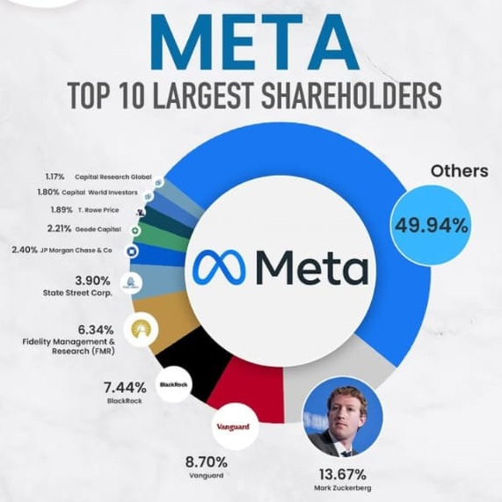

Slide 13
Turnover of the Company
Meta Platforms, Inc. reported a total revenue of $164.50 billion for the year ending December 31, 2024
This represents a 21.94% increase from the previous year. The company's revenue growth is driven by its investments in AI, virtual reality, and other innovative technologies.

Slide 14
Vision And Mission of the Meta Corp.
Vision Statement
Meta's vision is to "connect 3 billion people through its digital platforms by 2030". This vision emphasizes global connectivity and the development of the metaverse, aiming to create a more interconnected world through advanced digital infrastructure and innovative technologies.
Mission Statement
Meta's mission is to "give people the power to build community and bring the world closer together". This mission focuses on empowering individuals to create social connections, build communities, and foster global interactions through Meta's various platforms1.

Slide 15
Selection process/ Hiring procedure
Meta's hiring process typically involves several stages designed to evaluate candidates thoroughly. Here's a general overview:
Application: Submit your resume and cover letter through Meta's careers website or other job platforms.
Screening: Your application is reviewed to assess your qualifications and experience.
Phone Interview:
  A recruiter may conduct a phone interview to discuss your background and interest in the role.
  For technical roles, this may include a coding assessment or technical questions.
On-Site or Virtual Interviews:
  Multiple rounds of interviews with team members and managers.
  Focus areas include:
    Technical Skills: Coding exercises, system design, or technical discussions.
    Behavioral Questions: Assessing cultural fit and work ethic using the STAR method (Situation, Task, Action, Result).
    Problem-Solving: Hypothetical scenarios to evaluate critical thinking.
Hiring Committee: A group reviews your performance in interviews and decides whether to extend an offer.
Offer Stage: If successful, you'll receive an offer detailing the role, compensation, and benefits.

Slide 16
SWOT analysis of Meta (formerly Facebook), highlighting its Strengths, Weaknesses, Opportunities, and Threats:
Strengths:
Strong Brand Identity: Meta is one of the most recognized tech brands globally, with platforms like Facebook, Instagram, and WhatsApp under its umbrella.
Diverse Portfolio: It operates across social media, virtual reality (Oculus), and advertising, reducing dependency on a single revenue stream.
Massive User Base: With billions of active users, Meta has unparalleled reach and engagement.
Advertising Dominance: Meta generates significant revenue through targeted advertising, leveraging its vast user data.

Slide 17
Weaknesses:
Privacy Concerns: Meta has faced criticism and legal challenges over data privacy and security.
Dependence on Advertising: A large portion of its revenue comes from ads, making it vulnerable to changes in the advertising market.
Reputation Issues: Past controversies, including misinformation and platform misuse, have impacted its public image.
Opportunities:
Metaverse Expansion: Meta’s focus on the metaverse opens new avenues for growth in virtual and augmented reality.
Diversification: Expanding into hardware (e.g., VR devices) and other tech sectors can reduce reliance on social media.
Emerging Markets: Increasing internet penetration in developing countries offers opportunities to grow its user base.
Threats:
Regulatory Scrutiny: Governments worldwide are imposing stricter regulations on data privacy and monopolistic practices.
Competition: Rivals like Google, TikTok, and Snapchat pose significant challenges in the social media and advertising space.
Ad-Blocking Technology: The rise of ad-blockers could impact Meta’s advertising revenue.

Slide 18
Thank You
Presented By,
Miss Deepshikha Shrivastava

