Slide 1

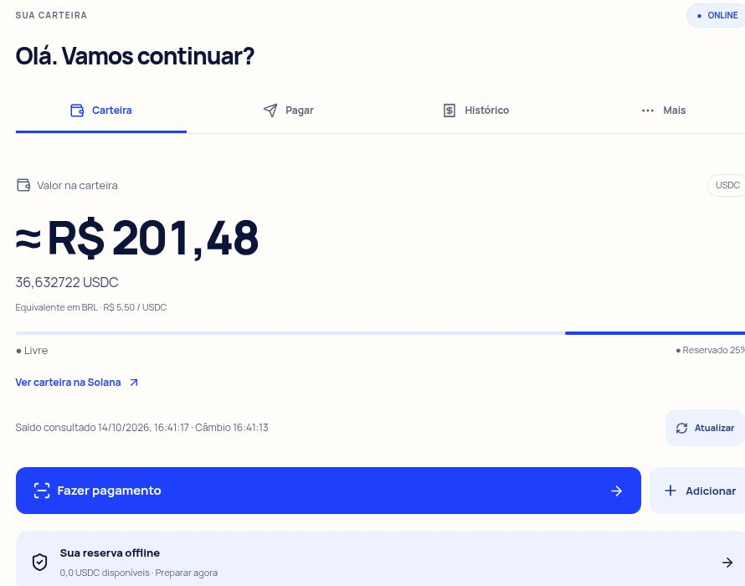
ShimoPay
ShimoPay
Payments during
connectivity outages
Authorize locally. Settle in USDC
when connectivity returns.
Diego Shimohama
São Paulo, Brazil
Solana Devnet prototype. English deck with original Portuguese product screens.
01
Notes:
Business pitch, October 14, 2026. Development prototype. Current wallet screenshot captured read-only at https://shimopay-mobile.vercel.app/customer/home on October 14. Shared development wallet. Screenshot does not establish new payments or customers.

Slide 2

ShimoPay
The checkout problem
The customer is ready.
The connection fails.
A merchant must wait, ask for
another payment method or
accept uncertainty.
Need to validate: how often outages affect checkout and which merchants lose sales.
02
Notes:
Illustrative customer scenario, not a completed interview or documented merchant outage. No measured outage frequency or lost-sales claim. Cafe image is an AI-generated editorial illustration, not a customer/pilot photograph.

Slide 3
ShimoPay
The merchant’s reason to pay
Checkout continuity
8 recovered sales
Accept a locally verifiable payment intent.
See what remains pending.
Reconcile after connectivity returns.
could cover BRL 79/month
Illustration: BRL 25 ticket
and 40% contribution margin.
BRL 10 contribution per sale.
Illustrative economics before fees, support costs and failed-settlement losses.
03
Notes:
Value proposition and numerical illustration are hypotheses. Example: BRL 25 ticket, assumed 40% contribution margin produces BRL 10 contribution per recovered sale. Proposed BRL 79 monthly subscription requires ceil(79/10)=8 incremental recovered sales before added fees, labor and acceptance losses. BRL 79 is a midpoint illustration within proposed BRL 49–99 range. No measured merchant margins or recovered sales.

Slide 4
ShimoPay
Brazil’s small-ticket payment market
24 million
76%
active small businesses
in Brazil
of Pix transactions between
individuals and businesses
were up to BRL 60 in 2025
Sources: Sebrae, June 2026. Banco Central do Brasil, Pix report 2023–2025, p.14.
04
Notes:
Market context, not ShimoPay TAM or proven demand. Sebrae headline reports 24 million active small businesses, published June 26, updated July 6, 2026: https://agenciasebrae.com.br/dados/pequenos-negocios-somam-24-milhoes-de-empresas-ativas/. BCB Relatório de Gestão do Pix 2023–2025, p.14: 76% of transactions between individuals and legal entities were up to BRL 60 in 2025. https://www.bcb.gov.br/content/estabilidadefinanceira/pix/relatorio_de_gestao_pix/relatorio_gestao_pix_2026.pdf. These universes differ and must not be multiplied to infer a customer count.

Slide 5
ShimoPay
The first addressable customer
Initial segment
Cafés and independent food vendors in São Paulo.
Small purchases where waiting can disrupt checkout.
Qualification
Recurring connectivity interruptions, compatible phones
and willingness to accept pending settlement.
First scale target
100 paying locations after pilot validation.
The reachable merchant count still needs research.
Expansion hypothesis: merchant software distribution, then other Brazilian cities.
05
Notes:
Initial customer and expansion strategy are proposed, not completed research. Broad national small-business count is not an addressable market estimate. SAM needs qualification by geography, outage frequency, wallet adoption, legal feasibility and willingness to pay. The 100-location target below is a planning scenario, not a forecast or market-share assertion.

Slide 6
ShimoPay
How ShimoPay addresses the problem
01 Prepare online
The customer reserves a spending allowance in escrow.
The merchant caches the session policy.
02 Authorize offline
The customer signs locally and shares a QR or envelope.
The merchant verifies and records pending settlement.
03 Settle online
Either party reconnects to submit the payment.
Solana transfers USDC and provides an on-chain receipt.
Pending acceptance carries risk until settlement. Current implementation uses test USDC.
06
Notes:
Current core flow: https://github.com/dshimo0/shimo-pay-mobile/blob/main/README.md and docs/DEMO.md. Prepare online, escrow-backed session, cache policy. Locally sign and verify Ed25519 intents without internet. Settle test USDC on Solana Devnet after either party reconnects. Session allowance and expiry do not eliminate conflicting intent acceptance across disconnected merchants. Solana is the prototype's programmable escrow/settlement rail, not an offline blockchain. Production feasibility and cost advantage over custody remain unproven.

Slide 7
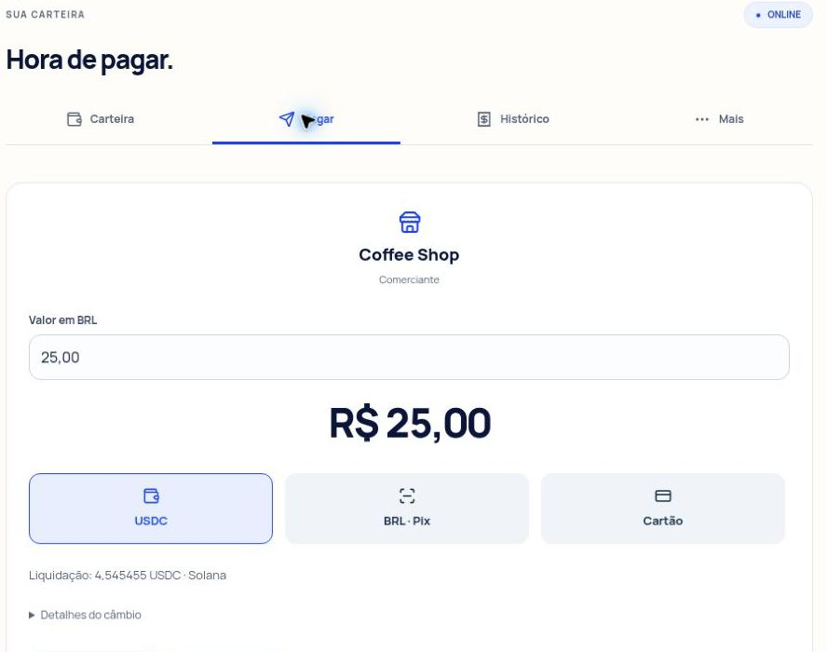
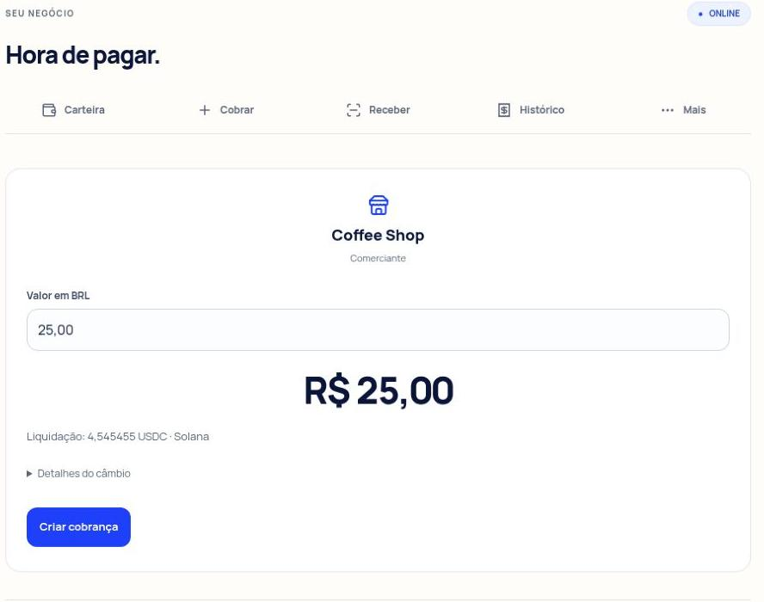
ShimoPay
The customer and merchant product
Customer reviews the purchase
Merchant prepares a charge
Current UI, Oct 14. USDC on Devnet. Pix/card online sandbox. Fiat conversion/payout simulated.
07
Notes:
Current read-only screenshots captured October 14, 2026 at https://shimopay-mobile.vercel.app/customer/home and /merchant/dashboard. Original UI in Portuguese. BRL 25 displayed quote is 4.545455 USDC at BRL 5.50/USDC. Capture shows review/charge setup, not a new payment or personal accounts. USDC is the Devnet rail. Pix/card are online sandbox options, fiat conversion/payout remains simulated.

Slide 8
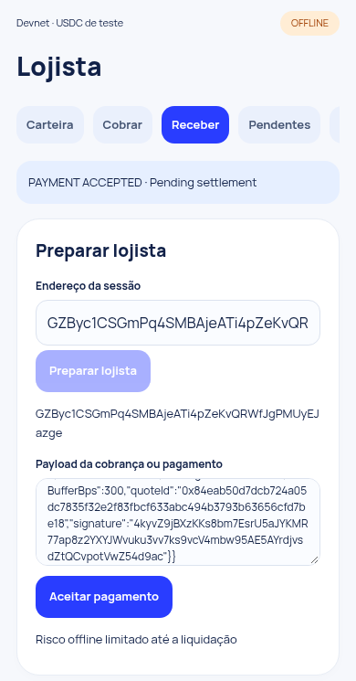
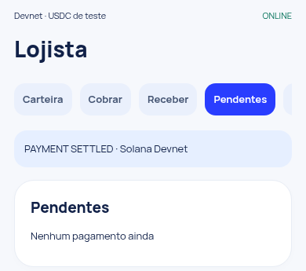
ShimoPay
Offline acceptance and pending settlement
Local verification
without network calls
The merchant verifies locally.
Only the merchant reconnects
in the recorded test.
Acceptance and settlement
have separate visible states.
Recorded developer test, Oct 12, earlier UI. Merchant risk remains until final settlement.
08
Notes:
Recorded test screenshots from October 12, 2026: https://github.com/dshimo0/shimo-pay-mobile/blob/main/docs/evidence/mobile-live-offline.png and mobile-live-settled.png. They show earlier product UI, not current October 14 captures. Offline evidence JSON: offlineApiRequests 0, offlinePwaReload true, independentMerchant true and payerStillOfflineAtSettlement true. Only merchant reconnection is demonstrated. This is developer test evidence, not a merchant pilot. Original Portuguese product UI.

Slide 9
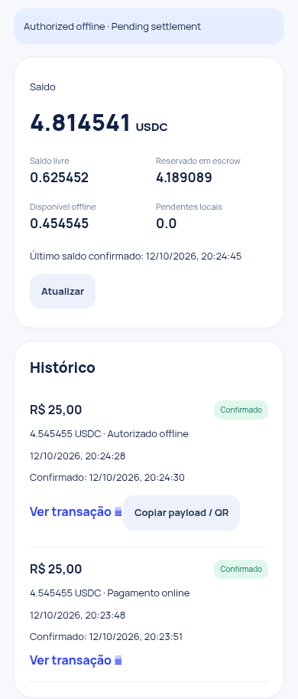
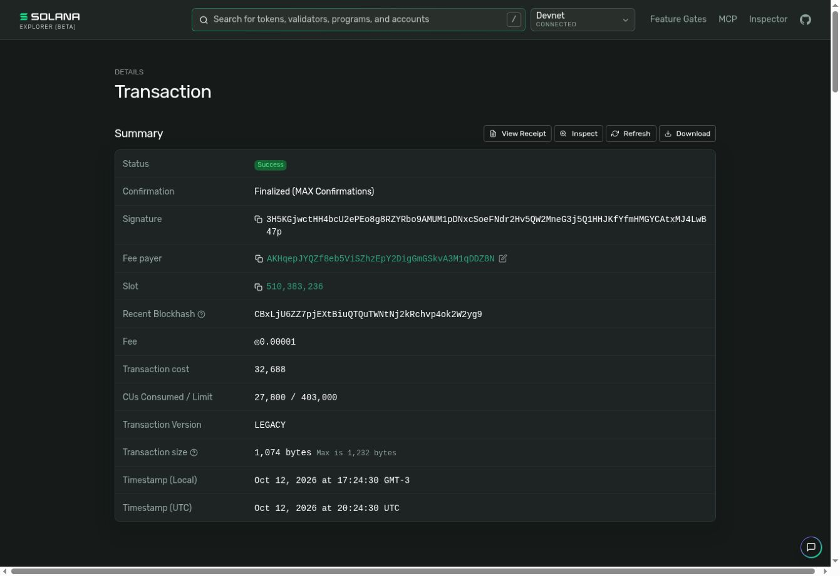
ShimoPay
Technical progress with verifiable evidence
2 payments
BRL 25 each
1 online, 1 authorized offline
4.545455 test USDC each
Developer tests.
No validated merchant pilot
or revenue yet.
09
Notes:
One documented developer-run test: https://github.com/dshimo0/shimo-pay-mobile/blob/main/docs/evidence/mobile-live-full.json checkedAt 2026-10-12T20:24:46.524Z. 2 BRL 25 payments, 1 online and 1 authorized offline, each 4.545455 test USDC at BRL 5.50/USDC. Replay rejected true. Screenshot https://github.com/dshimo0/shimo-pay-mobile/blob/main/docs/evidence/mobile-live-wallet.png. Explorer confirmed Success/Finalized at https://explorer.solana.com/tx/3H5KGjwctHH4bcU2ePEo8g8RZYRbo9AMUM1pDNxcSoeFNdr2Hv5QW2MneG3j5Q1HHJKfYfmHMGYCAtxMJ4LwB47p?cluster=devnet. No external users, commercial pilot or revenue. Latest UI captures are read-only and do not change this evidence.

Slide 10
ShimoPay
Alternatives and ShimoPay’s positioning
Alternative | What it offers | ShimoPay’s proposed position
Cash | Checkout without connectivity | Digital record and later USDC settlement
Offline card systems | Deferred processing under provider rules | Phone-based intent with Solana escrow
Solana Pay | Standard QR / URL payment requests | Local intent verification, later settlement
Offline payments already exist. Superiority, adoption cost and loss rates require benchmarking.
10
Notes:
Comparison covers categories and design choices, not verified superiority. Solana Pay URL/QR payment requests: https://docs.solanapay.com/core/overview and https://docs.solanapay.com/core/transfer-request/overview. Offline card systems exist. Stripe Terminal terms describe offline mode processing-failure risk: https://stripe.com/legal/ssa-services-terms. Stripe example does not establish regional availability in Brazil. ShimoPay design from https://github.com/dshimo0/shimo-pay-mobile/blob/main/README.md. Benchmark setup cost, adoption, settlement reliability and total economics with actual merchants.

Slide 11
ShimoPay
How ShimoPay would make money
BRL 49–99
Who pays
The merchant benefiting
from payment continuity.
per merchant location / month
Later revenue options
Proposed subscription for checkout
continuity and payment reconciliation.
Consumer access without a subscription.
Partner software licensing
and service commissions,
after adoption validation.
All pricing and future revenue options are hypotheses. Network/provider fees need separate design.
11
Notes:
Proposed business model, not validated pricing or revenue. BRL 49–99/location/month was introduced as a founder application hypothesis. Consumer access without subscription, business reconciliation offering, possible partner licensing and eventual service commissions are new strategic proposals. Consumer zero subscription does not mean zero network/provider fees. No active partnerships, fees, commissions or FX revenue.

Slide 12
ShimoPay
Subscription revenue scenarios
Paying locations | Monthly revenue | Annual recurring run rate
100 | BRL 7,900 | BRL 94,800
1,000 | BRL 79,000 | BRL 948,000
10,000 | BRL 790,000 | BRL 9,480,000
Profitability depends on support, security, provider fees
and who bears failed offline settlement losses.
Illustrative scenarios at BRL 79/month. These are not forecasts or achieved revenue.
12
Notes:
Illustrative steady-state arithmetic, not forecasts, targets by date, customer counts or valuation. BRL 79/location/month. MRR=locations*79. Annual recurring run rate=MRR*12. Excludes churn, free trials, discounts, taxes and variable costs. Margins, acquisition cost and willingness to pay remain unvalidated. No transaction volume or FX revenue included.

Slide 13
ShimoPay
Go-to-market starts with merchant discovery
Discovery
Interview 8–12 São Paulo establishments.
Record outage frequency, lost sales and current workarounds.
Design partners
Seek 2 merchants to test the workflow with test tokens.
Measure repeat use and willingness to pay.
Distribution
Start with direct onboarding. Test merchant software
partnerships after the pilot economics work.
Success criteria: repeat usage, reliable settlement and value above fees and acceptance losses.
13
Notes:
Proposed plan. 8–12 merchant interviews and 2 design partners from earlier deck plan, not completed. Proposed pilot success metrics: checkout completion, settlement success and latency, disputes/losses, willingness to pay and repeat usage. Legal/security readiness gates real-money testing. 100 paying locations is a later scenario conditional on validated demand, not committed timeline.

Slide 14
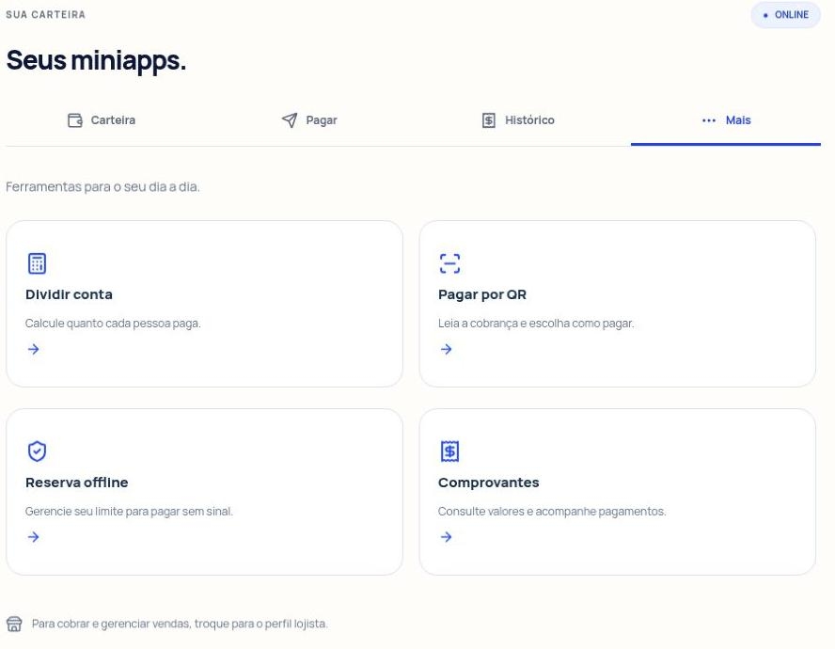
ShimoPay
A wallet with a path to everyday services
Today
Payment tools share one
consumer experience.
After merchant adoption
Add services and partner
integrations that increase
useful wallet activity.
Current tools shown. Partner marketplace and commission revenue remain future hypotheses.
14
Notes:
Current October 14 screenshot: https://shimopay-mobile.vercel.app/customer/stores. Four entries divide bill/pay QR/offline reserve/receipts. These are product navigation/tools, not a commercial partner marketplace. Broader miniapps/partner integration and commissions are future vision, no existing agreements. Product began after founder China visit March 2025. Focus core merchant payment validation before expansion.

Slide 15
ShimoPay
The path to a controlled commercial pilot
Wallet security
Individual ownership and transaction authentication.
Protected device keys and tested recovery.
Acceptance policy
Define purchase/session limits and loss allocation.
Conflicting intents can still fail at settlement.
Commercial readiness
Resolve compliance and fiat provider requirements.
Run a controlled pilot before handling real funds.
Mainnet and production fiat depend on these gates. Escrow does not guarantee every accepted payment.
15
Notes:
Production readiness boundaries from https://github.com/dshimo0/shimo-pay-mobile/blob/main/README.md and docs/DEMO.md. Shared dev wallets, incomplete individual custody/authentication/hardware key protection. Escrow caps chain spending but not aggregate offline merchant acceptance losses. Proposed loss allocation is merchant-borne only with explicit pilot agreement, no adopted policy/guarantee. Fiat conversion/payout simulated. No claim of legal/regulatory approval. Dates are not committed.

Slide 16
ShimoPay
Founder fit and the next milestone
Diego Shimohama
25+ years in IT, security, identity and infrastructure.
Founder of Naapi and Hack-Cancer. Builder of BioFlow.
Naapi claims assessment: 20 days to 3 minutes.
Experience with fraud identification and instant payments.
Seeking merchant design partners and technical mentorship
to validate a controlled pilot and a full-time transition.
16
Notes:
Founder-reported: Diego Shimohama, 25+ years IT/security/identity/infrastructure, Zurich LATAM professional experience, no employer endorsement. Naapi claims assessment reduction from 20 days to 3 minutes, fraud reduction/identification and instant payments are user-supplied achievements, not independently audited and not attributed to a Brasilseg pilot. Hack-Cancer community and BioFlow evidence triage founder experience. ShimoPay idea after China visit March 2025, mobile UI predates competition, integrations during hackathon described in earlier submission. Solo technical founder, part-time alongside Zurich. Request: merchant design partners, mentorship and funding sufficient for full-time transition, no amount invented.

Slide 17
ShimoPay
Sources and evidence
Market
Sebrae: 24 million active small businesses, June 2026.
Banco Central: Pix report 2023–2025, pp.14 and 20.
Product
README.md, docs/DEMO.md and recorded Devnet evidence.
Current screenshots: Oct 14. Recorded payment screens: Oct 12.
Alternatives
Solana Pay documentation. Stripe Terminal service terms.
Full source URLs and assumptions appear in speaker notes.
Demo: shimopay-mobile.vercel.app. Repository: github.com/dshimo0/shimo-pay-mobile.
17
Notes:
Sources retrieved October 14, 2026. Research records market context and competitor capabilities only. Product evidence comes from repo/live read-only capture, with historical/current distinctions. Commercial scenarios/targets/pricing are assumptions. Cafe illustration generated with built-in image tool from prompt: small independent São Paulo cafe checkout interrupted by connectivity, editorial illustration with dark green/lime palette, no text/alcohol/logos. Embedded asset cafe-illustration.png.
https://agenciasebrae.com.br/dados/pequenos-negocios-somam-24-milhoes-de-empresas-ativas/
https://www.bcb.gov.br/content/estabilidadefinanceira/pix/relatorio_de_gestao_pix/relatorio_gestao_pix_2026.pdf
https://github.com/dshimo0/shimo-pay-mobile/blob/main/README.md
https://github.com/dshimo0/shimo-pay-mobile/blob/main/docs/DEMO.md
https://github.com/dshimo0/shimo-pay-mobile/blob/main/docs/evidence/mobile-live-full.json
https://docs.solanapay.com/core/overview
https://stripe.com/legal/ssa-services-terms
https://explorer.solana.com/tx/3H5KGjwctHH4bcU2ePEo8g8RZYRbo9AMUM1pDNxcSoeFNdr2Hv5QW2MneG3j5Q1HHJKfYfmHMGYCAtxMJ4LwB47p?cluster=devnet

