Slide 1
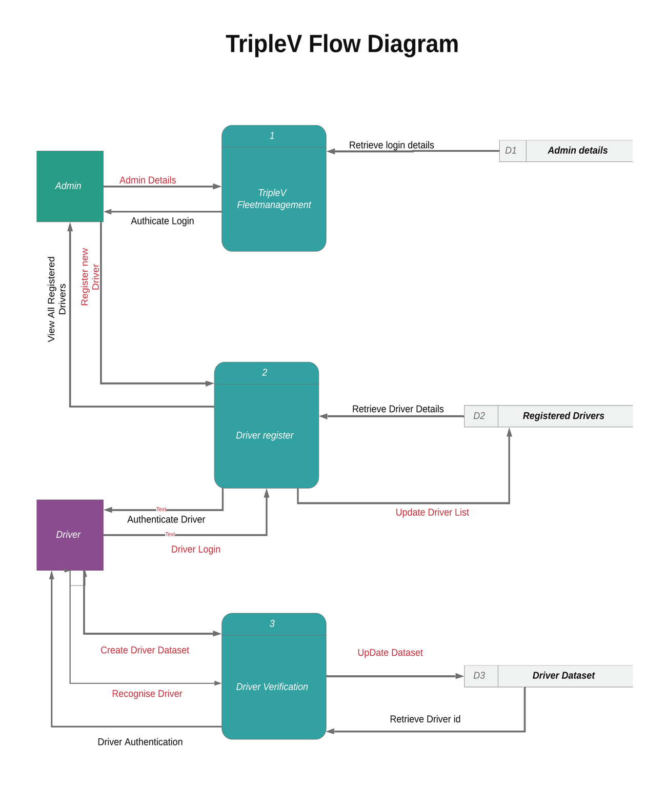



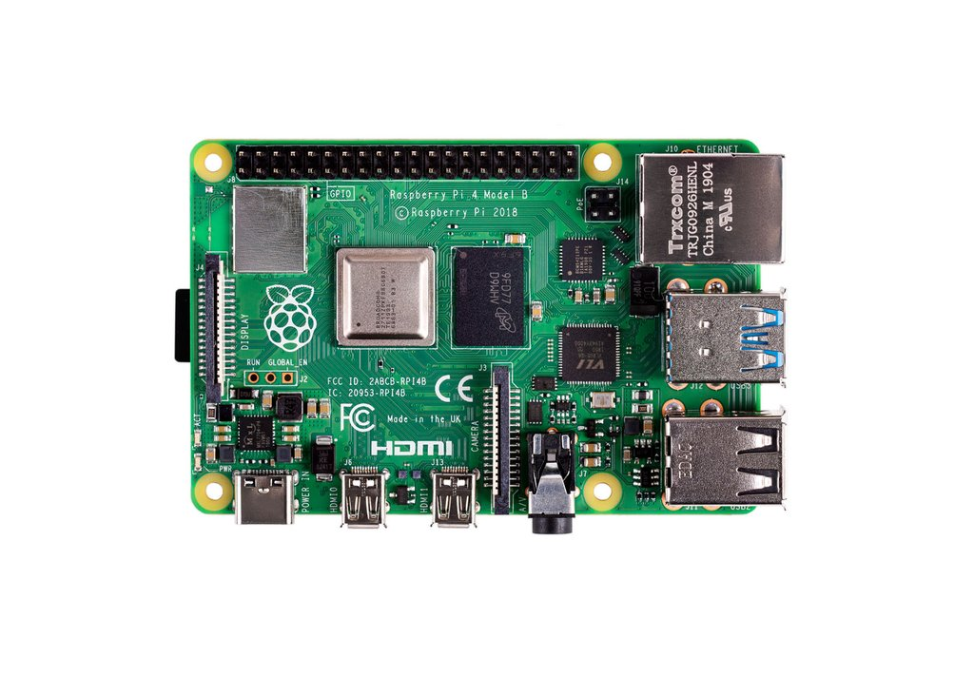
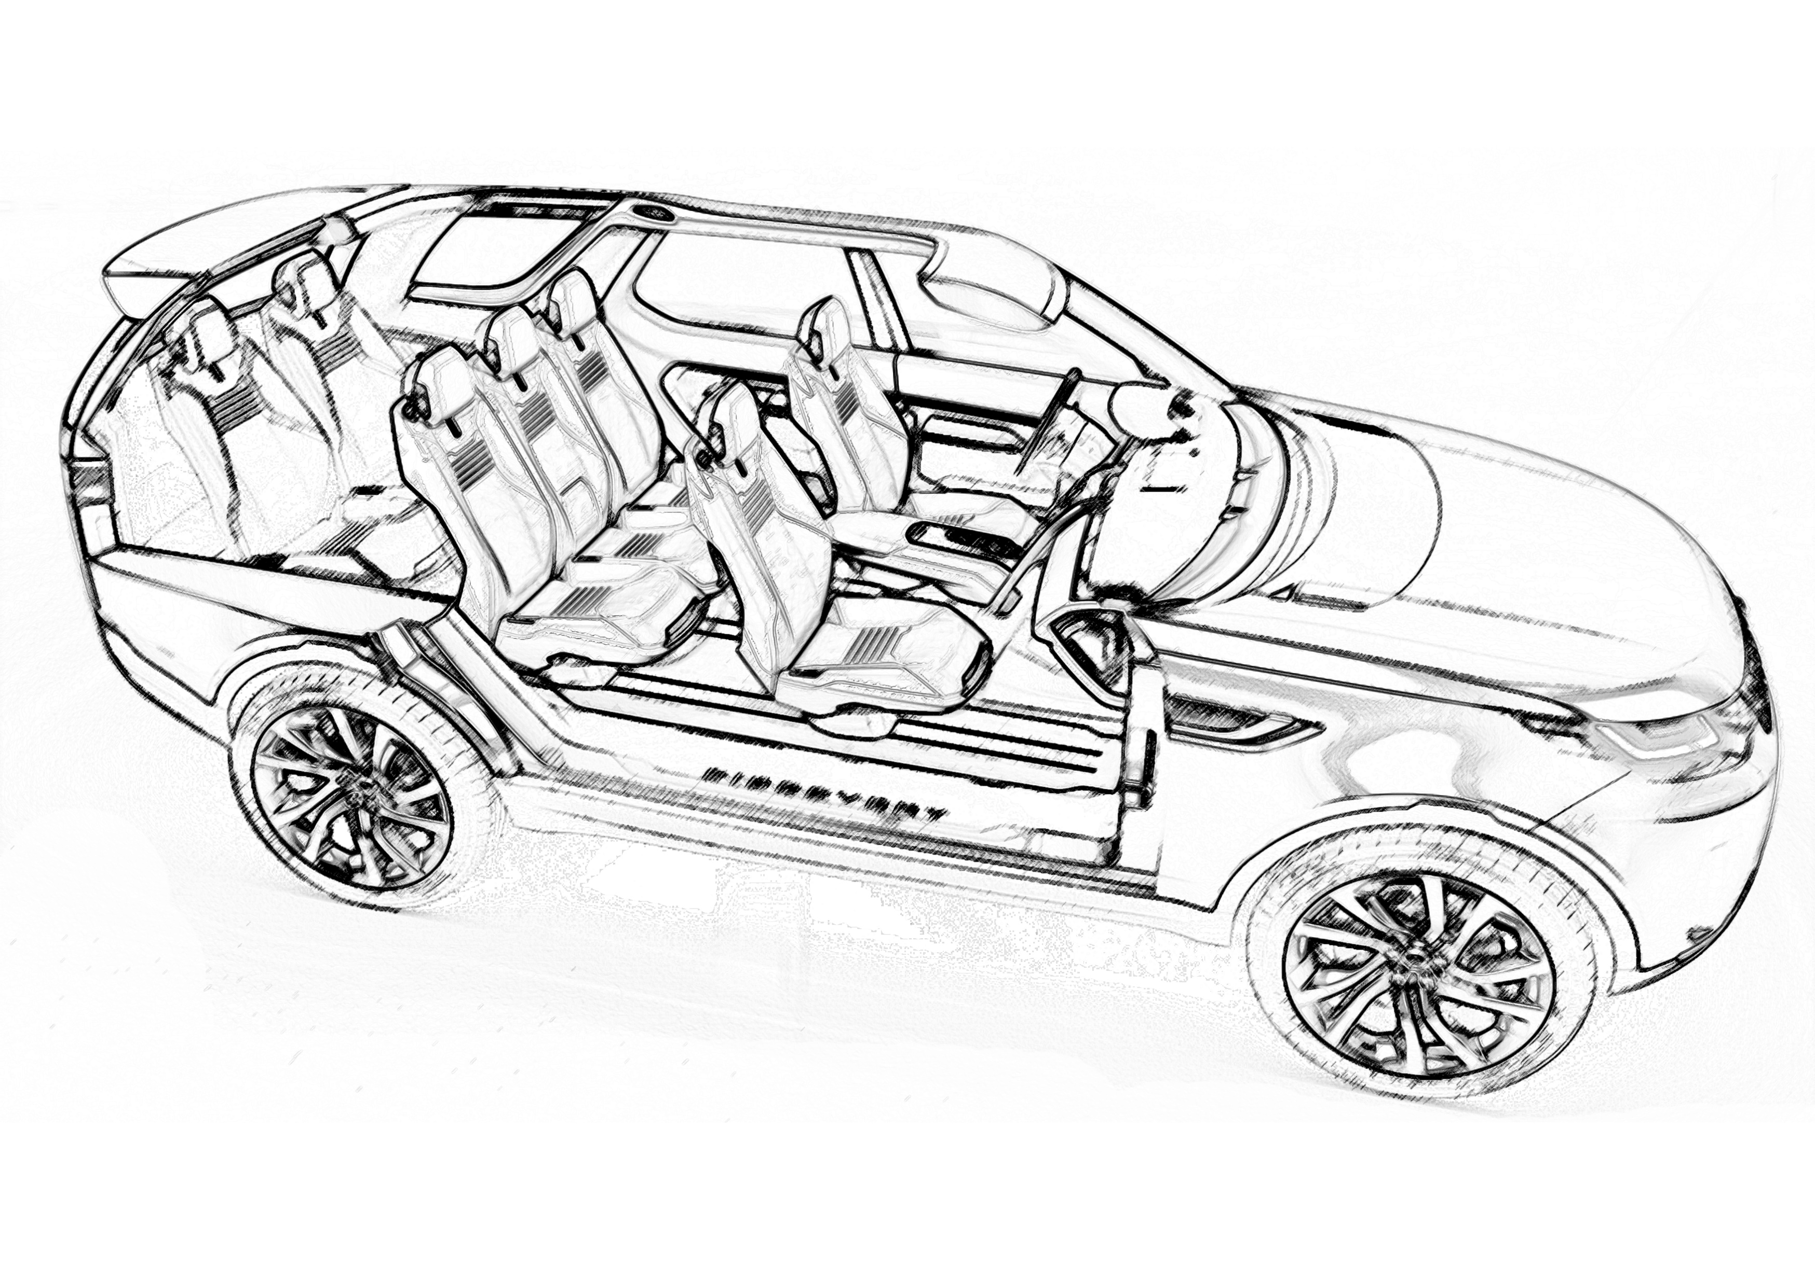
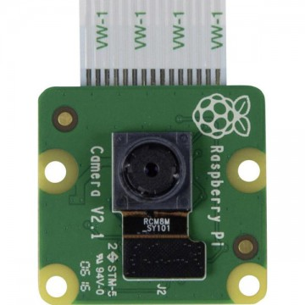
Vehicle Visage Verification
John Lawless
BEng Software and Electronic Engineering(Hons)
Project Description
Vehicle Visage Validation (TripleV) is an intelligent, networked, fleet management system. The inspiration for this project came while on placement with JLR, Shannon and observing how difficult it can be to monitor users and keep track of multiple vehicles in a large fleet.
The function of TripleV is to allow a fleet manager have full control over who is registered on a vehicle and therefore who has access to a vehicle at all times. This is achieved with the use of a web-based login/register application, a NoSQL database, hosted in the cloud, and face recognition software on a Raspberry Pi with a Pi-camera attached. The object is to allow a driver to login to the facial recognition software with a secure key provided by the administrator and allow them to register their image on the system.
Administrator logs into the online system and registers the details of the new driver, along with the registration of the vehicle and a key for accessing the face recognition software. All details are stored on a Mongodb Atlas, cloud based, database. All the information stored on the database is encrypted with bcrypt for added security.
At the vehicle, the driver must enter the secure key and their details into the onboard system. The information plus the registration of the vehicle is sent to the database. If all the information is correct and verified the driver can proceed to train his image into the face recognition software.
Once the face training is complete, the system will enter the face recognition algorithm and only if the driver is recognised will the vehicle start.
With the growth in sales of electric vehicles (evs) and the difficulty for young drivers to access insurance on these vehicles due to evs instant 100% torque output and incredible acceleration, this system could be developed further to incorporate individual profiles for drivers that corresponded to customised torque curves on these vehicles. Opening ev ownership to a whole new market.
Skills and Technology
Product idea creation and development
Project Planning
Agile Project Management
Version Control
Software Build and Test
Python Programming
HTML, CSS, Java Script for web Development
Node.js
Mongodb Atlas
OpenCv
Face Recognition Software
Problem Solving
Product Prototyping

