Slide 1
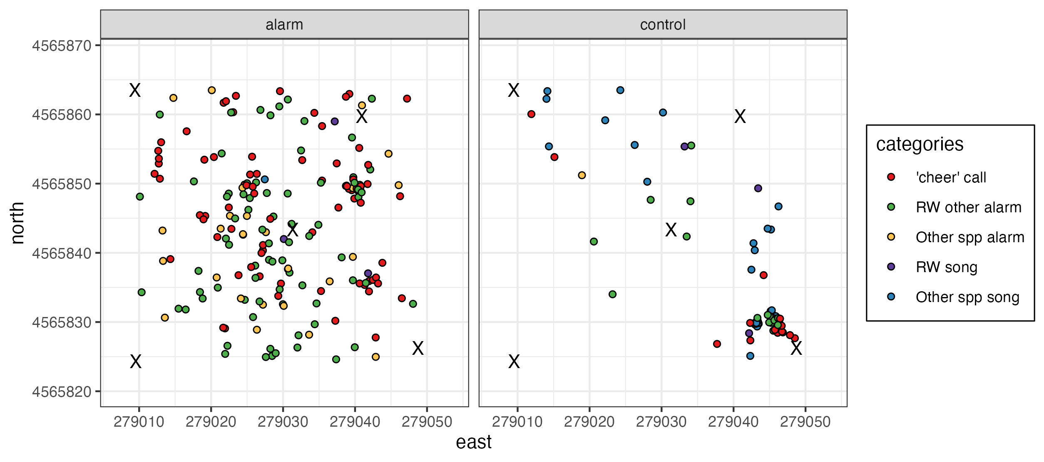
Full data, separated by treatment

Slide 2
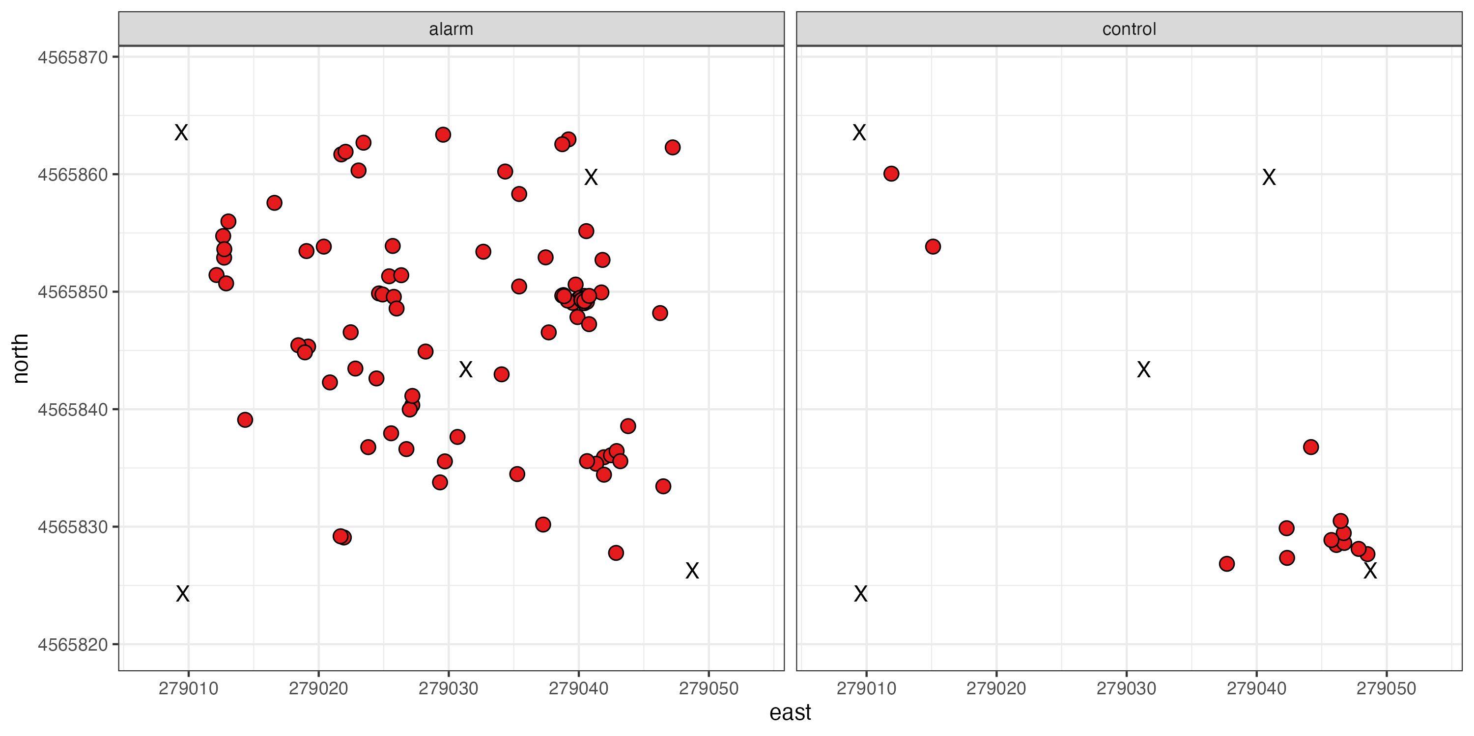
‘Cheer’ only

Slide 3
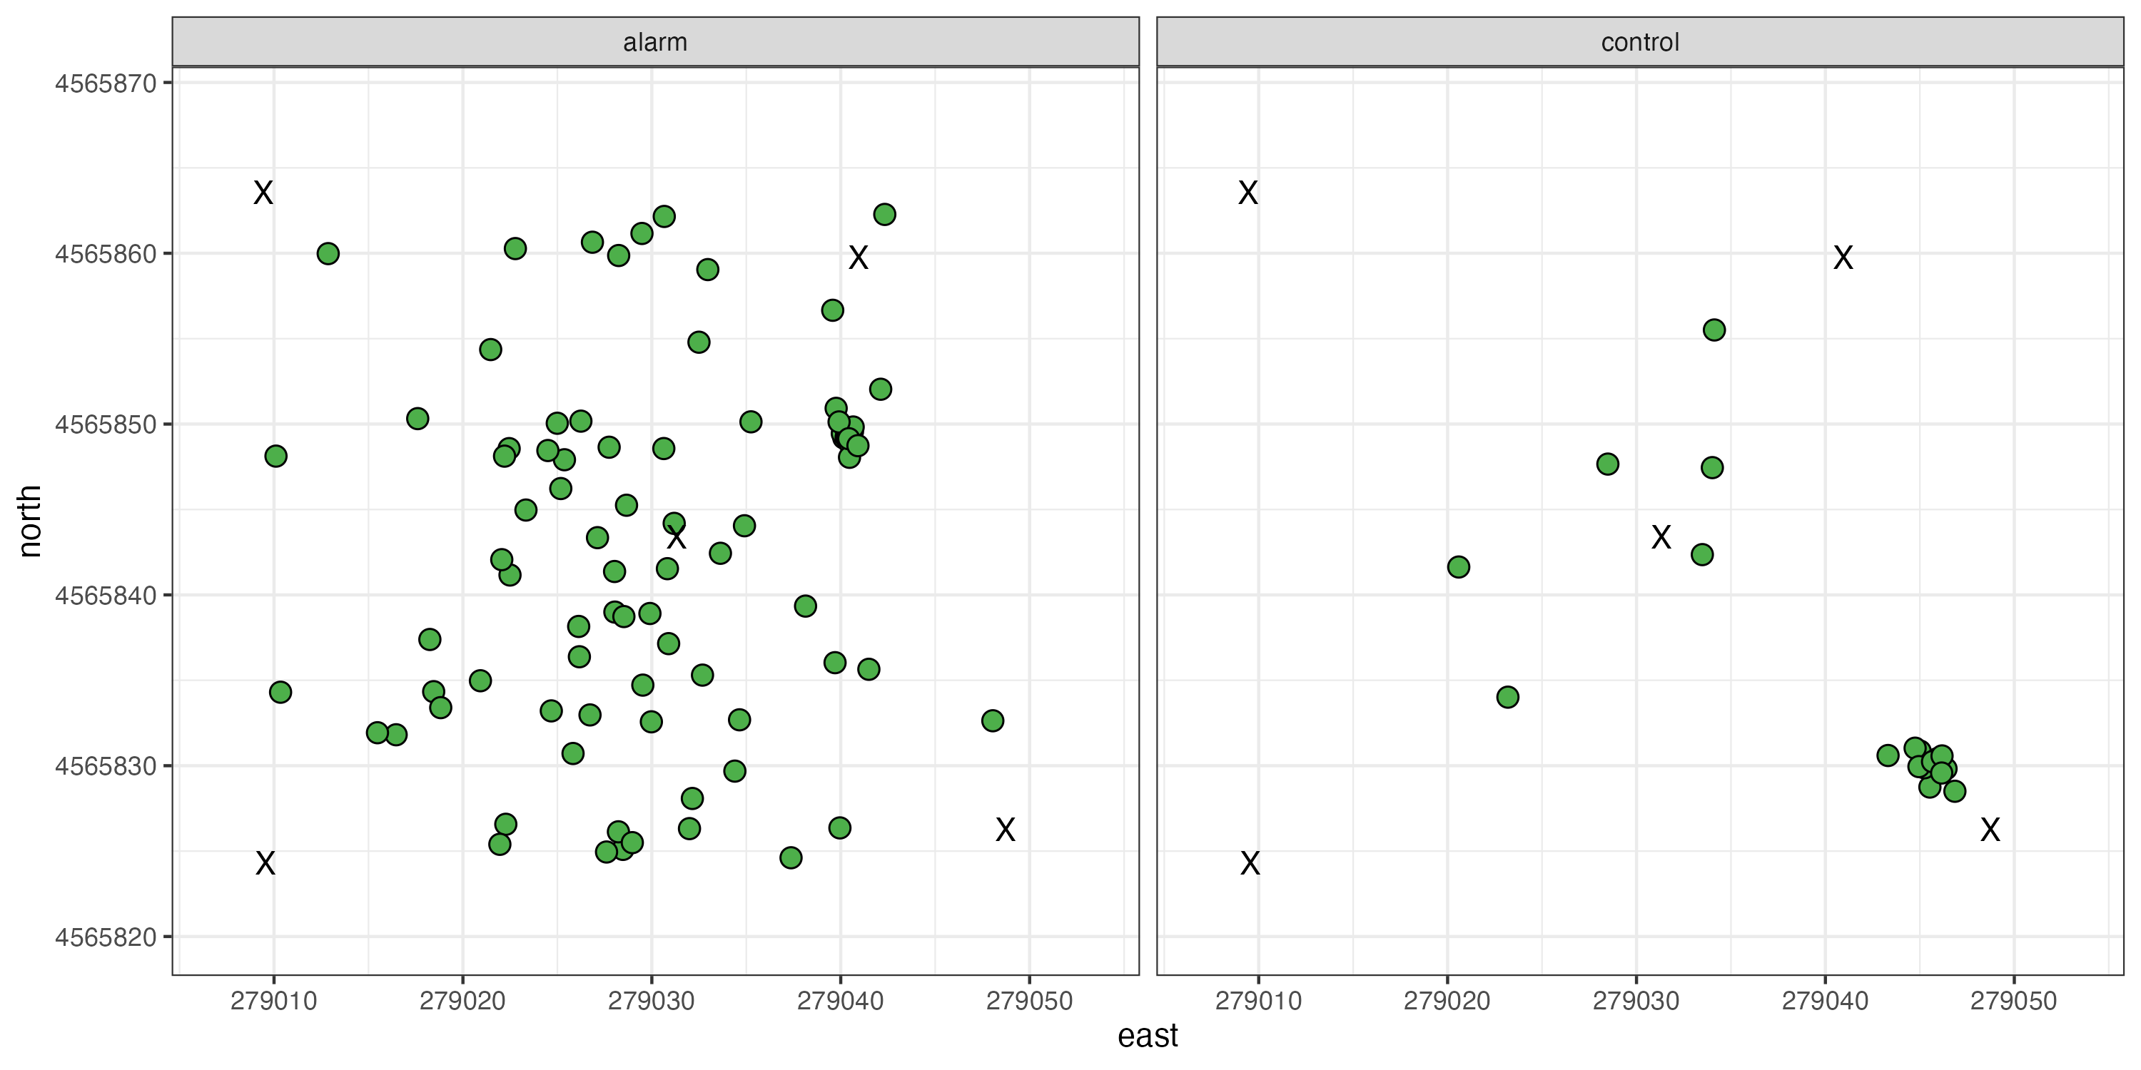
Other Redwing alarm calls

Slide 4
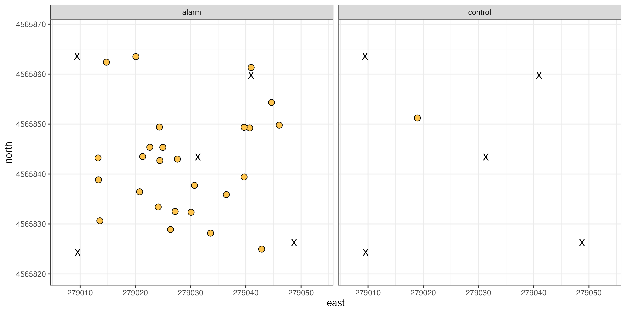
Other species alarm calls

Slide 5
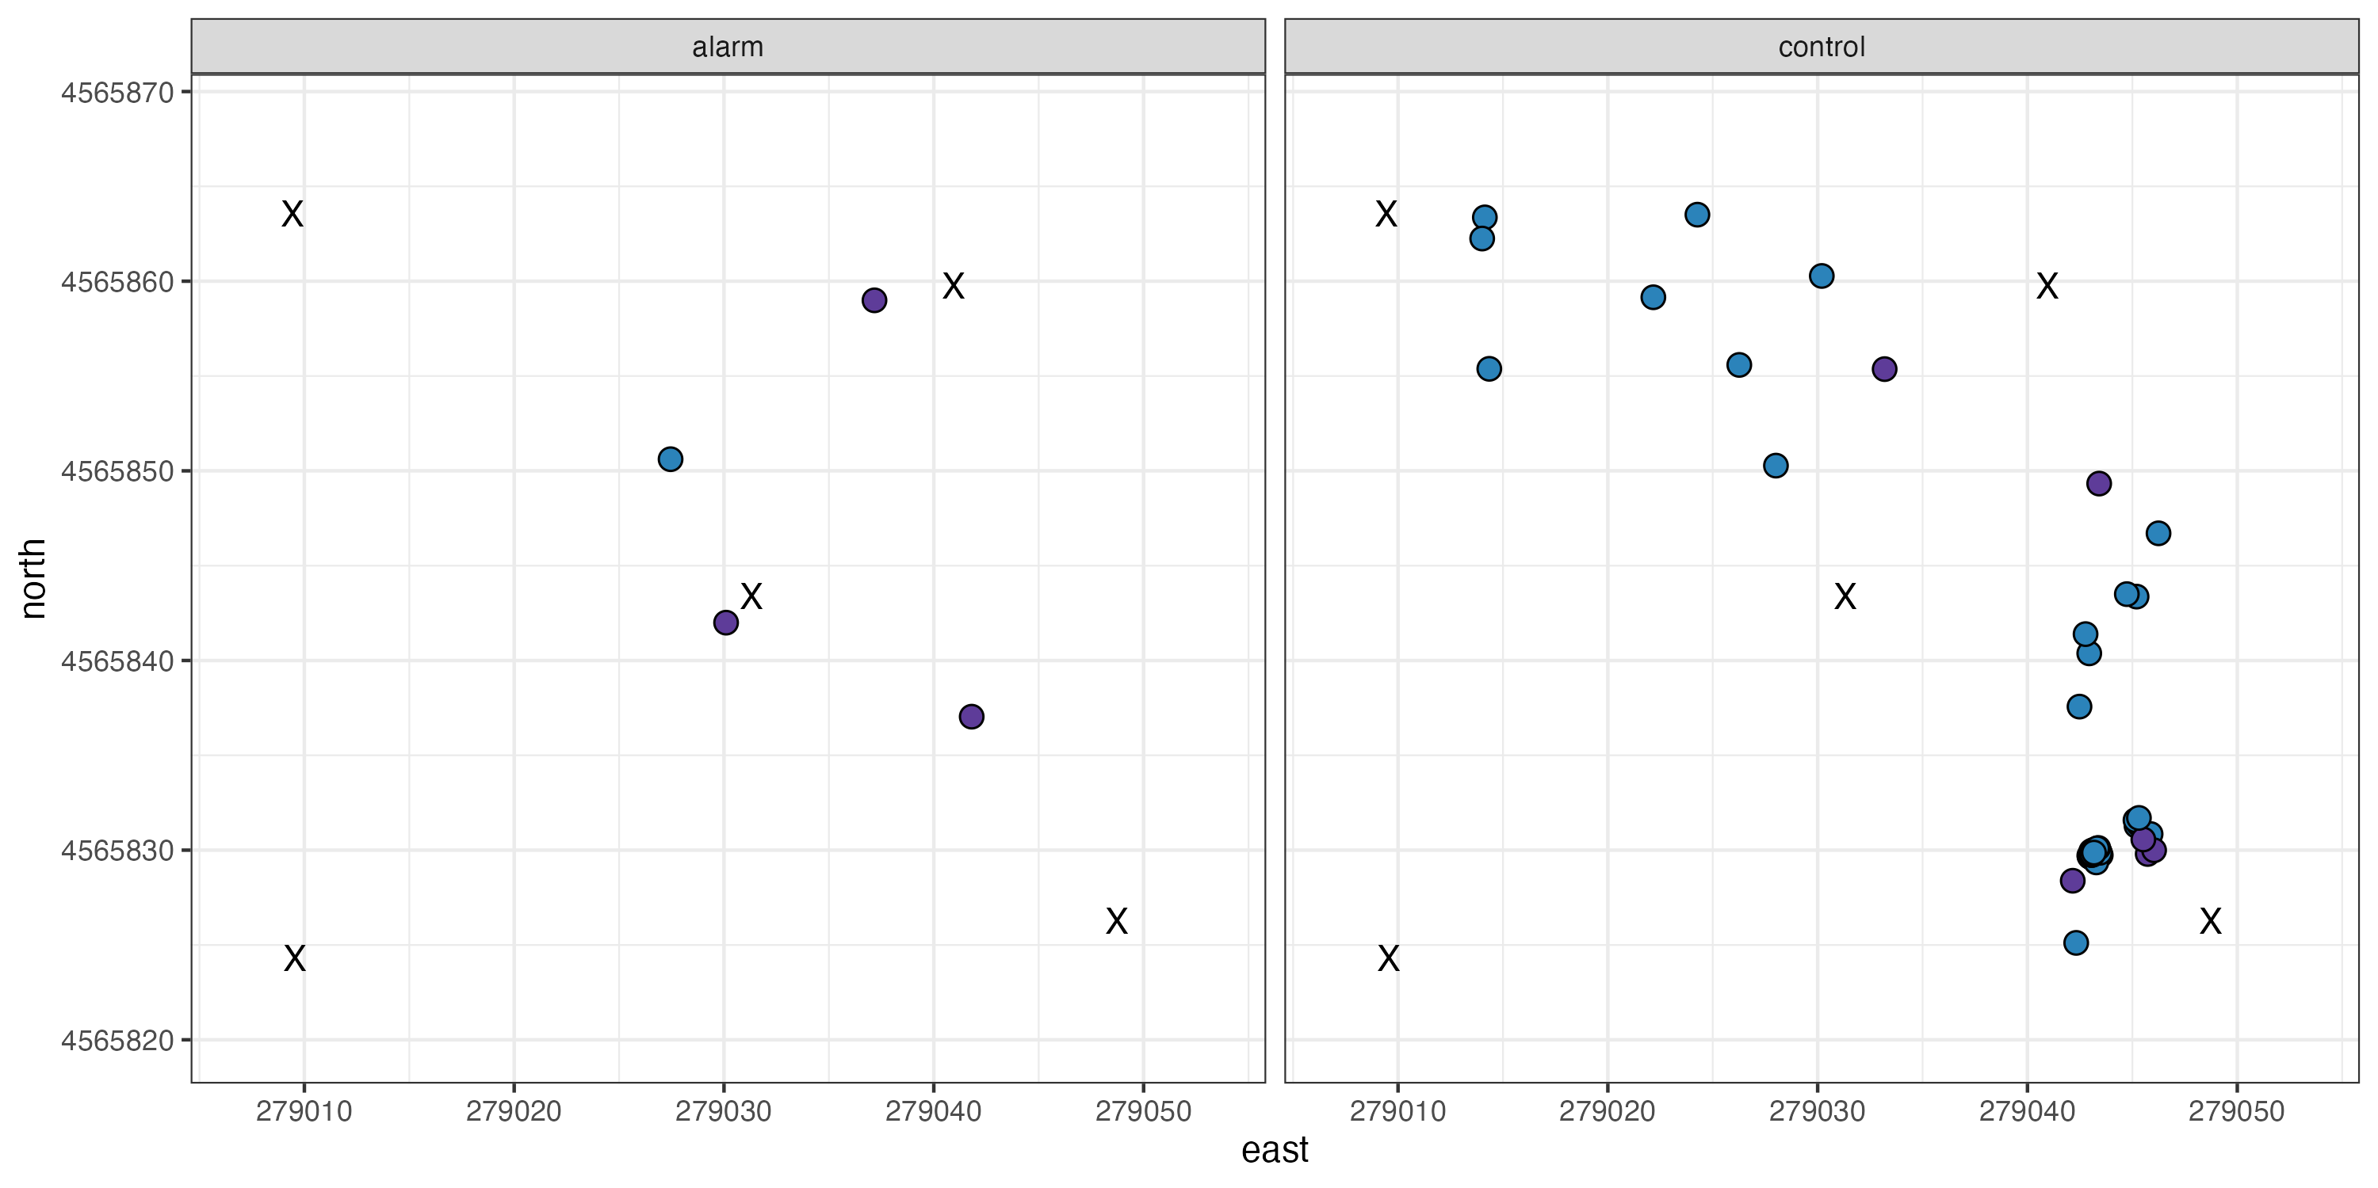
Songs (both redwings and other species)

Slide 6
All layers on top of each other

