Slide 1
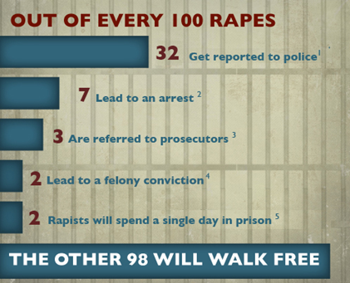



Sexual Assault is one of the most under reported crimes. 68% of assaults go unreported

Slide 3
What are some common concerns about reporting?
Fear, embarrassment, and shame.
Hesitation until the statute of limitations.
The perpetrator got scared away or stopped before finishing the assault. Attempted rape is a serious crime and can be reported.
I know the person who hurt me. About 2/3 of victims know the perpetrator.
I’ve been intimate with the perpetrator in the past, or am currently in a relationship with the perpetrator. Sexual assault can occur within a relationship.
I have no physical injuries, and I’m worried there’s not enough proof (ambiguity). Most sexual assaults do not result in external physical injuries.
I’m worried law enforcement won’t believe me (false accusation). There has been great investment in police training on this topic.
Difficult and tedious process that never experienced before. I don’t want to get in trouble. Sometimes minors are afraid of being disciplined, either by the law or by their parents, because they were doing something they shouldn’t have when the abuse occurred.
Articles from https://rainn.org/get-information/legal-information/reporting-rape

Slide 4


Breaking Down Barriers to Reporting
Use technology to provide a compelling reason and a safe way to report
We need a system that:
Provides easy-to-use diary style access
Educates victims
Ensures the privacy
Creates anonymized information
Smartphone application front end
Secure cloud server
Intelligent analysis tool as the backend system

Slide 5
The SANE App Requirements:
The privacy of both assaults and victims should be kept until a case is officially activated (by victims or law enforcement).
The victim/reporter’s secrete key can be deposited into the Cloud (to retrieve the data in case of the reporter’s absence due to the crime).
The data should be kept in the Cloud
Make sure no data or secret information remained in the user’s smartphone.
The information will be loaded and decrypted after a proper login.
Log out is required.
The data in the Cloud should be maintained in a strong security (even some hackers steal the data, they are not supposed to be able to identify/alter any the meaningful case).
the SANE system as a distributed security system. As an analogy, it is very similar to the (private vaults) Bank Safe Deposit Box Rentals. Using one key (either a client or banker) alone, one cannot access to the deposits. Only if both the bank and renter agree, the box can be accessed.
The data should be also handled with a strong privacy. Any researcher’s access to the data should not be directed to compromise the privacy (the researcher should not be able to find the identity by analyzing the data alone).

Slide 6
The SANE App functionalities:
Nickname and profile setup (one time setup)
Key deposit agreement (just incase of the absence of reporter (i.e., due to death, etc.), law enforcement can look up the record with warrant)
Agreement of some of anonymized information sharing (for the prevention and protection research purpose)
Diary (easy to record, texting style with some tagging (#”…”))
Evidence recording (voice recording and picture)
Q&A (survey style to begin with, but Siri or Alexa Style after all)
Need a good app name and mascot.

Slide 7
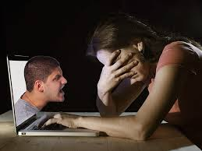





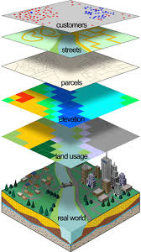





SAPE: Sexual Assault (SA) Protection, Prediction, and Education Service
The system consists of a front-end smartphone application, intelligent big data analysis tools, and a secure back-end cloud system.
The service enables easy-to-use secret diary and subject-matter expert (SME) led education for potential victims as well as generates SA related big data while ensuring the privacy & security.
Protection, Investigation, Intervention, and Correction
Secure Cloud
GIS
Secret Diary, Report
Education
Big Data Analytics
SAVE
Report
Led by School of Computer Engineering, School of Nursing, School of Medicine, and School of Law

Slide 8
SANE
3
4
APIs
General Data
Secured Identities
Dispatcher
2
1
APP
User Report App (easy-to-use, encrypt, picture, voice record)
Dispatcher (filter, classify, and encrypt)
Two data bases (general data and secured identities)
APIs for researchers and public officers

Slide 9
The SANE app can be used for the educational purposes:
Minors may not understand consent and what sexual assault is
It starts with simple questions, leading to more targeted questions
During the Q&A process the screen color will turn “RED” as the situation becomes serious enough to report
Q1. do you know the person?
Q2. How long …?
….
Q1. How open do you …?
Q2. How long …?
….
Q1. Are you …?
Q2. How long …?
….
Q1. do you know the person?
Q2. How long …?
….
Save
Save
Report
Save
Several related occasions

Slide 10
More data
More protection
SANE
1
2
6
Secured Identities
General Data
Inclusive Cyber bullying
5
Dispatcher
3
Big Data Analytics
4
When a symptom is found
APP
Police ask SANE for the contact
SANE finds the contact from the dispatcher
Dispatcher contact the app
When the user approve,
The dispatcher access to the secured identities
Chastise the SA case

