Slide 1

Financial Analysis of Nvidia
By: Dante Shoghanian & Wanqui Zhang

Slide 2
Agenda
Company Profile
Strategic Goals
Recent Performance highlights
Supply Chain Structure
Industry Demand Trends
Competitor Comparison
Balanced Scorecard
SWOT Analysis
Financial Forecast
Key Recommendations
Conclusion
Sources

Slide 3
Company Profile
Nvidia is categorized as a global technology company known for designing graphics processing units (GPU). The use cases for these products are in high-performance computing, visualizations, as well as gaming. Due to GPUs, they are also one of industry leaders in the realm of artificial intelligence (AI). Alongside the GPUs they develop the necessary software and hardware solutions for data centers, automotive industry as well as cloud applications.
Notable Events Timeline
1993 – Nvidia Founded
1999 – First GPU (GeForce 256)
2006 – CUDA Platform Released
2016 – AI Expansion
2020- Data Center Leadership
2022- ARM Acquisition Attempt
2023 – Gaming & AI Leadership

Slide 4
Strategic Goals
Expand AI & Machine Learning leadership
Invest in AI technologies in healthcare, data centers, visualizations, and gaming
Autonomous Technology
Lead development of AI platforms such as Nvidia DRIVE to host autonomous innovation
Gaming Leadership
Continue to remain leaders in the industry with further advancement of real-time ray tracing and AI-enhanced graphics
Diversification
Reach new markets, including professional visualizations such as Omniverse as well as diving into cloud services

Slide 5
Recent Performance highlights

Slide 6
Supply Chain Structure
Sourcing
Components such as semiconductors and raw materials are obtained from global suppliers: Micron, SK Hynix, and Samsung
Manufacturing
Nvidia outsources its manufacturing to foundries associated with Taiwan Semiconductor Manufacturing company (TSMC) and Samsung which handle the fabrication of chips (5nm, 4mn, 3mn)
Advanced Lithography
Assembly and Testing
Product assembly, testing, and packaging is done with partners within Taiwan, ASE Technology and South Korea, Amkor Technology
Distribution
The products are distributed globally through a network of logistic providers and partners such as: A2 Global Electronics + Solutions, AIChipLink Technology, Fusion Worldwide, NewPower Worldwide, and North Shore Components
Products are shipped to OEMs (Original Equipment Manufacturers), retailers, and data centers
Logistics
Global Shipping Partners include FedEx, UPS, and DHL, These partners handle shipping with both air and sea freight
Warehouse Management Systems (WMS) and Enterprise Resource Planning (ERP) to manage inventory, track product movement, and optimize warehouse operations

Slide 7
Supply Chain Structure
Sourcing
Micron, SK Hynix, and Samsung
Manufacturing
TSMC and Samsung
Distribution
A2 Global Electronics + Solutions AIChipLink Technology, Fusion Worldwide, NewPower Worldwide, and North Shore Components
Logistics
FedEx, UPS, and DHL
Warehouse Management Systems (WMS) and Enterprise Resource Planning (ERP)
Assembly and Testing
ASE Technology and Amkor Technology

Slide 8
Industry Demand Trends

Slide 9
Industry Demand Trends
Cloud Computing – GPUs are used in major platforms such as Amazon web services (AWS), Microsoft Azure, Google Cloud Platform (GCP), and IBM Cloud
Gaming – GeForce GPUs high performance graphics. RTX real time ray tracing and AI enhanced graphics. GeForce NOW, streaming service
Data Centers – GPUs acceleration for AI training, high performance computing, and data analytics. CUDA Platform, Networking, AI enterprise Suite software
AI – GPU acceleration for deep learning and machine learning, optimized libraries for AI model development
Automotive – Partnerships Mercedes-Benz, Jaguar Land Rover, Volvo, Hyundai, Tesla, Polestar, Lucid, Amazon Zoox, General motors Cruise, Li Auto, BYD, Xpeng, Nio, Zeekr

Slide 10
Competitor Comparison 2024
KPIs | NVIDIA | AMD | Comparison
Revenue (millions) | 60922 | 23276 | 37646
Net Profit Margins | 48.8% | 5.8% | 43.0%
Return on Equity | 69.2% | 2.4% | 66.8%
Return on Assets | 45.3% | 2.0% | 43.3%
Earnings per Share | $12.1 | $0.84 | 11.24
DSI (Inventory to Sales) | 114.6 | 139.8 | 25.2
DSO (Sales to Cash) | 41.4 | 87.2 | 45.8
DPO (Purchase to Payment) | 42.7 | 156.6 | 113.9
Cash Conversion Cycle | 113.3 | 40.4 | 72.9
Current Ratio | 4.2 | 2.8 | 1.4

Slide 11
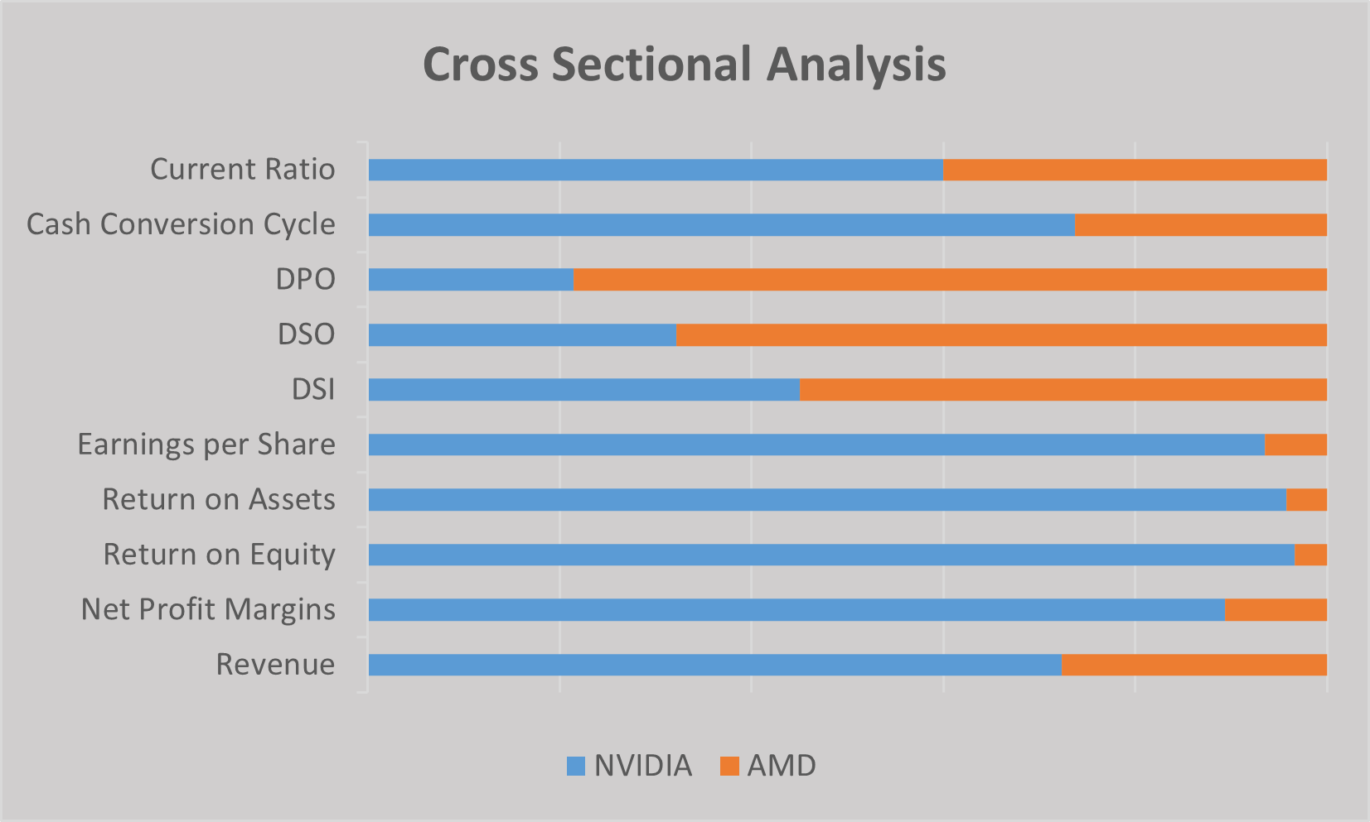
Competitor Comparison 2024

Slide 12
Balanced Scorecard
Learning and Growth
Internal Processes
Customer
Financial
Enhance Demand Forecasting and Product Transition
Innovation and Adaptability
Talent Retention
Diversify Manufacturing
Customer Retention and Satisfaction
Maximize Operating Profitability
Increase R&D resources
Employee Engagement Programs
Expand Partnerships with Global Foundries
Implement Advanced Demand Forecasting Models
Expand into new markets
Cost Optimization Programs
Product releases
Turnover rate
Reduce Lead Times
Improve Demand Forecast
Increase adoption rate
Operating Income Growth
6-10 per year
< 3% per year
15%
10%
15%
12%

Slide 13
SWOT Analysis
SWOT
Strengths
Market position in computing
Innovation and Leadership
Partnerships and Acquisitions
Global Presence
Weaknesses
Dependent to Third-Party Suppliers and manufacturing
Concentrated Revenue
Demand Forecast
Product Defects
Opportunities
Growing Demand
Expansion in industries
Data Privacy and Cybersecurity
Sustainability
Threats
Competition
Economic and geopolitical uncertainty
Regulations
Technology Disruption

Slide 14
Financial Forecast

Slide 15
Financial Forecast

Slide 16
Key Recommendations
Improve Supply Chain Resilience
Diversify Suppliers: Obtain different geographic locations to avoid any type of dependences on specific regions
Long-Term contacts: Securing long-term contracts would help ensure product availability
Expanding into healthcare
Medical Technology: Works with imagine processing units such as MRIs, CT scans, and X-rays with NVIDIA GPUs
Genomics: Using high computing power to perform analysis, aiding in personalized medicine
R&D
Quantum computing: prepare for the next advancements in computing power
Next-Gen GPU: continue with the research to advance the capability of chips

Slide 17
Conclusion
Market Leadership in GPUs
Data centers, gaming, and professional visualization
AI & ML
GPUs capability of handling the workloads
Expansion into New Markets
Healthcare, IoT, and autonomous vehicles
Obtaining Partnerships
Nvidia continues to partner with industry leaders
Investment Considerations
Growth Potential
Strong demand in virtual all sectors of technology
Financial Performance
Increase revenue and profitability
Market opportunities
Expansion into various industries created new sources of revenue
Risks and Challenges
Competition and regulations may impact growth
Notes:
Dante

Slide 18
Sources
Revenue
https://www.cnbc.com/2024/10/03/nvidia-ceo-demand-for-blackwell-ai-chip-is-insane.html
https://techcrunch.com/2023/03/21/nvidia-partners-with-google-cloud-to-launch-ai-focused-hardware-instances/
https://www.nasdaq.com/articles/where-will-nvidia-stock-be-2025#:~:text=Consensus%20estimates%20forecast%20Nvidia%20to,increase%20from%20the%20previous%20year.
https://www.sec.gov/ix?doc=/Archives/edgar/data/1045810/000104581024000029/nvda-20240128.htm
Cost of Revenue
https://www.reuters.com/technology/nvidia-says-us-speeded-up-new-export-curbs-ai-chips-2023-10-24/
https://nvidianews.nvidia.com/news/nvidia-announces-financial-results-for-second-quarter-fiscal-2025
https://a2globalelectronics.com/shortage-mitigation/need-chips-node-size-determines-semiconductor-availability/#:~:text=Prepayments%20are%20Becoming%20the%20Norm&text=In%20December%2C%20AI%20leader%20NVIDIA,the%20most%20advanced%20memory%20chips.
https://www.tomshardware.com/news/tsmc-collects-huge-prepayments
https://www.sec.gov/ix?doc=/Archives/edgar/data/1045810/000104581024000029/nvda-20240128.htm
Supply Chain
https://www.nasdaq.com/articles/better-artificial-intelligence-ai-stock-nvidia-vs-tsmc#:~:text=As%20it%20turns%20out%2C%20Nvidia,chip%20manufacturing%20capacity%20to%20Nvidia.
https://www.moomoo.com/community/feed/nvidia-supply-chain-in-one-chart-who-are-the-suppliers-111805778165765
https://www.sec.gov/ix?doc=/Archives/edgar/data/1045810/000104581024000029/nvda-20240128.htm
SWOT
https://www.sec.gov/ix?doc=/Archives/edgar/data/1045810/000104581024000029/nvda-20240128.htm
Balanced Scorecard
https://www.sec.gov/ix?doc=/Archives/edgar/data/1045810/000104581024000029/nvda-20240128.htm
Strategic Goals
https://www.sec.gov/ix?doc=/Archives/edgar/data/1045810/000104581024000029/nvda-20240128.htm
Market Trends
https://www.statista.com/outlook/tmo/data-center/worldwide#revenue
https://www.alliedmarketresearch.com/autonomous-vehicle-market
https://www.statista.com/outlook/dmo/digital-media/video-games/worldwide#revenue

Slide 19
Sources
https://finance.yahoo.com/news/nvidia-stock-climb-next-12-025439259.html
https://www.nytimes.com/2024/09/13/business/nvidia-stock-market-ai.html
https://www.sec.gov/ix?doc=/Archives/edgar/data/1045810/000104581024000029/nvda-20240128.htm
https://www.investopedia.com/nvidia-stock-rebounds-best-way-to-play-artificial-intelligence-8712187
https://finance.yahoo.com/news/nvidia-faces-investor-scrutiny-over-171203643.html
https://www.nytimes.com/2024/06/18/technology/nvidia-most-valuable-company.html?searchResultPosition=3
https://www.nytimes.com/2024/08/06/technology/nvidia-antitrust-scrutiny.html?searchResultPosition=8
https://www.nytimes.com/2024/08/29/technology/apple-nvidia-openai.html?searchResultPosition=5
https://www.nytimes.com/2024/01/29/technology/ai-chips-nvidia-amazon-google-microsoft-meta.html?searchResultPosition=14
https://www.nytimes.com/2023/11/21/business/nvidia-revenue-earnings.html?searchResultPosition=10

