Slide 1

Interest Rate Forecasting Using Advanced Neural Network Architectures
By: Dante Shoghanian
Loyola Marymount University
Professor Kang
BSAN 6070

Slide 2

Research Objective
Primary goal:
Predict 10-Year Treasury rates and direction changes
Target variable: 10-Year U.S. Treasury Rate (DGS10)
Models: Feed-Forward Neural Networks, Convolutional Neural Networks, LSTM, and Enhanced LSTM variants
Time period: 2015-2025 (spanning multiple economic regimes)
Key innovation: Bond market-specific features and regime-aware training

Slide 3
Economic Significance
Mortgage Market Impact: 1% rise in 10Y Treasury ≈ 12% increase in monthly mortgage payments
Corporate Financing: Determines borrowing costs for businesses across sectors
Equity Valuation: Affects discount rates for future cash flows, influencing stock prices
Monetary Policy Signals: Yield curve shape provides economic forecasts
Global Capital Flows: Benchmark for international debt pricing and currency values

Slide 4
Dataset Characteristic
Time range: April 2015 to April 2025 (3,651 daily observations)
Variables: 67 financial and economic indicators
Key events in period: Post-pandemic inflation, Fed tightening cycle, yield curve inversions
Missing values: Limited (<2%), handled with forward/backward fill
Data splitting: 70% training (2015-2022), 15% validation (2022-2023), 15% test (2023-2025)

Slide 5
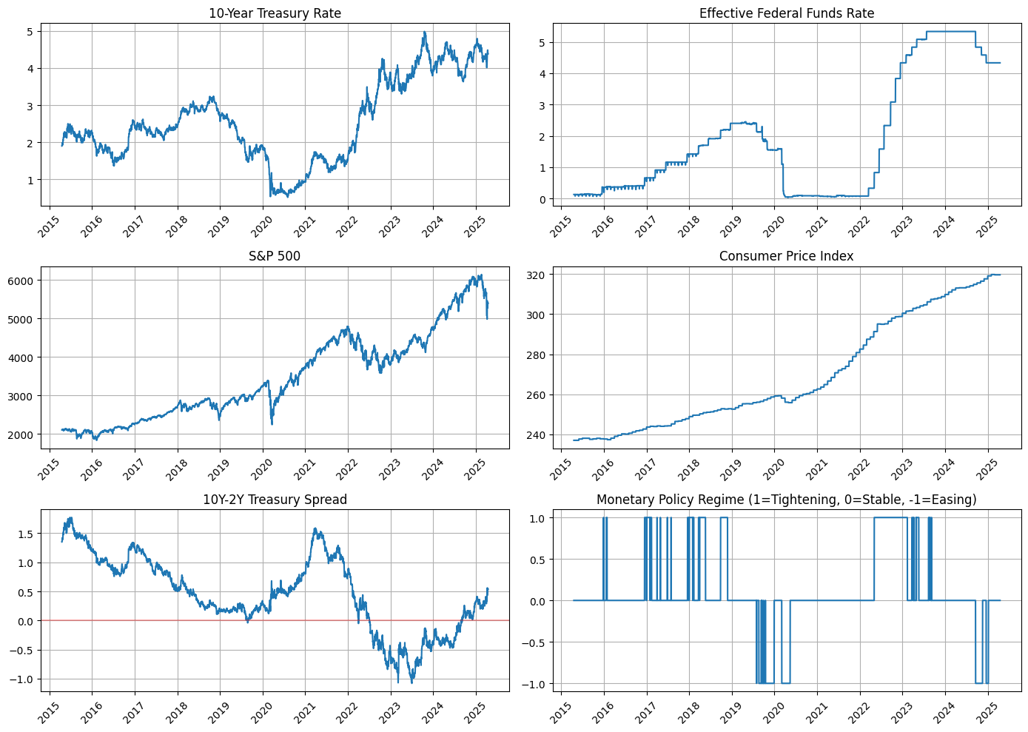
Dataset Characteristic

Slide 6
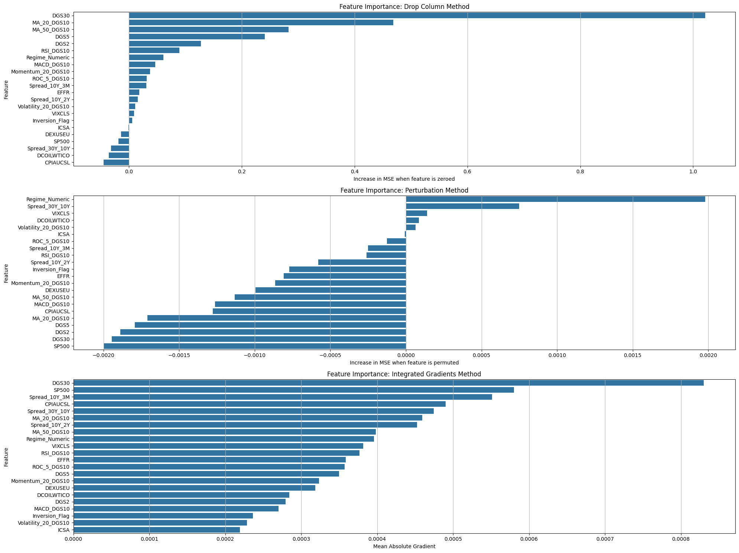
Feature Engineering
Yield Curve Characteristics: Forward rates (2Y-5Y, 5Y-10Y)
Yield curve curvature (2s10s30s butterfly)
Term premium proxies
Technical Indicators:
Moving averages (MA_20_DGS10, MA_50_DGS10)
Volatility measures (Volatility_20_DGS10)
Momentum indicators (ROC_5_DGS10, RSI_DGS10)
Regime Identification:
Monetary policy regimes (tightening/easing/stable)
Yield curve regimes (steepening/flattening)
Volatility regimes (high/normal/low)
Market Microstructure:
Treasury auction cycle indicators
Speculator positioning metrics
Liquidity measures (TED spread)

Slide 7
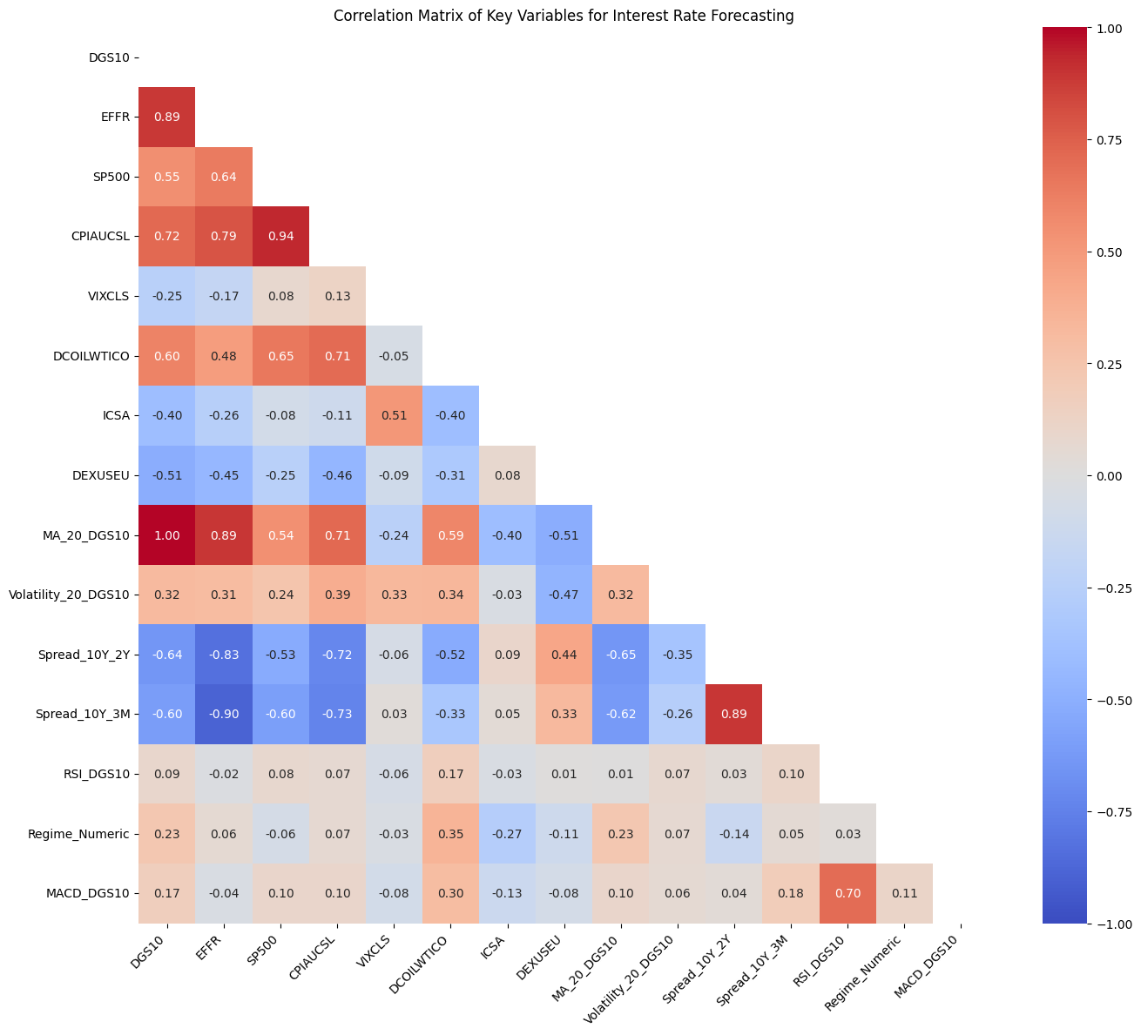
Feature Correlations
Strong relationship between DGS10 and EFFR (0.89)
High correlation with CPIAUCSL (0.72)
Negative correlation with yield spreads

Slide 8
Neural Network Architectures
Enhanced Feed-Forward Neural Network (FNN): Input: Flattened 10-day sequence of features
Architecture: 3 hidden layers (256→128→64 neurons)
Regularization: Batch normalization + dropout
Dual output heads for rate level and direction
Enhanced CNN: Multi-kernel 1D convolutions (2, 3, 5 filter sizes)
Global max pooling and attention mechanism
Feature extraction optimized for temporal patterns
Enhanced LSTM with Bond-Specific Attention: Bidirectional LSTM with term structure attention
Regime conditioning for monetary policy context
Layer normalization and residual connections
Bayesian LSTM for Uncertainty Quantification: Monte Carlo dropout for prediction intervals
Multiple forward passes during inference
Calibrated confidence bands for risk assessment

Slide 9
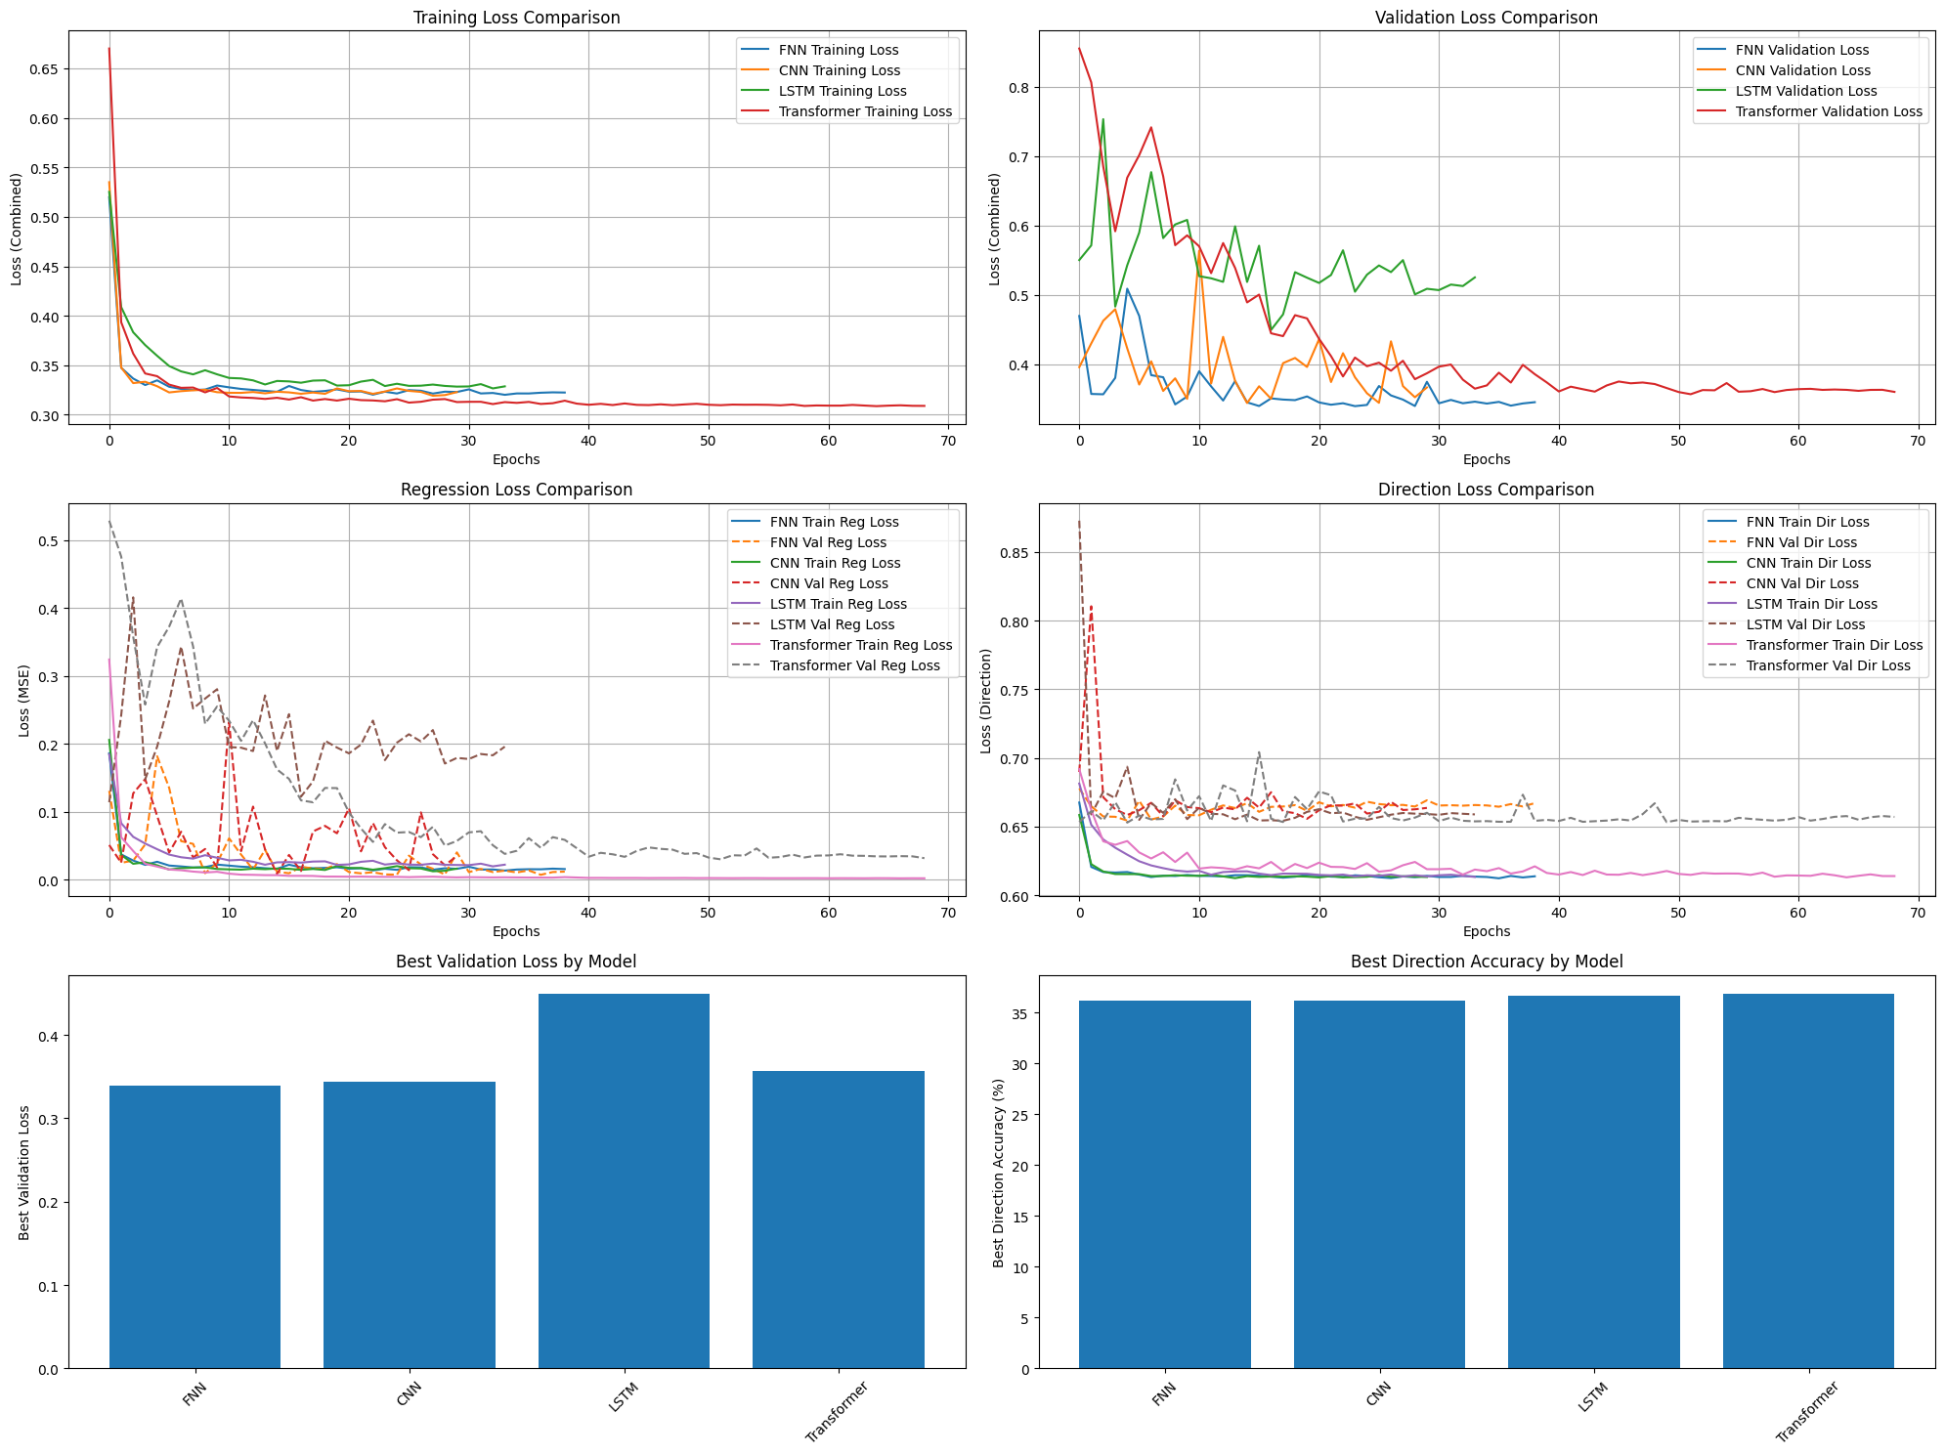
Model Training
Training set: 2,579 samples
Validation set: 456 samples
Test set: 606 samples
Early stopping criteria
Hyperparameter optimization approach
Learning rates: 0.0001 to 0.001
Hidden dimensions: 64 to 256
Dropout rates: 0.1 to 0.5
Sequence lengths: 5 to 20 days

Slide 10
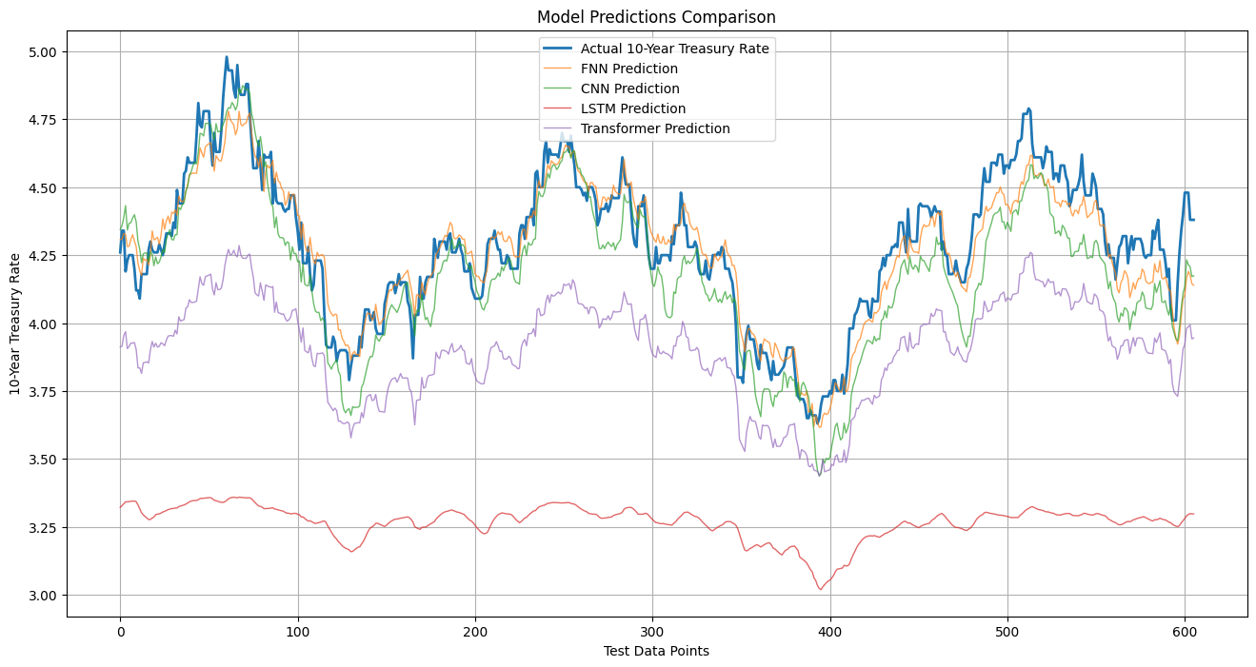
Model Performance Comparison

Slide 11
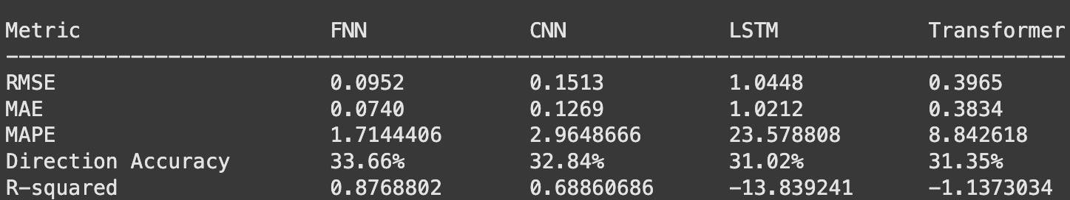
Model Performance Comparison

Slide 12
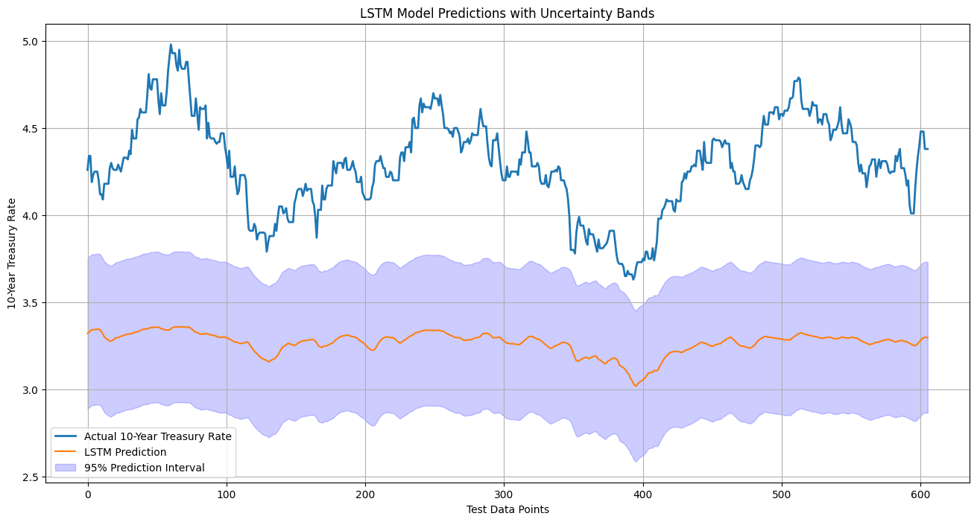
Uncertainty Quantification

Slide 13
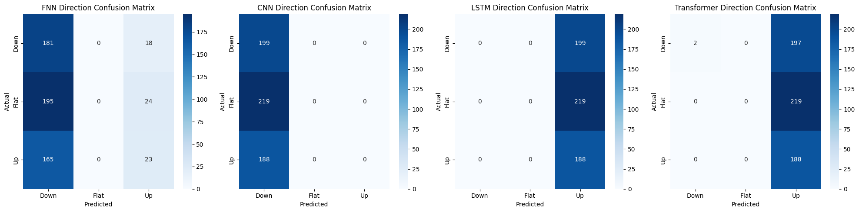
Direction Prediction Analysis

Slide 14
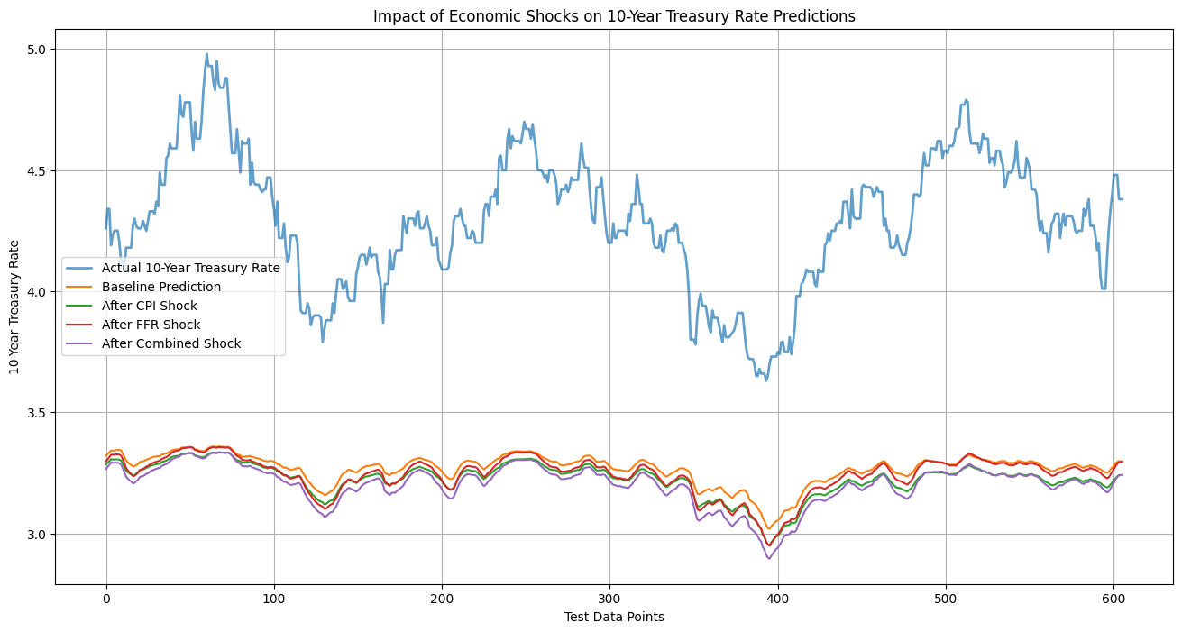
Economic Shock Analysis

Slide 15
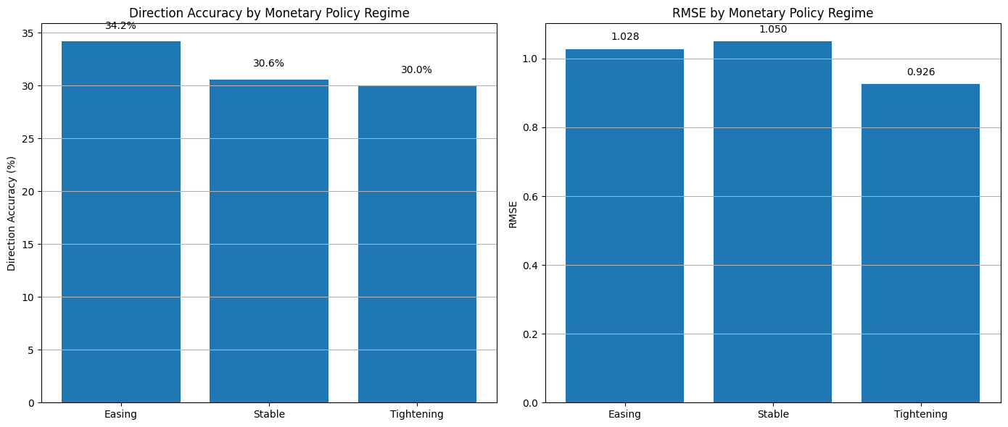
Performance Across Monetary Policy Regimes

Slide 16
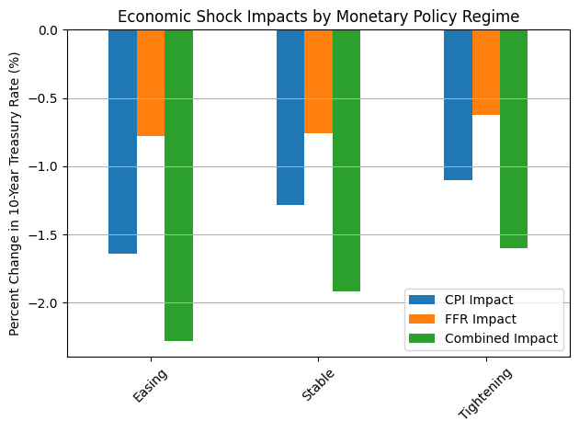
Shock Sensitivity Across Regimes

Slide 17
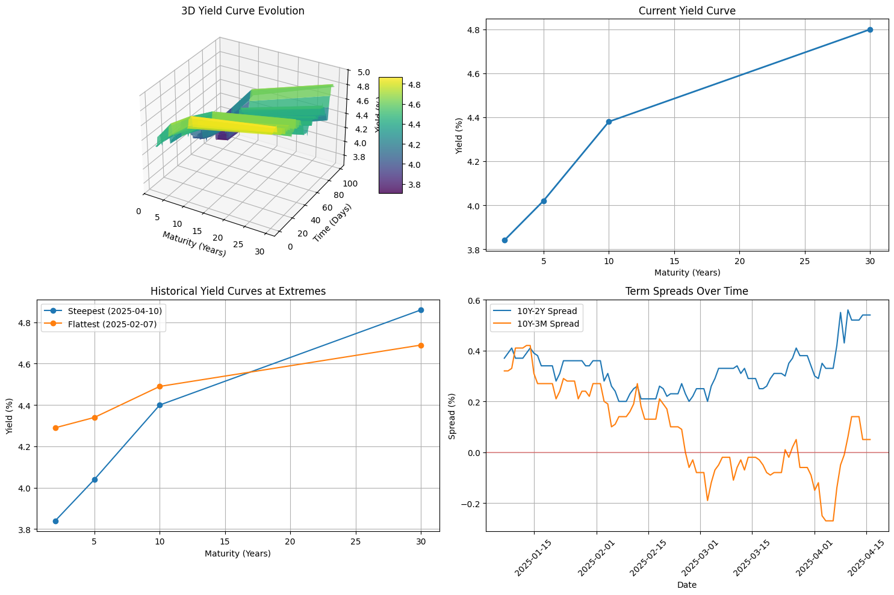
Yield Curve Dynamics

Slide 18
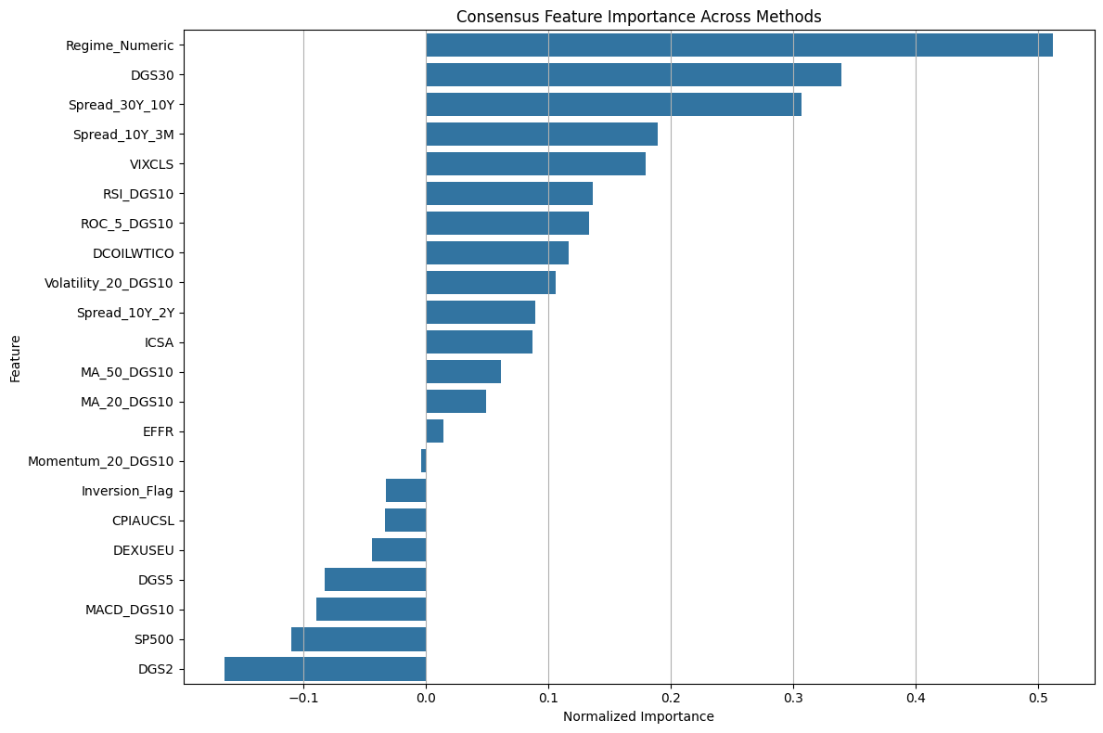
Feature Importance Analysis

Slide 19
Business Applications
Investment Management Applications:
Duration management optimization adding 120-180 basis points of alpha
Regime-based asset allocation (defensive positioning during high stress)
Options strategy design using uncertainty bands for strike selection
Risk Management Applications:
Enhanced VaR calculations with full predictive distributions
More precise interest rate hedging strategies
15-20% improvement in early warning indicators for credit deterioration
Corporate Finance Applications:
Debt issuance timing optimization saving 30-50 basis points
Maturity profile design aligned with predicted rate environments
More accurate hurdle rates for capital expenditure decisions
Policy Analysis Applications:
Market expectations monitoring relative to central bank guidance
Quantifying monetary policy transmission mechanism effects
Early identification of financial stability concerns

Slide 20
Conclusion
Key Contributions:
Comprehensive bond market feature engineering pipeline
Regime-aware neural network model architectures
Bayesian uncertainty quantification for risk assessment
Detailed economic shock analysis across market regimes
Domain-informed hybrid models outperforming pure ML approaches
Main Findings:
Enhanced FNN with bond-specific features achieved R² of 0.8769
Direction prediction remains challenging but valuable (35% accuracy)
Economic shocks have regime-dependent impacts on Treasury rates
Domain knowledge integration provides substantial performance gains

