Slide 1

Indexed Search Tree (Trie)
Nelson Padua-Perez
Chau-Wen Tseng
Department of Computer Science
University of Maryland, College Park

Slide 2


Indexed Search Tree (Trie)
Special case of tree
Applicable when
  Key C can be decomposed into a sequence of subkeys C₁, C₂, … C_{n}
  Redundancy exists between subkeys
Approach
  Store subkey at each node
  Path through trie yields full key
Example
  Huffman tree
C₁
C₂
C₃
C₃
C₄

Slide 3

Tries
Useful for searching strings
  String decomposes into sequence of letters
  Example
    “ART” ⇒ “A” “R” “T”
Can be very fast
  Less overhead than hashing
May reduce memory
  Exploiting redundancy
May require more memory
  Explicitly storing substrings
A
R
S
E
T
“ART”

Slide 4
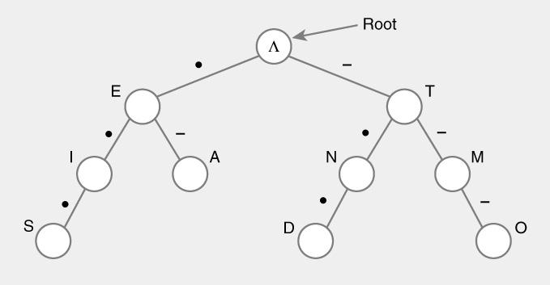
Standard Tries
Approach
  Each node (except root) is labeled with a character
  Children of node are ordered (alphabetically)
  Paths from root to leaves yield all input strings
Trie for Morse Code

Slide 5
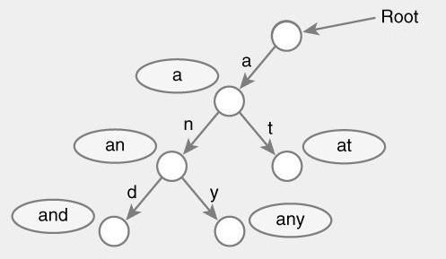
Standard Trie Example
For strings
  { a, an, and, any, at }

Slide 6
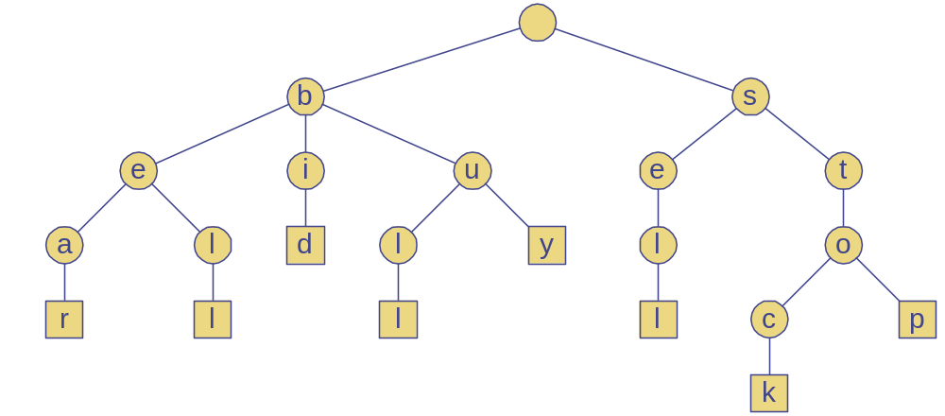
Standard Trie Example
For strings
  { bear, bell, bid, bull, buy, sell, stock, stop }

Slide 7
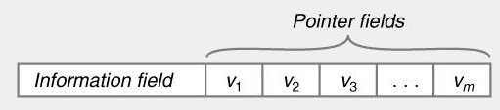
Standard Tries
Node structure
  Value between 1…m
  Reference to m children
    Array or linked list
Example
  Class Node {
    Letter value; // Letter V = { V₁, V₂, … V_{m} }
    Node child[ m ];
  }

Slide 8
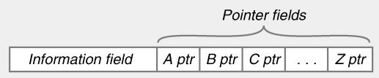
Standard Tries
Efficiency
  Uses O(n) space
  Supports search / insert / delete in O(d×m) time
  For
    n total size of strings indexed by trie
    d length of the parameter string
    m size of the alphabet

Slide 9
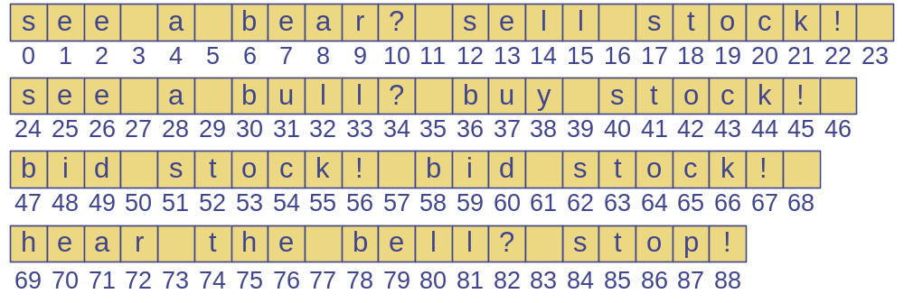
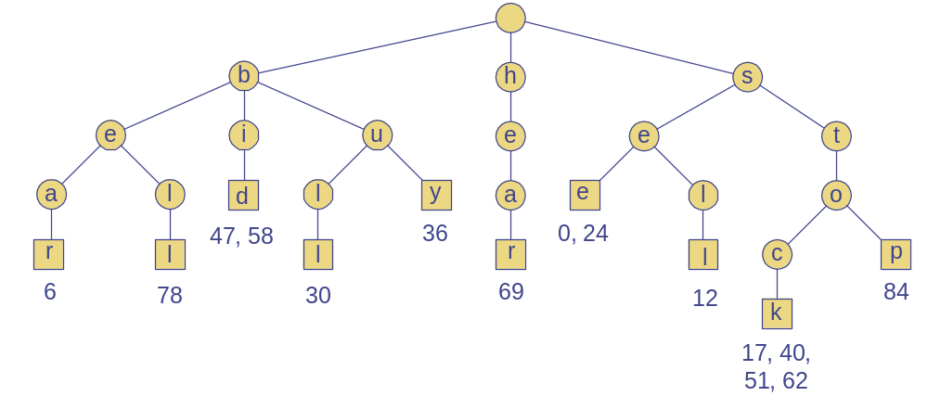
Word Matching Trie
Insert words into trie
Each leaf stores occurrences of word in the text

