Slide 1
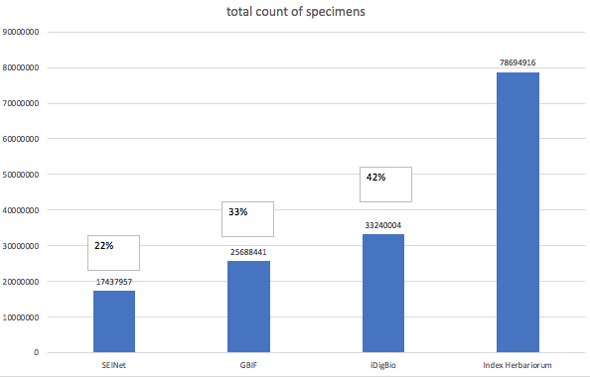
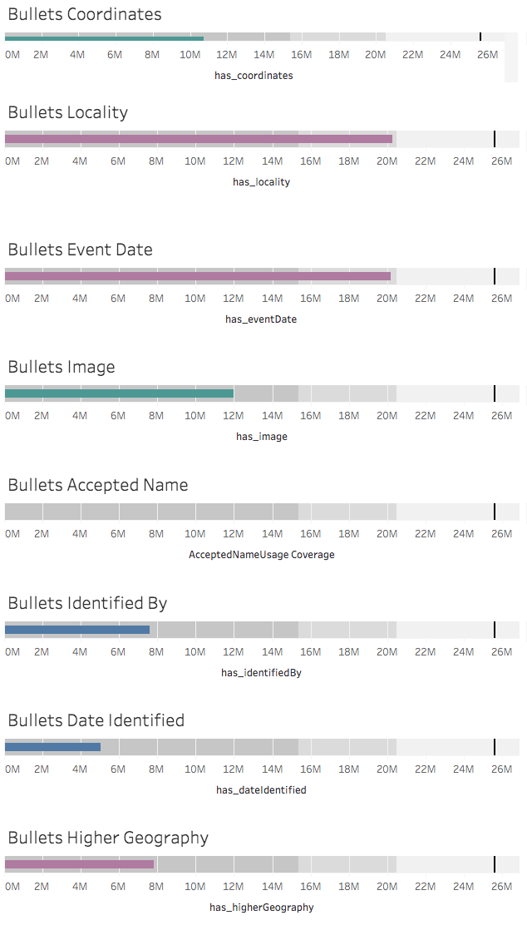
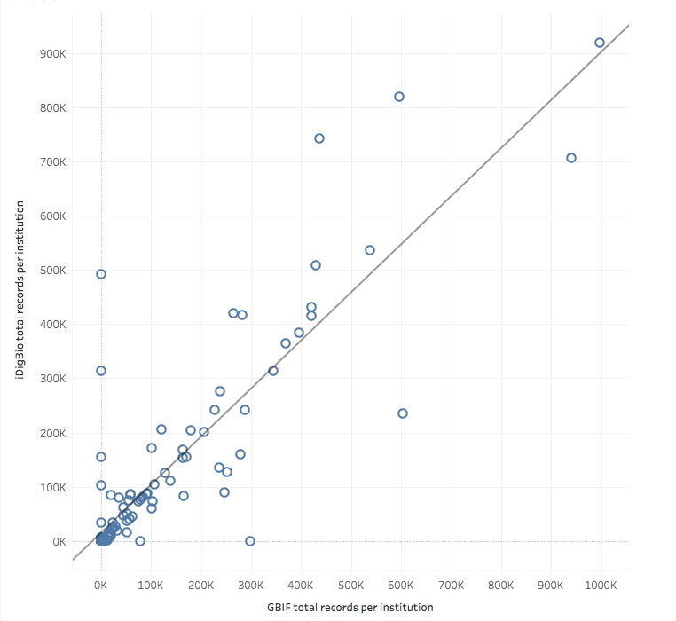
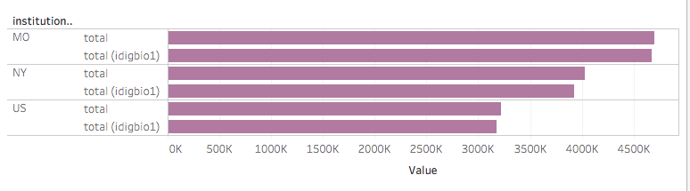
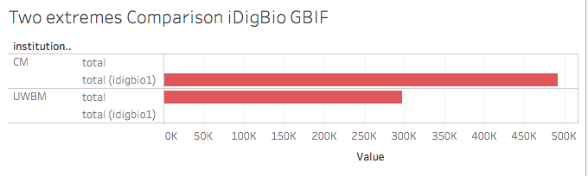
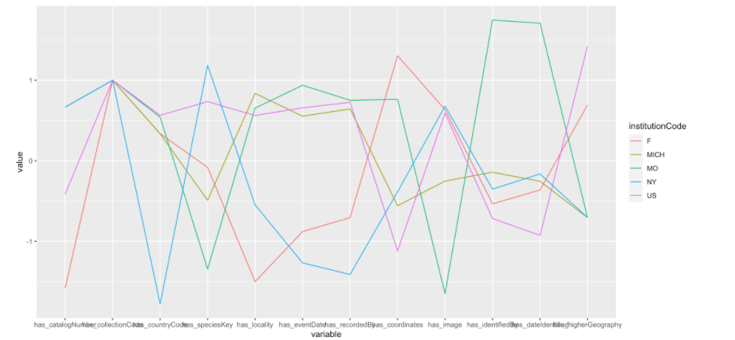
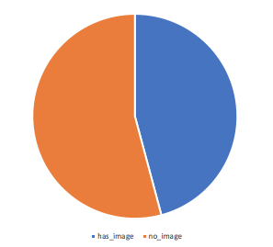
How close are we to our goal of making all botanical specimen information in US collections available online?
How close are we to high quality digitization?
GBIF
iDigBio
Symbiota
Violin plots (not histograms) for top three vars, for iDigBIo and GBIF
Collection codes
Locality
Image
What degree of overlap exists between the records available on GBIF and on iDigBio?
Sankey diagram here
How do institutions compare in terms of digitization priorities?
Collection codes
MO
NY
Locality
US
Image
MO
NY
US

