Slide 1




Capstone Project Comprehensive Product Strategy Shridhar Dhuri
Objective: Deliver a robust strategy for launching “SpectraVision”. A comfort-focused eye shield for spectacle wearers in theaters.
Focus: Align market needs, development processes, and AI-driven innovation to create a customer-first product experience.
Deliverables: A detailed written report and this executive presentation outlining strategy, validation, pricing, and long-term growth.

Slide 2
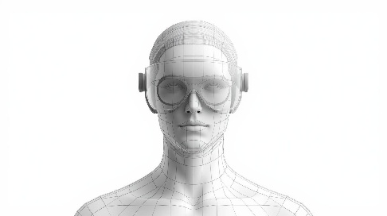
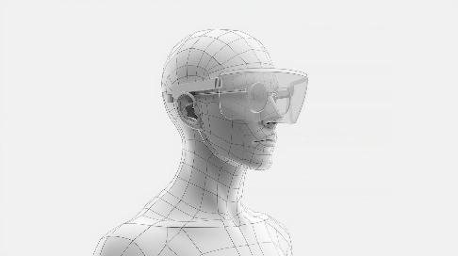
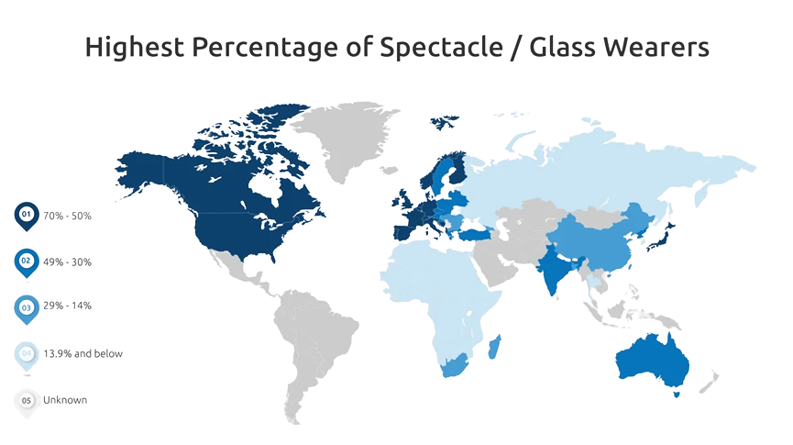
Product Concept and Market Opportunity
Product Concept and Market Fit
Concept:
A curved eye shield designed for spectacle users to comfortably enjoy 3D cinema without hassle.
Target Audience:
Urban movie-goers aged 18–45, families, frequent cinema visitors, and multiplex operators.
Market Opportunity:
30–40% of adults globally wear spectacles.
Premium cinema experiences are growing, but spectacle users face discomfort with existing solutions.

Slide 3

Strategy Highlights
Development, Testing, and Go-to-Market
Validate using surveys (Van Westendorf, Kano analysis) and feedback loops
prototyping, pilot testing in select theaters
Build an MVP using Agile frameworks
scaling through partnerships
Begin with MVP trials and later refine based on user data
Development
Testing
Positioning and Differentiation: For spectacle wearers seeking comfort and premium cinema experiences, 3D Shield offers a hassle-free, hygienic viewing solution that fits over glasses without discomfort.
Unique Selling Points: Comfort, hygiene, compatibility with spectacles, and co-branding opportunities with theatres.

Slide 4
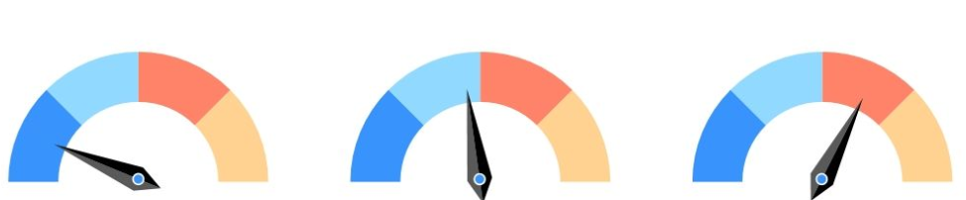

Performance Metrics and AI Integration
Measuring Success and Leveraging AI
KPIs for Success:
Integration:
Personalization – Suggest optimal shield designs based on facial features and usage
Predictive Analytics – Forecast demand and customer satisfaction trends using data-driven models.
Adoption Rate – % of spectacle users opting for the product
Customer Satisfaction – NPS score above 70
Repeat Usage – Frequency of usage per month

Slide 5
Strategic Recommendations
Next Steps and Future Roadmap
Global Expansion
Launch in key markets like North America, Europe, and Asia with localized marketing and pricing strategies
Build strategic alliances with multinational cinema chains and optical brands to accelerate reach
Adapt the product to comply with region-specific regulations and cultural preferences for comfort and usage
Long-term Strategy
Expand to global markets within 12 months.
Introduce premium variants with advanced optics.
Integrate AI-driven personalization tools and predictive customer insights for sustained engagement.
Immediate Actions
Finalize the MVP design with key features for comfort and hygiene.
Conduct pilot tests in metro theaters and gather feedback.
Launch targeted marketing campaigns with influencers and cinema partnerships.

