Slide 1
Digital Image Processing Team Avacado – 17 VISUAL CHESS RECOGNITION TA – ESHAN GUPTA https://github.com/orgs/Digital-Image-Processing-IIITH/teams/avocado Sasanka GRS - 2019112017 Aishwaryabharathi Upadhyayula –2020102060 Keerthi Pothalaraju – 2020102010 Shriya Dullur -2020102006

Slide 2
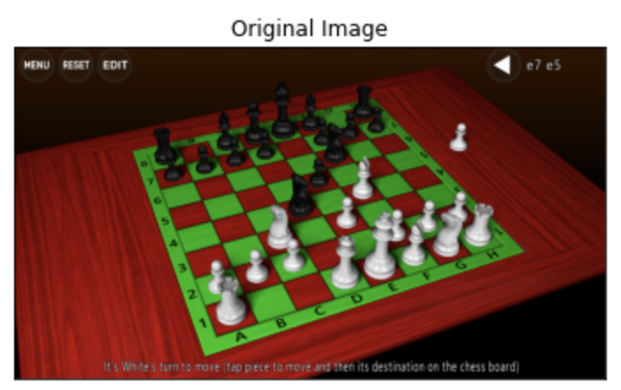
OBJECTIVE:
- To identify the chessboard, chess pieces and occupancy in a given dataset of chessboard images.
We aim to use image processing techniques to detect the chess board and deep learning to detect the chess pieces.

Slide 3
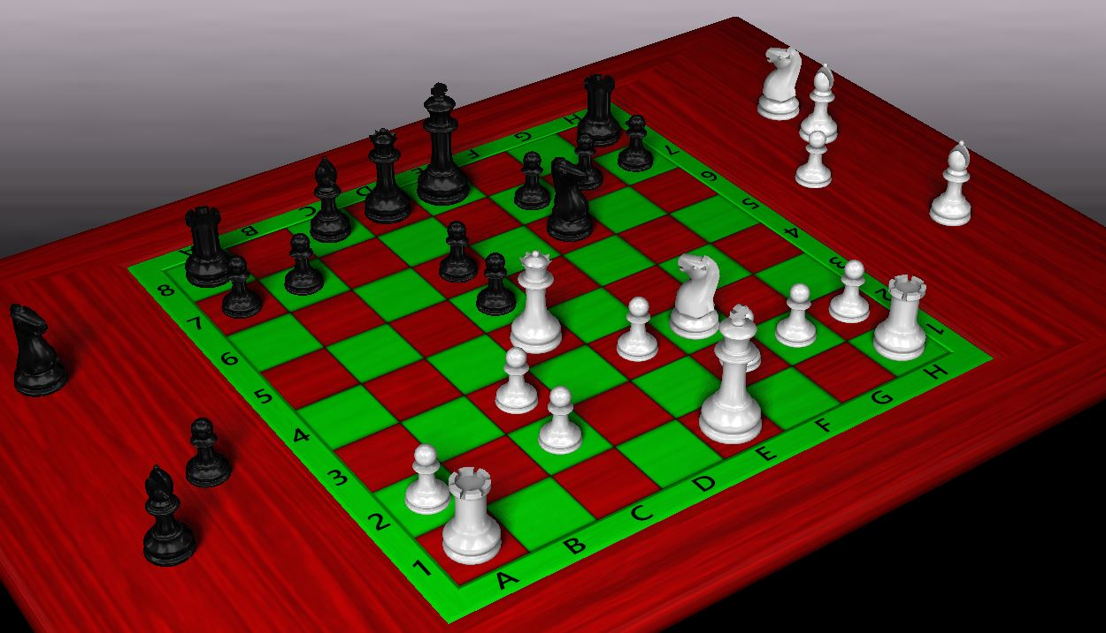
Chess Board Detection
For the purpose of chessboard detection, we use image processing methods .
A red and green chessboard is chosen to distinguish a white square from a white piece and black square from a black piece.
The Green, Red and Blue channels are separated.
The Blue channel is later used for distinguishing between the white and black pieces.

Slide 4
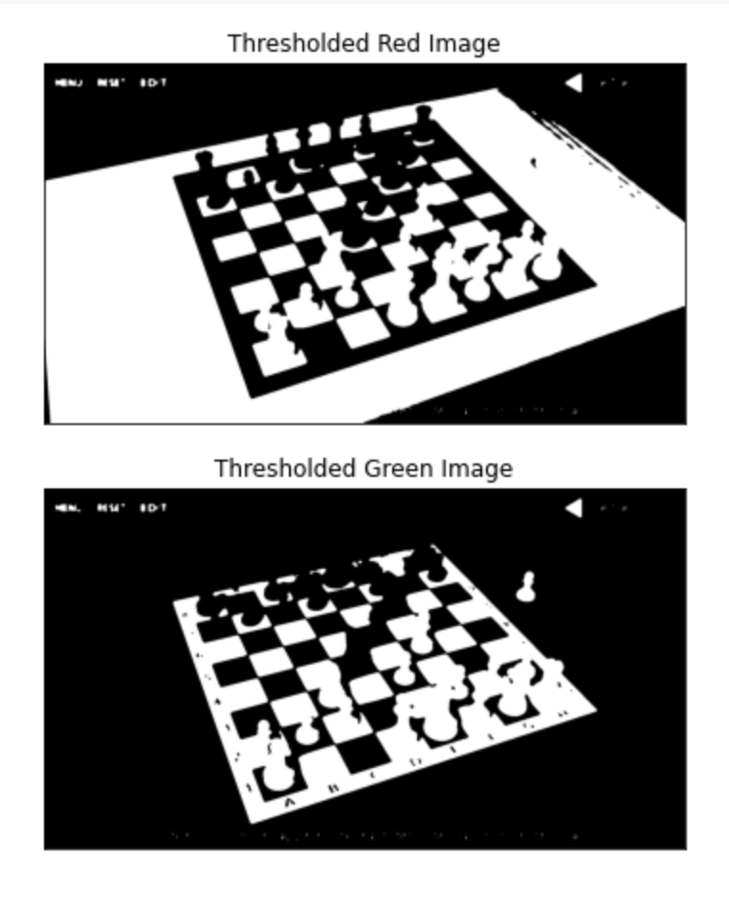
Chess Board Detection
Median Blur is applied on the Red and Green channels to remove the noise in the channels.
The edges are detected using the canny edge detection.
The Green channel image and the red channel image are thresholded using Otsu's thresholding before detecting the edges.

Slide 5
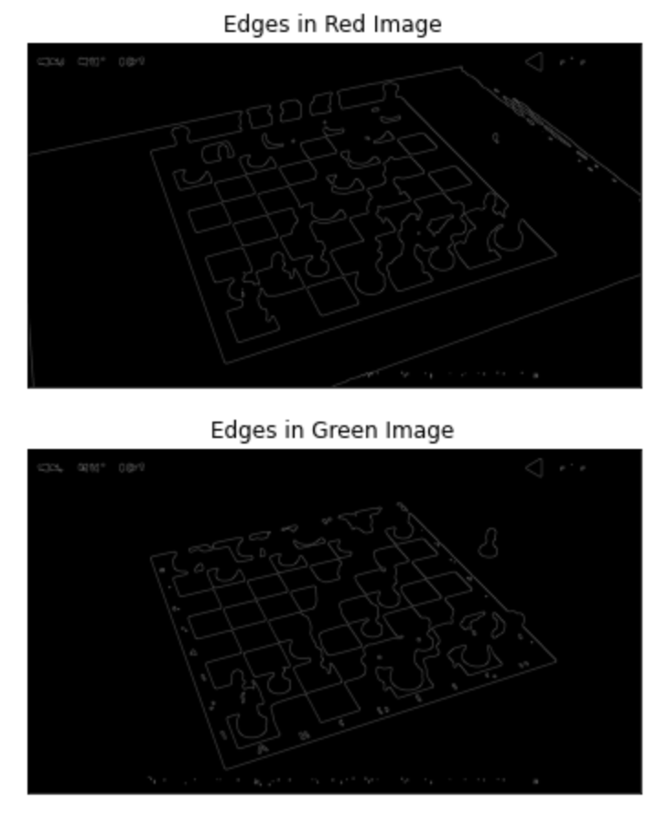
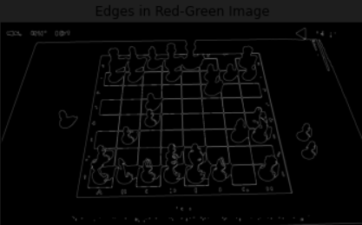
Chess Board Detection
Edges are detected from the combined Red and Green channels.
Edges in combined Red-Green channel

Slide 6
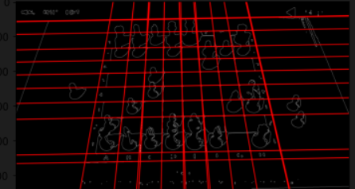
Chess Board Detection
After obtaining the canny edge detected image, we apply the Hough transform for detecting the lines in the image

Slide 7
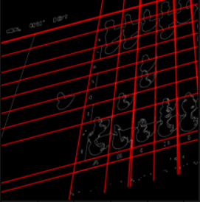
Chess Board Detection
Fewer lines than expected are detected due to overlap with pieces. Ideally 9 horizontal lines and 9 vertical lines are to be detected on the board.
4 intersections points are taken from the set of intersected lines and the homography matrix is generated.
The image is warped to detect all the squares in the image.

Slide 8
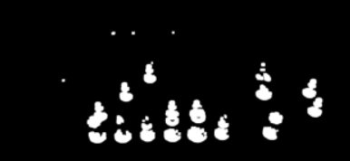
Chess Piece Detection
The white piece and Black piece are isolated by taking the help of the blue channel.
The blue image is blurred using median blurring to highlight the white pieces.
The blurred images are dilated to and thresholding is done on this dilated image to get the white pieces.

Slide 9
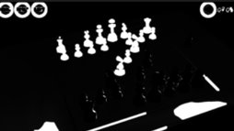
Chess Piece Detection
Median filter is applied on the Blue channel and then diluted.
An Ideal range thresholding is done on this image.
All the value above the threshold of 80 are made 0 and all the values between 70 and 10 are made 255.
We get the black pieces by performing the above operations.

Slide 10
Chess Pieces Classification
CNN is used for the classification of the chess pieces.
We have trained the CNN using the dataset procured for chess piece detection.
During the testing, the image containing the black isolated chess piece images and the white isolated piece images are given separately to the CNN.
The individual squares are identified, and the cropped squares are given as the input to the CNN.

Slide 11
Chess Pieces Classification
The CNN outputs the chess piece and identifies it as one of the following :
Bishop
Pawn
Knight
Rook
Queen
King

Slide 12
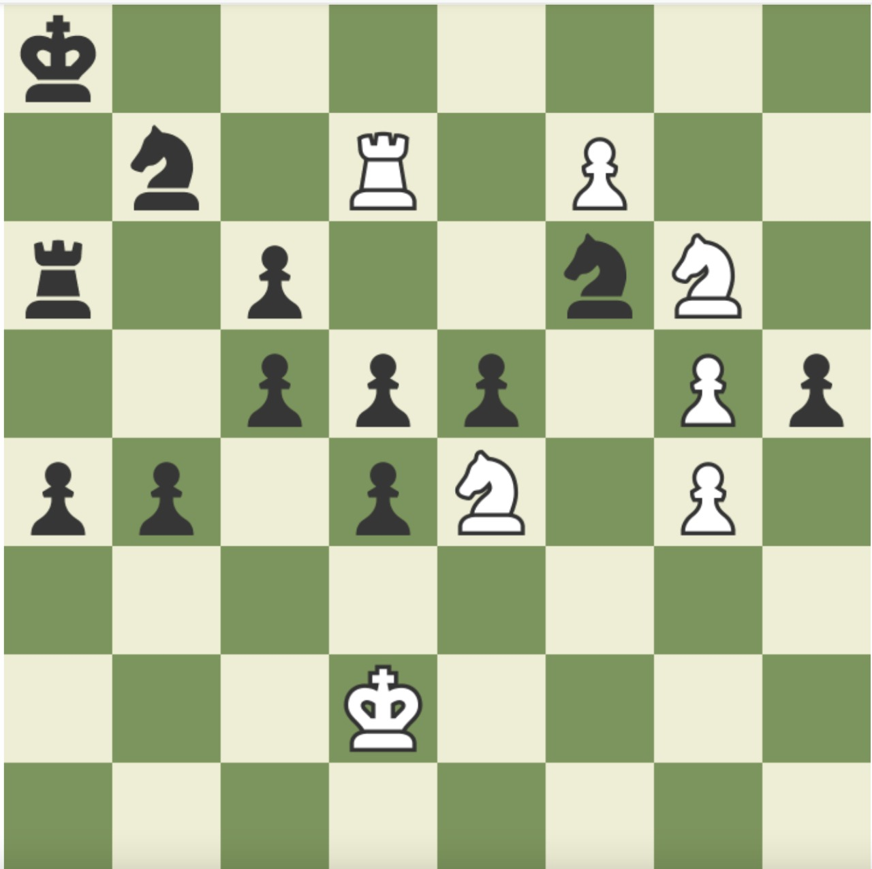
Chess State Digitization
Here, we use the observations obtained to digitize the state, i.e., we place synthetic pieces on a synthetic chess board at the detected locations.
We aim to make it look like this -

Slide 13

GUI
This project is visualised in a Graphical User Interface (GUI) using Streamlit.
Streamlit is an open-source webapp framework for creating beautiful web apps in minutes.
Streamlit GUI is created on Python language.
Reason for choosing this application is its ease-of-use, ability to generate GUIs with very few lines of code.

Slide 14
GUI
For our project, the requirements in the GUI is an input image which is the captured image of the chess board with pieces placed.
Output would be an image which is a digital chessboard with pieces placed on it like the ones on the original chess board.
User has a provision to input an input image (JPG,PNG) and clicks on the "OUTPUT" button.
After a few seconds, once the backend code has executed, the output chessboard image is displayed on the GUI

Slide 15
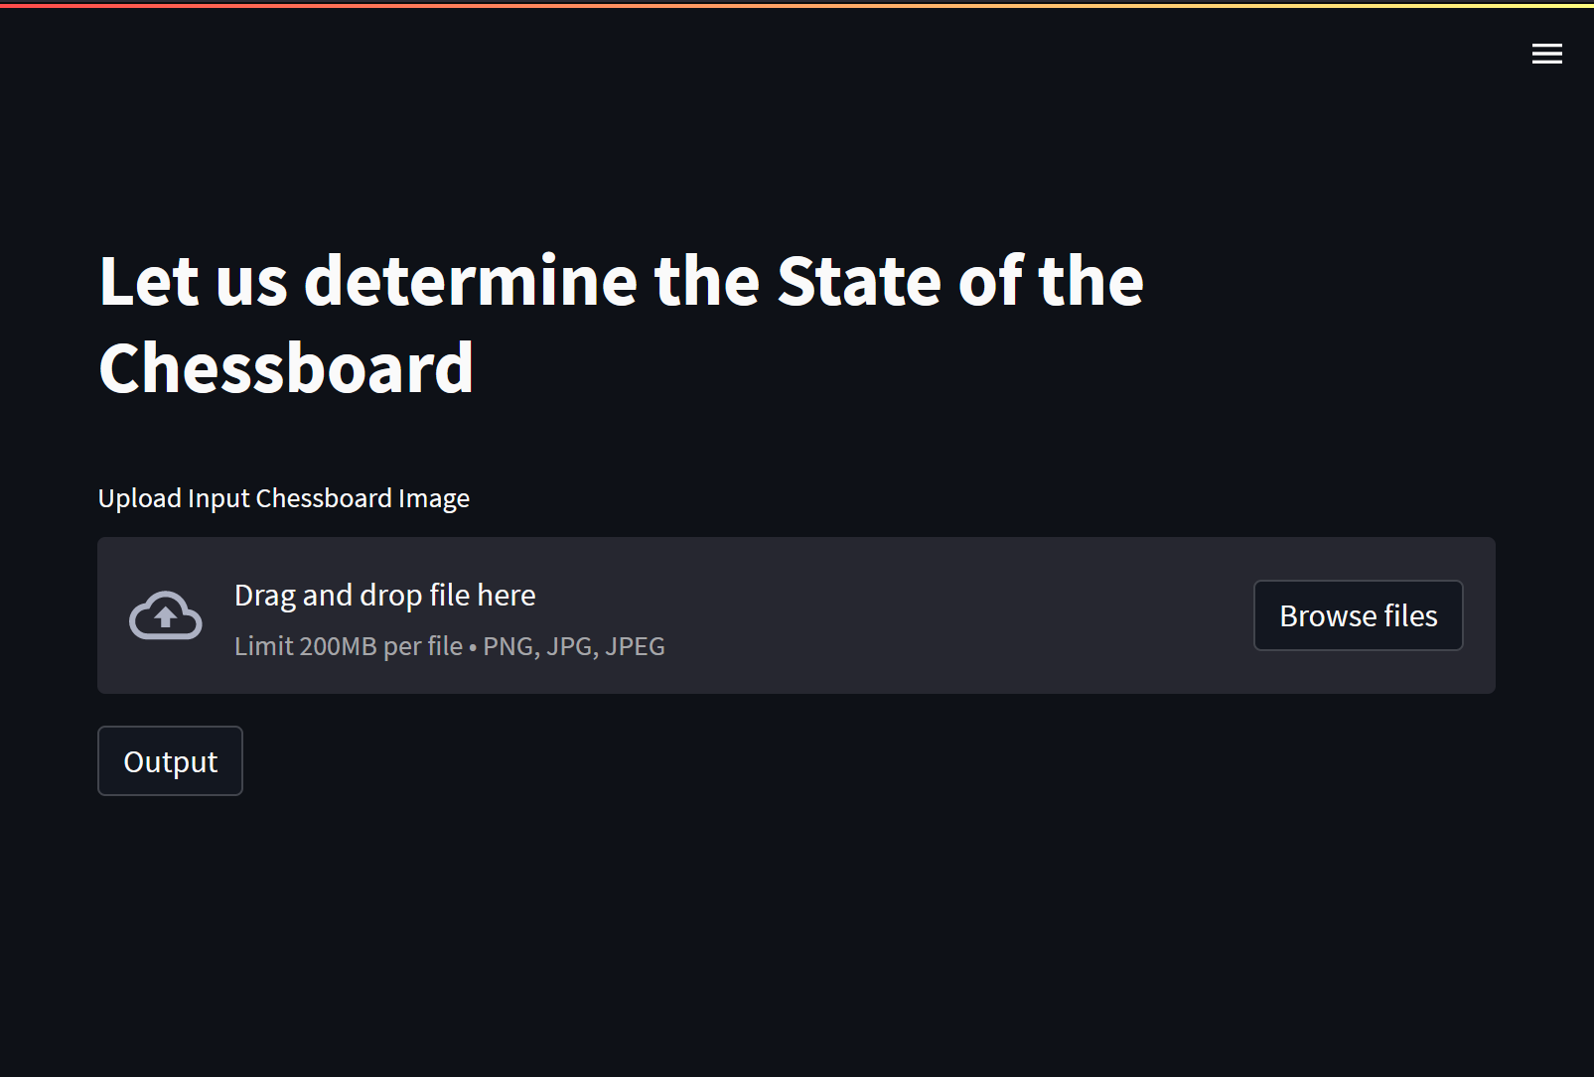
GUI – Start Screen
Input Image
Output Button

Slide 16
WORK DIVISION
Keerthi Pothalaraju -Chessboard detection: RGB separation,homography,chess piece(black and white) isolation,presentation
Shriya Dullur - Chessboard detection: Noise removal, Edge detection,Hough transform, Presentation
Aishwaryabharathi Upadhyayula(User Interface,presentation)
Sasanka GRS -Chess piece training and detection(CNNs),output generation

Slide 17
THANK YOU

