Slide 1

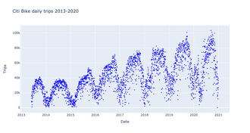
The Balancing Act
Key facts
Over the past decade, Citi Bike has become a vital part of New York City’s transportation landscape. As the nation’s largest bikeshare system, Citi Bike enables millions of trips each month and has a network of over 1,800 stations and 26,000 bikes. Riders took 30 million trips on Citi Bike in 2022 – five times as many as when the system first launched in 2013. Preserving Citi Bike as a high-quality transportation service is a matter of public interest.
Notes:
https://comptroller.nyc.gov/reports/riding-forward-overhauling-citi-bikes-contract-for-better-more-equitable-service/#endnotes
https://en.wikipedia.org/wiki/Citi_Bike#2020s

Slide 2
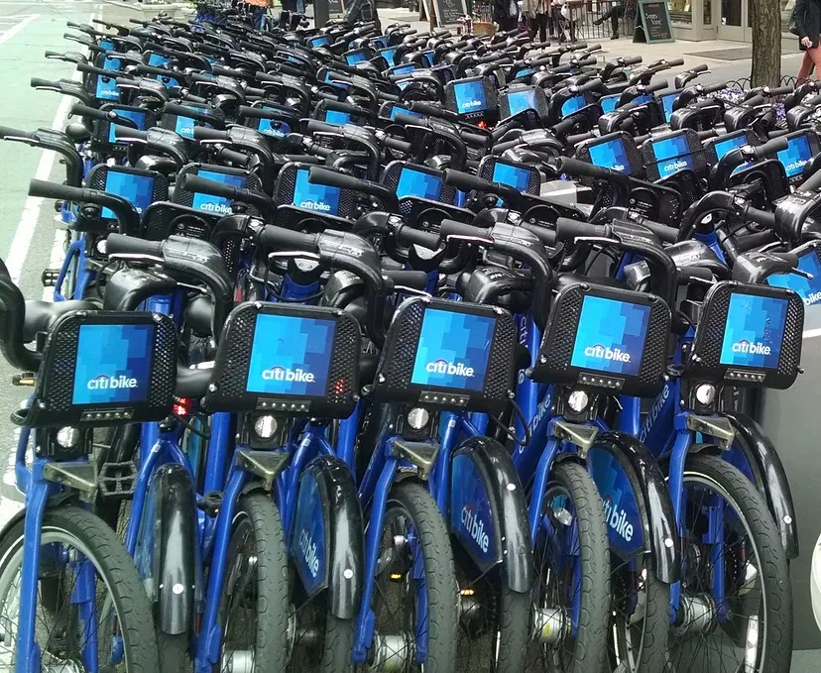
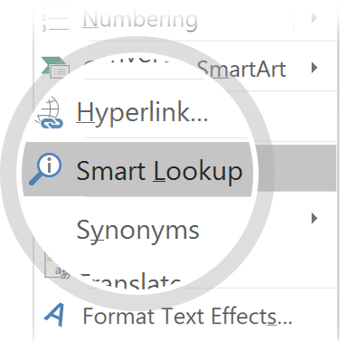
Challenges
As has been recently documented by the press, one of the major challenges that Citi Bike is facing is the rebalancing of their stations. As origins and destinations of Citi Bike trips are not necessarily symmetrical during the day, Citi Bike has been forced to constantly move bikes around the city, taking them from full stations and delivering them to empty ones. This problem is both financially expensive and frustrating for Citi Bike users: many people complain about either not finding bikes at their stations of origin or not finding empty spots when they arrive at their final destinations.
Use Smart Lookup to learn more
1
Highlight one of the related topics
Right-click on the topicChoose "Smart Lookup"
2
3
Notes:
https://ride.citibikenyc.com/blog/rebalancing-the-citi-bike-system

Slide 3
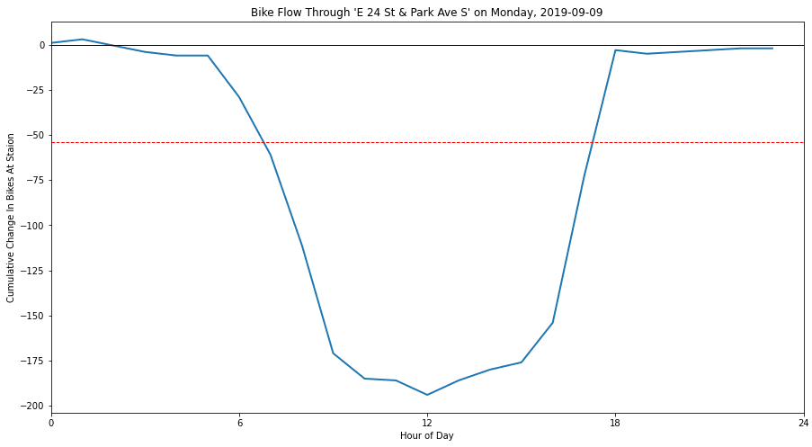
Rebalance
What is rebalancing? Why do we care?
Consider the flow of bikes through a popular commuter station E 24 St & Park Ave S on Monday, September 9, 2019. This station has a maximum capacity of 54 bikes. However, there are more bikes being ridden out of the station than coming in. Even if the station were to start out the day fully-stocked, it would get depleted halfway through the morning commuter rush hour. A significant number of riders would be without a bike! This would quickly lead to dissatisfied members canceling their subscriptions.

Slide 4
More about Rebalancing
How is it possible that a station supplies more bikes than its capability? Well, through the Citi Bike operations team’s diligent rebalancing efforts. The team physically moves bikes from one station to another to:
Ensure there are sufficient bikes to satisfy predicted demand
Ensure there is space at destination stations to receive incoming bikes
Minimize the number of unused bikes idling at unpopular stations
How does Citi Bike rebalance bikes?
Citi Bike employs several methods to manage rebalancing needs:
Valet Service - employee's staff popular stations to manage incoming and outgoing bikes, artificially increasing station capacity and temporarily alleviating rush-hour problems
Bike Trains - employees ride ebikes towing carriages of 12-16 bikes—ideal for going in and around tight neighborhood streets
Motorized Vehicles - higher-capacity vans operate 24/7 to keep bikes moving to and from the most popular stations
Bike Angels - launched in 2018, this program grants Citi Bike riders (non-employees) traveling along in-demand rebalance routes a free trip and reward points

Slide 5

Let's Deep Dive !!

Slide 6
Data Sources
Citi bike Trip History
This dataset from Citi bike's website includes extensive details of every single ride for every individual for a month. The fields include Ride ID, Rideable type, Started at, Ended at, Start station name, Start station ID, End station name, End station ID, Start latitude, Start longitude, End latitude, End Longitude, Member or casual ride. Start station name and End station name will help me analyze the high demand stations and routes. Started at and Ended at would give me the peak hours of operation.
Here I have used March 2020 data , for EDA . Reason being smaller than the most
General Bikeshare Feed Specification (GBFS)
This dataset published by Citi bike is needed to determine bike capacity at each station. Fields needed include latitude, longitude, station name, and capacity (number of docks).

Slide 7
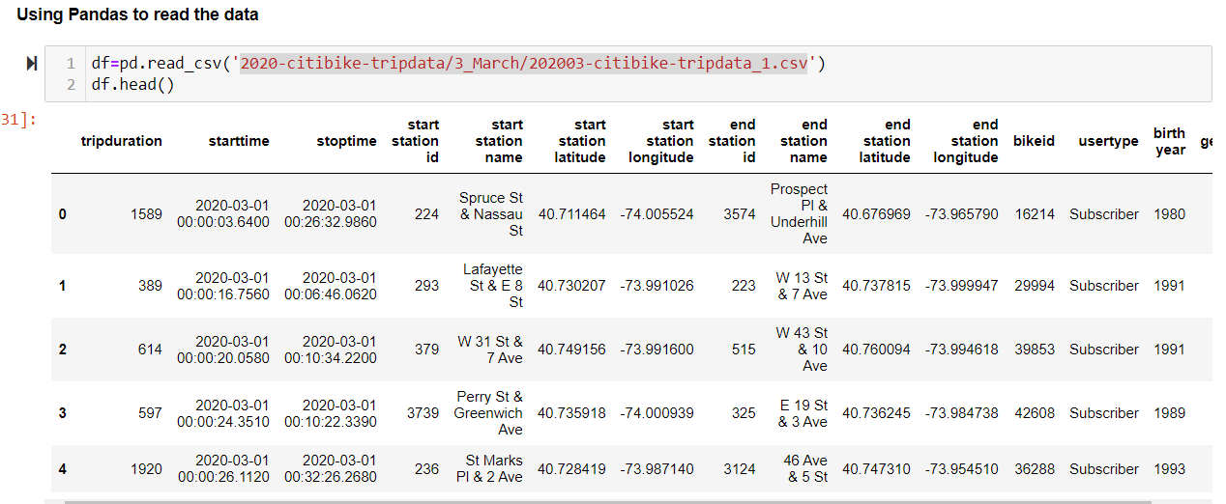
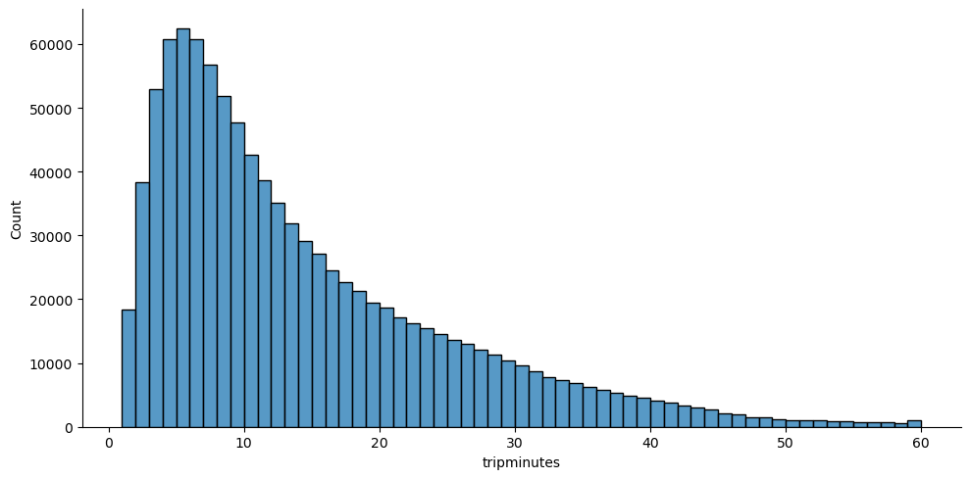
Exploratory Data Analysis
Notes:
This chart shows that the most common trip is five minutes long (the tallest bar) followed by four and six minutes (the bars before and after that one). After that, the chart shows a classic “long tail” of fewer trips for longer rides.

Slide 8
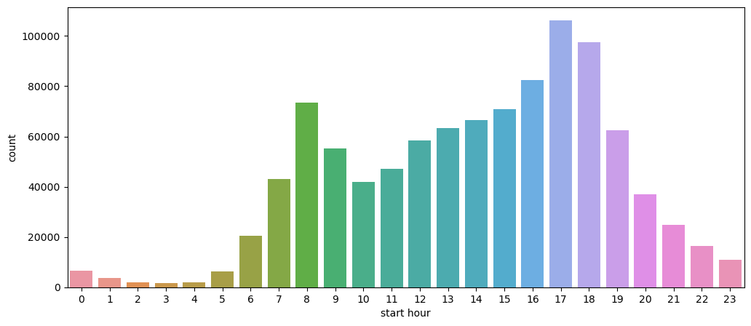
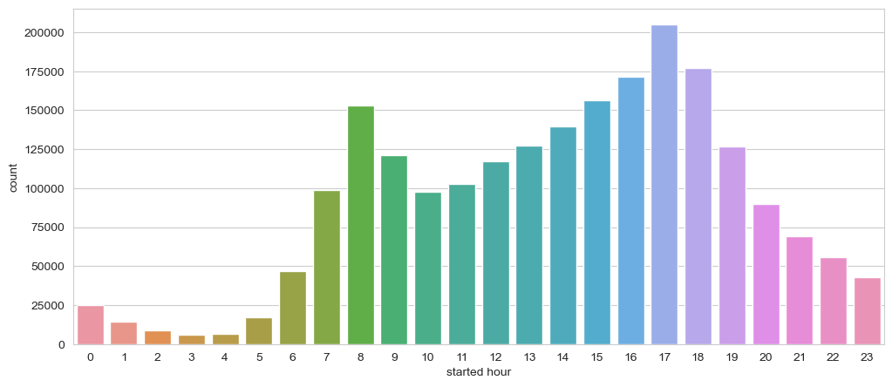
EDA
Rides by Hour and Day 2020
Rides by Hour and Day 2024

Slide 9
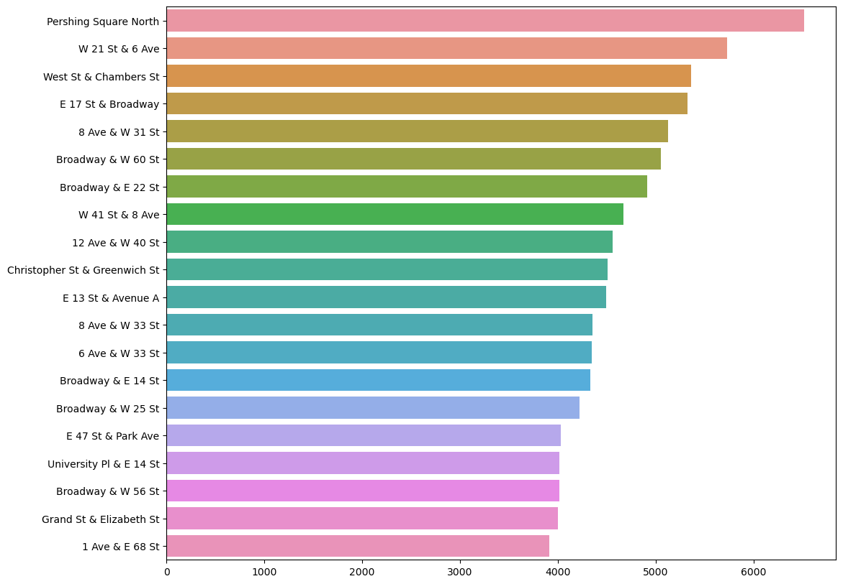
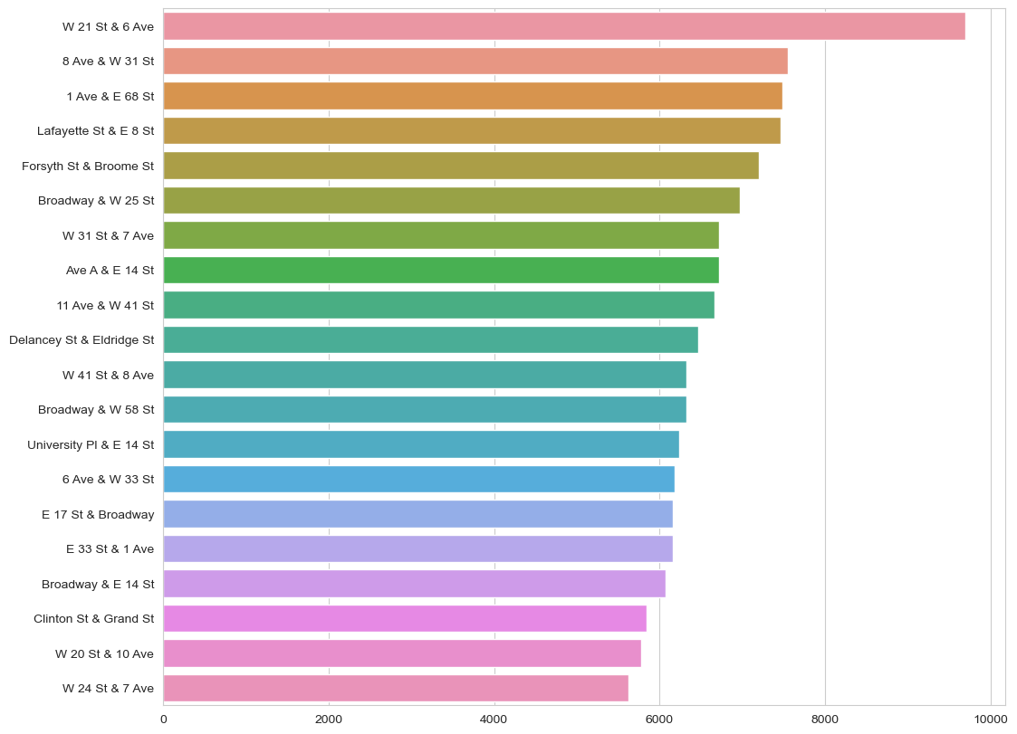
Most Used Stations 2020 2024
Notes:
The counts are conveniently in descending order of frequency so if we select the first 20 values we will get the 20 most frequently used stations.

Slide 10
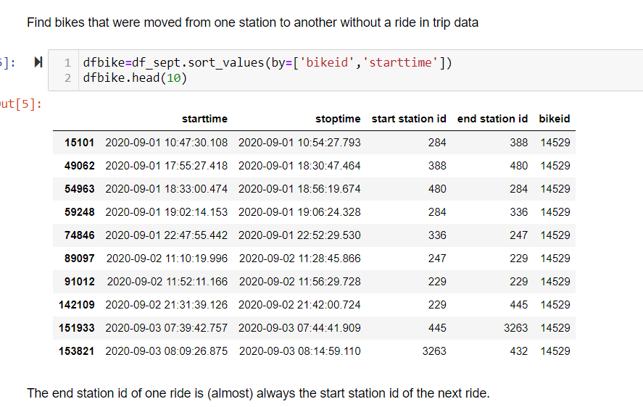
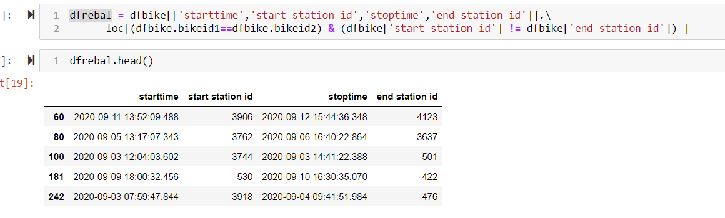
Rebalance for Sept 2020
Notes:
Here each record represents the time period that a bike was docked. I can see that one ride ended at station 388 and the next one started at the same station. It then was then docked at station 480, and so on.

Slide 11
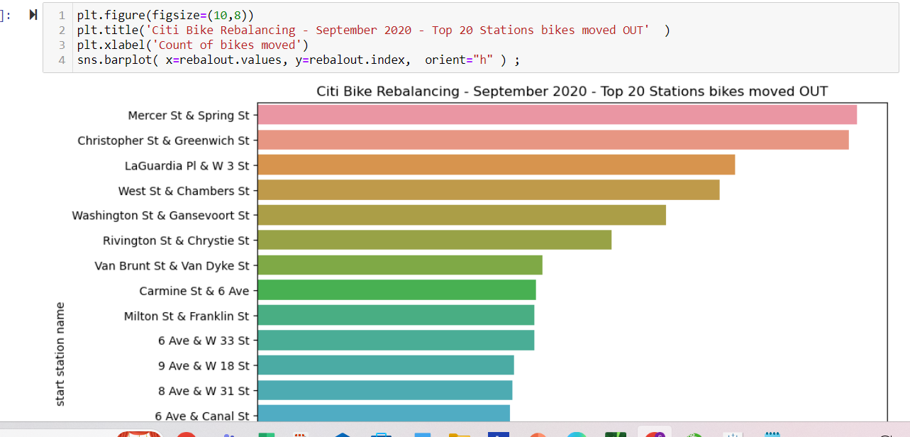
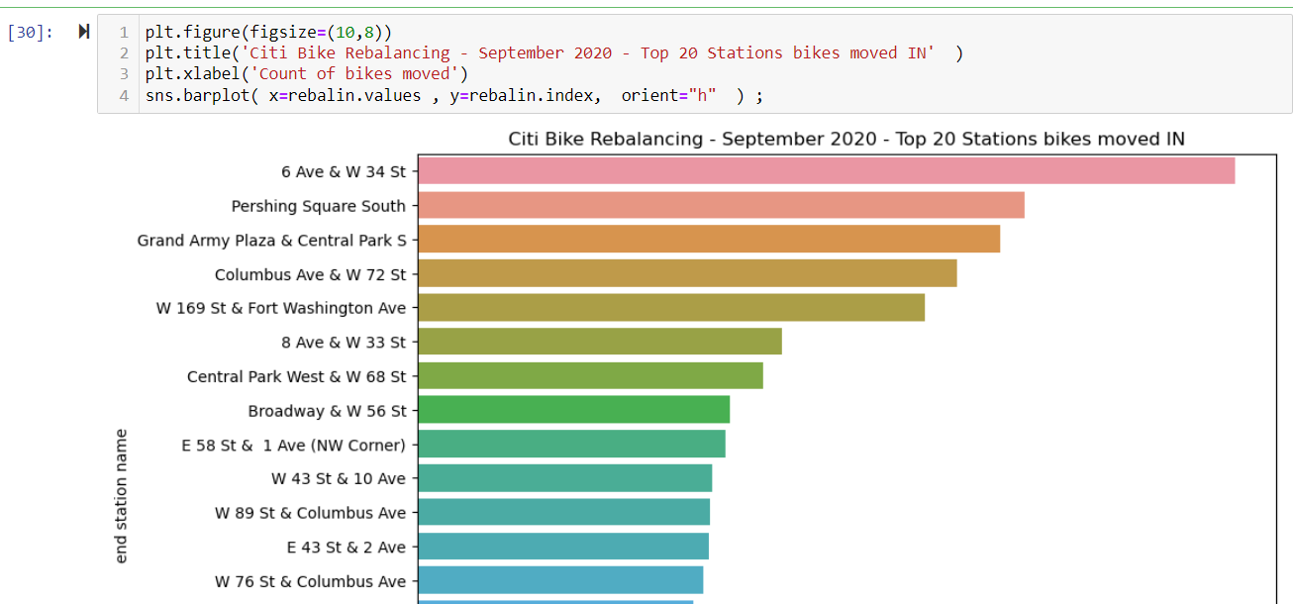
Which Stations gets Rebalanced?
Notes:
The Citi Bike Monthly Operating Reports page has links to operating reports for each month of operation. For September 2020 it says:
Citi Bike staff rebalanced a total of 51,179 bicycles during the month of September… utiliz[ing] box trucks, vans, contracted trikes, articulated trikes (‘bike trains’), valets, and member incentives (‘Bike Angels’) to redistribute bikes system-wide.
So although the official count of over 51,179 is higher than what I found, it also includes rides by “Bike Angels,” members who are incentivized to ride bikes for the purpose of rebalancing. Those rides would appear as “regular” rides in the tripdata files. I would say my derived counts are close enough for government work.

Slide 12
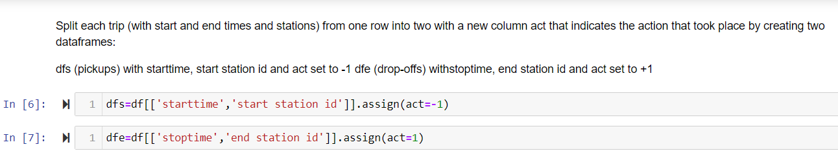
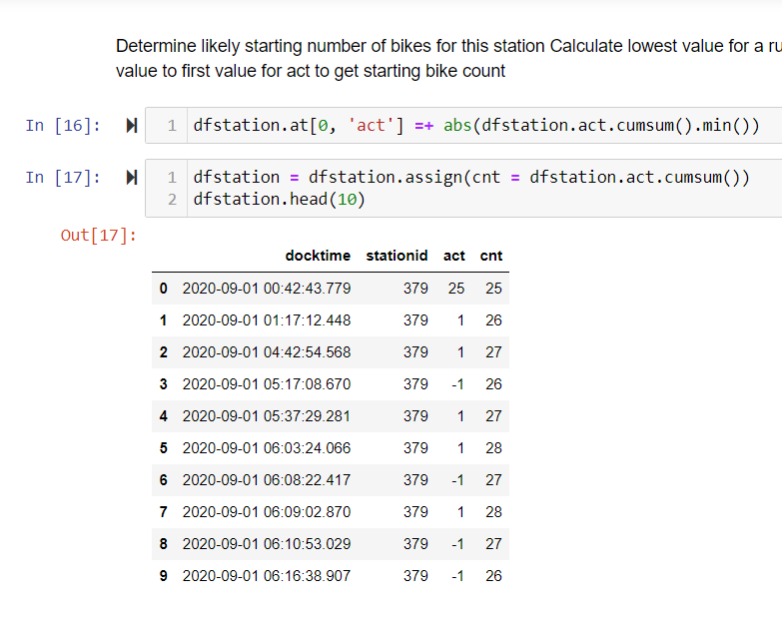
Estimating Bike Availability from NYC Bike Share Data
Calculate bike counts for one station
I The number of bikes increases and decreases at the station by calculating a running sum of the act column:
Notes:
How can availability of bikes (and docks) be determined? Citi Bike provides a real-time feed of station status with the number of available bikes and docks as a web service. Links to a description and the URL can be found on the Citi Bike System Data page.
However Citi Bike does provides monthly trip data files with a record for each trip that includes the start and end time and station. It’s possible to use this data to estimate bike availability.
On each trip a bike is picked up at one station and dropped off at another. When a bike is picked up there’s one less bike at the start station; when it’s dropped off there’s one more bike at the end station.

Slide 13
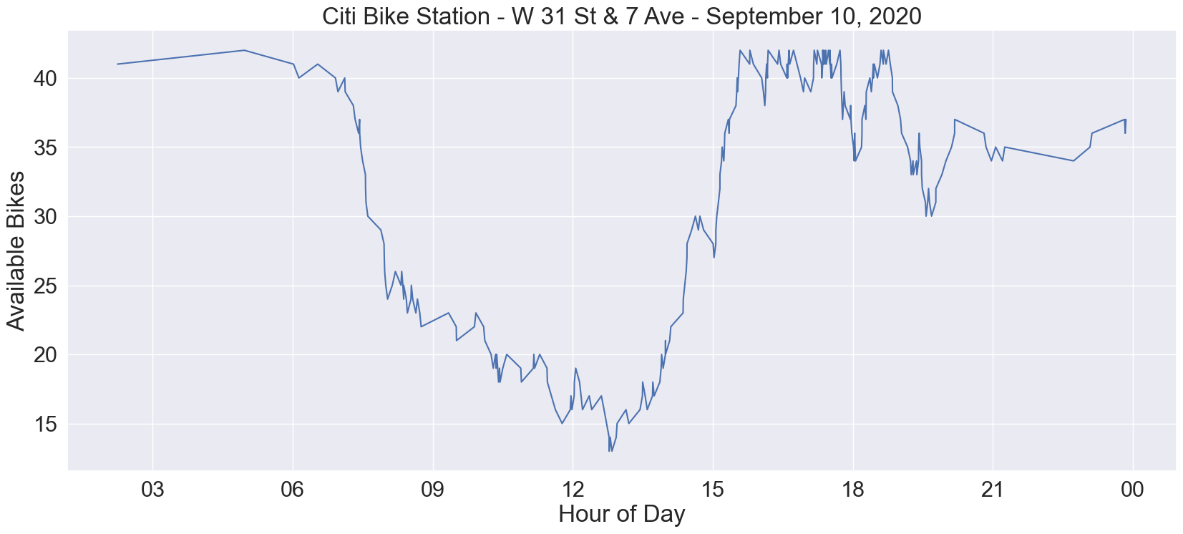
Availability :One day One Station
Notes:
As the data is huge , We can check the availability for One station a day .

Slide 14
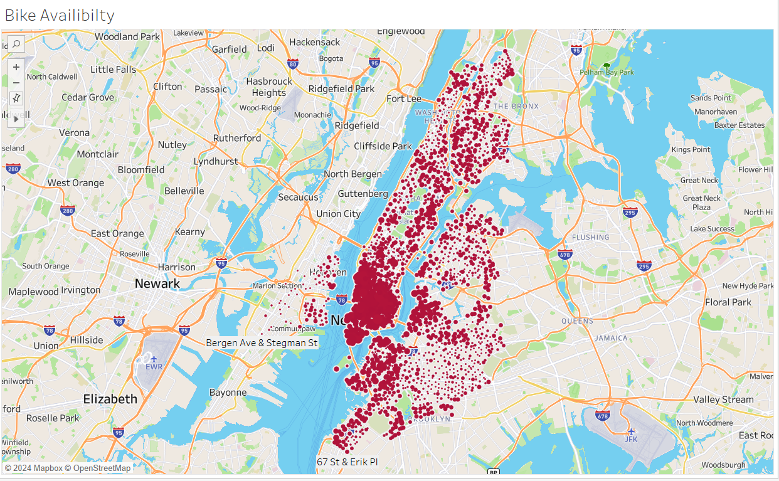
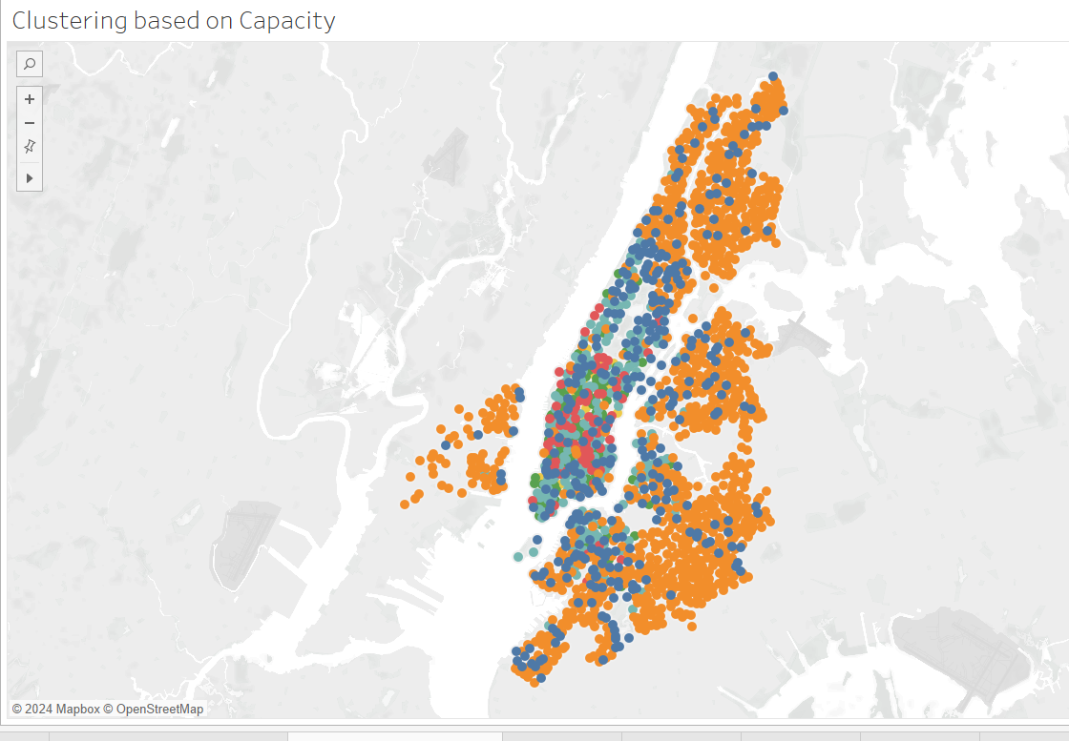
Availability of Docks , Bikes using gbfs data

Slide 15
Conclusion
Even though Citi Bike doesn’t provide information about bikes moved manually for rebalancing and other purposes, it can be derived from the trip data by looking at the movements for individual bikes and where their location changed without a ride.
This information is more meaningful in the aggregate (by neighborhood) than it is for individual stations.
We can get a rough idea when bikes are rebalanced at a station by looking at when the bikes were taken for a ride.
Even though Citi Bike doesn’t provide historical data about bike and dock availability, an estimation can be derived from the trip data files that reflects actual station usage.

Slide 16
Future Work
There are numerous ways to dive into trip and rebalance data to understand needs and motivations of bike-share participants or the general movement of individuals around New York.
Other future work could include:
Create a real-time model to predict when a station needs to be rebalanced.
Create a real time model to predict the availability of docks and bikes.
More research can be done in terms of ebikes, with more addition of ebikes recently .
Focusing on a specific year, season, or days to understand and predict usage and rebalance needs with respect to changes in overall ridership and events such as holidays and professional sports games
Make an overall model so that Citi bikes can be introduced in more cities .

