Slide 1
Indian Language Identification using Audio Foundation Models
Exploring Zero-Shot, Prompt Learning, and Cross-Domain Generalization

Slide 2
1. Zero-Shot CLAP (Baseline)
Architecture: Base CLAP (HTSAT Audio Encoder + RoBERTa Text Encoder).
Modification from CLAP: None. This is the exact pre-trained architecture.
How it works: Uses a static, hard-coded text prompt ('A person speaking in {language}').
In-Domain Accuracy (Ekstep): ~75-80%
Cross-Domain Accuracy (IITMandi): Severely degraded.
Conclusion: Strong baseline but rigid prompt structure limits adaptation.

Slide 3
2. CoOp (Context Optimization)
Architecture: Continuous Prompt Learning.
Modification from CLAP: The discrete English words in the text prompt are replaced by learnable continuous vectors (V1, V2, ...).
How it works: The Audio and Text encoders are 100% frozen. Only the continuous prompt vectors are trained via backpropagation on the Ekstep dataset.
In-Domain Accuracy (Ekstep): 53.17%
Cross-Domain Accuracy (IITMandi): 28.40%
Conclusion: Static learned vectors easily overfit to the training domain's specific acoustic signature.

Slide 4
3. CoCoOp (Conditional Context Optimization)
Architecture: Dynamic Audio-Conditioned Prompting.
Modification from CLAP: Introduces a lightweight neural 'Meta-Net'.
How it works: The Meta-Net takes the specific Audio Embedding as input and generates a dynamic bias vector, which is added to the CoOp text tokens. The prompt adapts to every single audio clip.
In-Domain Accuracy (Ekstep): 89.58%
Cross-Domain Accuracy (IITMandi): 24.75%
Conclusion: Incredibly powerful for in-domain data, but suffers from Catastrophic Domain Overfitting when faced with background noise.

Slide 5
4. PALM (Prompt Alignment Learning)
Architecture: Joint Space Alignment.
Modification from CLAP: Adds an adapter layer to the text encoder to force alignment between the audio and text spaces.
How it works: Uses few-shot prompt learning combined with a cross-modal alignment objective to bridge the modality gap.
In-Domain Accuracy (Ekstep): 76.05%
Cross-Domain Accuracy (IITMandi): 25.66%
Conclusion: Better than base CoOp, but still succumbs to cross-domain acoustic shift.

Slide 6
5. Supervised Acoustic Baselines
Architecture: Pure Acoustic Encoders (Whisper, WaveLM, Wav2Vec2, DistilHuBERT).
Modification from CLAP: Completely discards the Text Encoder and contrastive learning. Replaces it with a Supervised Logistic Regression Probe on top of frozen audio features.
Whisper (In-Domain -> Cross-Domain): 95.76% -> 82.77%
WaveLM (In-Domain -> Cross-Domain): 95.32% -> 80.81%
Wav2Vec2 (In-Domain -> Cross-Domain): 92.91% -> 52.10%
Conclusion: Massive pre-trained acoustic models retain highly robust features across domain shifts, proving the vulnerability lies in CLAP's Audio-Text alignment mechanism.

Slide 7
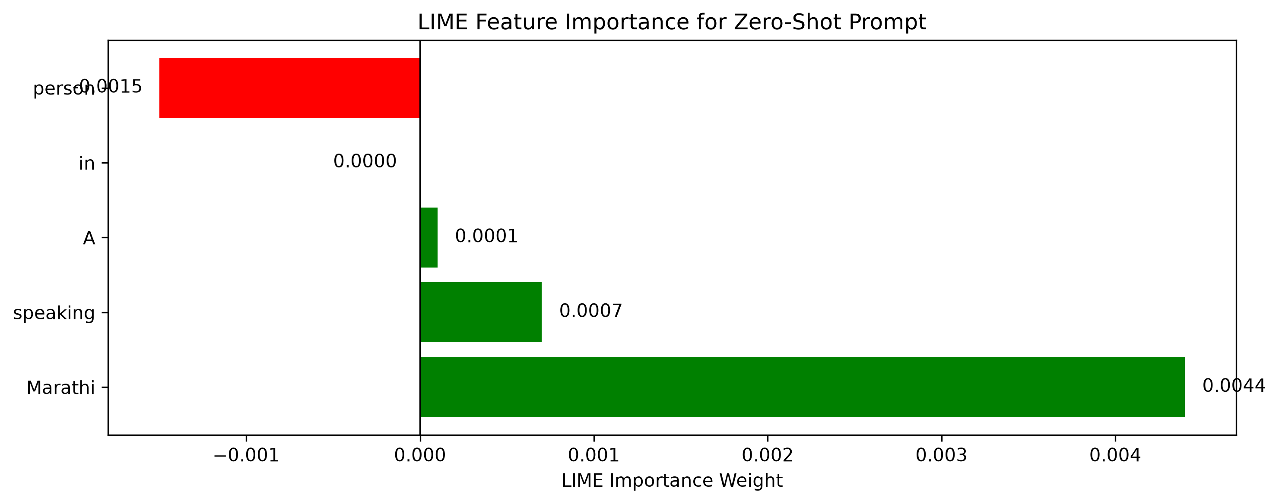
6. XAI Interpretability: Text Prompt (LIME)
Objective: Why did the Text Prompts fail in cross-domain?
Method: Applied LIME feature attribution to the Zero-Shot text prompt.
Results (Weights): 'Marathi' (+0.0044), 'speaking' (+0.0007), 'person' (-0.0015).
Analysis: The text encoder is working perfectly. It applies maximum positive weight to the actual class label (Marathi) and ignores grammatical fluff.
Conclusion: The failure is NOT a text-understanding issue.

Slide 8
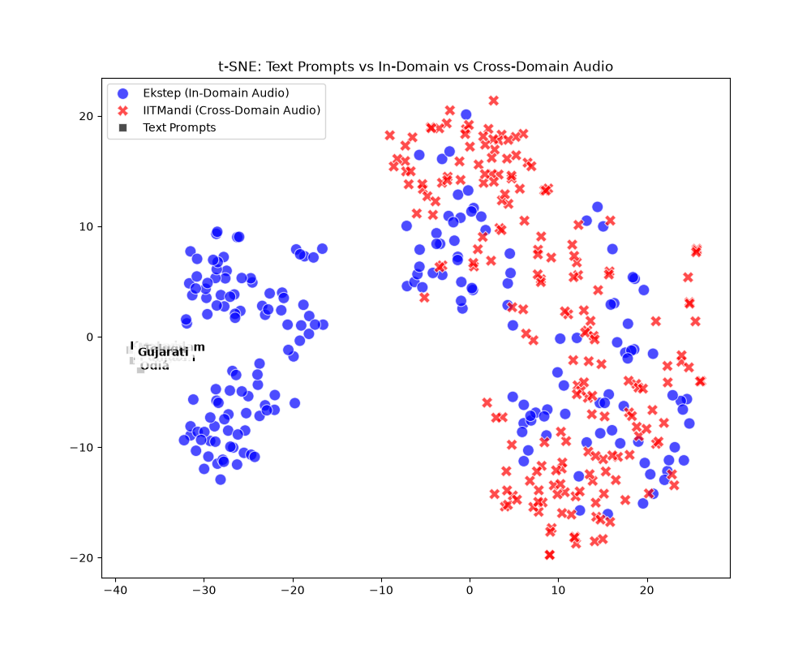
7. XAI Interpretability: Acoustic Shift (t-SNE)
Objective: Visualizing the latent space alignment.
Method: t-SNE plot of Ekstep Audio (Blue), YouTube Audio (Red), and Text Prompts (Black).
Analysis: During training, CoOp/CoCoOp learned prompt vectors that anchor directly to the In-Domain (Ekstep) audio clusters.
The Failure: When tested on YouTube data, the acoustic background noise physically shifted the audio embeddings to a completely different region of the latent space.
Final Conclusion: The rigid text prompts were left stranded in the latent space, misaligned from the new noisy audio data.

