Slide 1
Indian Language Identification using Audio Foundation Models
Visual Architecture Exploration

Slide 2
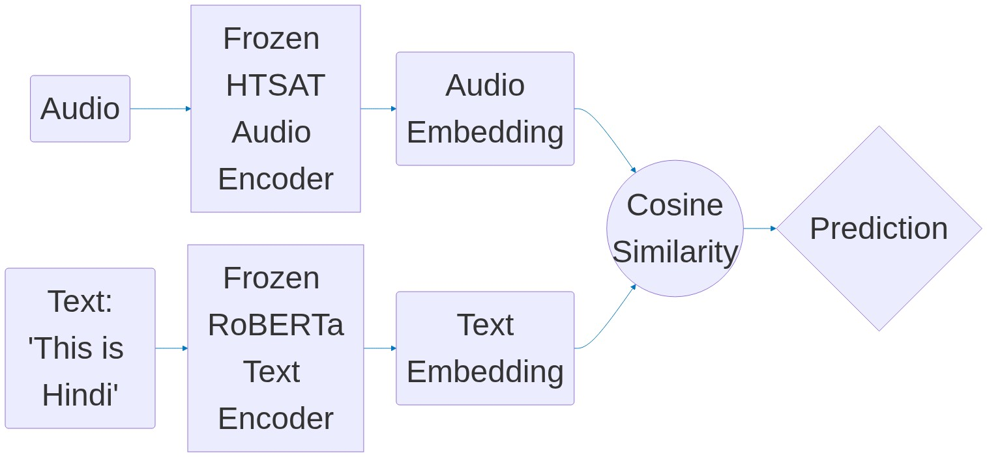
1. Zero-Shot CLAP (Baseline)
Results: Strong In-Domain (~75%), but fails completely in Cross-Domain due to rigid text prompts.

Slide 3
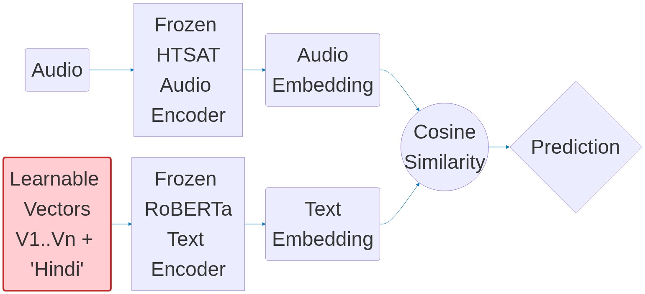
2. CoOp (Context Optimization)
Modification: Replaces discrete words with continuous learnable vectors (Pink).
Results: 53.17% (In-Domain) | 28.40% (Cross-Domain). Succumbs to Catastrophic Domain Overfitting.

Slide 4
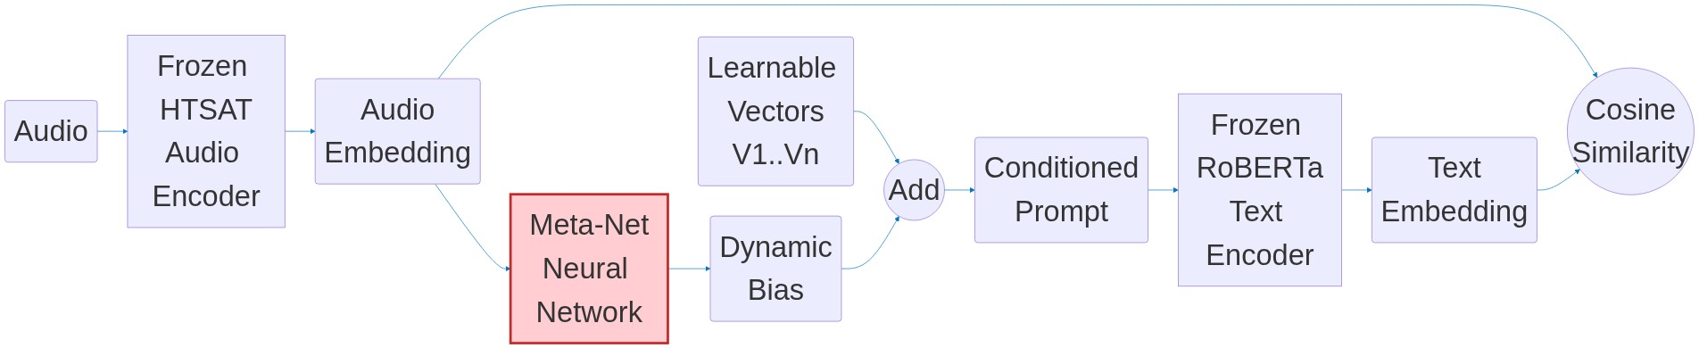
3. CoCoOp (Conditional Context Optimization)
Modification: Introduces Meta-Net (Pink) to dynamically adapt the prompt to each audio instance.
Results: Near SOTA 89.58% (In-Domain) | 24.75% (Cross-Domain). Highly powerful but heavily reliant on domain-specific acoustic features.

Slide 5
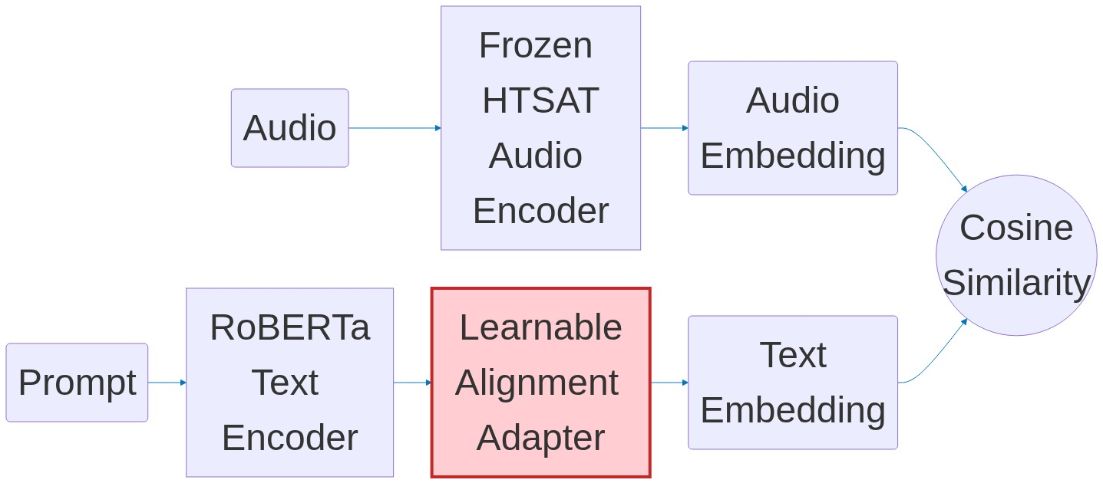
4. PALM (Prompt Alignment Learning)
Modification: Adds a learnable adapter (Pink) to force alignment between Audio and Text spaces.
Results: 76.05% (In-Domain) | 25.66% (Cross-Domain).

Slide 6
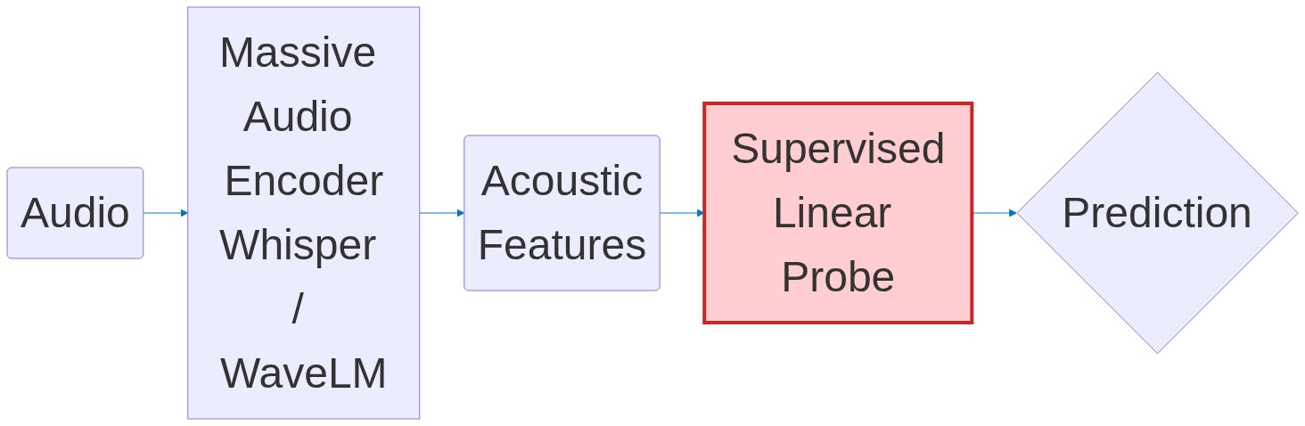
5. Alternative Acoustic Encoders
Modification: Abandons the Contrastive Text Encoder entirely for a pure Supervised Linear Probe (Pink).
Results: Whisper dropped only slightly (95% -> 82%) in cross-domain, proving the failure lies in the rigid Prompt-Audio alignment, not just acoustic degradation.

Slide 7
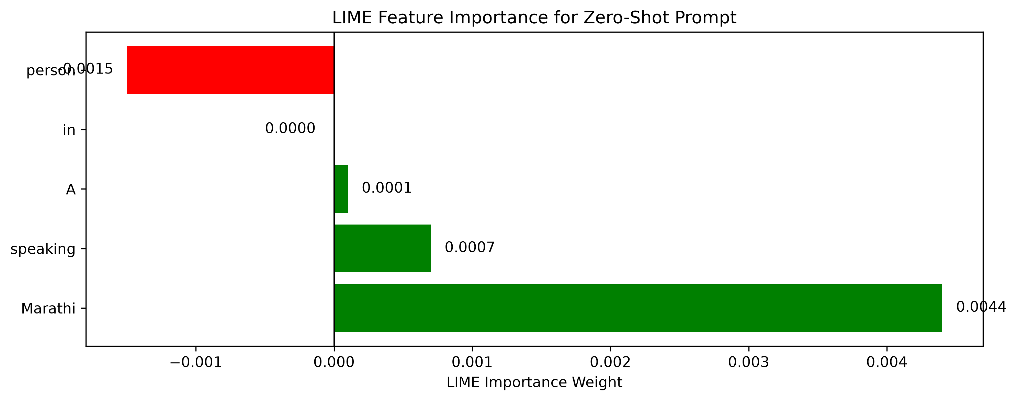
6. XAI: Why did prompts fail? (LIME)
Text Encoder analysis: Did the text prompt fail?
LIME proves it assigned max positive weight to 'Marathi'.
Conclusion: The text prompt functioned perfectly.

Slide 8
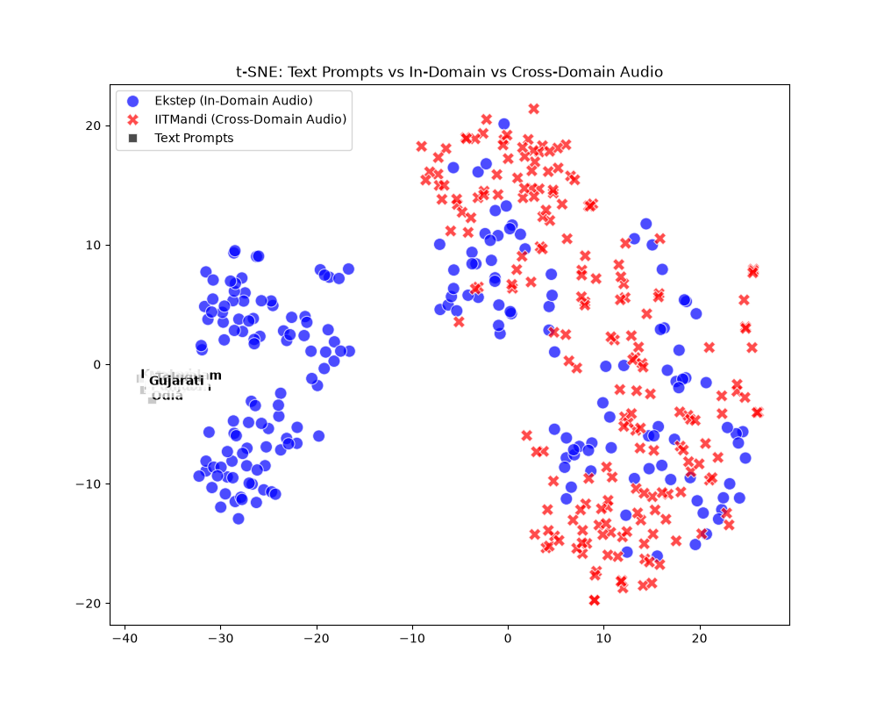
7. XAI: Acoustic Shift (t-SNE)
Visualizing the Latent Space.
The YouTube Audio (Red) physically shifted away from the prompt anchors due to background noise.
Final Conclusion: Static text prompts misaligned with shifting audio embeddings.

