Slide 1
(Your Title Here)
Add your name, date, and affiliation
Notes:
Replace this with your presentation title, name, and date.

Slide 2
Data Funnel and Dataset at a Glance
The Data Funnel:
475 unique organoid wells imaged across 11 days
→ ~260 have Day 30 expert survey labels (majority vote, min 4 votes)
→ 220 remain after requiring complete metabolite data + valid image + mask
Train / Val / Test Split (organoid-level):
158 train / 18 validation / 44 test organoids
Test labels: 35 Acceptable, 9 Not Acceptable (per day)
11 Time Points: Day 3, 6, 8, 10, 13, 15, 17, 20.5, 24, 26, 28, 30
Key takeaway: only 9 negative test samples per day
Notes:
We start with 475 organoids, but after requiring survey labels and complete metabolite data, only 220 remain. The test set has just 9 negatives per day -- keep this number in mind; it comes back in Observation 3.

Slide 3
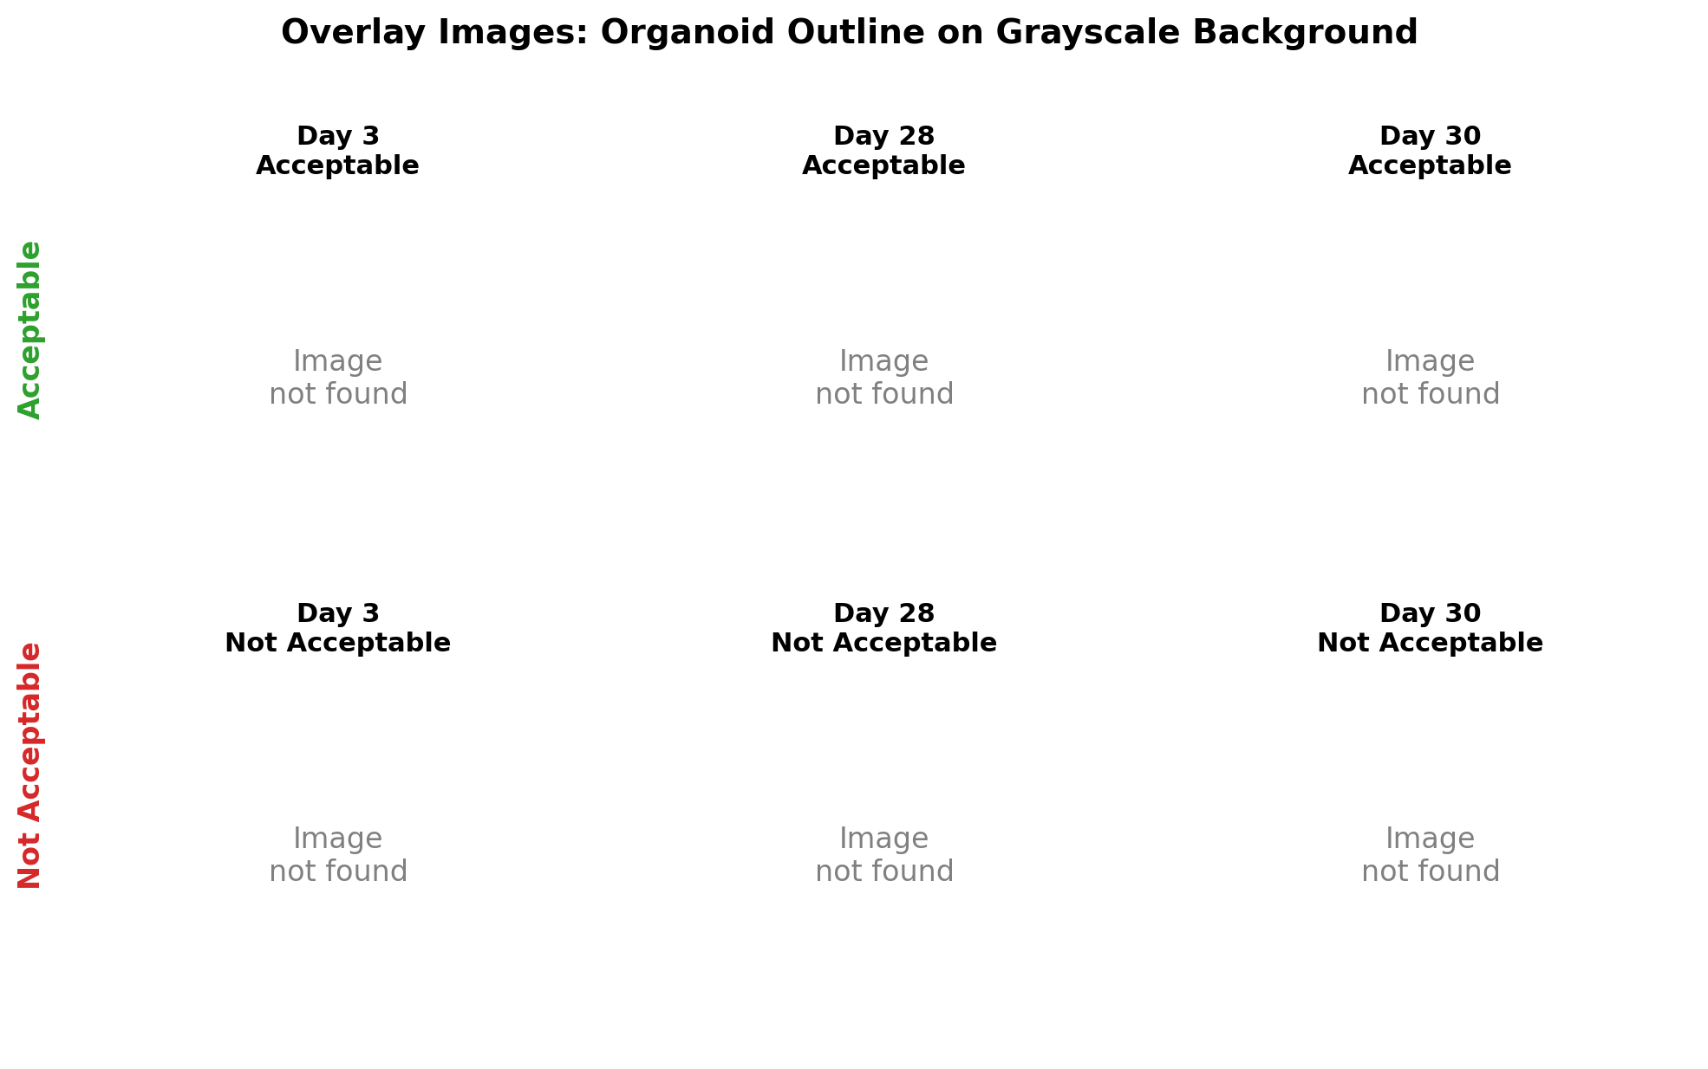
Labels, Class Imbalance, and What the Model Sees
Class split: 72.5% Acceptable vs 27.5% Not Acceptable
Imbalance handled with balanced class weights:
• Minority class (~Not Acceptable) gets ~2.5× weight in loss
• sklearn compute_class_weight("balanced")
Labels from expert surveys at Day 28/30,
propagated backward to earlier days
Image representation: overlay (green outline on grayscale) →
Notes:
The class imbalance is structural -- most organoids are acceptable. We up-weight the minority class ~2.5x during training, but 9 negatives in the test set still makes evaluation fragile. The overlay images show the organoid's boundary on a neutral background -- this is what the model actually sees. Notice how early-day organoids look similar regardless of label, while late-day ones show clear differences.

Slide 4
Data Engineering Pipeline (Brief)
Pipeline in one line:
Raw TIFF → best-focus selection → resize 512×384 → SegFormer segmentation → overlay → mean-fill background → split
Key decisions:
• Two segmentation models: Early (Day 3-10) and Late (Day 13-30) due to morphology differences
• Overlay representation = organoid shape on neutral background. Shape is the primary signal.
• Other representations tested (RGB mask, filled mask) -- overlay performed best
This is a 2-stage pipeline: segmentation quality directly affects classification
Notes:
15-step pipeline from raw TIFF to training-ready images. The key design decision is the overlay representation -- showing the organoid's boundary on a neutral background. This works well, suggesting morphological shape is the main signal for quality classification. Keep this brief -- ~90 seconds.

Slide 5
Two Models, One Question
Per-Day EfficientNet:
• One model per day. Sees only the image at day D.
• No history, no temporal context.
EfficientNet Time-Series (effnet_ts):
• Sees the full image sequence up to day D.
• Temporal context from all earlier days.
Same backbone (EfficientNet-B0), same split, same class weighting.
Primary metric: balanced accuracy at validation-optimal threshold.
Note: thresholds are chosen by the validation set. At a naive 0.5 cutoff, results are worse.
The question: does seeing history help?
Notes:
The core comparison: a simple per-day model vs a temporal model that sees the full history. Same backbone, same data, same split. The only difference is temporal context. Thresholds are optimized on validation -- at 0.5, performance would be worse.

Slide 6
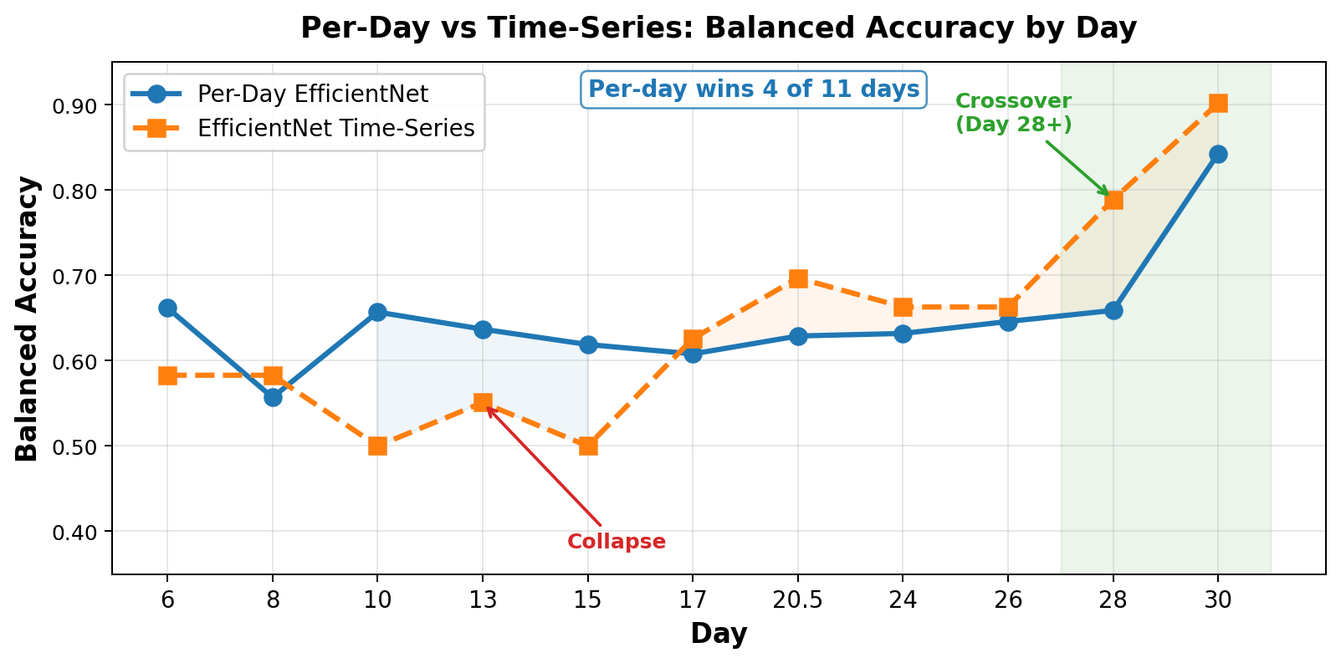
Per-Day vs Time-Series: Performance Across Days
Notes:
Per-day wins 9 out of 11 days. Time-series only overtakes at days 28-30. The dips at day 13 and 15 are where the time-series model completely collapses. This is a striking result -- the simpler model wins almost everywhere. This leads us to our three observations.

Slide 7
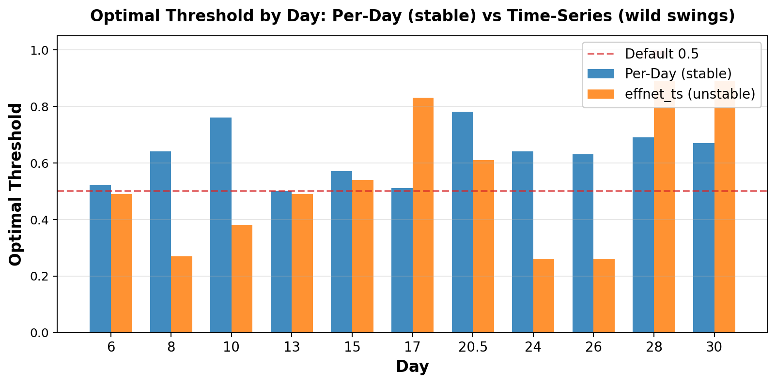
Obs 1: Model Calibration is Unstable
effnet_ts thresholds:
• Range: 0.10 – 0.90 (9× spread)
• Cannot deploy with a single cutoff
Per-day thresholds:
• Range: 0.51 – 0.58 (stable)
Why? The temporal model
absorbs noise from earlier
days, distorting its
probability outputs.
→ Connects to Obs 2
Notes:
The time-series model's optimal threshold swings from 0.10 to 0.90 across days. You cannot deploy this with a single cutoff. The per-day model stays in a tight 0.51-0.58 range. This instability is because the temporal model is absorbing noise from earlier days -- which connects directly to Observation 2.

Slide 8
Obs 1 (cont.): Day 13/15 — The Extreme Collapse
effnet_ts on Day 13:
• Predicted probabilities collapse to ~0.21 (range 0.207 – 0.222)
• At threshold 0.5: predicts ALL as "Not Acceptable"
• Result: 0 true positives out of 31 → balanced accuracy = 0.50
Remediation attempts (briefly):
• Grayscale normalization → still collapsed
• Filled mask input → still collapsed
• Transform auditing (Day 13 vs Day 28) → no obvious input bug
Per-day model on same days: balanced_acc = 0.676 (Day 13), 0.619 (Day 15)
→ Per-day handles these days fine. The issue is in temporal modeling.
Notes:
Days 13 and 15 are the extreme case -- probabilities collapse to 0.21. We tried three fixes, none worked. The per-day model handles these days fine. This points to a fundamental issue with temporal modeling on early sequences, not a data preprocessing bug.

Slide 9
Obs 2: In Early Days, Past Signals Are Noise
Per-day model wins on 9 of 11 days (Day 6 – Day 26)
Advantage ranges from +0.002 to +0.227 balanced accuracy
Time-series only wins at Day 28 and Day 30
Advantage: +0.134 to +0.214
The key insight:
• The per-day model ignores history and performs better
• If history were informative, the time-series model should dominate
• It doesn't → temporal signal from earlier days is not informative
• The past is noise that distorts the time-series model
This explains Observation 1: noisy past signals → unstable calibration
Notes:
If past images helped, the time-series model should dominate. It loses on 9 of 11 days. In early days, the organoid's past appearance cannot predict its future quality. The past is noise. This also explains why the time-series model's threshold calibration is so unstable -- it's fitting to noise.

Slide 10
Obs 2 (cont.): Why History Helps Only at Day 28+
By Day 28–30, the organoid has shown most of its developmental trajectory
• Cumulative visual evidence is finally informative
• Quality differentiation happens late — this makes biological sense
Earlier days (6–26): acceptable and not-acceptable look similar
• Morphological ambiguity before differentiation
• Adding ambiguous past images only adds noise
Implication for deployment:
• Use per-day model for days 6–26
• Switch to time-series model for days 28+
• Hybrid strategy is optimal
Notes:
History becomes signal only near the end of the experiment. This makes biological sense -- quality differentiation happens late. For deployment, the hybrid strategy -- per-day early, time-series late -- is optimal.

Slide 11
Obs 3: The Hidden Small-N Fragility Problem
5,168 total images sounds large, but...
The funnel again:
475 wells → ~260 labeled → 220 after filtering
44 in test set, only 9 negatives per day
Impact of a single misclassification:
• 1 wrong prediction out of 9 negatives = specificity changes by 11%
• 2 wrong predictions = specificity changes by 22%
The 0.227 balanced_acc gap (Day 13, per-day vs effnet_ts)
could be driven by just 2–3 samples
Many performance differences may not be statistically significant.
Notes:
5,168 images sounds like a lot, but after filtering and splitting, the test set has only 9 negative samples per day. A single misclassification flips specificity by 11%. This means many of the performance differences we've shown may not be statistically significant.

Slide 12
Obs 3 (cont.): What This Means for All Our Results
Threshold sensitivity (Obs 1) is amplified by small n:
• Shifting the threshold moves a few predictions
• With 9 negatives, that's a huge percentage swing
Reproducibility runs (3 runs, fixed seed) produce identical results
• The instability is systematic, not random
• Same seed → same result, but the evaluation is still fragile
What we need:
• More labeled negatives ("Not Acceptable" organoids)
• Cross-validation with confidence intervals
• This is the single most impactful improvement
Notes:
This is the sobering meta-observation. Before we over-interpret any metric difference, we need to acknowledge that our evaluation is statistically fragile. More labeled data -- especially 'not acceptable' -- is the single most impactful improvement we can make.

Slide 13
Can the Classifier Replace Manual Scoring?
Partial yes at late days:
• Day 28–30: effnet_ts achieves 0.76–0.82 balanced accuracy
• Useful as a screening tool / pre-filter
Not yet for early days:
• Days 6–17: performance 0.50–0.67 — not reliable enough
• Cannot replace expert review at early time points
Cost-saving potential:
• Pre-filter at late days: flag clear acceptables automatically
• Route ambiguous cases to experts
• Could reduce manual review by ~50% at late days
Notes:
The classifier can save costs as a pre-filter for late-day assessments, but cannot fully replace expert review, especially at early time points. At day 28-30 it is useful as an automated screening tool.

Slide 14
What Is Wrong with the Image Data
Class imbalance: 72.5% Acceptable
• Models default to majority class despite 2.5× weighting
Label propagation assumption:
• Labels from Day 28/30 applied backward to earlier days
• Assumes quality is determined at seeding — may not be true
Small labeled set:
• Only 220 usable organoids out of 475
• Only 9 negatives in the test set per day
Morphological ambiguity:
• In early days, acceptable and not-acceptable organoids look similar
• Not solvable by better models alone
Notes:
The data has structural problems that better models alone cannot solve: too few labeled negatives, a questionable label propagation assumption, and inherent visual ambiguity in early development.

Slide 15
Recommendations
Short-term:
• Deploy per-day model at Day 28–30 as automated pre-screening
• Hybrid strategy: per-day for early days, time-series for late days
Medium-term:
• Collect more "Not Acceptable" labels (target: 100+ negatives in test)
• Report all metrics with confidence intervals
Long-term:
• Investigate whether organoid quality is truly fixed at seeding
• (the backward label propagation assumption)
Overlay approach works well → shape is signal
• Simpler shape-based methods could be viable alternatives
Notes:
Three concrete next steps: deploy late-day screening now, collect more negative labels, and question whether backward label propagation is biologically valid. The fact that overlay images work well suggests simpler shape-based methods could also be effective.

Slide 16
Bilinear Combined Model: Image + Metabolite
Tested 7 fusion strategies to add metabolite data into the image classifier
(concat, gated, FiLM, bilinear, prior, classifier_only, cross_attention)
Best result: Bilinear fusion
• Day 30: 0.87 balanced accuracy (best across all approaches)
• Day 28: 0.75 balanced accuracy
• Days 8, 13, 20.5: collapses to ~0.50 (same problem as image-only)
Confirms Observation 2:
• Late-day data is where the signal lives — for both images and metabolites
• Metabolite signal is also noisy in early days
• No single fusion strategy wins every day
Next step: Run same 7 strategies with time-series backbone
Notes:
We tested 7 ways to combine metabolites with images. The bilinear approach hits 0.87 at day 30 -- our best result. But it doesn't help early days. This confirms what we learned: late-day data is where the signal lives. The combined approach is promising but needs further validation with the time-series backbone.

