Slide 1
Metabolite Preprocessing Variants
series_idor · n=139 · 10×4-fold repeated CV
Comparing: nan-floor · raw values · MalateGlo excluded

Slide 2
Three Metabolite Preprocessing Approaches
Background MalateGlo assay occasionally produces extreme negative concentrations (e.g. −5662 µM) interpreted as assay failure. The original pipeline replaces values < −500 µM with NaN. This experiment tests whether that correction matters and whether MalateGlo adds value. Variant 1 — met_nan (original) Concentration values below −500 µM → NaN. LightGBM handles NaN natively. Variant 2 — met_raw Raw concentration used as-is. No floor applied. Tests whether outlier flagging matters. Variant 3 — met_no_malate MalateGlo feature excluded entirely (all 3 MalateGlo columns: concentration, initial, growth rate). Tests whether MalateGlo adds discriminative signal. Note: MalateGlo is only present for days > Dy10 (conditional metabolite). All three variants are trained independently on the same fold splits in every repeat. Comparison is therefore perfectly controlled for cohort and fold assignments.

Slide 3
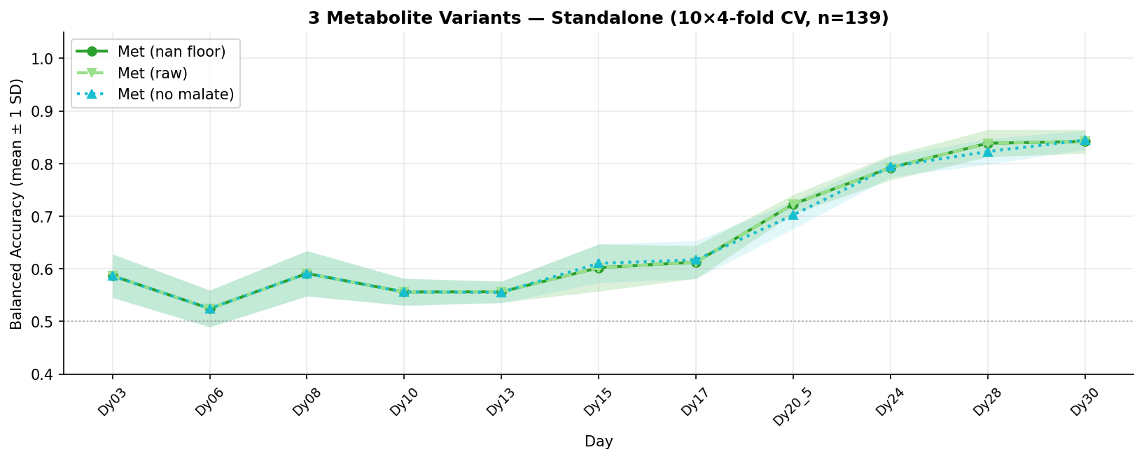
Standalone BA — 3 Met Variants

Slide 4
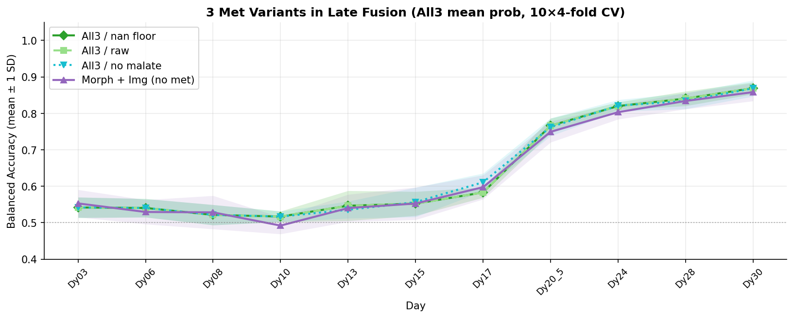
Late-Fusion BA — 3 Met Variants vs Morph+Img Baseline

Slide 5
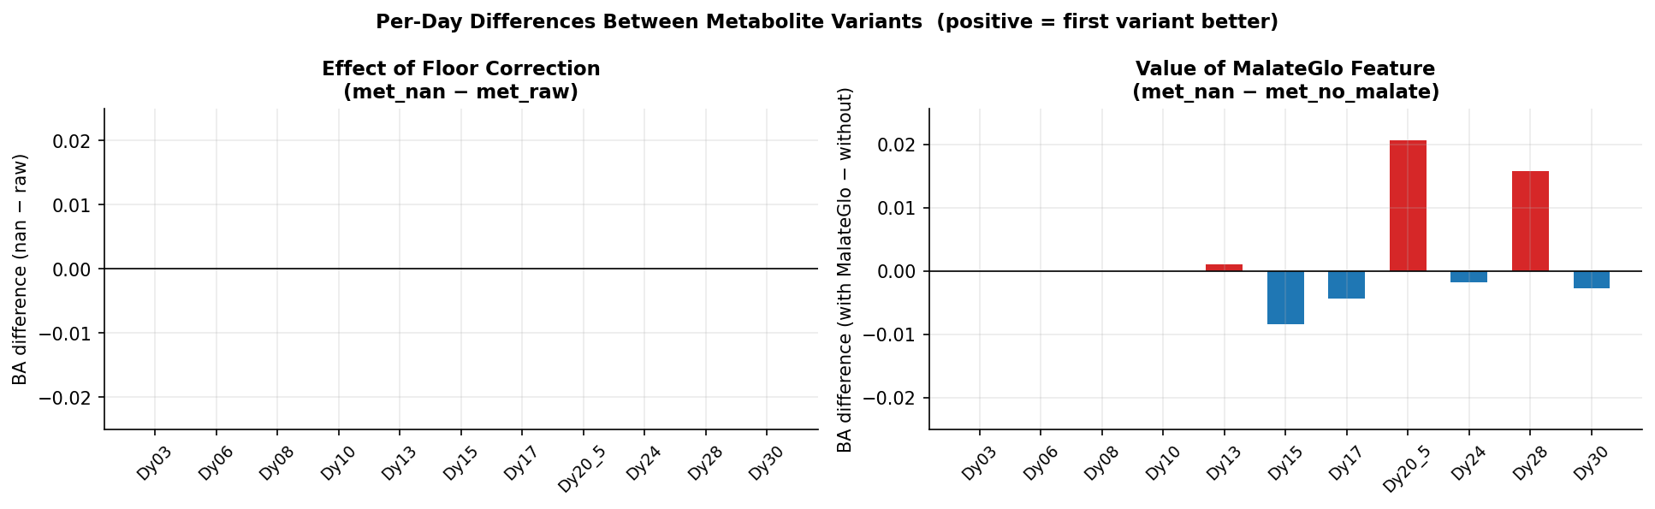
Per-Day Differences Between Variants

Slide 6
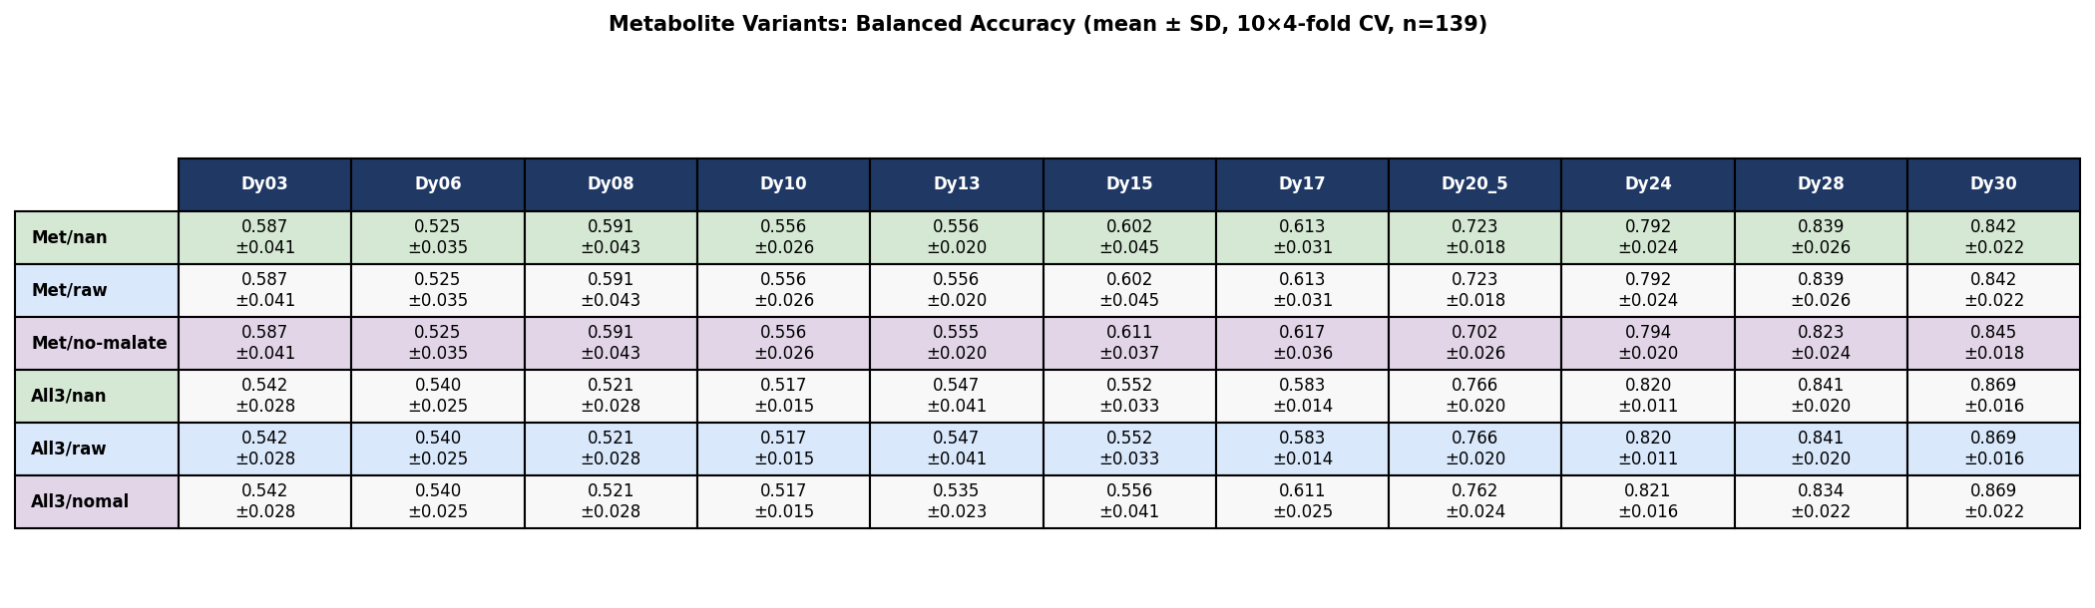
Numeric Summary Table

Slide 7
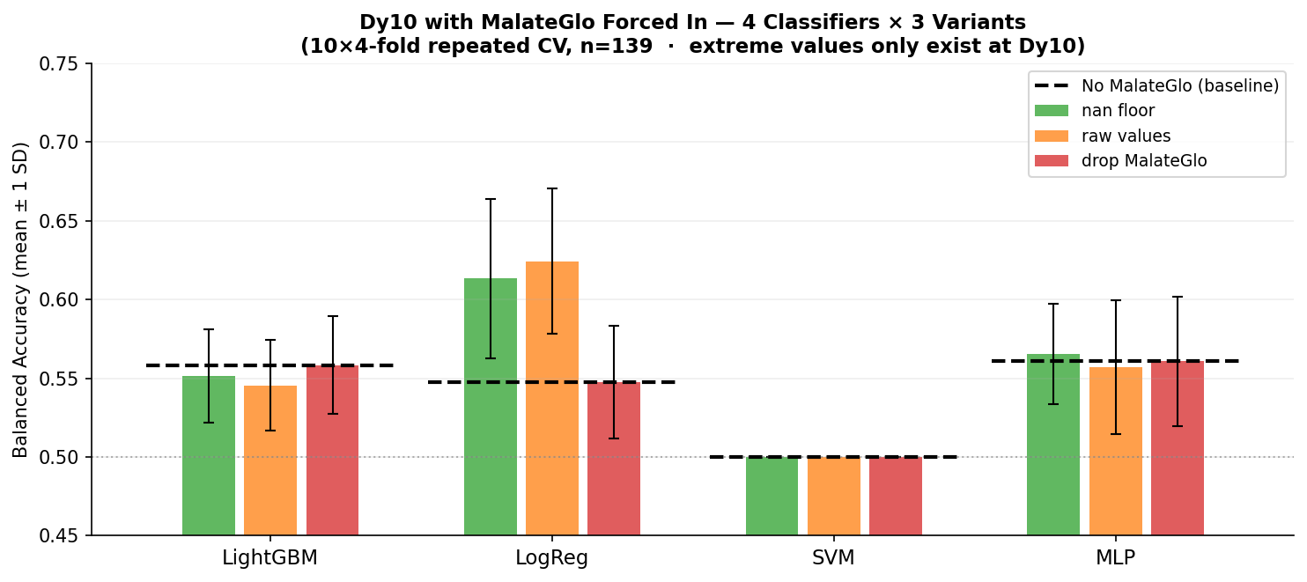
Dy10 Experiment: Forcing MalateGlo In Where Outliers Live
Why this experiment? Extreme MalateGlo values (e.g. −5662 µM) exist only at Dy10. MalateGlo is normally excluded for days ≤ Dy10 (conditional metabolite), so the floor correction never fires in the standard pipeline. Here we force MalateGlo into Dy10 features to test the correction directly. Key findings • nan vs raw: ~0.006–0.011 BA difference — floor correction works but the effect is tiny, within repeat noise (±0.03–0.05 SD). • LogReg: nan=0.613 > drop/baseline=0.548 — gains most from keeping MalateGlo (even with outliers replaced by NaN). • LGBM/MLP: nan ≈ raw ≈ drop ≈ baseline — insensitive to MalateGlo at Dy10. • SVM: stuck at 0.500 regardless — features not separable at Dy10.

Slide 8
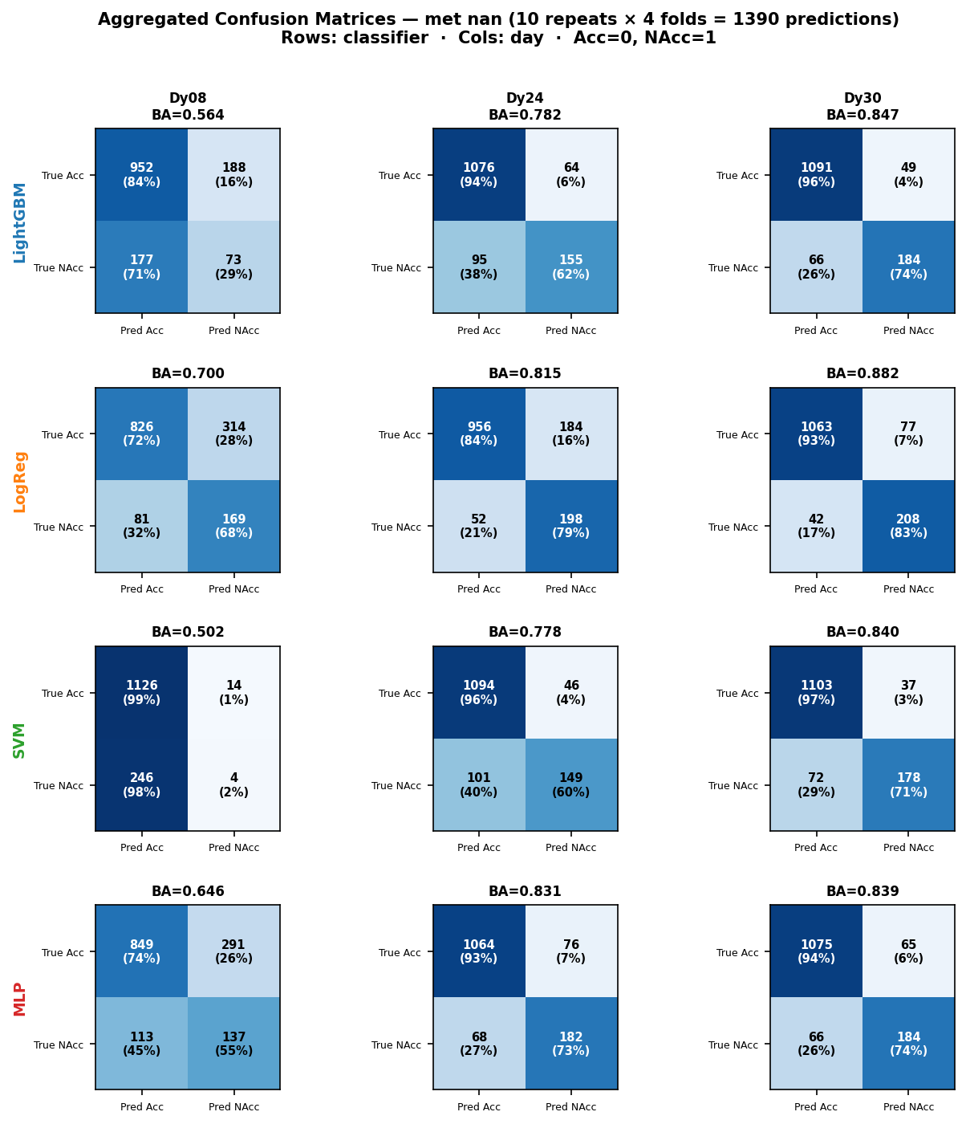
Confusion Matrices — 4 Classifiers × Key Days (met_nan, aggregated 10 repeats)

Slide 9
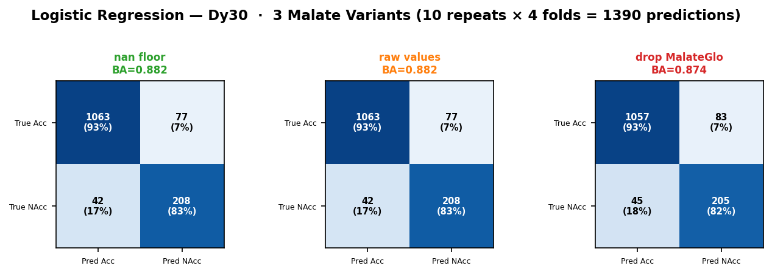
Malate Variant Effect on Confusion Matrix — LogReg at Dy30

Slide 10
Observations & Conclusions
1. Floor correction (met_nan) vs raw values (met_raw) Max |BA difference| across all days = 0.0000 — exactly zero. → Root cause: extreme MalateGlo values (e.g. −5662 µM) exist only at Dy10, but MalateGlo is a conditional feature excluded for days ≤ Dy10. At Dy13+, where MalateGlo IS used, all values are > −500 µM — floor never fires. → Confirmed by Dy10 forced-inclusion experiment (see next slide). 2. Dropping MalateGlo (met_no_malate) reduces BA at late days: Dy20_5 (+0.021), Dy28 (+0.016) → MalateGlo contributes signal at late time points where malate metabolism diverges between Acceptable and Not-Acceptable organoids. 3. Metabolite BA improves strongly with organoid age: Early days (≤Dy17) mean BA = 0.576 Late days (≥Dy20) mean BA = 0.799 → Metabolic signatures become more discriminative as organoids mature. 4. Late-fusion gain (All3 mean vs Met alone) at late days: Mean gain = +0.025 over 4 days → Combining all three modalities consistently outperforms any single modality.

