Slide 1


Tutorial
Le Phuoc Son
Hoang Huu Hanh
Hue University
Notes:
<numéro>

Slide 2
What is Protégé?
Protégé is a free, open-source platform
Provides a suite of tools to construct domain models and knowledge-based applications with ontologies
Support the creation, visualization, and manipulation of ontologies in various representation formats.
Notes:
<numéro>

Slide 3
What is Protégé?
The Protégé platform supports two main ways of modeling ontologies:
The Protégé-Frames editor
The Protégé-OWL editor
Notes:
<numéro>

Slide 4
Protégé-OWL
The Protégé-OWL editor enables users to:
Load and save OWL and RDF ontologies.
Edit and visualize classes, properties, and SWRL rules.
Define logical class characteristics as OWL expressions.
Execute reasoners such as description logic classifiers.
Edit OWL individuals for Semantic Web markup.
Notes:
<numéro>

Slide 5
Download Protégé-OWL
http://protege.stanford.edu/
Protégé 4 - support for OWL 2.0
Protégé 3 - support for OWL 1.0, RDF(S), and Frames
Notes:
<numéro>

Slide 6
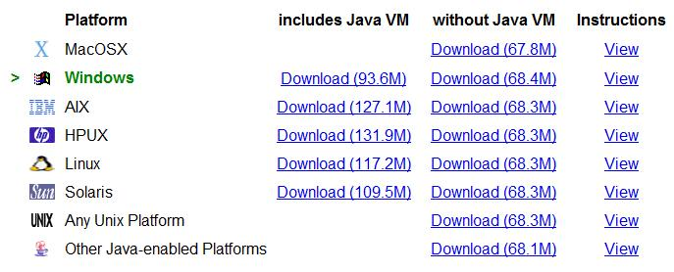
Protégé-OWL 3.4.1
Notes:
<numéro>

Slide 7
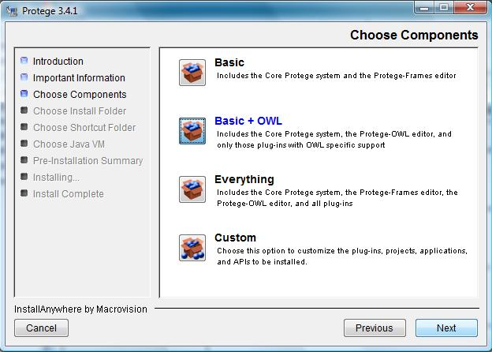
Install Protégé-OWL 3.4.1
Select “Basic + OWL” in the installation Wizard
Notes:
<numéro>

Slide 8
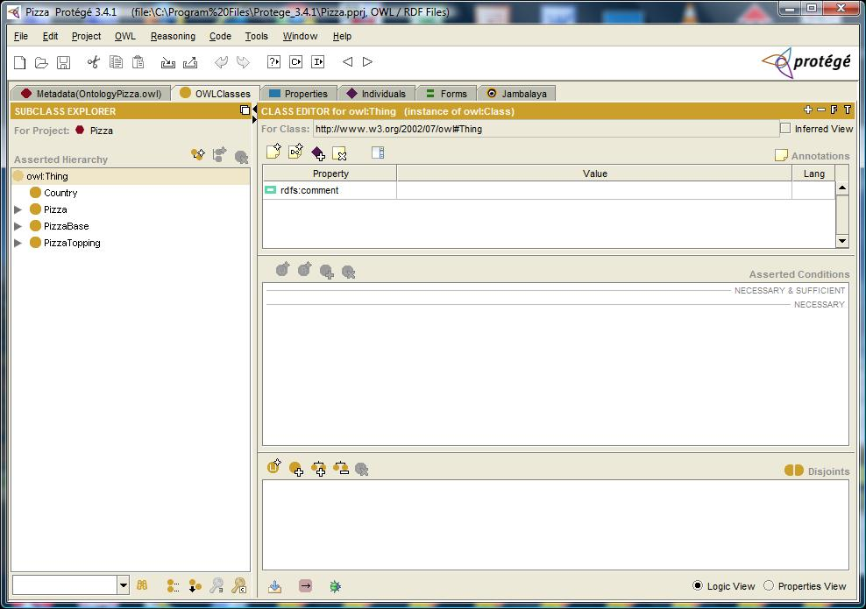
Protégé User Interface
Notes:
<numéro>

Slide 9
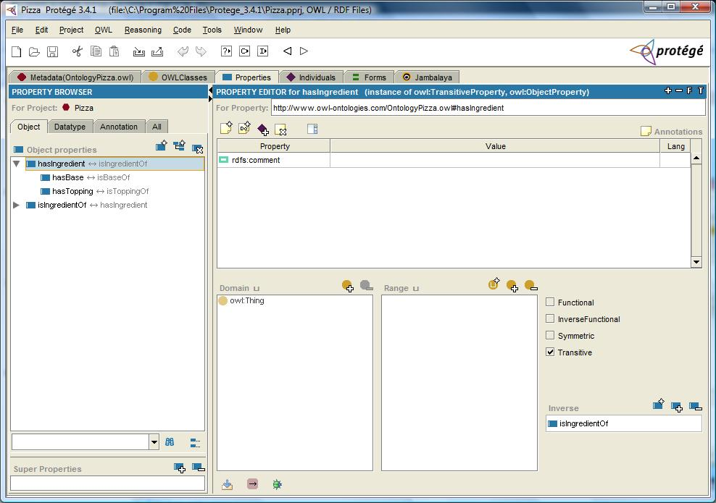
Properties Tab
Notes:
<numéro>

Slide 10
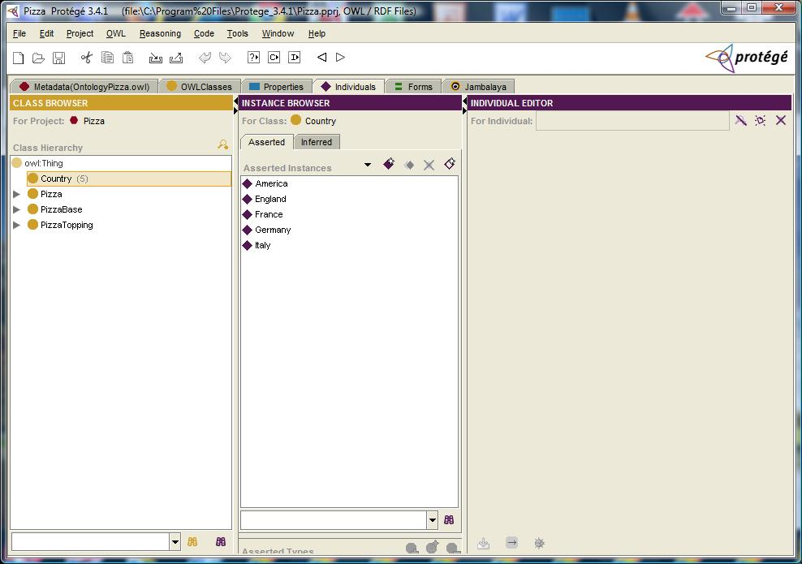
Individuals Tab
Notes:
<numéro>

Slide 11
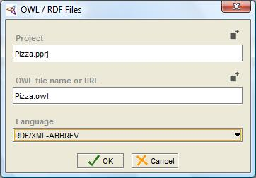
Saving Projects
Notes:
<numéro>

Slide 12
Building an OWL Ontology
Notes:
<numéro>

Slide 13
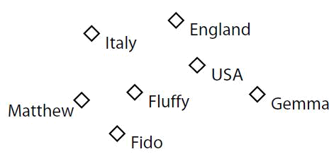
Components of OWL Ontologies
Individuals: represent objects in the domain that we are interested in.
Notes:
<numéro>

Slide 14
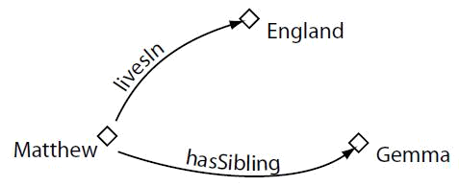
Components of OWL Ontologies
Properties: binary relations on individuals.
Notes:
<numéro>

Slide 15
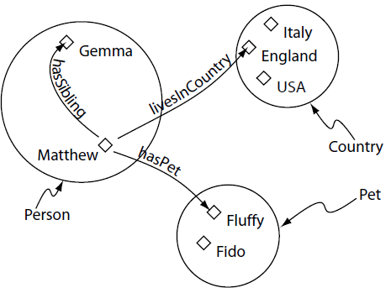
Components of OWL Ontologies
Classes: sets that contain individuals.
Notes:
<numéro>

Slide 16
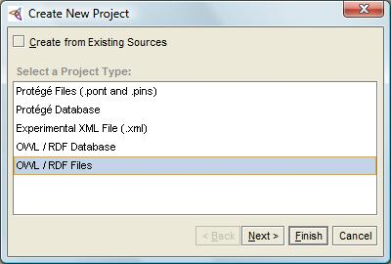
Building an OWL Ontology
Start Protégé
When the Create New Project dialog box appears, select ‘OWL/RDF Files’ from the ‘Project Type’ list section.
Notes:
<numéro>

Slide 17
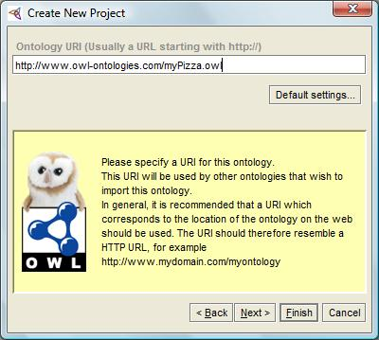
Building an OWL Ontology
Specify a URI for this ontology.
Pizza Ontology
Notes:
<numéro>

Slide 18
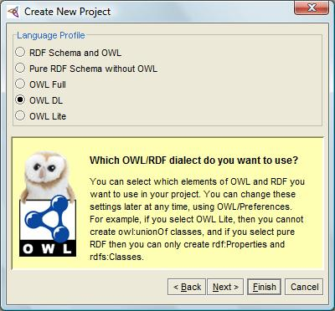
Building an OWL Ontology
Select which elements of OWL and RDF you want to use in your project.
Notes:
<numéro>

Slide 19
Creating named class
Select the Classes tab use the ‘Create subclass’ to create Pizza, PizzaBase and PizzaTopping.
Ensuring that owl:Thing is selected before the ‘Create subclass’ button is pressed;
Rename the class using the ‘Class editor widget’.
Notes:
<numéro>

Slide 20
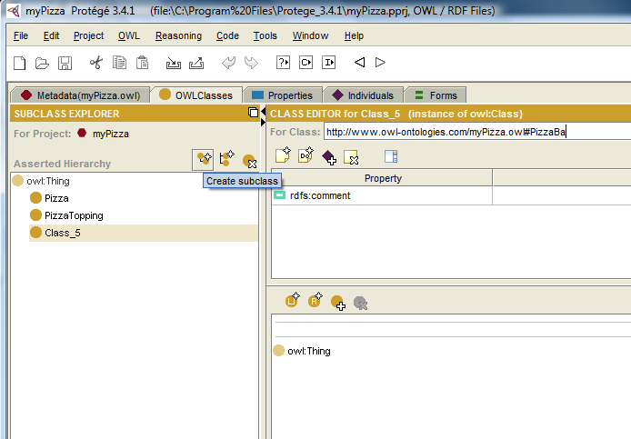
Creating named class
Notes:
<numéro>

Slide 21
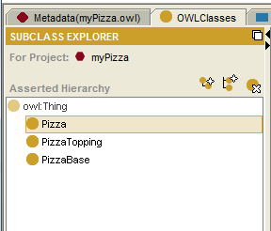
Creating named class
The Initial Class Hierarchy
Notes:
<numéro>

Slide 22
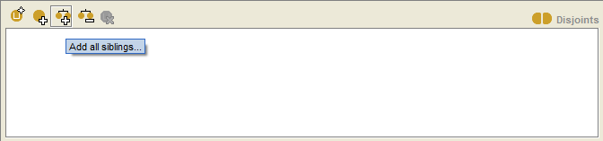
Disjoint Classes
To specify classes that are disjoint from the selected class the ‘Disjoints widget’ which is located in the lower right hand corner of the ‘OWLClasses’ tab is used.
Notes:
<numéro>

Slide 23
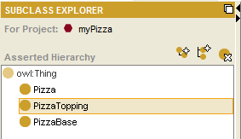
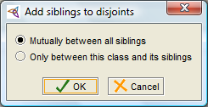
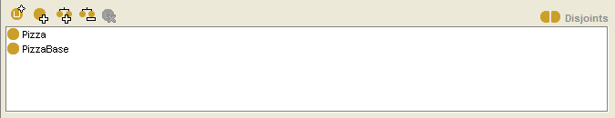
Disjoint Classes
Select the class Pizza in the class hierarchy.
Press the ‘Add all siblings...’ button on the disjoint classes widget.
Notes:
<numéro>

Slide 24
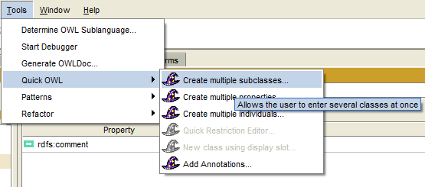
Using The OWL Wizards To Create Classes
The OWL Wizards plugin is an extensible set of Wizards that are designed to make carrying out common, repetitive and time consuming tasks easy.
Notes:
<numéro>

Slide 25
Using The OWL Wizards To Create Classes
Use the ‘Create multiple subclasses...’ Wizard to create ThinAndCrispy and DeepPan as subclasses of PizzaBase.
Notes:
<numéro>

Slide 26
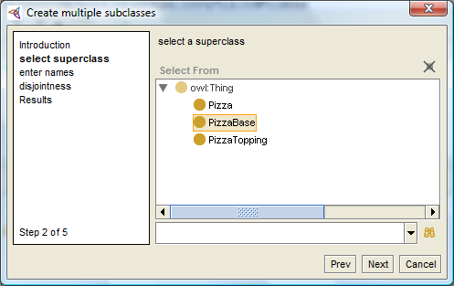
Using The OWL Wizards To Create Classes
Notes:
<numéro>

Slide 27
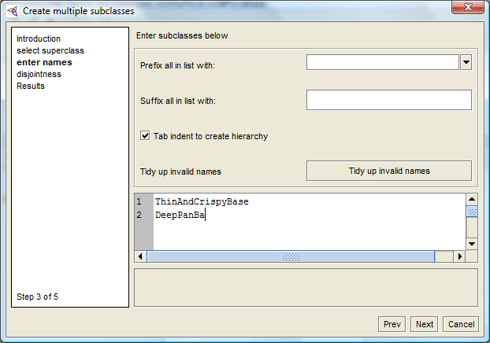
Using The OWL Wizards To Create Classes
Notes:
<numéro>

Slide 28
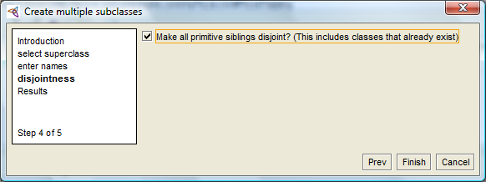
Using The OWL Wizards To Create Classes
Notes:
<numéro>

Slide 29
Using The OWL Wizards To Create Classes
PizzaTopping: MeatTopping, VegetableTopping, CheeseTopping and SeafoodTopping.
MeatTopping: SpicyBeefTopping, PepperoniTopping, SalamiTopping, HamTopping.
VegetableTopping: TomatoTopping, OliveTopping, MushroomTopping, PepperTopping, OnionTopping and CaperTopping.
PepperTopping: RedPepperTopping, GreenPepperTopping and JalapenoPepperTopping.
CheeseTopping: MozzarellaTopping, ParmezanTopping.
SeafoodTopping: TunaTopping, AnchovyTopping and PrawnTopping.
Notes:
<numéro>

Slide 30
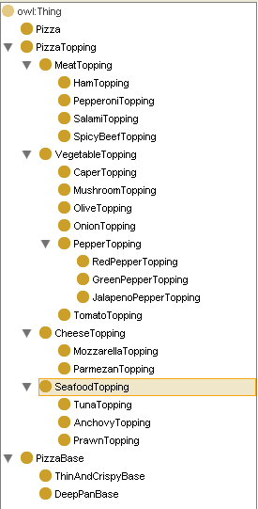
Class
Hierarchy
Notes:
<numéro>

Slide 31
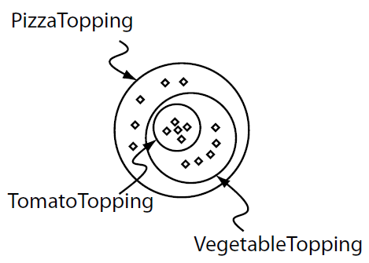
Meaning of subClasses
Notes:
<numéro>

Slide 32
OWL Properties
There are two main types of properties, Object properties and Datatype properties.
Object properties link an individual to an individual.
Datatype properties link an individual to an XML Schema Datatype value or an rdf literal.
OWL also has a third type of property – Annotation properties.
Annotation properties can be used to add information (metadata— data about data) to classes, individuals and object/datatype properties.
Notes:
<numéro>

Slide 33
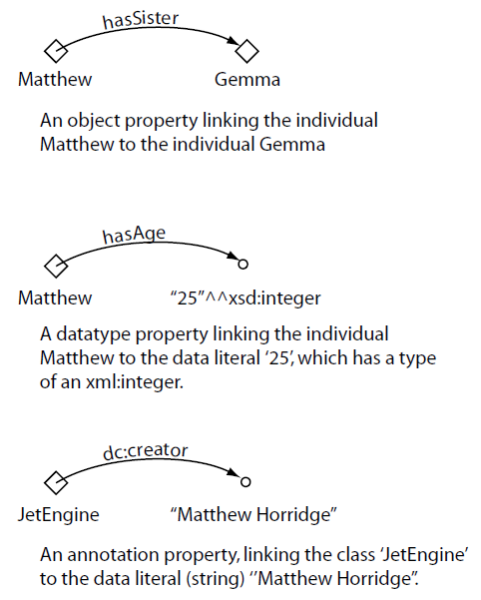
The Different
Types of
OWL Properties
Notes:
<numéro>

Slide 34
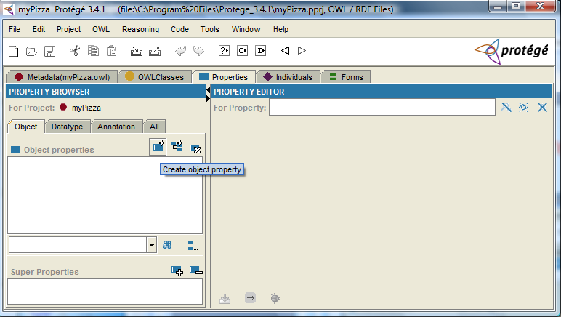
Create Properties
Notes:
<numéro>

Slide 35
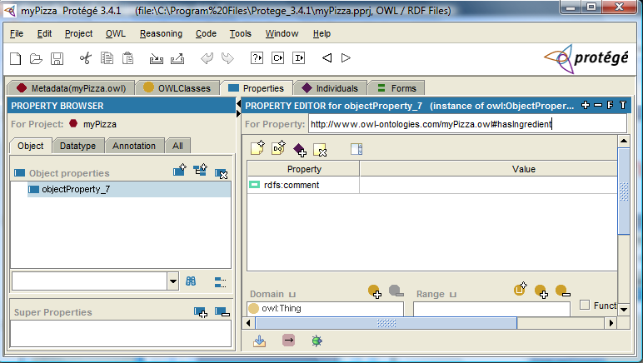
Create Properties
Notes:
<numéro>

Slide 36
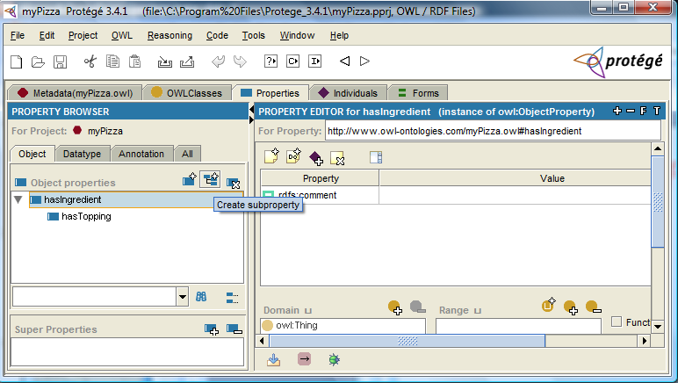
Create subProperties
Notes:
<numéro>

Slide 37
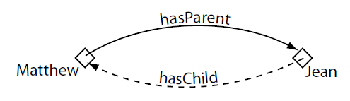
Inverse Properties
Notes:
<numéro>

Slide 38
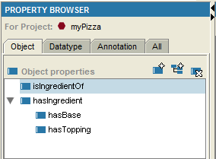
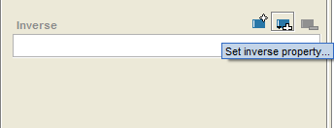
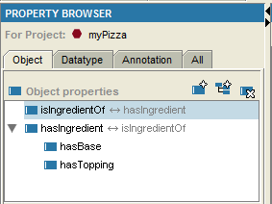
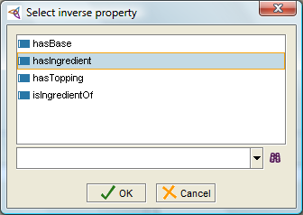
Inverse Properties
Notes:
<numéro>

Slide 39
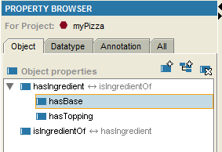

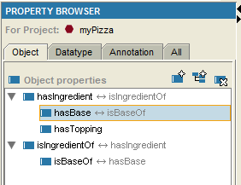
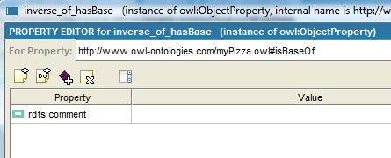
Inverse Properties
Notes:
<numéro>

Slide 40
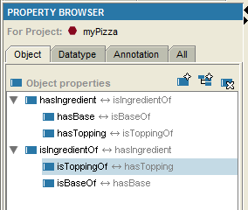
Inverse Properties
isToppingOf < - - > hasTopping
Notes:
<numéro>

Slide 41
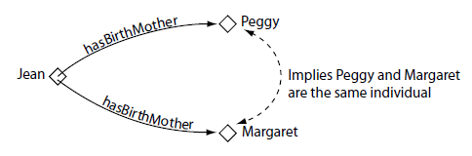
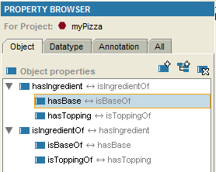
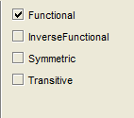
Functional Properties
Property Characteristics
Widget
Notes:
<numéro>

Slide 42
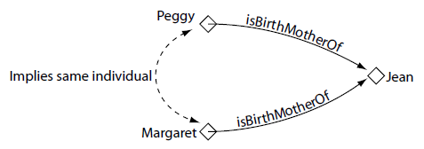
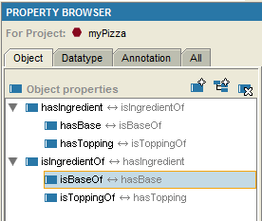
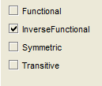
Inverse Functional Properties
Notes:
<numéro>

Slide 43
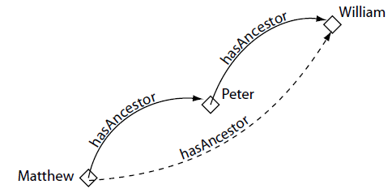
Transitive Properties
Notes:
<numéro>

Slide 44
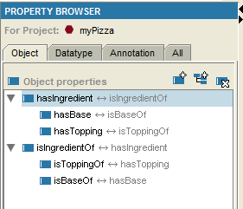
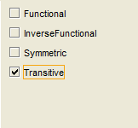
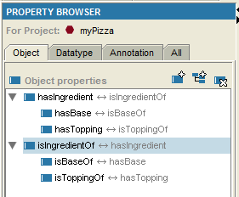
Transitive Properties
Notes:
<numéro>

Slide 45
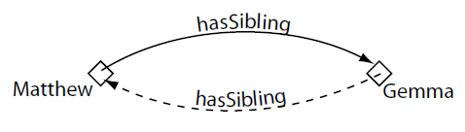
Symmetric Properties
Notes:
<numéro>

Slide 46
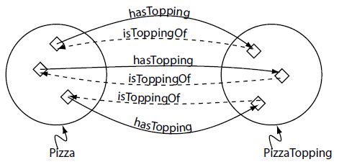
Property Domain and Range
The domain and range for the hasTopping property and its inverse property isToppingOf
Notes:
<numéro>

Slide 47
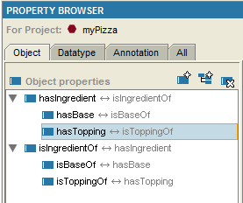



Property Domain and Range
Range Widget
Specify the range of hasTopping
Notes:
<numéro>

Slide 48




Property Domain and Range
Domain Widget
Specify the domain of hasTopping
Notes:
<numéro>

Slide 49

Property Domain and Range
Specify the domain of isToppingOf
=> Specify the domain and range for the hasBase property and its inverse property isBaseOf
Notes:
<numéro>

Slide 50
Describing and Defining Class
Property Restrictions
- Quantifier Restrictions
- Cardinality Restrictions
- hasValue Restrictions.
Notes:
<numéro>

Slide 51
Describing and Defining Class
Quantifier Restrictions
- The existential quantifier, which can be read as at least one, or some.
- The universal quantifier, which can be read as only
Notes:
<numéro>

Slide 52

Existential Restrictions
The Restriction hasTopping Mozzarella. This restriction describes the class of individuals that have at least one topping that is Mozzarella. The restriction describes an anonymous (unnamed) class of individuals that satisfy the restriction.
Notes:
<numéro>

Slide 53

Existential Restrictions
Conditions Widget
Notes:
<numéro>

Slide 54


Existential Restrictions
Type PizzaBase or ...
Add a restriction to Pizza that specifies a Pizza must have a PizzaBase
Notes:
<numéro>

Slide 55

Existential Restrictions
Conditions Widget: Description of a Pizza
Notes:
<numéro>

Slide 56

Existential Restrictions
In order for something to be a Pizza it is necessary for it to have a (at least one) PizzaBase
Notes:
<numéro>

Slide 57

Creating Some Different Kinds Of Pizzas
Create a subclass of Pizza called NamedPizza, and a subclass of NamedPizza called MargheritaPizza
Notes:
<numéro>

Slide 58

Creating Some Different Kinds Of Pizzas
Create an existential restriction on MargheritaPizza to specify that a MargheritaPizza has at least one MozzarellaTopping
Notes:
<numéro>

Slide 59

Creating Some Different Kinds Of Pizzas
Create an existential restriction on MargheritaPizza to specify that a MargheritaPizza has at least one TomatoTopping
Notes:
<numéro>

Slide 60



Creating Some Different Kinds Of Pizzas
Create AmericanaPizza by cloning and modifying the description of MargheritaPizza
Notes:
<numéro>

Slide 61

Creating Some Different Kinds Of Pizzas
Create AmericanaPizza by cloning and modifying the description of MargheritaPizza
Notes:
<numéro>

Slide 62
Creating Some Different Kinds Of Pizzas
An AmericanHotPizza is almost the same as an AmericanaPizza, but has Jalapeno peppers on it—create this by cloning the class AmericanaPizza and adding an existential restriction along the hasTopping property with a filler of JalapenoPepperTopping.
A SohoPizza is almost the same as a MargheritaPizza but has additional toppings of olives and and parmezan cheese create this by cloning MargheritaPizza and adding two existential restrictions along the property hasTopping, one with a filler of OliveTopping, and one with a filler of ParmezanTopping.
Create an AmericanHotPizza and a SohoPizza
Notes:
<numéro>

Slide 63

Creating Some Different Kinds Of Pizzas
Create an AmericanHotPizza and a SohoPizza
Notes:
<numéro>

Slide 64

Creating Some Different Kinds Of Pizzas
Create an AmericanHotPizza and a SohoPizza
Notes:
<numéro>

Slide 65

Creating Some Different Kinds Of Pizzas
Make subclasses of NamedPizza disjoint from each other
Notes:
<numéro>

Slide 66



Using a Reasoner
compute the inferred ontology class hierarchy
consistency checking
Determining the OWL Sub-Language
Notes:
<numéro>

Slide 67

Using a Reasoner
Notes:
<numéro>

Slide 68

Inconsistent Classes
Add a Probe Class called ProbeInconsistentTopping which is a subclass of both CheeseTopping and Vegetable
Notes:
<numéro>

Slide 69

Inconsistent Classes
The Class ProbeInconsistentTopping found to be inconsistent by the reasoner
Notes:
<numéro>

Slide 70
Inconsistent Classes
Remove the disjoint statement between CheeseTopping and VegetableTopping, what happens?
Notes:
<numéro>

Slide 71
Necessary And Sufficient Conditions (Primitive and Defined Classes)
All of the classes that we have created so far have only used necessary conditions to describe them.
Necessary conditions can be read as, “If something is a member of this class then it is necessary to fulfil these conditions”.
With necessary conditions alone, we cannot say that, “If something fulfils these conditions then it must be a member of this class”.
A class that only has necessary conditions is known as a Primitive Class.
Notes:
<numéro>

Slide 72

Necessary And Sufficient Conditions (Primitive and Defined Classes)
Create a subclass of Pizza called CheesyPizza and specify that it has at least one topping that is a kind of CheeseTopping
Notes:
<numéro>

Slide 73

Necessary And Sufficient Conditions (Primitive and Defined Classes)
Convert the necessary conditions for CheesyPizza into necessary & sufficient conditions
Notes:
<numéro>

Slide 74

Necessary And Sufficient Conditions (Primitive and Defined Classes)
Use the reasoner to automatically compute the subclasses of CheesyPizza
Notes:
<numéro>

Slide 75


OWLViz
Download and install a recent version of Graphviz:
http://www.graphviz.org
Notes:
<numéro>

Slide 76

OWLViz
OWLViz Displaying the Asserted Hierarchy for CheesyPizza
Notes:
<numéro>

Slide 77

OWLViz
OWLViz Displaying the Inferred Hierarchy for CheesyPizza
Notes:
<numéro>

Slide 78

Universal Restrictions
Create a class to describe a VegetarianPizza
Notes:
<numéro>

Slide 79

Universal Restrictions
Create a class to describe a VegetarianPizza
Notes:
<numéro>

Slide 80

Universal Restrictions
Convert the necessary conditions for VegetarianPizza into necessary & sufficient conditions
Notes:
<numéro>

Slide 81
Closure Axioms
Press the ‘Classify taxonomy’ button.
You will notice that MargheritaPizza and also SohoPizza have not been classified as subclasses of VegetarianPizza
Notes:
<numéro>

Slide 82

Closure Axioms
Add a closure axiom on the hasTopping property for MargheritaPizza
Notes:
<numéro>

Slide 83

Closure Axioms
Add a closure axiom on the hasTopping property for SohoPizza
Notes:
<numéro>

Slide 84

Closure Axioms
Automatically create a closure axiom on the hasTopping property for AmericanaPizza
Notes:
<numéro>

Slide 85

Closure Axioms
Automatically create a closure axiom on the hasTopping property for AmericanHotPizza
Notes:
<numéro>

Slide 86

Closure Axioms
Use the reasoner to classify the ontology
Notes:
<numéro>

Slide 87

Closure Axioms
Visualizating in OWLViz
Notes:
<numéro>

Slide 88

Closure Axioms
Visualizating in OWLViz
Notes:
<numéro>

Slide 89

Value Partitions
to refine our descriptions of various classes.
Notes:
<numéro>

Slide 90


Value Partitions
Create a ValuePartition to represent the spiciness of pizza toppings
Notes:
<numéro>

Slide 91

Value Partitions
Create a ValuePartition to represent the spiciness of pizza toppings
Notes:
<numéro>

Slide 92



Value Partitions
Create a ValuePartition to represent the spiciness of pizza toppings
Notes:
<numéro>

Slide 93

Value Partitions
Create a ValuePartition to represent the spiciness of pizza toppings
Notes:
<numéro>

Slide 94

Using Quick Restriction Editor
Use the properties matrix wizard to specify the spiciness of pizza toppings
Notes:
<numéro>

Slide 95

Using Quick Restriction Editor
Use the properties matrix wizard to specify the spiciness of pizza toppings
Notes:
<numéro>

Slide 96

Using Quick Restriction Editor
Use the properties matrix wizard to specify the spiciness of pizza toppings
Notes:
<numéro>

Slide 97

Using Quick Restriction Editor
Use the properties matrix wizard to specify the spiciness of pizza toppings
Notes:
<numéro>

Slide 98

Using Quick Restriction Editor
Use the properties matrix wizard to specify the spiciness of pizza toppings
Notes:
<numéro>

Slide 99

Creating Individuals
The Individuals Tab
Notes:
<numéro>

Slide 100

Creating Individuals
Create a class called Country and populate it with some individuals
Notes:
<numéro>

Slide 101

Creating Individuals
Create a class called Country and populate it with some individuals
Notes:
<numéro>

Slide 102
hasValue Restrictions
A hasValue restriction, denoted by the symbol ∃, describes the set of individuals that have at least one relationship along a specified property to a specific individual.
For example, the hasValue restriction hasCountryOfOrigin ∃ Italy (where Italy is an individual) describes the set of individuals (the anonymous class of individuals) that have at least one relationship along the hasCountryOfOrigin property to the specific individual Italy.
Notes:
<numéro>

Slide 103

hasValue Restrictions
Create a hasValue restriction to specify that MozzarellaTopping has Italy as its country of origin
Notes:
<numéro>

Slide 104

hasValue Restrictions
Create a hasValue restriction to specify that MozzarellaTopping has Italy as its country of origin
Notes:
<numéro>

Slide 105

hasValue Restrictions
Create a hasValue restriction to specify that MozzarellaTopping has Italy as its country of origin
Notes:
<numéro>

Slide 106
Some different problems
Cardinality Restrictions
Enumerated Classes
Annotation Properties
. . .
Will be presented in the next time???
Notes:
<numéro>

Slide 107
Thanks for your attention
Notes:
<numéro>

