Slide 1


EmptyPage

Slide 2


NewStory
New +
Story
Bookmarks
+

Slide 3

NewCohort
New +
Story
Bookmarks
Data source:
Please select the source study of your data
SUBSET_A
UBIOPRED
ECLIPSE
AIRPROM
Keyword
Optionally you can provide a term to search the available data

Slide 4


ConceptSelection
New +
Story
Bookmarks
Data source:
Please select the source study of your data
UBIOPRED_A
UBIOPRED
ECLIPSE
AIRPROM
Keyword
Optionally you can provide a term to search the available data
FEV
Bronchoscopy Visit 1
FEV1 Change
Bronchoscopy Visit 2
FEV1 Post Salbutamol (L)
FEV1 Pre Salbutamol (L)
Longitudinal 1 1
FEV1 Absolute Change
FEV1 Change
FEV1/FVC Post Salbutamol Actual Ratio
FEV1/FVC Pre Salbutamol Actual Ratio

Slide 5


ConceptFiltering
New +
Story
Bookmarks
Data source:
Please select the source study of your data
UBIOPRED_A
Filtering
You can put a constrain on the selection of patient
<
UBIOPRED
FEV1 Post Salbutamol (L)
< <= = != => >
ECLIPSE
$x$ * 0.8
AIRPROM
$$x$$
FEV1 Post Salbutamol (L)
Keyword
Optionally you can provide a term to search the available data
FEV
Bronchoscopy Visit 1
FEV1 Change
Bronchoscopy Visit 2
FEV1 Post Salbutamol (L)
Distribution of values for the concept
You can see under the distribution of FEV Post Salbutamol (L) across the whole study as well as the current subset
FEV1 Pre Salbutamol (L)
Longitudinal 1 1
FEV1 Absolute Change
FEV1 Change
FEV1/FVC Post Salbutamol Actual Ratio
FEV1/FVC Pre Salbutamol Actual Ratio
Cancel
Confirm

Slide 6
CohortViewOne
New +
Story
Bookmarks
NON ACOS ASTHMATIC
306
+
Analyse

Slide 7
CohortViewTwo
New +
Story
Bookmarks
NON ACOS ASTHMATIC
306
UBIOPRED ACOS
194
+
Analyse

Slide 8



CohortCombinationLogic
New +
Story
Bookmarks
NON ACOS ASTHMATIC
306
UBIOPRED ACOS
194
+
NON ACOS ASTHMATIC
OUTER JOINED
UBIOPRED ACOS
37
Analyse

Slide 9
FinalCohort
New +
Story
Bookmarks
NON ACOS ASTHMATIC
306
UBIOPRED ACOS
194
ECLIPSE ACOS
875
NON ACOS COPD
1284
NON ACOS ASTHMATIC
OUTER JOINED
UBIOPRED ACOS
37
SET 1
OUTER JOINED
ECLIPSE ACOS
912
Analyse

Slide 10

AnalysisPanel
New +
Story
Bookmarks
1
2
3
4
5
6
7
8
9
10
11
12
13
14
15
16
17
18
19
20
21
22
23
24
25
26
27
28
29
30
31
32
33
34
35
36
37
38
39
40
41
42
43
44
45
#' Borderline analysis code editor.
#' Welcome !
#' @return The result object of the analysis.
start <- function() {
}
Weighted Gene Co-expression Network
Gene State Variation
Gene Wide Association Study
K-Means Clustering
Survival Analysis
Dummy Analysis
Compute the Result

Slide 11
AnalysisSelection
New +
Story
Bookmarks
Dummy Analysis
1
2
3
4
5
6
7
8
9
10
11
12
13
14
15
16
17
18
19
20
21
22
23
24
25
26
27
28
29
30
31
32
33
34
35
36
37
38
39
40
41
42
43
44
45
#' Super Dummy Analysis.
#'
#' @return The result object of the analysis.
start <- function() {
add(1, 2)
add(1.0, 2.0)
add(-1, -2)
add(-1.0, -2.0)
add(1.0e10, 2.0e10)
paste("one", "two")
paste('one', 'two')
paste(NULL, NULL)
paste(NA, NA)
paste("multi-
line",
'multi-
line')
}
#' Add together two numbers.
#'
#' @param x A number.
#' @param y A number.
#' @return The sum of \code{x} and \code{y}.
#' @examples
#' add(1, 1)
#' add(10, 1)
add <- function(x, y) {
x + y
}
#' Concatenate together two strings.
#'
#' @param x A string.
#' @param y A string.
#' @return The concatenated string built of \code{x} and \
#' @examples
#' strcat("one", "two")
strcat <- function(x, y) {
paste(x, y)
}
Weighted Gene Co-expression Network
Threshold increment
This value defines the stepping value between threshold computation trial. It must be an integer number.
Gene State Variation
Gene Wide Association Study
K-Means Clustering
Survival Analysis
Dummy Analysis
Compute the Result

Slide 12
AnalysisParameter
New +
Story
Bookmarks
Dummy Analysis
1
2
3
4
5
6
7
8
9
10
11
12
13
14
15
16
17
18
19
20
21
22
23
24
25
26
27
28
29
30
31
32
33
34
35
36
37
38
39
40
41
42
43
44
45
#' Super Dummy Analysis.
#'
#' @return The result object of the analysis.
start <- function() {
add(1, 2)
add(1.0, 2.0)
add(-1, -2)
add(-1.0, -2.0)
add(1.0e10, 2.0e10)
paste("one", "two")
paste('one', 'two')
paste(NULL, NULL)
paste(NA, NA)
paste("multi-
line",
'multi-
line')
}
#' Add together two numbers.
#'
#' @param x A number.
#' @param y A number.
#' @return The sum of \code{x} and \code{y}.
#' @examples
#' add(1, 1)
#' add(10, 1)
add <- function(x, y) {
x + y
}
#' Concatenate together two strings.
#'
#' @param x A string.
#' @param y A string.
#' @return The concatenated string built of \code{x} and \
#' @examples
#' strcat("one", "two")
strcat <- function(x, y) {
paste(x, y)
}
Weighted Gene Co-expression Network
Threshold increment
This value defines the stepping value between threshold computation trial. It must be an integer number.
Gene State Variation
42
42
Gene Wide Association Study
K-Means Clustering
Survival Analysis
Dummy Analysis
Compute the Result

Slide 13


AnalysisCustom
New +
Story
Bookmarks
Custom #3
1
2
3
4
5
6
7
8
9
10
11
12
13
14
15
16
17
18
19
20
21
22
23
24
25
26
27
28
29
30
31
32
33
34
35
36
37
38
39
40
41
42
43
44
45
#' Borderline analysis code editor.
#' Welcome !
#' @return The result object of the analysis.
start <- function() {
}
New +
Distribution of values for the concept
You can see under the distribution of FEV Post Salbutamol (L) across the whole study as well as the current subset
Custom #1
Custom #2
Compute the Result

Slide 14
WGCNAStepOne
New +
Story
Bookmarks
Weighted Gene Co-expression Network Analysis Step 1
1
2
3
4
5
6
7
8
9
10
11
12
13
14
15
16
17
18
19
20
21
22
23
24
25
26
27
28
29
30
31
32
33
34
35
36
37
38
39
40
41
42
43
44
45
#' WGCNA Network topology analysis
#‘
library(WGCNA);
options(stringsAsFactors = FALSE);
df = read.table("CONCEPTS", sep = "\t", na.strings = "")
colnames(df) <- df[1, ]
df = df[-1, ]
acos.map <- -1:2
names(acos.map) <- c("NA","Healthy_Control", "ACOS_Subje
df$ACOS<-acos.map[df$ACOS]
gender.map <- 0:1
names(gender.map) <- c("female", "male")
df$Sex <- gender.map[df$Sex]
cohort.map <- 0:4
names(cohort.map) <- c("cohort_v", "cohort_a", "cohort",
df$Cohort <- cohort.map[df$Cohort]
df_clinical$`IL17 (Serum)` <- NULL
df_clinical$`Monocytes Pct (Blood)` <- NULL
df_clinical$`Basophils (Blood)` <- NULL
df_expression <- log2(df_expression)
colnames <- as.data.frame(colnames(df_expression))
colnames(colnames) <- "Sample_ID"
colnames <- merge(colnames, df_omics_mapping, by.x = "Samp
colnames(df_expression) <- colnames$subject_id
df_t_expression <- t(df_expression)
gsg = goodSamplesGenes(df_t_expression, verbose = 3);
# Remove the offending genes and samples from the data:
if (!gsg$allOK)
{
# Optionally, print the gene and sample names that were
if (sum(!gsg$goodGenes) > 0)
printFlush(paste("Removing genes:", paste(names(df_t
if (sum(!gsg$goodSamples) > 0)
printFlush(paste("Removing samples:", paste(rownames
Weighted Gene Co-expression Network
Gene State Variation
Network topology
The first step of the WGCNA pipeline consists in the selection of a soft-threshold power β to which co-expression similarity is raised to calculate adjacency
Gene Wide Association Study
K-Means Clustering
Survival Analysis
Dummy Analysis
Compute the Result

Slide 15
WGCNAStepOneResult
New +
Story
Bookmarks
Weighted Gene Co-expression Network Analysis Step 1
Network topology
The first step of the WGCNA pipeline consists in the selection of a soft-threshold power β to which co-expression similarity is raised to calculate adjacency
Status: COMPLETE
Execution time: 3.45s
18
20
5
6
7
8
9
10
14
16
4
12
3
2
1
Go Further

Slide 16
WGCNAStepTwo
New +
Story
Bookmarks
Weighted Gene Co-expression Network Analysis
1
2
3
4
5
6
7
8
9
10
11
12
13
14
15
16
17
18
19
20
21
22
23
24
25
26
27
28
29
30
31
32
33
34
35
36
37
38
39
40
41
42
43
44
45
#' WGCNA Network topology analysis
#' Step 2 Module detection
#'
# Block-wise network construction and module detection
bwnet = blockwiseModules(
df_filtered_t_expression,
maxBlockSize = 2000,
power = base_sputum_power,
TOMType = "unsigned",
minModuleSize = 30,
reassignThreshold = 0,
mergeCutHeight = 0.25,
numericLabels = TRUE,
saveTOMs = TRUE,
verbose = 3)
# open a graphics window
sizeGrWindow(12, 9)
# Convert labels to colors for plotting
ModuleColors = labels2colors(bwnet$colors)
# Plot the dendrogram and the module colors underneath
for (block in 1:length(bwnet$dendrograms)){
png(filename = paste("EAEHan", block, ".png", sep = ""),
width = 8,
height = 5,
units = 'in',
res = 300)
plotDendroAndColors(
bwnet$dendrograms[[block]],
ModuleColors[bwnet$blockGenes[[block]]],
main = paste("module colors in block", block),
"Module colors",
dendroLabels = FALSE,
hang = 0.03,
addGuide = TRUE,
guideHang = 0.05)
dev.off()
}
newdatTraits <- datTraits
newdatTraits$ACOS_NonACOS <- newdatTraits$ACOS
newdatTraits$ACOS_HC <- newdatTraits$ACOS
newdatTraits$NonACOS_HC <- newdatTraits$ACOS
Weighted Gene Co-expression Network
Module trait extraction
The second step is a block-wise network construction and module detection where we take pre-clustered genes into blocks (block size = 21) and perform network analysis in each block separately.
Soft-thresholding power
Used to raise co-expression similarity and calculate adjacency
7 (suggested value from previous step)
Compute the Result

Slide 17
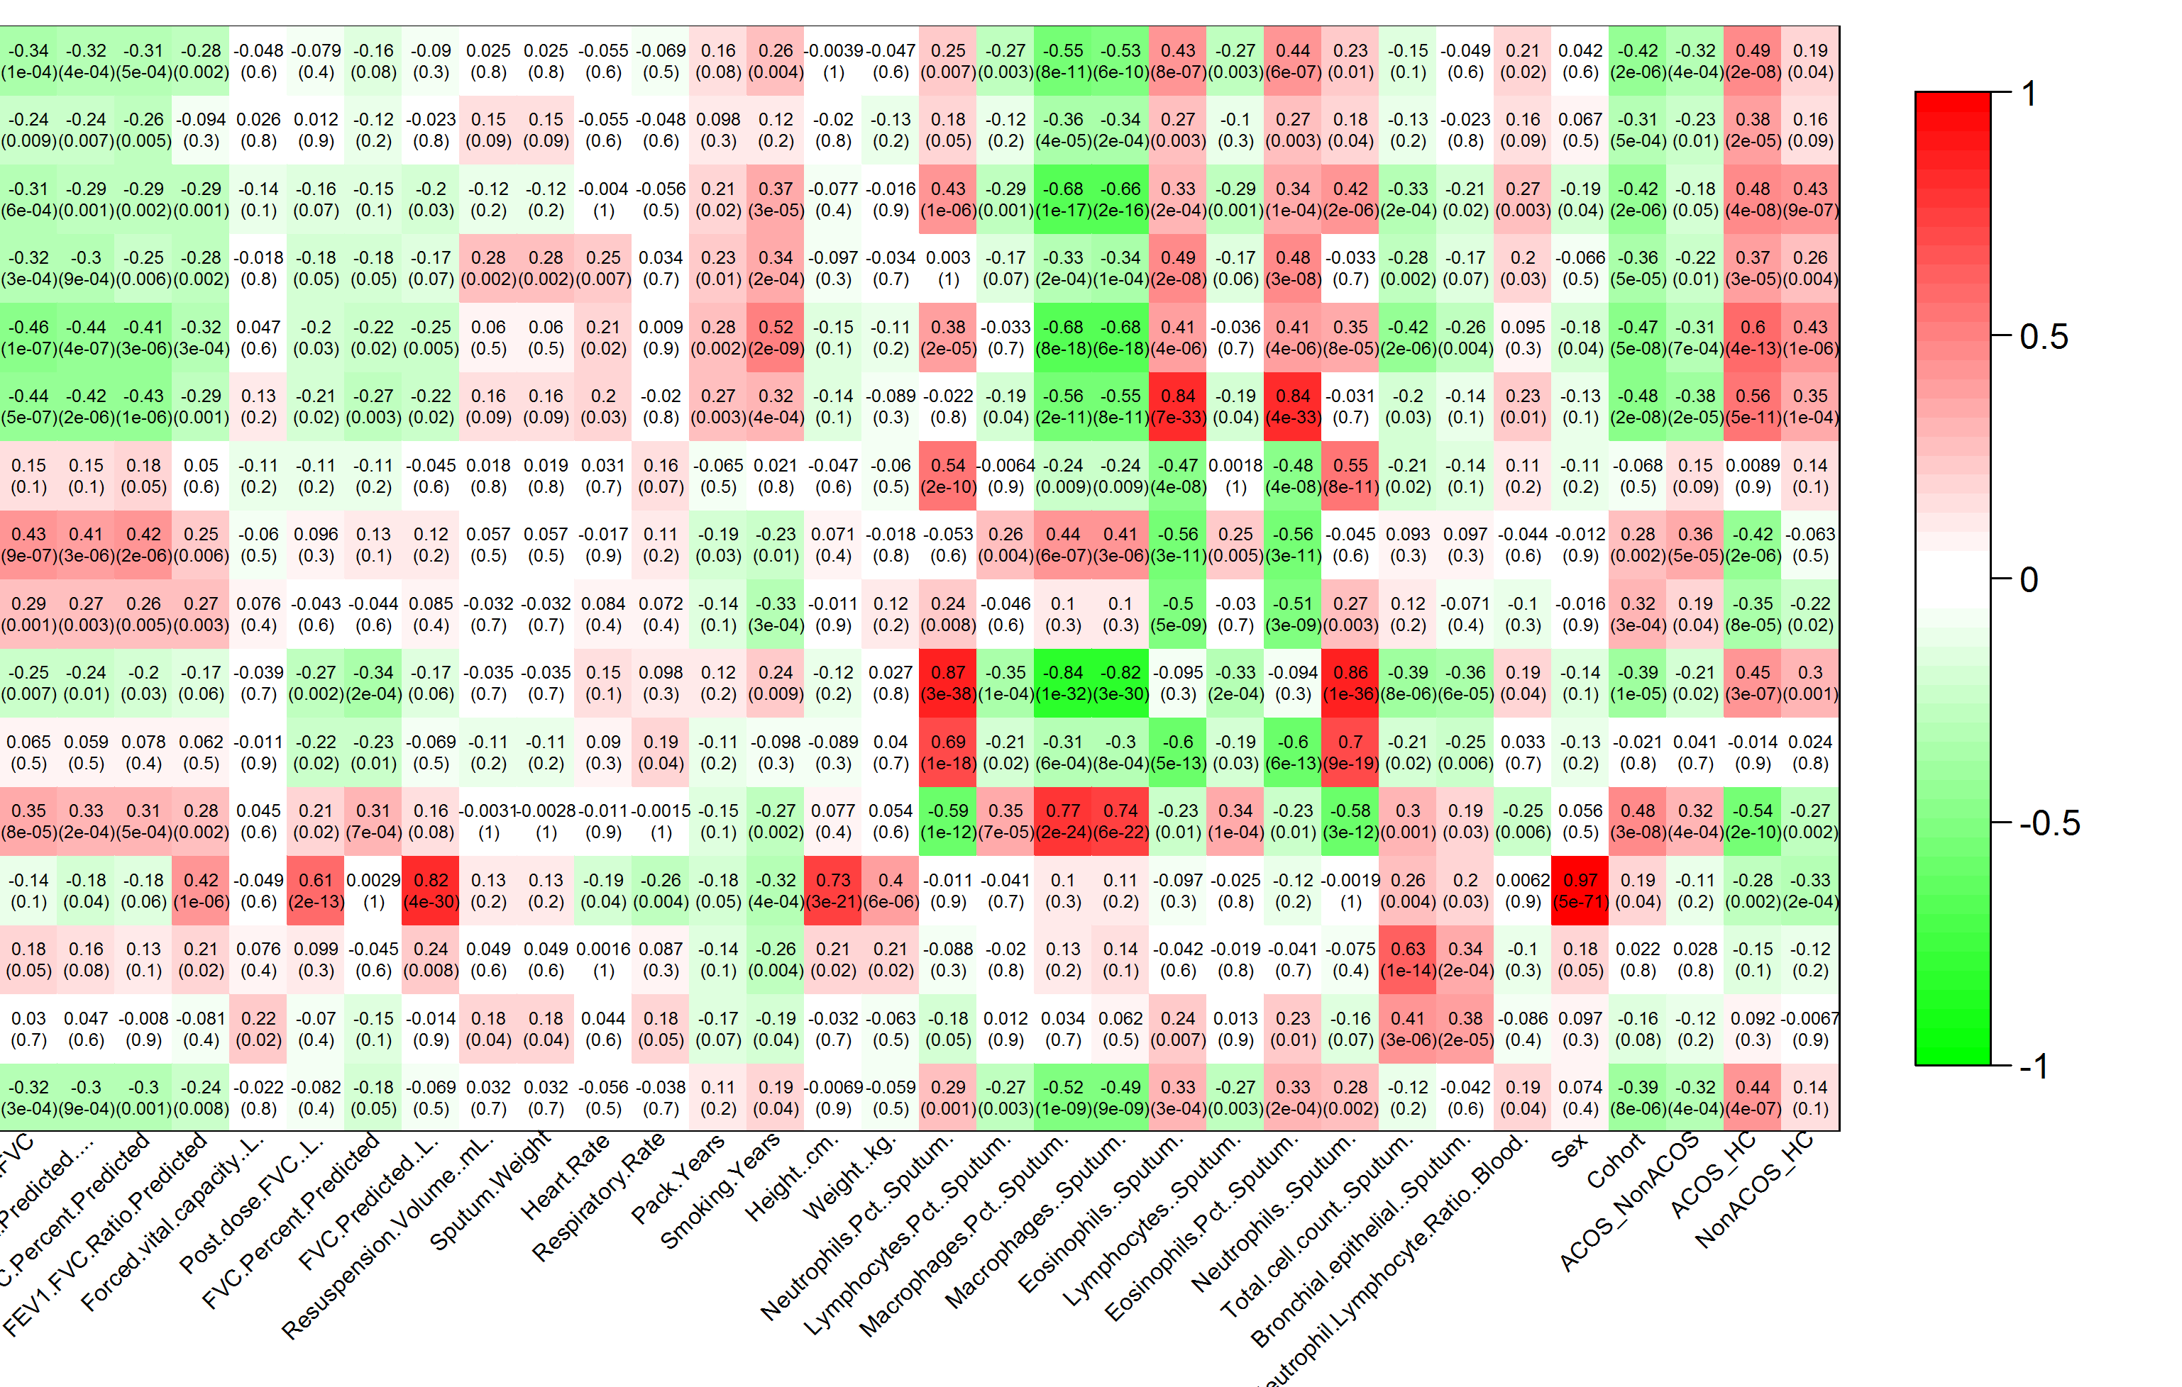
WGCNAStepTwoResult
New +
Story
Bookmarks
Weighted Gene Co-expression Network Analysis Step 2
Module trait extraction
The second step is a block-wise network construction and module detection where we take pre-clustered genes into blocks (block size = 21) and perform network analysis in each block separately.
Status: COMPLETE
Execution time: 5.13min
Go Further

Slide 18

StoryTreeView
New +
Story
Bookmarks
Weighted Gene Co-expression Network Analysis Step 2
Module trait extraction
The second step is a block-wise network construction and module detection where we take pre-clustered genes into blocks (block size = 21) and perform network analysis in each block separately.
Cohort Selection
WCGNA Step 1
WCGNA Step 1 Result
WCGNA Step 2
WCGNA Step 2 Result
Gene State Variation Analysis
WCGNA Step 1
WCGNA Step 1 Result
WCGNA Step 2
WCGNA Step 2 Result
Go Further

Slide 19



UserManagement
Users
Data Sources
Plugins
User Management
Add user +
Here you can find the list of all users on this instance of Borderline
You can create, modify or delete them as you wish
User List
Activity Logs
Filter …
Eve Morton EveMorton@rhyta.com
Ellis Lawrence EllisLawrence@jourrapide.com
Aaliyah Leach AaliyahLeach@teleworm.us
Summer Duncan SummerDuncan@teleworm.us
Nathan Brennan NathanBrennan@armyspy.com
Kai Sun KaiSun@thebest.worldwide

Slide 20


UserEdit
Users
Data Sources
Plugins
Kai Sun
Add user +
Here are all the information about Kai Sun who connected last on the 06/05/2017
Please adjust according to the relevant procedure
User List
Activity Logs
Email address
KaiSun@thebest.worldwide
Password
• • • • • • • • • • • • • •
• • • • • • • • • • • • • •
Permitted data sources
+
I2B2_UBIOPRED
620 subjects
Last time updated: 23/04/16
I2B2_ECLIPSE
2638 subjects
Last time updated: 12/03/15
+
Cancel
Save

Slide 21
DataSourceManagement
Users
Data Sources
Plugins
Data Sources Management
Add data source +
Here you can find the list of all data sources connected to this instance of Borderline
You can create, modify or delete them as you wish
Sources List
Usage Statistics
Filter …
TS_XX 127.0.0.1 : 4042
TS_4444 146.169.15.15 : 80
I2B2_UBIOPRED 146.169.16.32 : 8080
I2B2_ECLISPE 46.169.16.33 : 8080
TRANSMART_PUBLIC 92.45.28.254 : 3950
TRANSMART_FOUNDATION 92.45.28.253 : 3950
ETRIKS_TM 131.29.56.76 : 443

Slide 22
DataSourceEdit
Users
Data Sources
Plugins
TRANSMART_PUBLIC
Add data source +
Here are all the information about the TRANSMART_PUBLIC data source
Please adjust according to the relevant procedure
Sources List
Usage Statistics
Server URL
public.etriks.org
Port
80
Cancel
Save

Slide 23
ExtensionManagement
Users
Data Sources
Plugins
Plugins Management
Go to plugin store
Here you can find the list of all extensions installed on this instance of Borderline
You can enable or disable non-system ones as you wish
Installed Plugins
Filter …
Storyline
Storyline
Store
Dashboard

