Slide 1

3D gaze estimation in an immersive data visualization environment
UROP
Andrianirina RAKOTOHARISOA
Friday 4th October

Slide 2
Contents
Introduction
Objective
Problem
Solution
Tools
Kinects
Libraries
Implementation
Experiments
Reducing the impact of outliers
Difficulties
Conclusion

Slide 3
Introduction

Slide 4
The Global Data Observatory
64 screens
Total resolution: 130M pixels
Notes:
immersive data visualization environment

Slide 5
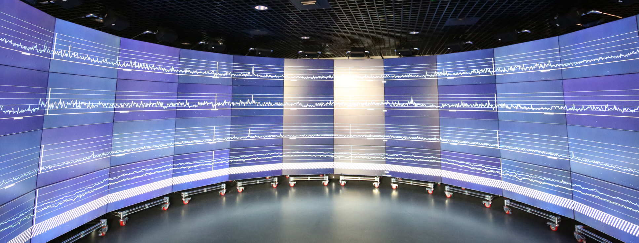
The Global Data Observatory
Why do we want to estimate the gaze ?
Complex environment → areas can be forgotten
Study the relevant data
Use Machine Learning:
Hypothesis on what is considered as important and what isn’t
Notes:
immersive data visualization environment

Slide 6
Objective

Slide 7
Problem
Being able to estimate the gaze based on face orientation and body posture
→ The user(s) will move
→ Many people can use the GDO simultaneously
→ We have to see the estimations displayed on screens

Slide 8
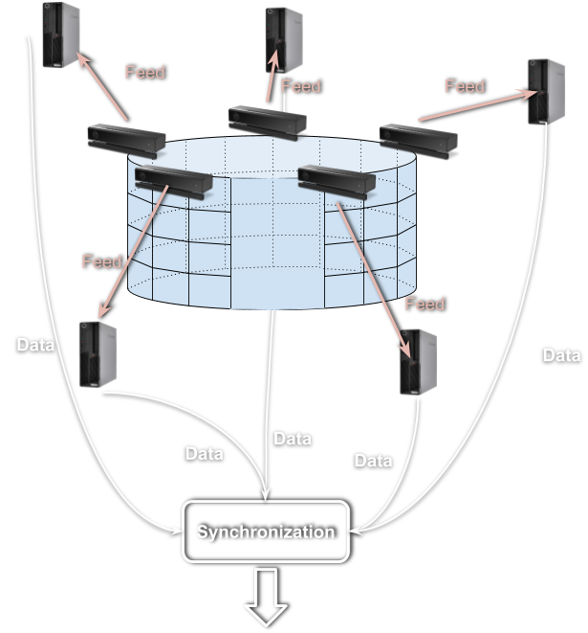
Solution
Use Kinects to record the scene
Use Python

Slide 9
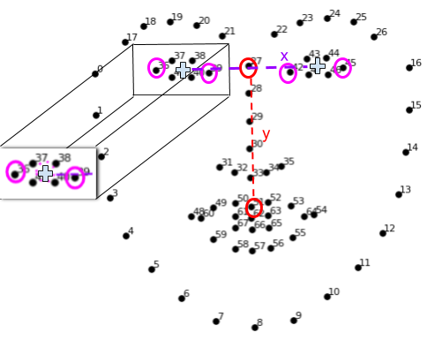
Libraries
Face_alignment from A.Bulat*
Detect face features
Detect face orientation
Estimate gaze direction
*: https://github.com/1adrianb/face-alignment

Slide 10
Libraries
PyKinect2
Access the kinects functions easily
Floor plane
Coordinate mapper
Skeletons
Notes:
Class diagram
Object driven python
PyKinectRuntime is where all the objects are defined
PyKinectV2 methods/functions that call the objects

Slide 11
Libraries
Pytorch
Move the heavy computations on the GPU
Designed for Machine Learning and widely used in Computer Vision

Slide 12
Implementation

Slide 13
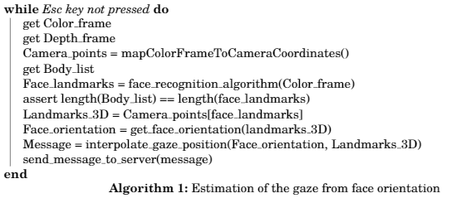
Algorithm
Kinect warm up
Face recognition
Coordinate Mapping
Send the coordinates

Slide 14
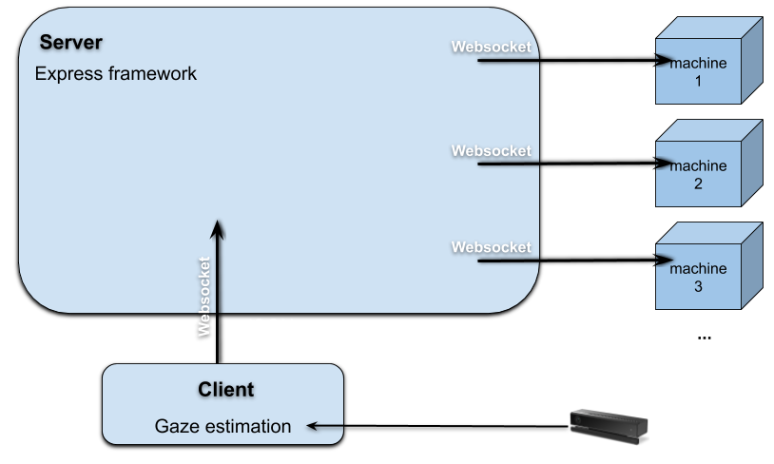
Sending the data to the server
Why a websocket ?
Bidirectional communication

Slide 15
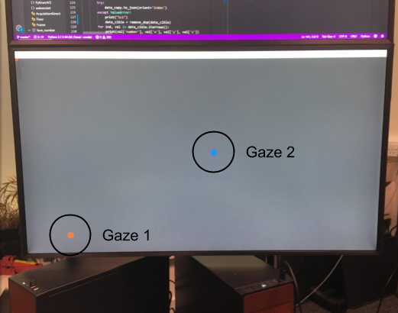
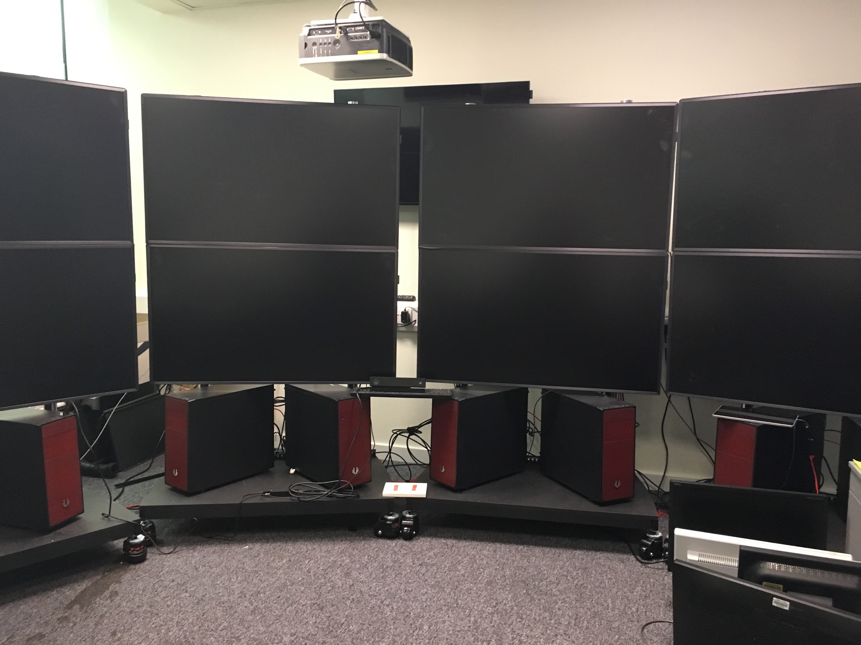
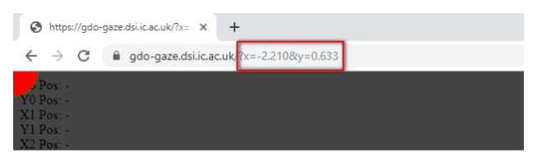
Drawing the gaze on screen
Coordinates of the top right corner of the screen (in m)
y
x
kinect

Slide 16
Experiments

Slide 17
Experiment 1: Reducing the impact of outliers

Slide 18
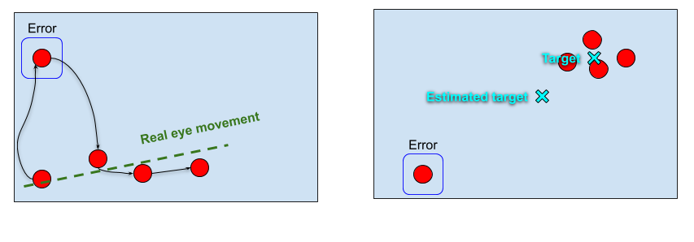
Experiment 1: Reducing the impact of outliers
How can we prevent random errors from corrupting our data ?

Slide 19
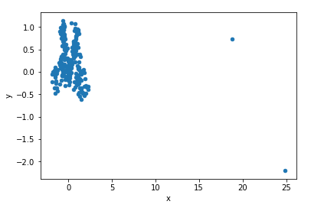
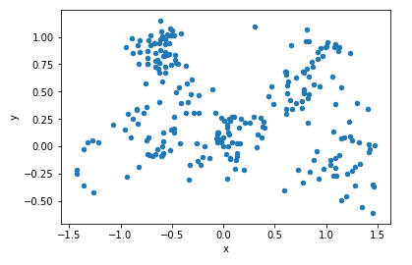
Experiment 1: Reducing the impact of outliers
Adding a threshold
Before
After

Slide 20
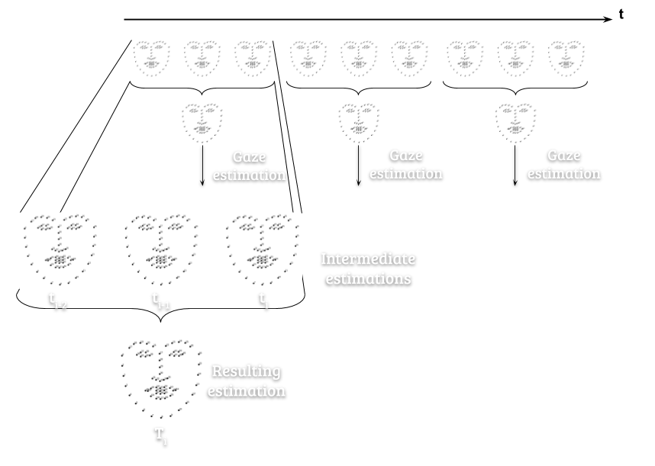
Experiment 1: Reducing the impact of outliers
Use averages
Reduce outliers’ impact
Mode 2

Slide 21
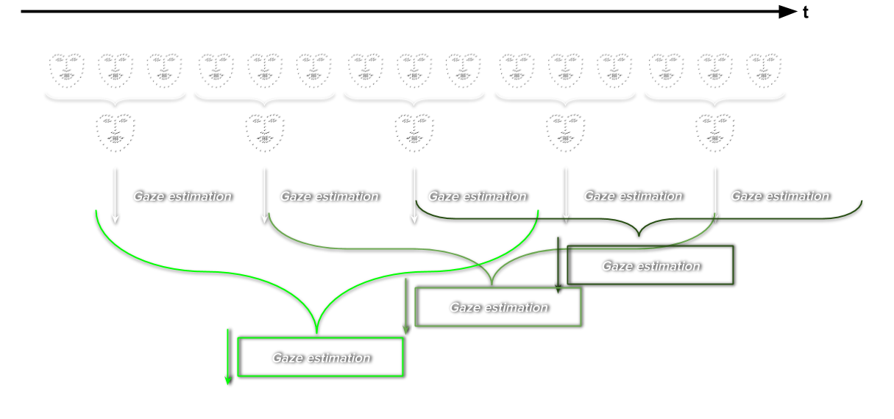
Experiment 1: Reducing the impact of outliers
Use averages and moving averages
Reduce outliers’ impact
Smoothen the trend
Mode 3

Slide 22
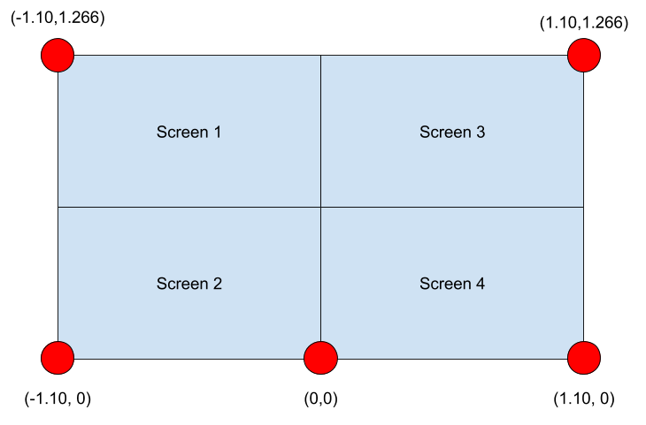
Experiment 1: Reducing the impact of outliers
Protocol:
For each Mode:
For every target
Kinect warm-up
Fixing the target

Slide 23
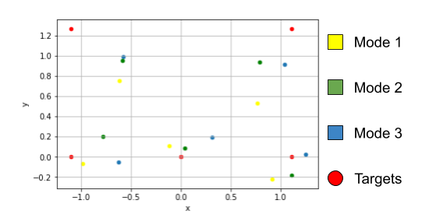
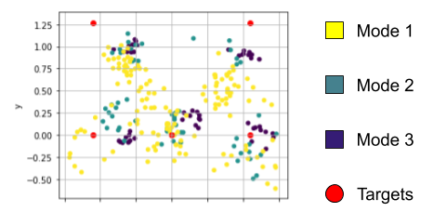
Experiment 1: Reducing the impact of outliers
Mean
Results:
Modes 2 and 3 help reduce the variance
Target location and variance are not independent
Accuracy depends on the target location
Residual errors are not solved by moving averages
Notes:
Variance: In Mode 1, the mean variance along the x axis equals 0.12 and 0.03 along the y axis. In Mode 2,it is divided by more than 5 along the x axis and slightly smaller along the y axis. On the otherhand, in Mode 3, the variances alongside the x and y axis are in average 10 times lower than inMode 1 (respectively 0.010 against 0.12 and 0.003 against 0.03)
The variance is bigger on the right and low parts of the DO-Dev

Slide 24
Experiment 1: Reducing the impact of outliers
Conclusion
Using averages and moving averages help reducing the impact of random outliers
Adding moving averages on top of regular averages is not significantly better for fixation tasks
Residual errors are not solved

Slide 25
Difficulties

Slide 26
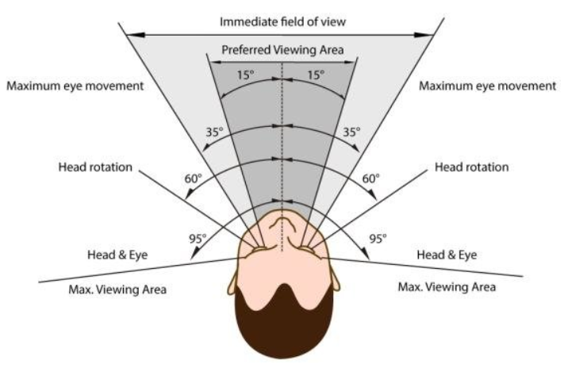
Accuracy
Our software doesn’t take the human visual field into account
Use eye-tracking in our software ?

Slide 27
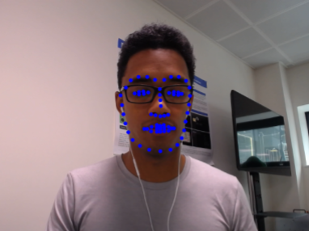
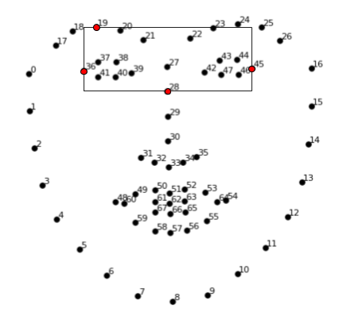


Accuracy
Possible solution
Crop eye region
Tile cropped region
Detected face landmarks
Classification
Getting eye direction

Slide 28
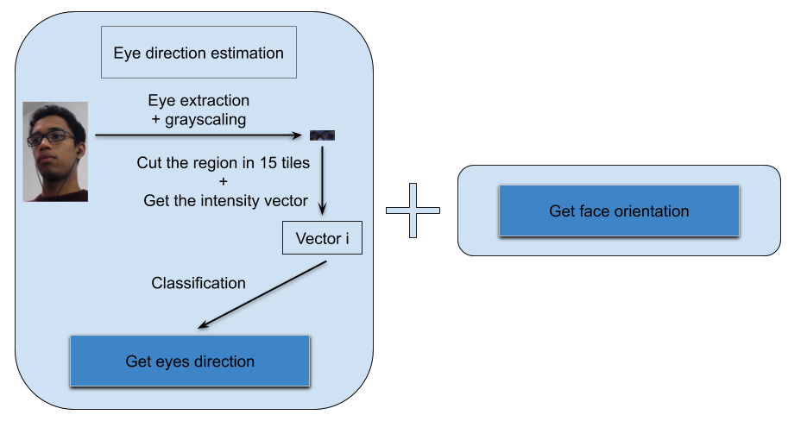
Accuracy

Slide 29
Accuracy
Possible causes of failures:
The resolution of the kinect color frame is too low
Our training set of vectors is not big enough so we encounter a problem of overfitting
Conditions in the DO-Dev or GDO

Slide 30
Conclusion
Notes:
Create a software from the beginning
Still many things to improve: the software on itself (usable), move it to the GDO

Slide 31
Conclusion
Creation of a software
Several areas of improvement
Move it from the DO-Dev to the GDO

Slide 32
Thank you

