Slide 1
10-Repeat 4-Fold Cross-Validation
series_idor · n=139 · Metabolite + Morphology + Image
Late fusion: mean probability · majority vote

Slide 2
Study Design
Cohort • 139 organoids, series_idor (BA1 + BA2), including 6 stitched • 25 Not-Acceptable / 114 Acceptable · 11 time points: Dy03–Dy30 Why repeated k-fold? • With 25 NAcc in 139 total, a single 4-fold run puts only 6–7 NAcc in each test fold — one wrong prediction = ±0.07 BA. High variance. • 10 independent repeats (different random seeds) halve the SD of the BA estimate without requiring more data or more GPU time. Fold structure • Stratified 4-fold: label ratio preserved in every fold • Seed for repeat r = 1 + r × 1000 → genuinely independent splits • All modalities (met, morph, image) use the same fold partition per repeat → required for valid late-fusion evaluation What is stored per repeat • OOF balanced accuracy (single number per modality) • OOF probabilities + binary predictions per organoid • Fold assignment for every organoid (which fold 0–3 it was tested in) • Confusion matrix [[TN,FP],[FN,TP]] per single modality

Slide 3
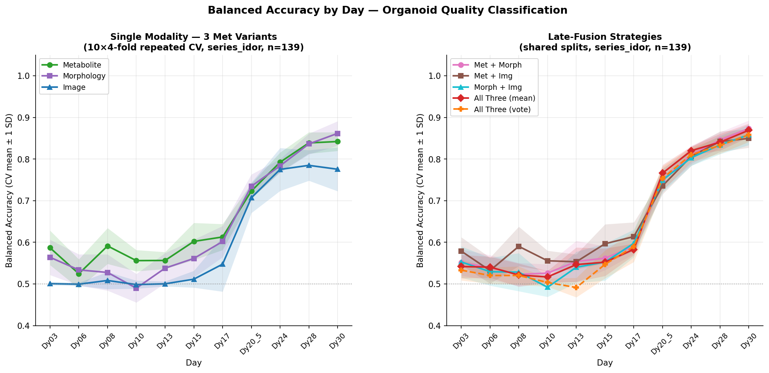
Aggregated Results: Mean ± SD over 10 Repeats

Slide 4
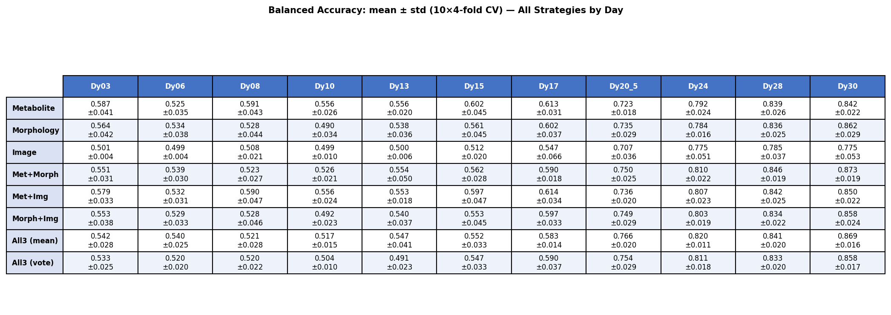
Summary Table: Balanced Accuracy (mean ± SD)

Slide 5
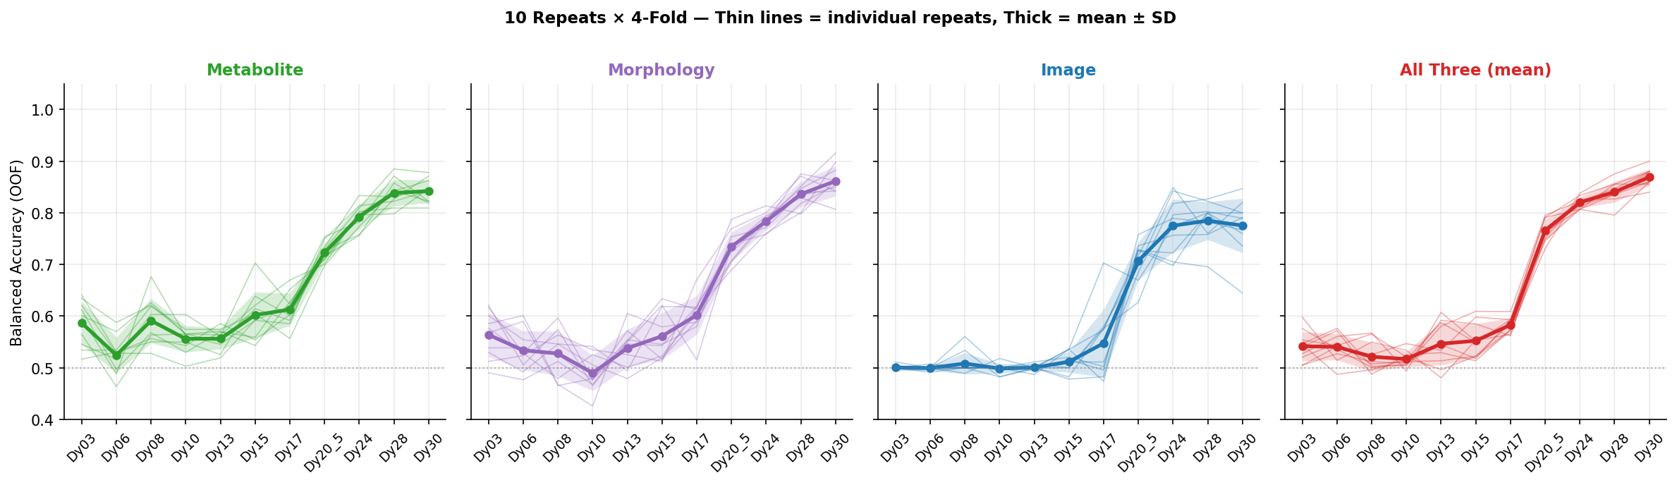
Repeat-Level Variance — 4 Key Strategies

Slide 6
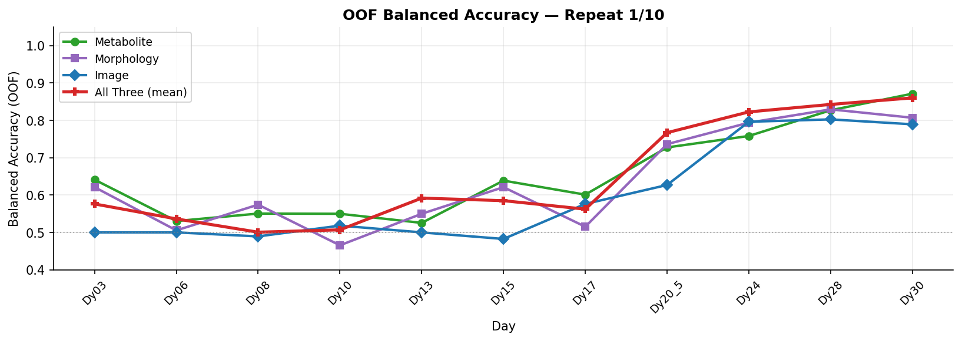
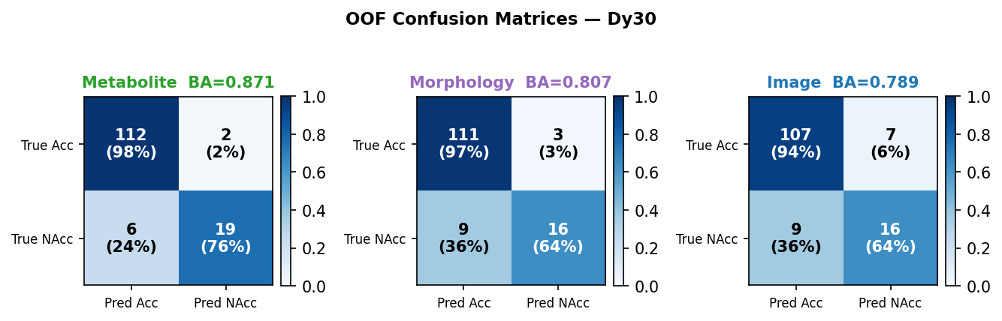
Repeat 1 / 10 (seed = 1)

Slide 7
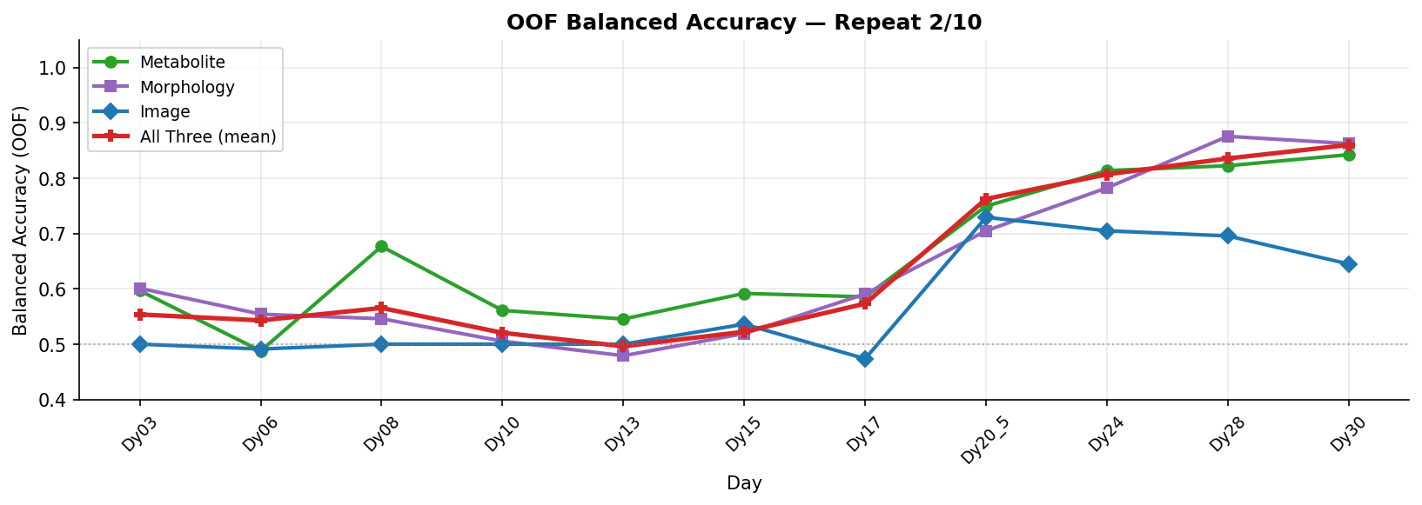
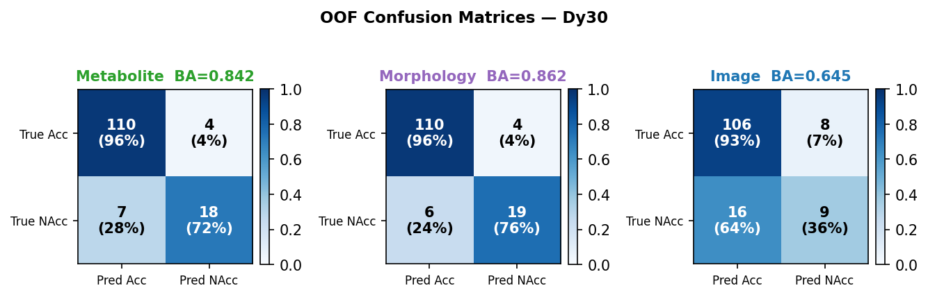
Repeat 2 / 10 (seed = 1001)

Slide 8
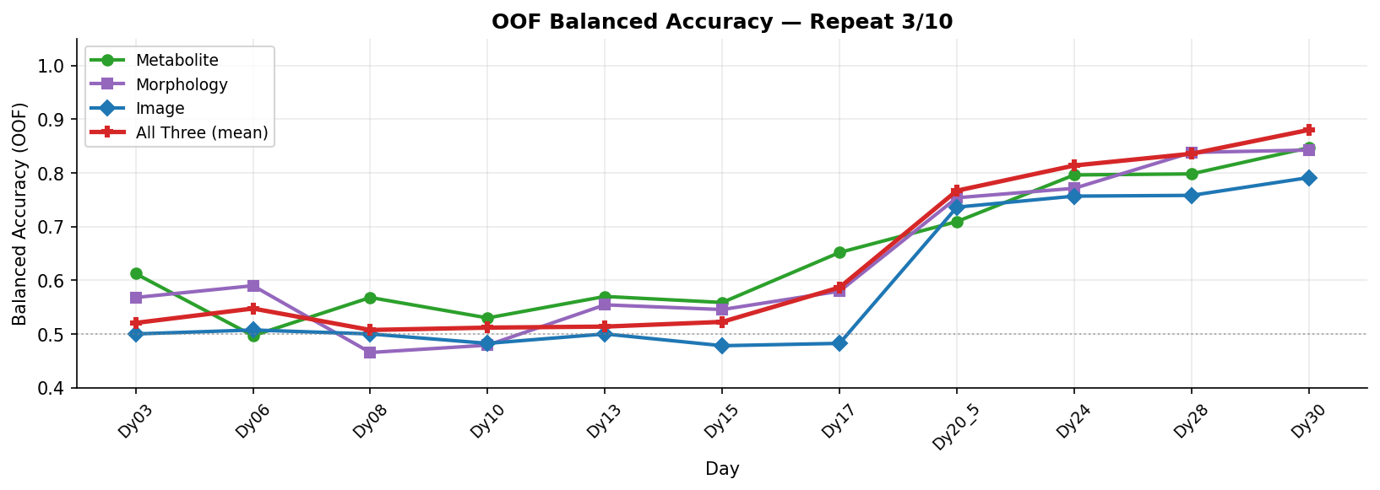
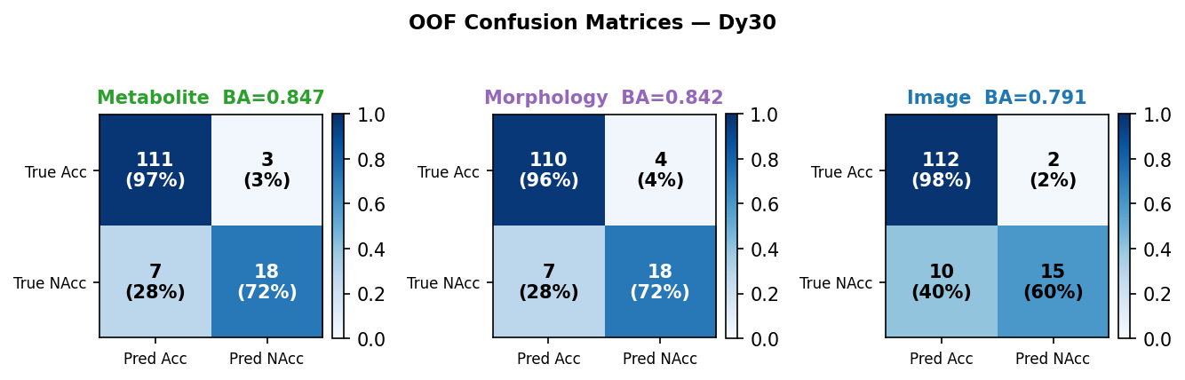
Repeat 3 / 10 (seed = 2001)

Slide 9
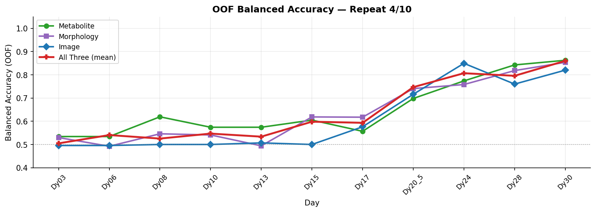
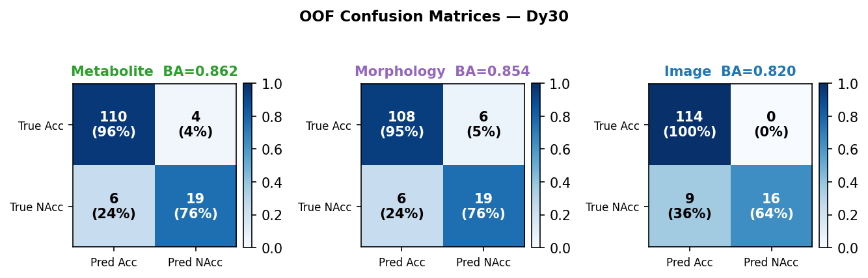
Repeat 4 / 10 (seed = 3001)

Slide 10
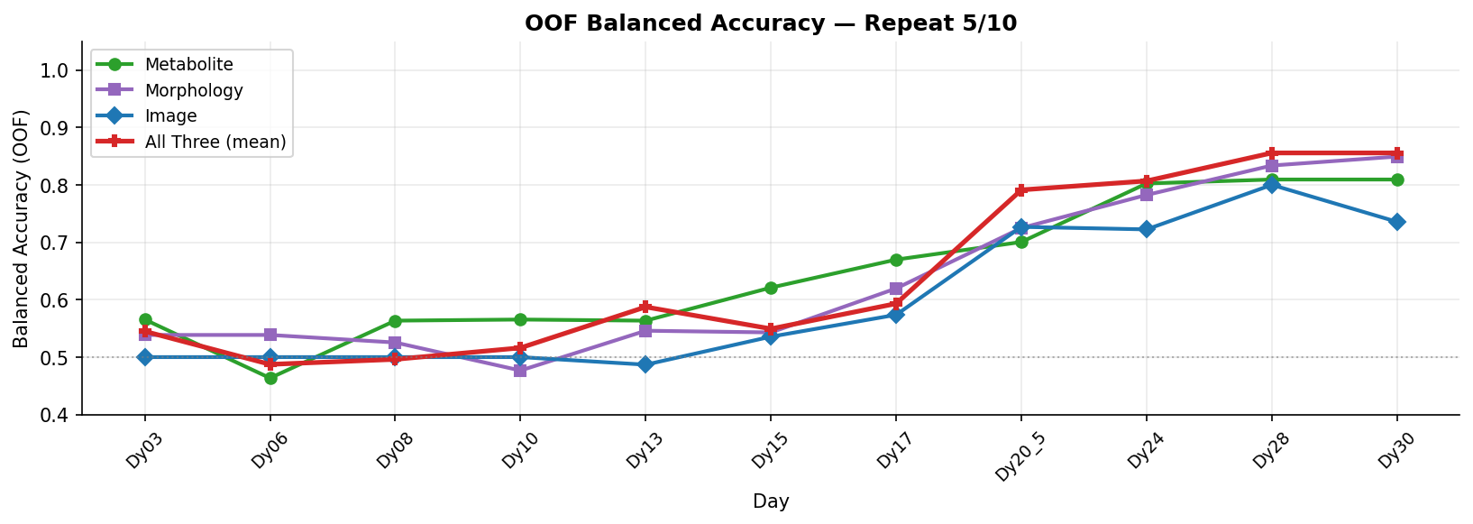
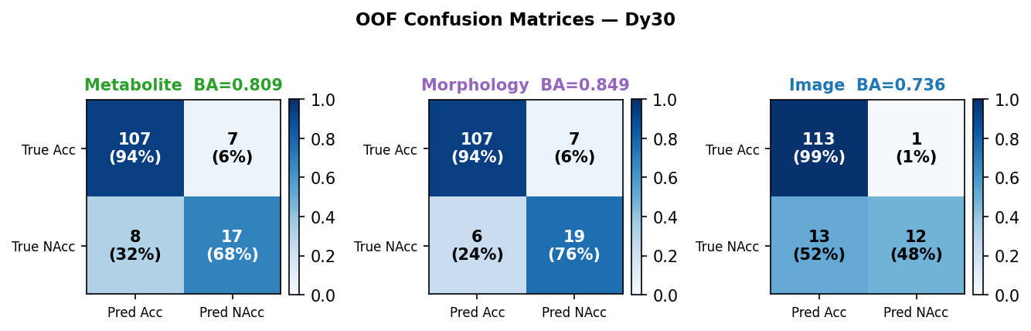
Repeat 5 / 10 (seed = 4001)

Slide 11
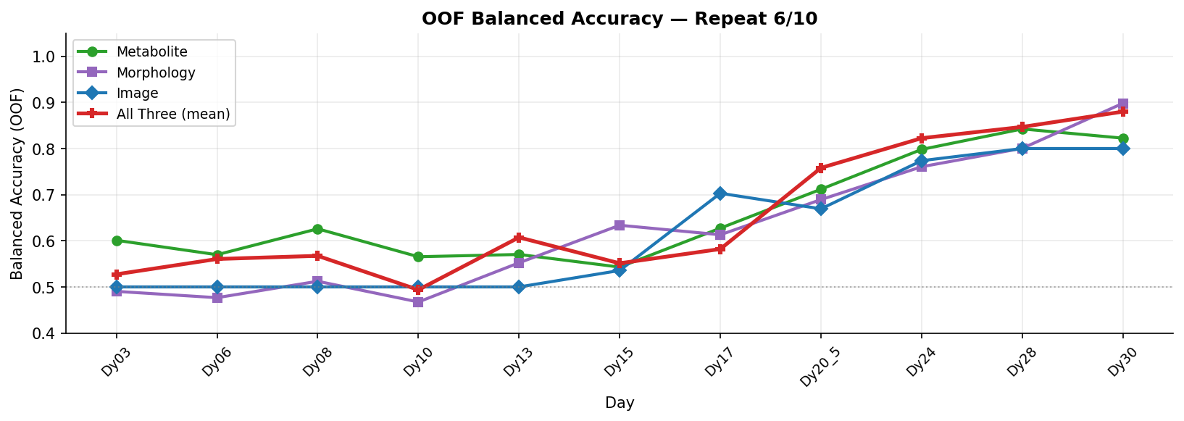
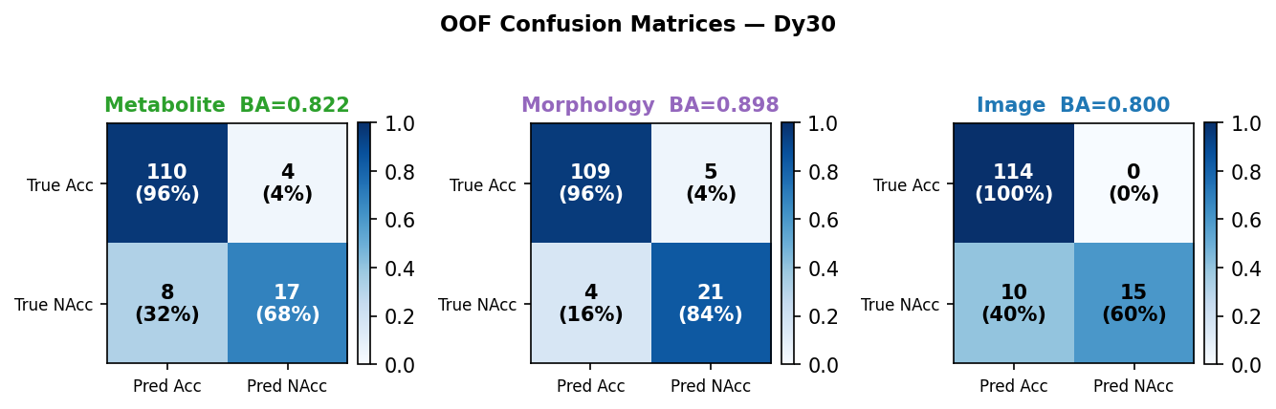
Repeat 6 / 10 (seed = 5001)

Slide 12
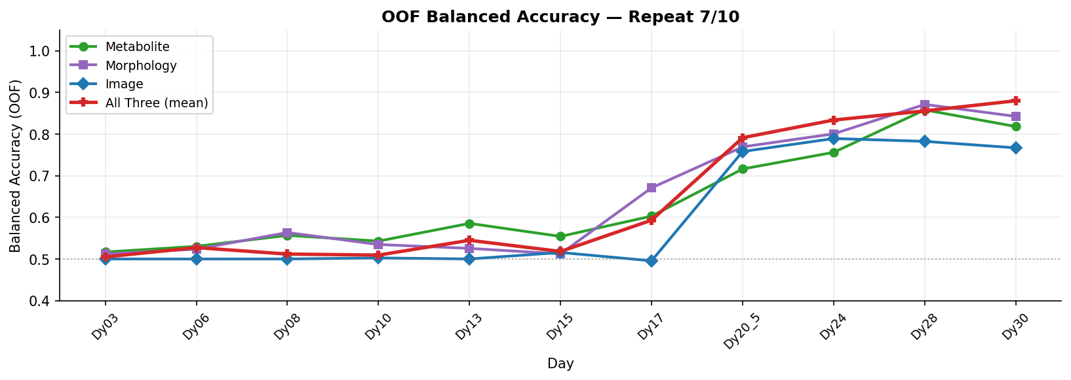
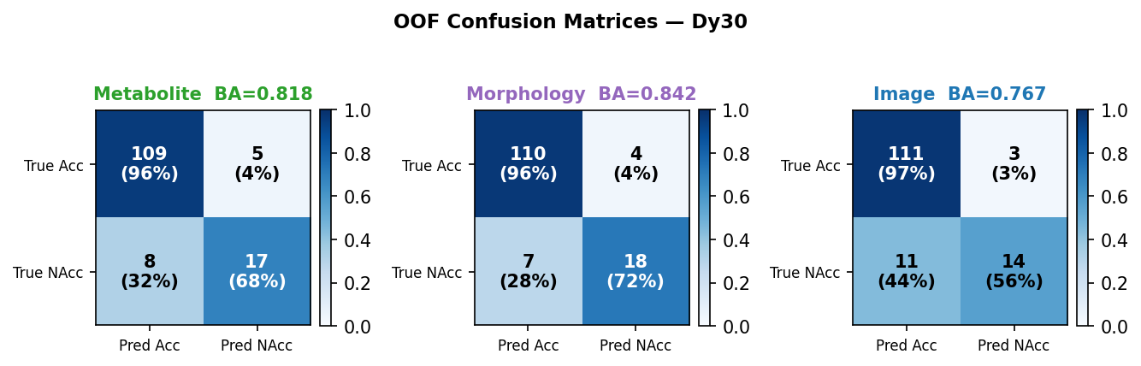
Repeat 7 / 10 (seed = 6001)

Slide 13
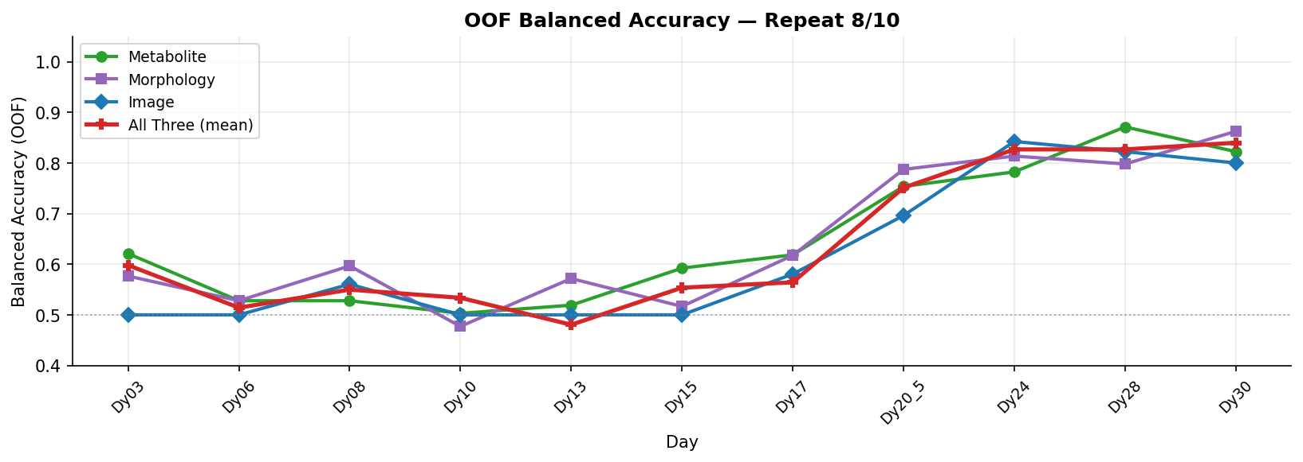
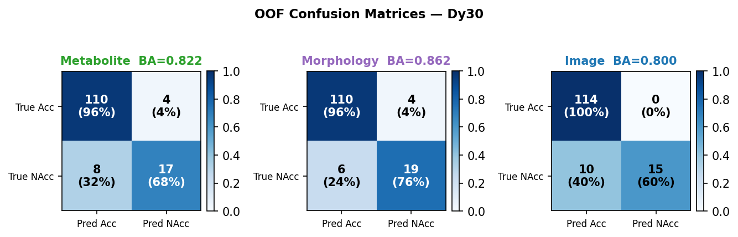
Repeat 8 / 10 (seed = 7001)

Slide 14
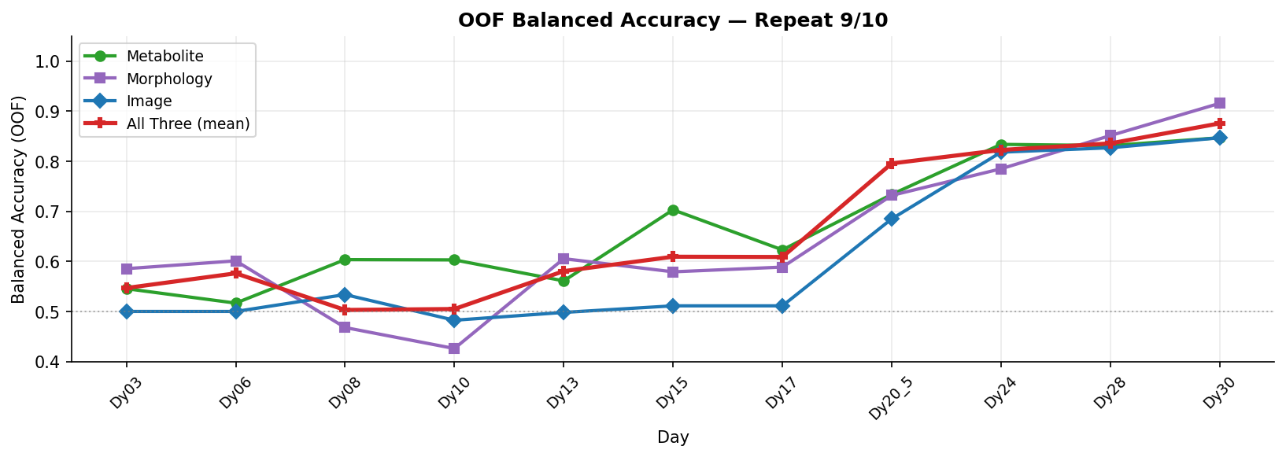
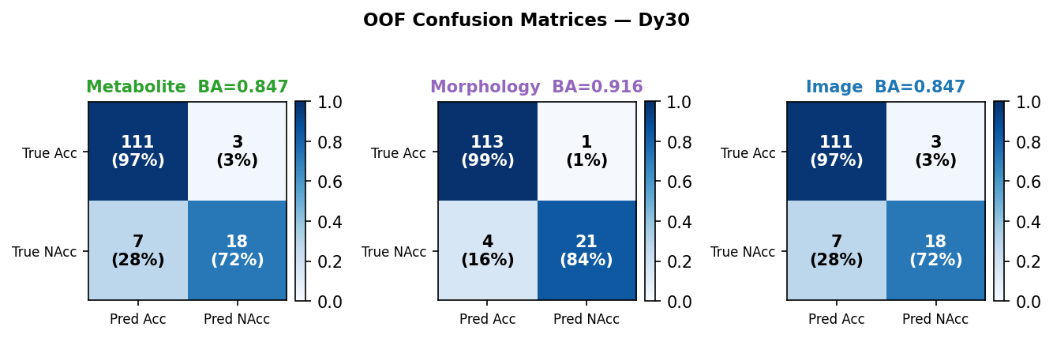
Repeat 9 / 10 (seed = 8001)

Slide 15
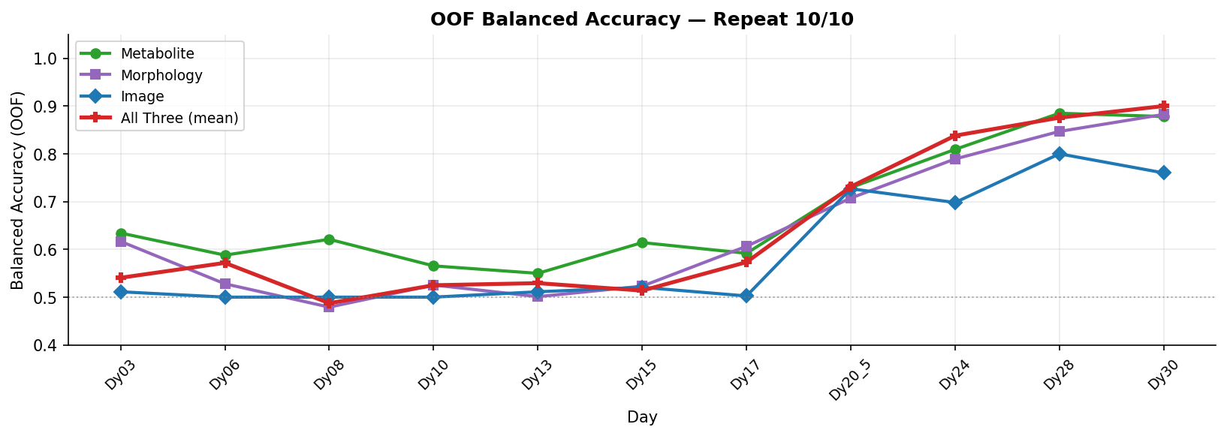
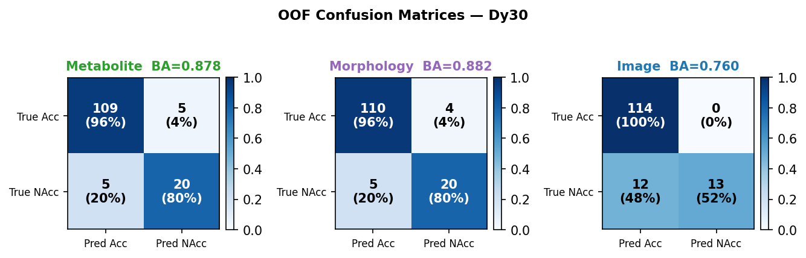
Repeat 10 / 10 (seed = 9001)

