Slide 1
Metabolite-Based Organoid Quality Classifier
6 assay panels · LightGBM vs Logistic Regression · 5-fold stratified CV
195 labeled organoids · 11 timepoints (Day 3 – 30) · Threshold fixed at 0.5
• Metabolite assays measure extracellular metabolite concentrations from culture media
• Features engineered: raw concentration + growth delta (change from prior timepoint) + initial concentration (Day 3 baseline)
• MalateGlo Dy10 data quality issue discovered and resolved — results unaffected
• Performance improves strongly from Day 20.5, peaking at 0.84 balanced accuracy on Day 30

Slide 2
Feature Engineering
6 metabolite assays × 3 feature types = up to 18 features per organoid per day
Assay (column)
Metabolite
Biological role
Feature types extracted:
GlucoseGlo
Glucose
Energy substrate
Concentration (µM)
GlutamateGlo
Glutamate
Amino acid / TCA input
Raw assay value at this timepoint
LactateGlo
Lactate
Glycolysis output
PyruvateGlo
Pyruvate
Glycolysis / TCA junction
Growth delta (µM)
MalateGlo
Malate
TCA intermediate ★ data quality issue
Change since previous timepoint
BCAAGlo
BCAA
Branched-chain amino acids
Initial conc. (µM)
Value at very first timepoint (Day 3)
★ MalateGlo conditionally excluded at Dy10 (day_num > 10 condition in pipeline) and Dy13 growth delta — see slide 7 for data quality details.

Slide 3
Cross-Validation Design
Why k-fold CV instead of a fixed train/test split
Why 5-fold CV?
Dataset has only 205 organoids (31 Not Acceptable, 174 Acceptable). A single 80/10/10 split leaves only ~6 Not Acceptable in the test set — one wrong prediction changes balanced accuracy by ≥ 8 pp. 5-fold CV uses all 205 organoids for evaluation, giving a more reliable estimate.
Outer loop: 5-fold stratified CV
Organoids are shuffled and split into 5 folds, preserving class balance. Each fold's test set is held out while the other 4 folds train the model. Balanced accuracy is computed per fold, then averaged (mean ± std reported).
Inner loop: 3-fold GridSearch
Inside each outer fold, a 3-fold GridSearch selects hyperparameters (max_depth, num_leaves, learning_rate, n_estimators for LightGBM; C, penalty for LogReg). This prevents leakage from the test fold.
Threshold fixed at 0.5
Threshold is NOT tuned on validation data — fixing at 0.5 avoids a subtle form of data leakage where threshold optimisation inflates metrics. LightGBM's scale_pos_weight is set per fold to handle class imbalance.
Out-of-fold (OOF) aggregation
Predictions from all 5 held-out folds are concatenated to form a single OOF prediction covering all 205 organoids — reported alongside the per-fold mean ± std for transparency.

Slide 4
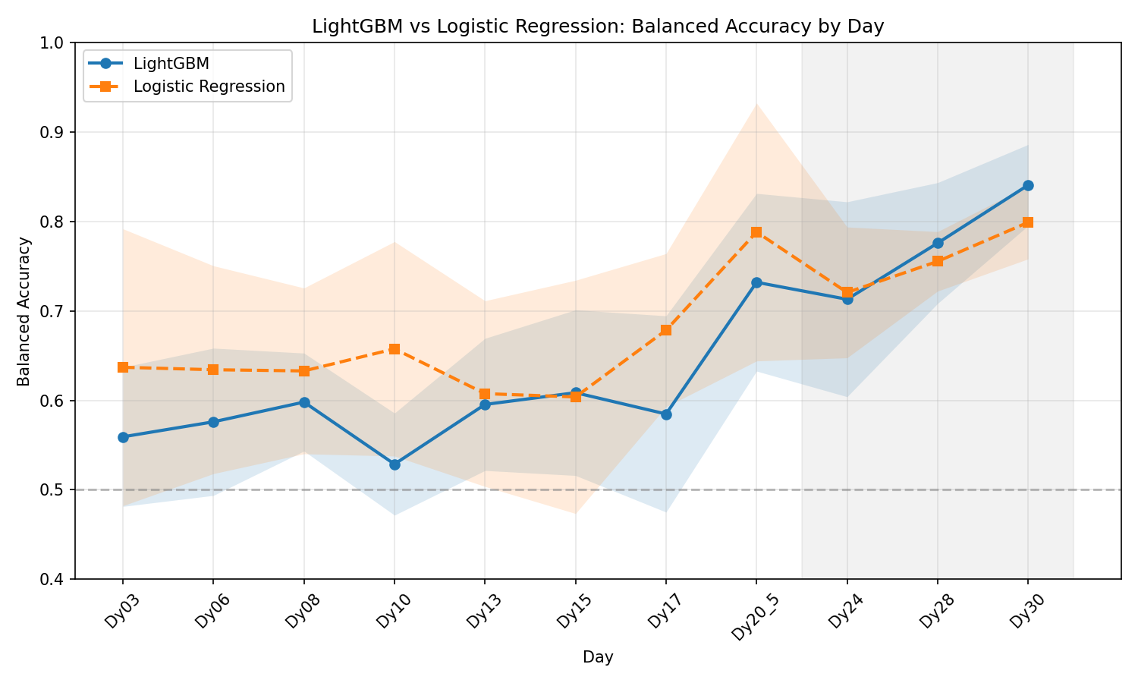
5-Fold CV Results — LightGBM vs Logistic Regression
195 labeled organoids · Shaded band = ±1 std across folds

Slide 5
Per-Day Results Table
Mean ± Std balanced accuracy (5-fold CV) · Recall = fraction of Not Acceptable correctly identified
Day
LGBM bal-acc
LGBM recall NA
LogReg bal-acc
LogReg recall NA
Dy03
0.559 ± 0.078
0.866
0.637 ± 0.155
0.640
Dy06
0.576 ± 0.082
0.866
0.634 ± 0.116
0.592
Dy08
0.598 ± 0.055
0.872
0.633 ± 0.093
0.756
Dy10
0.529 ± 0.057
0.890
0.658 ± 0.120
0.543
Dy13
0.595 ± 0.074
0.872
0.608 ± 0.104
0.610
Dy15
0.609 ± 0.093
0.902
0.604 ± 0.130
0.665
Dy17
0.585 ± 0.110
0.902
0.678 ± 0.086
0.713
Dy20_5
0.732 ± 0.099
0.921
0.788 ± 0.144
0.805
Dy24
0.713 ± 0.109
0.916
0.721 ± 0.073
0.778
Dy28
0.776 ± 0.068
0.971
0.755 ± 0.033
0.906
Dy30
0.841 ± 0.045
0.977
0.799 ± 0.041
0.860
Bold = better model for that day. Both models plateau ~0.63 on early days; LightGBM leads at Day 30 (0.841 vs 0.799).

Slide 6
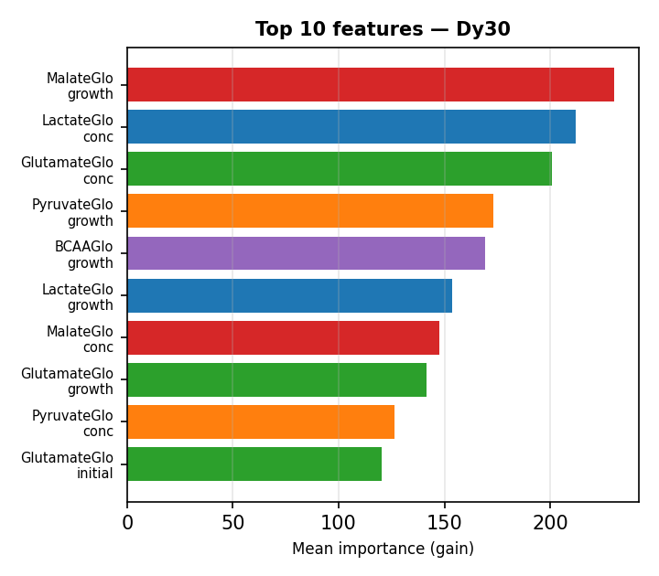
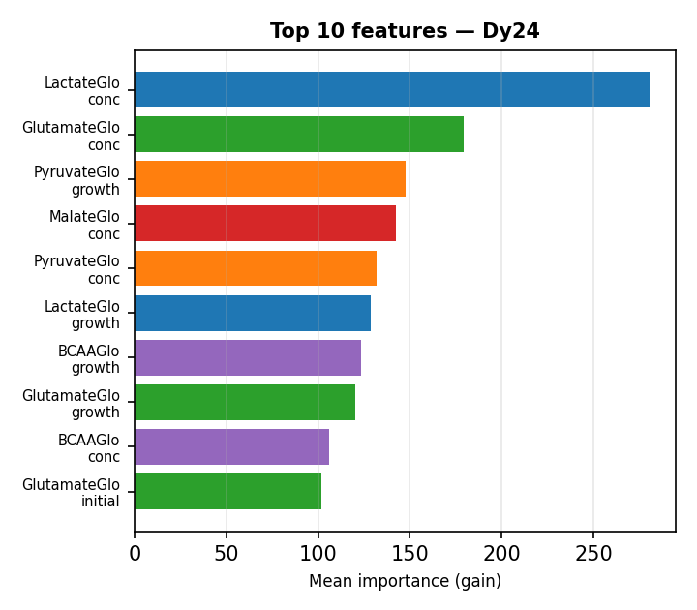
LightGBM Feature Importance
Mean gain across 5 folds — higher = more discriminative splits
Lactate and Glutamate dominate at Dy24. MalateGlo growth becomes the top feature at Dy30. Growth deltas (change since prior day) outweigh raw concentrations at late timepoints.

Slide 7
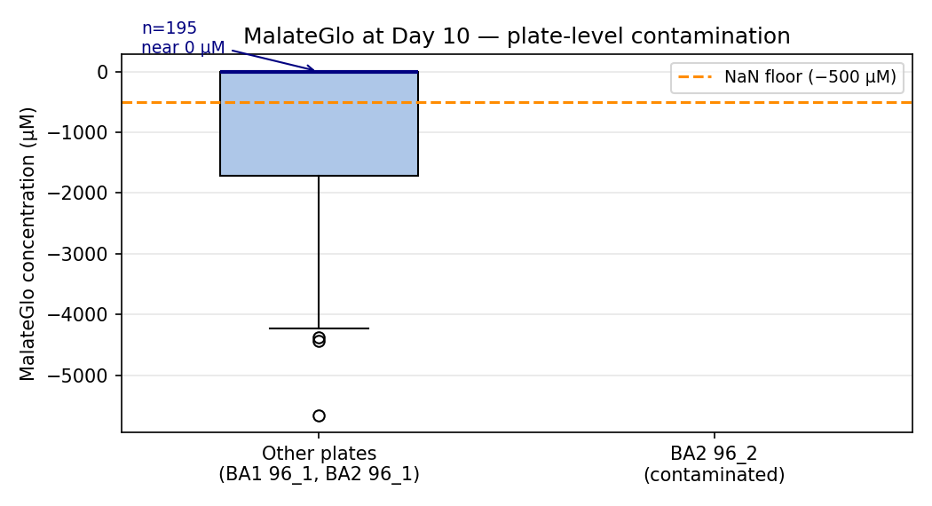
MalateGlo Data Quality Issue — Plate BA2 96_2 at Day 10
91 records (57 labeled) with highly negative MalateGlo values: −1064 to −5662 µM
Discovery
Outlier MalateGlo values of −5000 µM detected during data exploration. All 91 outlier records come from a single plate: BA2 96_2 on Day 10. Other 4 plates (BA1 96_1, BA2 96_1, BA3 96_1, BA4 96_1) show values near 0 µM.
Likely cause
Suspected plate-level contamination or assay failure for the MalateGlo assay on this specific plate-day combination.
Fix applied
Added CONCENTRATION_FLOOR = −500 µM in data_loader.py. Values below this floor are set to NaN. LightGBM handles NaN natively via its missing-value splits.
Downstream impact
MalateGlo_growth at Dy13 would also be affected (delta from Dy10 → Dy13 carries the NaN forward). However — see next slide — this is already harmless due to conditional exclusion.

Slide 8
MalateGlo Resolution — Results Unaffected
CONDITIONAL_METABOLITES already excludes MalateGlo at Day 10
CONDITIONAL_METABOLITES gate
CONDITIONAL_METABOLITES = {"MalateGlo": lambda day_num: day_num > 10} MalateGlo is only included as a feature when day_num > 10. Day 10 has day_num = 10 (not > 10), so MalateGlo_concentration is never in the Dy10 feature vector. The outliers never enter the model.
MalateGlo_growth at Dy13 also absent
The growth feature Δ(Dy13 − Dy10) would propagate the NaN. But the pipeline only computes growth deltas between consecutive days where the metabolite is included — since MalateGlo is excluded at Dy10, no growth delta is formed. Verified: 0 NaN values in MalateGlo_concentration at Dy13.
NaN floor as defensive programming
The CONCENTRATION_FLOOR = −500 µM fix was added anyway as a safety net for future edge cases. If a different plate were contaminated on a day where MalateGlo IS included (Dy13+), the NaN floor would protect the model.
Results comparison (Dy10 LightGBM):
With NaN floor (current): 0.529 ± 0.057
Without NaN floor (old): 0.529 ± 0.057 (identical — outliers were excluded by CONDITIONAL_METABOLITES)

Slide 9
Key Findings
Metabolites provide strong late-stage signal
Balanced accuracy rises from ~0.58 (Days 3–17) to ~0.77 (Days 20–30). Best performance: LightGBM at Day 30 = 0.841. This aligns with biology: metabolic differences become pronounced as organoids mature.
LightGBM outperforms Logistic Regression at late days
At Dy30: LightGBM 0.841 vs LogReg 0.799. The non-linear interactions between assays (e.g. Lactate + Glutamate + Malate growth) require tree-based splits to capture. LogReg plateaus earlier and shows higher variance.
Malate growth is top feature at Day 30
MalateGlo_growth (day-to-day change in malate concentration) ranks #1 at Dy30, ahead of raw Lactate and Glutamate concentrations. This suggests organoids are differentiated by TCA cycle activity in the final week of culture.
Data quality handled by conditional exclusion + NaN floor
MalateGlo at Dy10 had a plate-level contamination issue (values to −5662 µM). The pipeline's CONDITIONAL_METABOLITES gate already excluded MalateGlo at Dy10, so the model was unaffected. A NaN floor (−500 µM) was added as defensive code.

